Slide 1
Open Source Software Product Status
Susanne Strege – NASA Goddard Space Flight Center
susie.strege@nasa.gov
The Johns Hopkins University Applied Physics Laboratory
core Flight System Workshop
December 12, 2016

Slide 2
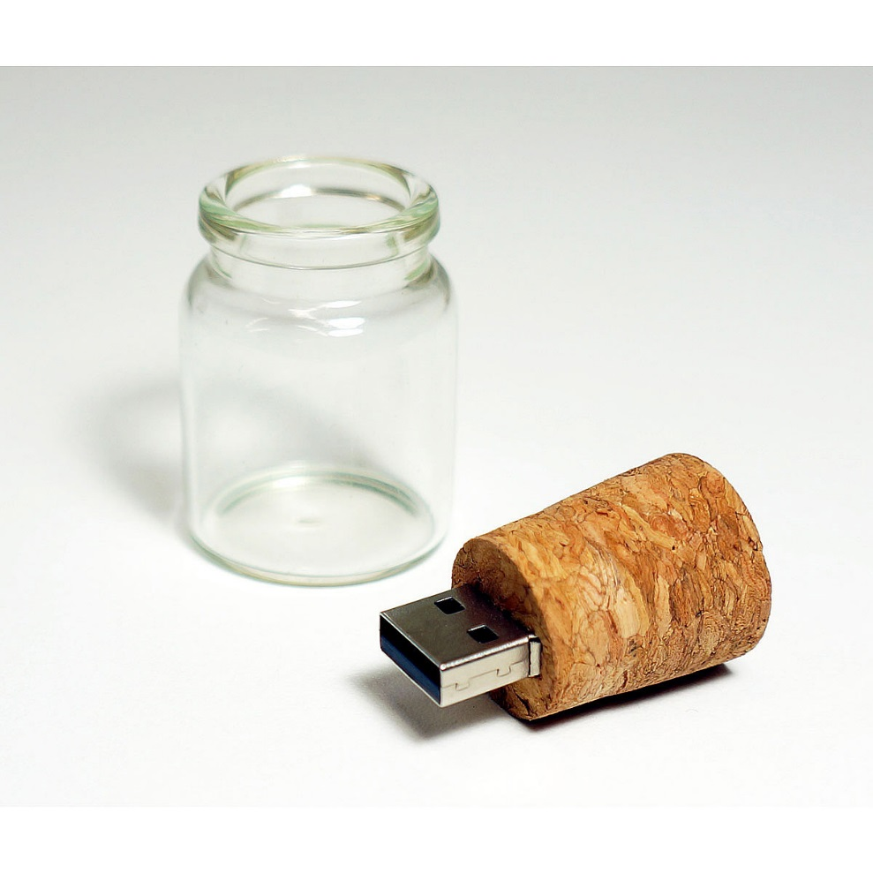
Agenda
2016 Accomplishments / Releases
2017 Product Releases
cFE 6.6.0 Enhancements
Application suite

Slide 3
Accomplishments / Releases
Open Source Core Product Releases this Year:
OSAL version 4.2.0.0, PSP version 1.3.0.0, cFE version 6.5.0.0
All changes reviewed by NASA wide CCB
Contains over 60 enhancements and bug fixes
Code & tests resulting from FY15 Class A work representing large part of additions
Enhanced cmake build system (in addition to classic build)
64-bit architecture support
Open Source Application Suite Releases this Year:
Health and Safety (HS) version 2.3.0.0
Stored Command (SC) version 2.5.0.0
Housekeeping (HK) version 2.4.1.0
Memory Manager (MM) version 2.4.1.0
Open Source Library Releases
New assert based unit test library: UT-Assert
Includes minor bug fixes and new UT-Assert unit tests

Slide 4
Current cFS Releases
Component | Release
cFE | 6.5.0.0
OSAL | 4.2.0
PSP | 1.3.0.0
CFDP Application | 2.2.1.0
Checksum Application | 2.3.1.0
Data Storage Application | 2.4.1.0
File Manager Application | 2.4.2.0
Housekeeping Application | 2.4.1.0
Health and Safety Application | 2.3.0.0
Limit Checker Application | 2.0.0.0
Memory Dwell Application | 2.3.0.0
Memory Manager Application | 2.4.1.0
Scheduler Application | 2.2.0.0
Software Bus Network Application | 1.0.0.0
Stored Command Application | 2.5.0.0

Slide 5
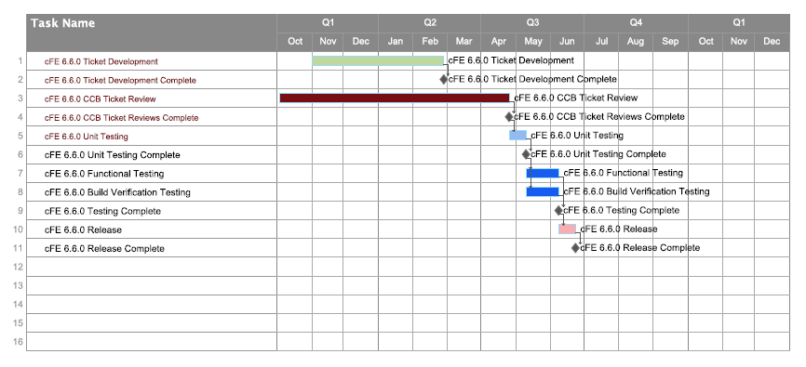
cFE 6.6.0 Enhancements
APID name space expansion
Shared Memory Multiprocessor (SMP) support
Electronic Data Sheets (EDS)
35+ Tickets
CCB ticket reviews include requirements, design, and code reviews

Slide 6
Application Suite
Release Schedule
Limit Checker 2.1.0.0
Updates include:
Minor bug/documentation fixes
UT-Assert unit tests
ITOS record files
File Manager 2.5.0.0
Updates include:
Minor bug fixes
New command to change file permissions
New configurations to prevent CPU hogging
UT-Assert unit tests & ITOS record files
Checksum 2.1.0.0
Updates include:
Minor bug fixes
New configurations to set checksum state following a reset
Requirement updates
UT-Assert unit tests & ITOS record files
Memory Dwell 2.3.1.0
Updates include:
Minor bug/documentation fixes
UT-Assert unit tests
ITOS record files
Data Storage 2.5.0.0
Updates include:
Minor bug fixes
New file attributes for sequence based files
Requirement updates
UT-Assert unit tests & ITOS record files
1/6/2017
1/13/2017
2/8/2017
2/22/2017
3/2017

Slide 7
Backup

Slide 8
Change Control Board (CCB)
Purpose
To form a NASA wide committee responsible for reviewing and approving/disapproving the proposed changes to the open source cFS core product baselines
Responsible for ensuring all core products maintain NPR-7150.2B Class B requirements
Includes members from six NASA centers and APL:
Ames Research Center
Glenn Research Center
Goddard Space Flight Center
Johnson Space Center
Langley Research Center
Marshall Space Flight Center
Meets bi-weekly
Special topic meetings are scheduled as needed

Slide 9
Release Process
Releases are typically driven by (and not limited to):
Hot fixes
Mission/Project needs
All release branches will go through a formal test and verification process:
Unit tests
Build verification tests
Functional tests
Includes creating/updating the release documentation:
Test reports
User’s guides
Version Description Documents
Includes generation of the open source tarball package

Slide 10
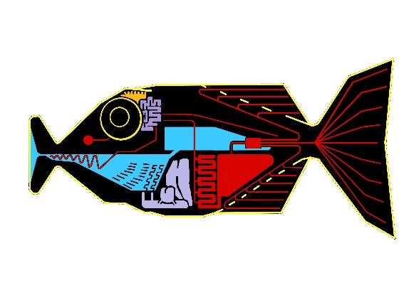
Babelfish: Overview
What is Babelfish?
A server maintained by NASA ARC
Accessible from outside the center with appropriate NASA credentials
Hosts distributed git repositories, Trac System, and Wiki for cFS
Source Code Control: the git Repositories
Issue Tracking: the Trac Ticketing System
Shared Documents: the Trac Wiki
Continuous Integration: the Bamboo Plans
Promotes collaboration across centers
Improvements made by members of the community are shared
Issues and bugs found are shared
Note: Continued functioning of the cFS Community also relies on Electronic Mail and Mailing lists (not hosted by Babelfish) and the periodic meetings of the Change Control Board (teleconferences, also not Babelfish)

Slide 11
cFS CCB Projects on Babelfish
Babelfish provides two services for each project:
git repository
Trac system
Provides issue tracking and Wiki services
Babelfish hosts six separate cFS projects/repos:
cfs_cfe
cfs_osal
cfs_psp
cfs_tools
cfs_apps
cfs_test
Anyone with an NDC account can acquire access
Contact Greg Limes (gregory.limes@nasa.gov) for an account

Slide 12
Babelfish: Bamboo
Babelfish shared resource providing automatic build and test services
We currently build:
OSAL
Compiles OSAL library
Performs some static code analysis (CppCheck)
Looking at other static analysis tools we can deploy
Runs unit tests
Some on the build agent
Others staged to target virtual machines pretending to be flight hardware
cFE
The same services as for OSAL listed above, but for a complete cFS Mission, where the collection of cFS Applications may vary from branch to branch
Current builds check a variety of branches
Additional procedures and facilities within each procedure are under consideration
Notes:
Why Bamboo, not Jenkins or GitLab-CI or BuildBot or other?
Mostly we fell into this one without discussion. I was managing a Bamboo plan for a cFS variant project (LADEE flight software) and it seemed useful to apply what I had learned to the cFS Community, even if the source code organization had been completely changed.
None of my Bamboo work prevents anyone else from setting up an independent automated build and test system; in fact, I would be very happy if other centers or projects set up their own Bamboo or Jenkins or GitLab-CI or whatever. We can trade scripts!

Slide 13
Babelfish: Trac System
Babelfish supported to set up issue tracking system quickly
Default issue tracking system
ConfiguraCCB chose to implement a design with many states
Narrows categorization of outstanding issues narrowly
Many “short-circuit” actions for fast update
Configuration of Ticket States and their transition can be customized
Each cFS git repository is coupled with a Trac database
Linkage between tickets, the Wiki, and git commits are closely coupled
Links that cross repository boundaries are not as tight and provide less “live” information
Notes:
In retrospect, it might have been worthwhile to solve the budget issues and set up Jira and Confluence instead – this would have allowed us to integrate more tightly with our Bamboo build servers.
Some projects may want to side-step the licensing issues entirely and select an entirely open source stack – GitLab is a very nice place to start, especially with the recent version that integrates GitLab-CI as an automatic build service.
I hear Jenkins is nice, too. Use what you want, but please, do plan up front for automatic build and test as part of your infrastructure!

Slide 14
Where is the cFS?
cFE open Internet access at http://sourceforge.net/projects/coreflightexec/
Source code
Requirements and user guides
Tools
OSAL open Internet access at http://sourceforge.net/projects/osal/
Source code
Requirements and user guides
Tools
cFS application suite and UT-Assert library is also available on sourceforge
Application sourceforge links are available from https://cfs.gsfc.nasa.gov
UT-Assert library is available at http://sourceforge.net/projects/cfs-ut-assert

