Slide 1
TECH SESSION #1
STANDARDS AND BUILD TOOLS
The Johns Hopkins University Applied Physics Laboratory
core Flight System Workshop
Jonathan Wilmot
December 12, 2016

Slide 2
Future Products & Technology
From the 2015 workshop
  Increasing the message name space (App ID)
  Software Bus Network
  Multicore
  Modeling/autocode
  Real-time Linux
  Partitioning
  Electronic Data Sheets
  OSAL/PSP layering
  Checkpoint restart
  Cmake build environment

Slide 3
Tools Inventory (1)

Slide 4
Tools Inventory (2)

Slide 5
Tools Inventory (3)
There are a lot more tools out there!
Please send your list to Jonathan.J.Wilmot@NASA.gov

Slide 6
cFS Message Name Space
What’s the Problem
  cFS Software Bus uses CCSDS Space Packets the APID (topic) and is limited to 2047 commands and 2047 telemetry packets
  Allocation and management of APIDs during development
  Early block assignments to subsystems
  Ripple effects of APID changes to code, documentation, tests, ground systems…
  Larger systems of systems may run out of APIDs
    Example: Habitat and Orion docked
  Formation flying, distributed, cluster satellites, small satellites
    Includes multi-processor, multi-core, and partitioned systems
  In CCSDS, the spacecraft ID is in the WAN frame and is stripped off as the packet goes up the protocol stack

Slide 7
Extending the CCSDS Message Header
Add an addition 32 bits to the CCSDS Space Packet secondary hdr
Increasing the potential APID name space from 2¹² to 2³⁷
For practical/efficiency reasons cFS will limit to 2³²
Changes are isolated to cFS SB and SBN
  Applications subscribe to a 32 bit number
    Change is transparent to applications after a recompile
Near term infusion
  GSFC Restore Servicing Payload mission
    Distributed system with 16 processors
    Currently implementing a 2¹⁶ mapping
      8 bits APID, 8 bits APID Qualifier
  AES Habitat
  GSFC WFIRST

Slide 8
Current CCSDS Space Packets
Primary Header
CCSDS APID allows 2¹¹ (2047) commands and an additional 2047 telemetry packets (APID = b11111111111 identifies an idle packet, typically used for fill)
PACKET.request is a Send (
  Space Packet,
  APID,
  APID Qualifier (optional),
  QoS Requirement (optional) )
“While the APID is contained in the Packet Primary Header of the Space Packet, the APID Qualifier does not appear in the data structure defined by the Space Packet Protocol. The value of the APID Qualifier is usually carried by a protocol (or protocols) of the underlying subnetworks.”
“The APID may uniquely identify the individual sending or receiving application process within a particular space vehicle”

Slide 9
Proposed Updates to CCSDS SPP

Slide 10
cFS Changes
CFS CFE_SB_MsgId_t changed from a uint16 to a uint32
  Full change requires minor changes in SB implementation but only transparent API change
  SubSystemId 2⁹ ⁼ 512
    Allows 512 subsystems with 2046 commands, and 2046 telemetry packets.
    2²⁰ allows ~1,048,576 APIDs within a vehicle (2x for cmds and tlm combined)
  SystemId 2¹⁶
    Can be populated with spacecraft ID but ignored in the mapping functions
Add #ifdef MESSAGE_FORMAT_IS_CCSDS_MTS (cfe_mission_cfg.h)
  If set apply new format
2³² mapping to CCSDS headers is mission dependent
  Can be in non contiguous header fields
  Changes are isolated to one file in SB implementation which has mappings
Change to be made backward compatible using tool chain and compilation options
  Does not require changes to cFS components (bubbles/lollipops)

Slide 11
Build & Development Tools

Slide 12
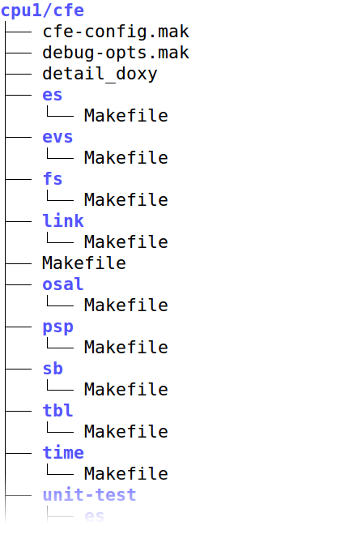
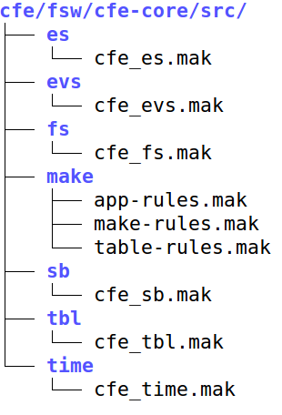
CFE/CFS 6.5 Build System
The “classic” CFE/CFS build system uses custom-written makefiles. The design of the makefile-based build system presents some challenges/concerns going forward.
Issue 1 – Two part design: Outer makefile in “build” directory references inner makefile with specific rules/targets
  Outer part is implemented by project/mission, sets up environment
  Inner part comes with CFS application or upstream source
  Both parts are “tightly coupled”; changes in one do affect the other, but they are not version controlled together because they come from different places.
Outer Makefiles
(mission customized)
Inner Makefiles
(provided by applications)

Slide 13
Next-Gen CFE/CFS Build System
Issue 2 – Does not handle “#include” dependencies well
  Relies on running explicit “make depend” target
  But this changes over time, and may be affected by mission/platform config
Issue 3 – Not readily extensible
  Adding apps or additional CPUs require “clone and modify” of multiple files.
    Number of total files to manage grows exponentially as (N_apps * N_cpus)
  Likewise, it is difficult to maintain multiple different configurations
    Such as a build for real Flight Avionics, a “hardware in the loop” simulation, or a fully simulated test.
    Each of these 3 would require its own entire “outer part” makefile copy.
    So the full total becomes (N_apps * N_cpus * N_configs)
Entire outer tree must be “cloned and owned” for cpu2

Slide 14
Solution: Cmake build generator
Using a “meta-makefile” to generate the actual makefiles helps solve these problems
Allows for clearer differentiation of information roles in build system
  Recipes for generating a single binary (very generic)
  Tuning for a particular board/architecture (board-specific)
  Collection of applications and table definitions (mission-specific)
All 3 can be specified independently and re-used as appropriate
Even if the same information needs to be in multiple makefiles, they can all be updated simultaneously by re-running the generator script (1 command)
BOARD
SUPPORT
Cross compiler,
Tuning Flags
(Part of PSP)
MISSION
SPECIFIC
App selection,
Table defintions
APPLICATION
RECIPES
(Part of Apps)
FINAL MAKEFILES

Slide 15
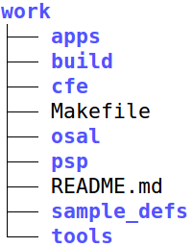
Directory Structure: Top Level
Top Level Directory
CFS Application Source Code
One subdirectory per application, which directly maps to
upstream/official source (not modified locally in any way)
Build Output and intermediate files
(100% generated files; not version controlled)
Subtrees containing “upstream” sources
Unmodified from their original state; no editing or
customizing to the target system in these files
Mission configuration
Contains “overrides” or extensions to the
distribution files that provide mission-specific needs
All “mission-specific” information is consolidated in the _defs directory, such as:
Number and type/architecture of processor boards in use, and the corresponding cfe_platform_cfg.h file for each processor board
CFS Applications to compile for each processor board
Top-level mission configuration (cfe_mission_cfg.h)
Table definitions
Script files
This keeps orginal source trees completely original so “diffs” and merges work!

Slide 16
Cmake and make
Classic make (cFS 6.4) will still be available in 6.5 and 6.6
For 6.6 the proposed approach is to include generated header files along with the EDS files in CM and in the open source releases
  If you use cmake the generated header files will be used instead of the distributed header file.
  If you use classic make the EDS files will be ignored but can be used for data base generation
We would encourage new projects to use cmake

Slide 17
Integrating EDS wth cmake
APIDs for all subsystems are defined in one mission XML file
The APIDs numbers are arbitrary and only represent a mission wide topic handle
cmake is set up to generate all of the APID header files prior to compiling the source code
cmake can be set up to generate the “as deployed” mission EDS which is imported into the database tools
  ITOS, ASIST, COSMOS…
  This effort is in progress
cmake can also be used to generate and allocate other cFS system wide identifiers such as Performance ID

Slide 18
Integrating EDS wth cmake
APIDs for all subsystems are defined in one mission XML file
The APIDs numbers are arbitrary and only represent a mission wide topic handle
cmake is set up to generate all of the APID header files prior to compiling the source code
cmake can be set up to generate the “as deployed” mission EDS which is imported into the database tools
  ITOS, ASIST, COSMOS…
  This effort is in progress
cmake can also be used to generate and allocate other cFS system wide identifiers like Performance ID

Slide 19
Unit Test Tool (ut-assert)

