Slide 1
UT-Assert Library
Presented by Charles Zogby, NASA-GSFC
charles.a.zogby@nasa.gov
The Johns Hopkins University Applied Physics Laboratory
core Flight System Workshop
December 12, 2016

Slide 2
Agenda
1.) UT-Assert Overview
2.) Benefits of Using UT-Assert
3.) UT-Assert Library Components
4.) Test Cases
5.) Test Output
6.) How to Get the UT-Assert Library

Slide 3
UT-Assert Overview
Used for unit testing cFS applications and tasks through the use of assert statements
  An assert statement evaluates whether a condition is true or false and returns PASS or FAIL.
  Each test case is self-verifying, rather than needing to be manually verified after running
Used to test functionality and code coverage of every function in an application, one at a time
  Each test should be completely independent from other tests
All cFS API library functions (OSAL, PSP, and cFE) are automatically substituted with UT-Assert stub and hook functions
  Every cFS API library function has a corresponding UT-Assert stub function
  Tests can set individual stub functions to behave in 3 different ways:
    1.) Return its default return value (usually CFE_SUCCESS)
    2.) Return a specified custom value
    3.) Execute a specified custom hook function and then return the resulting return value
  Some cFS API library functions have corresponding hook functions that are called by default
    Can be substituted for a custom hook function or a custom return value

Slide 4
Benefits of Using UT-Assert
  Predefined stub functions simplify testing of code that uses cFE, OSAL, and PSP
    No need to worry about how these functions work
    No need to set up complicated inputs to these functions
  Each test case is self-verifying, rather than needing to be manually verified after each run
    No need to compare output to an expected output
  Lends itself to good unit test coding practices
  Each test case only tests its designated function/operation
  Only results of function under test are verified – not results of subfunctions
  Facilitates testing of code coverage
    Keeping tests short and simple makes it easier to know exactly which lines you’re trying to cover

Slide 5
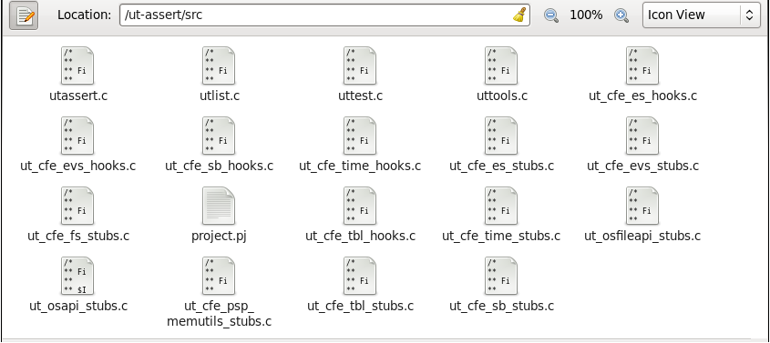
UT-Assert Library Components
Contents:
  utassert.c /.h – defines the standard assert function, along with a few related functions
  utlist.c – defines functions to create linked lists, which are used elsewhere in the library
  uttest.c – defines the functions used to add and run test cases
  uttools.c – defines miscellaneous functions that are useful for unit testing
  ut_cfe_***_stubs.c – defines the stub functions for a particular cFS component, and supporting functions
  ut_cfe_***_hooks.c – defines the default hook functions for a particular cFS component

Slide 6
Test Cases
Written by the user
Tests a single condition, branch of code, etc, using assert statements
Tests functionality and code coverage of each function in an application, one at a time
Only needs to test the designated section of code
  Sub-functions are tested in separate test cases

Slide 7
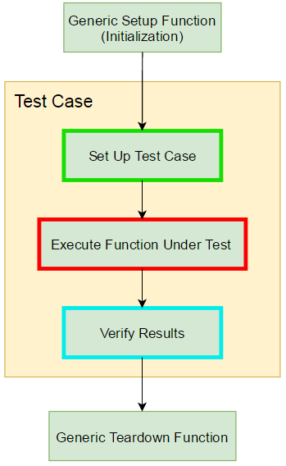
Test Case Flowchart

Slide 8
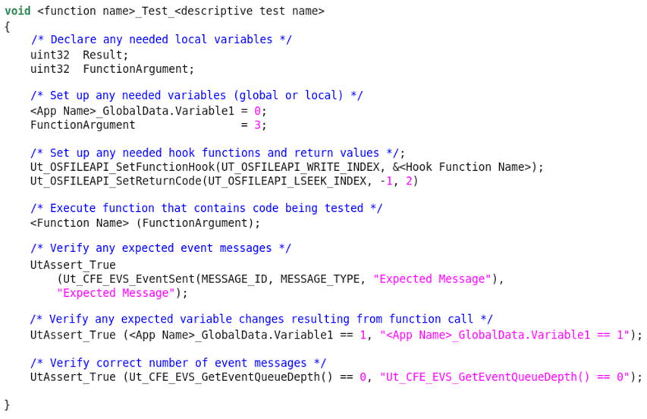
Test Case Example
Set Up Test Case
Execute Function Under Test
Verify Results

Slide 9
Test Output
Line-by-line code coverage detailed in .gcov files generated when gcov is run
Terminal Window Output example:
  Running Test: FM_InvokeChildTask_Test_WriteIndexEqualsQueueDepth
  PASS: FM_GlobalData.ChildWriteIndex == 0
  PASS: FM_GlobalData.ChildQueueCount == 1
  PASS: Ut_CFE_EVS_GetEventQueueDepth() == 0
  Running Test: FM_AppendPathSep_Test
  PASS: strncmp(Directory, 'directory/', OS_MAX_PATH_LEN) == 0
  PASS: Ut_CFE_EVS_GetEventQueueDepth() == 0
  Tests Executed: 178
  Assert Pass Count: 679
  Assert Fail Count: 0
  gcov: '../src/fm_tbl.c' 100.00% 52
  gcov: '../src/fm_child.c' 100.00% 481
  gcov: '../src/fm_app.c' 100.00% 120
  gcov: '../src/fm_cmds.c' 100.00% 285
  gcov: '../src/fm_cmd_utils.c' 100.00% 174

Slide 10
How to Get the UT-Assert Library
cFS NASA wide community Babelfish git repository
Sourceforge
  https://sourceforge.net/projects/cfs-ut-assert/

