Slide 1
TECH SESSION #1
ELECTRONIC DATA SHEETS
The Johns Hopkins University Applied Physics Laboratory
core Flight System Workshop
Jonathan Wilmot
December 12, 2016

Slide 2
Future Products & Technology
From the 2015 workshop
  Increasing the message name space (App ID)
  Software Bus Network
  Multicore
  Modeling/autocode
  Real-time Linux
  Partitioning
  Electronic Data Sheets
  OSAL/PSP layering
  Checkpoint restart
  Cmake build environment

Slide 3
Electronic Data Sheets
A machine readable definition of a software component or hardware device interface specification
  It is not an ICD in the sense that it does not define how your system will use it
We have focused on the software interfaces
  An EDS can contain mechanical, thermal, and other interfaces
Work originally started at AFRL as part of Spacecraft Plug-and-Play architecture (SPA) ~10 years ago
Goal - all software/hardware components come with an EDS
  Automation of component system integration

Slide 4
  CCSDS Electronic Data Sheet Standards
The CCSDS Spacecraft Onboard Interface Services Working Group has been working to standardize an XML schema and dictionary of terms for use in defining software and device interfaces
  The schema is based on XTCE but is much simpler due to a reduced scope
Area\WG | CCSDS |  | Document Title | Status | Start and / or Target Publication Date
SOIS-APP | 870.1 | GB | Electronic Data Sheets and Common Dictionary of Terms - Overview and Rationale | Draft will be updated with user's guide information. Will rename to "…-Overview" | Start date 05/02/2014 End date 01/10/2017
SOIS-APP | 876.0 | BB | XML Specification for Electronic Data Sheets for Onboard Devices and Software Components | All RIDs from second review dispositioned. Book updates in work | Start date 01/09/2012 End date 15/06/2018
SOIS-APP | 876.1 | MB | Specification for Dictionary of Terms for Electronic Data Sheets for Onboard Components | All RIDs from second review dispositioned. Book updates in work | Start date 04/23/2012 End date 15/03/2017

Slide 5
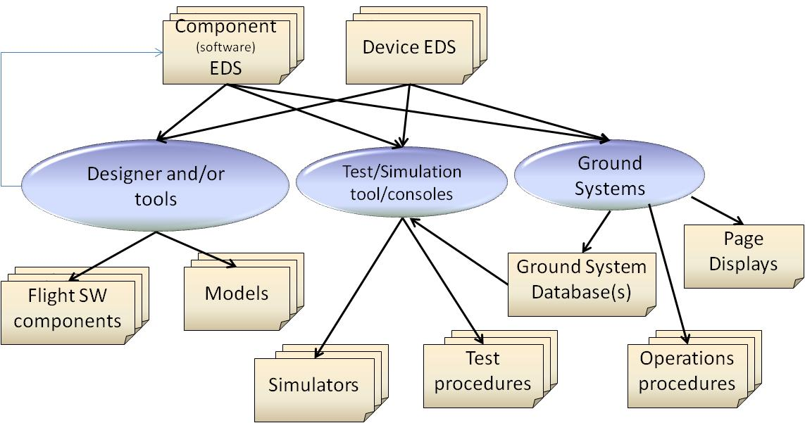
CCSDS SOIS:
Definition and Use of EDS

Slide 6
EDS Layers
HW and/or software
logic
SpaceWire
1553
Subnetwork
I/O
Sensor
Processing
Telemetry
Output

Slide 7
Status
NASA is integrating EDS into the cFS build system
  Tools and updates to be released in cFS 6.5 mid CY17
  Prototype tool developed to read EDS and generate XTCE to import into COSMOS
    ITOS and ASIST tools in work as well
ESA has developed tools to auto generate flight software for hardware device interfaces
  Demonstrated for JENA Star tracker
  ESA is investing 1.1 million Euro to mature EDS tools
CNSA/CAST is developing tools to integrate EDS into CAST software architecture
It should be noted that many cFS users have created database tools to define and manage the message formats and metadata
  The EDS can be used as source files for those tools

