Slide 1
OSAL and PSP Inventory and Status
Alan Cudmore – NASA Goddard Space Flight Center
Cal Tech – APL/JPL/Aerospace
core Flight System Workshop
December 12, 2016

Slide 2
GSFC OSAL Inventory
Operating System / Version | OSAL Version | Brief Description | OSAL Port Maintainer | Status
vxWorks 6.x | 4.2.1a | vxWorks Legacy 6.x | NASA/GSFC & cFS commuinity | Released
Posix / Linux 2.6+ | 4.2.1a | The Posix/Linux 2.6+ OSAL 32. bit | NASA/GSFC & cFS commuinity | Released
RTEMS 4.10 | 4.2.1a | The RTEMS OSAL cFS on RTEMS 4.10/4.11 releases. Future updates will include support for the RTEMS Dynamic Loader in RTEMS 4.11 and 4.12. | NASA/GSFC & cFS commuinity | Released
FreeRTOS 8.0.1 | 4.1.0 | The FreeRTOS OSAL supports the cFS on FreeRTOS 8.0.1 on the Gomspace Nanomind CPU for the Dellingr Cubesat Mission. | NASA/GSFC | In Development
VxWorks 6.7 SMP | 3.3 | The vxWorks 6.7 SMP OSAL was a techology development effort between GSFC and JHU/APL. | NASA/GSFC | In Development
Pike OS 3.x | 3.5 | The PikeOS OSAL was a technology development effort by GSFC. | NASA/GSFC | In Development

Slide 3
GSFC PSP Inventory
Operating System / Version | Processor Card/Hardware Platform | Version/ Release | Brief Description of PSP | PSP Port Maintainer | Status
vxWorks 6.x | MCP750 | 1.3.0.0 | Supports vxWorks on the MCP750 CPCI COTS board. | NASA/GSFC & cFS commuinity | Released
vxWorks 6.9 | SP0 | 1.3.0.0 | TBD | NASA/GSFC & cFS commuinity | Released
Posix / Linux 2.6+ | Generic Linux with 32 bit support - Desktop, Server, Raspberry Pi, etc | 1.3.0.0 | Supports cFE/cFS on Linux. Primarily intended for development and test. | NASA/GSFC & cFS commuinity | Released
RTEMS 4.10 | RTEMS i686 BSP - QEMU target | 1.3.0.0 | Supports cFE on RTEMS 4.10 / i686 / QEMU target. Future updates will include support for the RTEMS Dynamic Loader in RTEMS 4.11 and 4.12. | NASA/GSFC & cFS commuinity | Released
RTEMS 4.10 | MMS Misson - C&DH Processor Card ( RH5208 Coldfire ) | 1.1.0.0 | Supports cFE on RTEMS 4.10 for the MMS C&DH processor card. Uses RTEMS RFS file systems, GSFC EEPROM File system, and GSFC Static Loader for dynamic loading. | NASA/GSFC | Released
vxWorks 6.4 | GPM Mission - C&DH Processor ( BAE RAD750 ) | 1.0.0? | Supports the cFS on vxWorks 6.4 for the BAE RAD750 used on GPM | NASA/GSFC | Released
FreeRTOS 8.0.1 | Gomspace Nanomind | 1.2.0.0 | Supports the cFS on FreeRTOS for the Gomspace Nanomind Cubesat Processor - This relies on the Gomspace Nanomind firmware for OS, drivers, boot code, file systems, etc. | NASA/GSFC | In Development
VxWorks 6.7 SMP | Gaisler GR712 Dual Core LEON3 board | 1.1(?) | The vxWorks 6.7 SMP OSAL was a techology development effort between GSFC and JHU/APL. It was ported to work on vxWorks 6.7 on the LEON3 processor. This port has been given to JSC to continue evaluation and development. It is also being used as the basis of a new port for the GSFC Mustang CPU ( Dual Core LEON 3 / vxWorks ) project. | NASA/GSFC | In Development
Pike OS 3.x | Gaisler CPCI-XC4V LEON3 board | 1.1(?) | The PikeOS OSAL was a technology development effort by GSFC. It was ported to work on the PikeOS partioned operating system on a LEON3 processor. This port allows the cFE/cFS to run on a native PikeOS partition. There are some shortcomings like the lack of a dynamic loader, and limited file system support. In addition, PikeOS partitions have very limited C library functions. | NASA/GSFC | In Development

Slide 4
Future Platforms at GSFC
Xenomi Linux ( Jonathan?)
PACE Mission and PACE / OCI Instrument
vxWorks SMP / LEON3 Dual Core
vxWorks / LEON3-FT
SmallSat Cubesat Electronics Board
RTEMS – LEON3-FT
WFIRST Mission
RTEMS 4.12 – LEON4 Quad Core

Slide 5
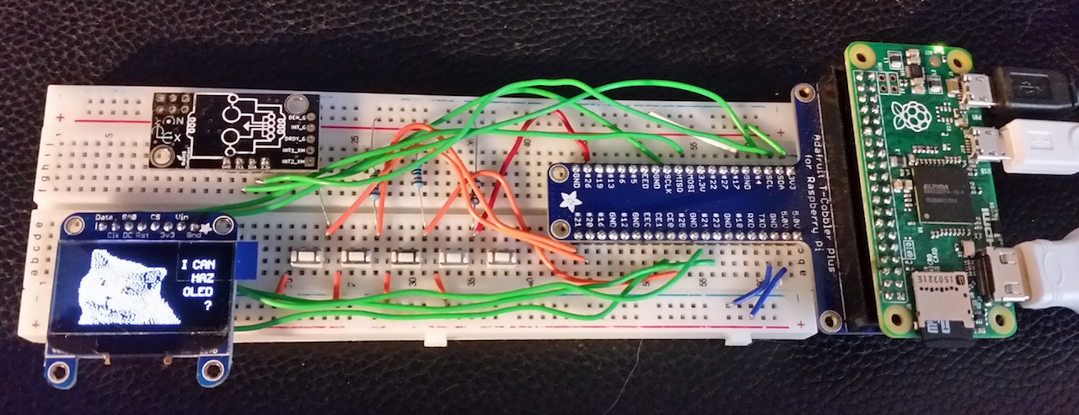
Platforms Outside of GSFC
APL
Solar Probe Plus – vxWorks 6.x LEON3-FT
JSC
OSAL – ARINC653
?
ARC
Ladee
Windhover Labs / JSC?
OSAL
Xenomai 3.0.1
Linux ( faster than real time support )
PSP
Xilinx Zync – Xenomai and Petalinux
Raspberry Pi Zero prototype

Slide 6
OSAL Roadmap ( GSFC )
Update RTEMS OSAL port
RTEMS 4.12 Compatibility
RTEMS Dynamic Loader Support
vxWorks SMP port
RTEMS SMP Port
FreeRTOS Port
FreeRTOS needs extra libraries / Infrastructure

