Slide 1
cFS and Multi-Core SMP
Alan Cudmore – NASA Goddard Space Flight Center
Cal Tech – APL/JPL/Aerospace
core Flight System Workshop
December 12, 2016

Slide 2
Existing work
In FY 2012 GSFC and APL worked on a joint research project to add multi-core support to the OSAL and cFE core.
Using older cFE and vxWorks 6.7 on LEON3 dual core CPU
OSAL supported processor affinity
cFE core startup code supported processor affinity
Code was given to JSC to continue work
Not much happened at GSFC and APL since then
Question – are there any other cFS multi-core implementations out there?

Slide 3
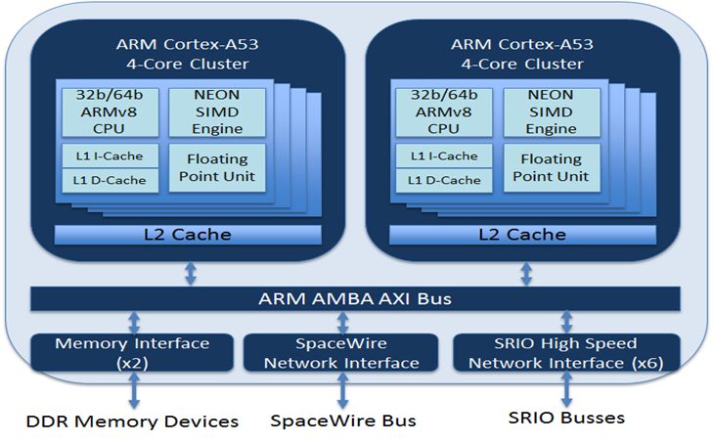
Upcoming SMP work at GSFC
MUSTANG processor card
Will be used on PACE C&DH card and PACE/OCI instrument
Dual Core LEON3
FPGA based LEON3-FT
Using vxWorks 6.x
WFIRST Mission
Designing a LEON4 Quad core based CPU card
Will use RTEMS and cFS with SMP support
High Performance Spacecraft Computer
Much longer term – 8 core CPU
Other GSFC processors
Spacecube / Zync based systems

Slide 4
Future SMP OSAL/cFS OSAL
OSAL SMP API
OSAL API Processor Affinity Support
OSAL API Interrupt and locking
OSAL API Multi core control ?
OSAL SMP Ports
vxWorks – based on existing work
Linux/POSIX – Existing?
RTEMS – Using 4.11 / 4.12 SMP APIs

Slide 5
Future SMP OSAL/cFS cFE/cFS
What do we need in the cFE Core for SMP?
cFE core startup
processor affinity support for cFS apps
cFE Internal locking considerations
Need to remove or revisit interrupt locks and mutex use in cFE Core code
Questions
Do we need to choose where cFE core tasks run?
Do we need any other types of API support in the cFE?
My thought is to keep the cFE changes simple and minimal

Slide 6
Future SMP OSAL/cFS Other Considerations
Do we want to support power management or other upcoming standards?
http://www.multicore-association.org
Defines a number of multi-core standards and practices
Does this ( or should ) it relate to Partitioned Operating Systems, or AMP systems?

