Slide 1
Application Inventory
Susanne Strege – NASA Goddard Space Flight Center
susie.strege@nasa.gov
The Johns Hopkins University Applied Physics Laboratory
core Flight System Workshop
December 12, 2016

Slide 2
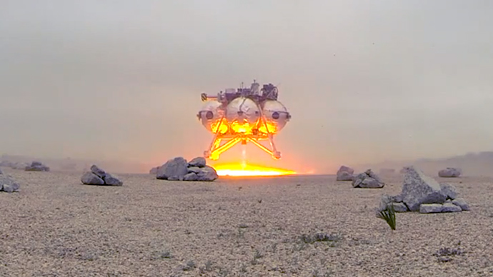
Application Catalog
Over 100 applications hosted from:
Goddard Space Flight Center
Ames Research Center
Johnson Space Center
Glenn Research Center
Independent Verification and Validation (IV&V) Facility
Johns Hopkins University Applied Physics Laboratory
Emergent Space Technologies
DARPA
Windhover Labs
Benefits
Community app store
Open to government and public
Promotes sharing and reuse
Promotes collaboration
Free Advertising
Insight into project/mission flight software work load, features, and overlap

Slide 3
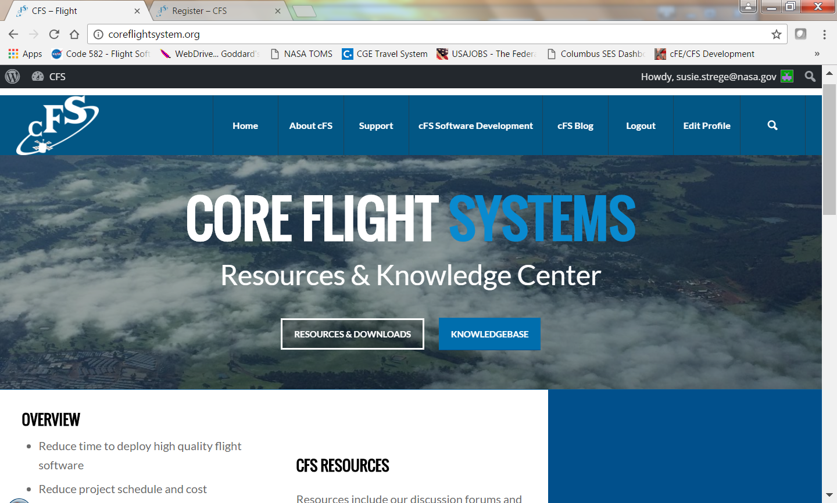
Where is the Application Catalog?
Currently available in electronic copy only (Working Excel and published .pdf formats)
For a copy contact: Susie Strege – susie.strege@nasa.gov
Plans
Publish the catalog on cFS public website: http://coreflightsystem.org
Enhance with:
Forms for adding new applications
Configurable displays
Search engine
Improvements suggested by active users

Slide 4
For catalog additions contact: susie.strege@nasa.gov or cfs-community@lists.nasa.gov

Slide 5
A Look Inside

Slide 6
File Commander eXtended FCX
Susanne Strege – NASA Goddard Space Flight Center
susie.strege@nasa.gov

Slide 7
File Commander eXtended (FCX)
Motivation
Highly regarded application by GPM operations team. In use on multiple current GSFC projects.
Status
Product under development
Requirements, design, code, and unit tests complete
Maintained by GSFC
Plans
Develop and run build verification tests and release as open source

Slide 8
FCX – Overview
FCX Sends CCSDS Packets from a file via the Software Bus
Supports command and telemetry packet distribution
Determines file type from cFE primary header sub-type field
Processes two sub-types using commanded delay value
FCX_FILE_SUB_TYPE packet data file has CFE primary header only
FCX_DS_FILE_SUB_TYPE packet data file also has DS secondary header
Processes one sub-type using Embedded Delay (ED) values
FCX_ED_FILE_SUB_TYPE packet data file has packets separated by delay values
FCX_ED_FILE_SUB_TYPE packet data file has CFE primary header only
This is a new file type with ccsds packets separated by 32 bit delay values
This file type should not be used for relative time sequencing due to the poor time resolution of the FCX child tasks
Creates a child task for each packet data file being processed
Each child task is terminated when its packet data file is closed
The number of child tasks is limited by a configuration definition

Slide 9
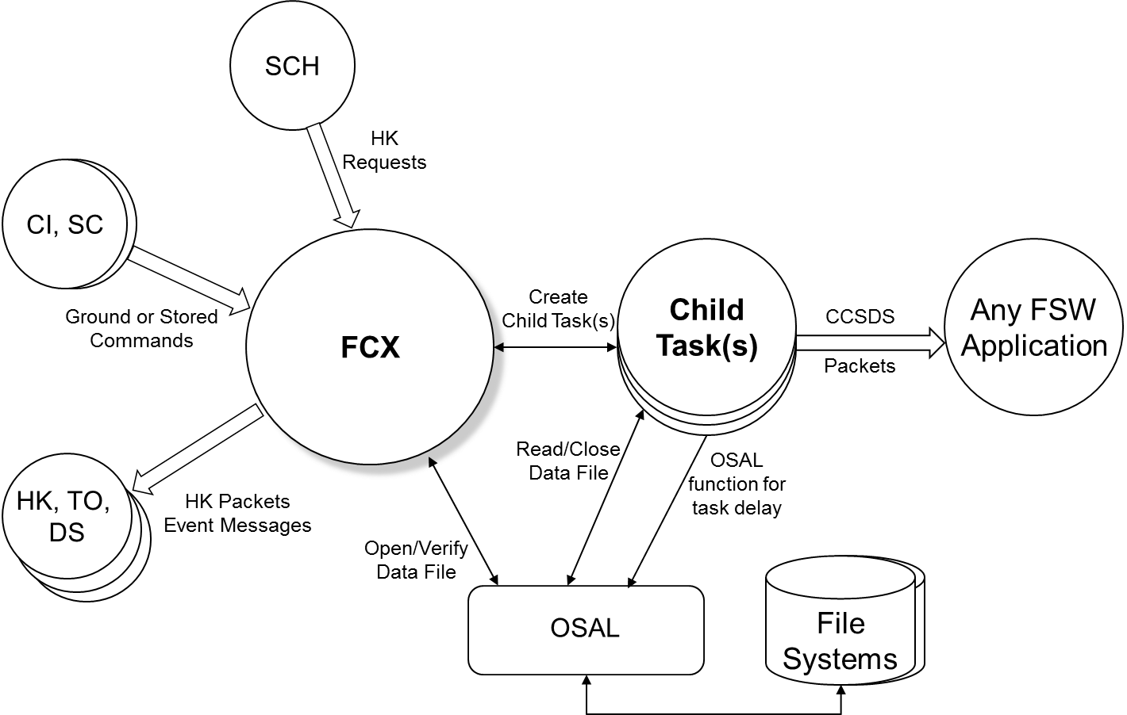
FCX – Context Diagram
Notes:
testnotes

Slide 10
Commands
Command | Description
No-op | General aliveness test – verifies command handler and event generation
Reset Counters | Reset housekeeping telemetry counters
Start Playback( filename, inter-packet delay time in ms, data array slot number) | Start playback of a file containing a header and CCSDS packets. If slot number = 0 then find UNUSED or STOPPED data array slot, else verify that commanded slot is not ACTIVE or PAUSED. Slot numbers start at one, not zero. Filename must contain a full path specification that is not already active. Initialize shared data array slot. Create child task. Read CCSDS packets from filename, and wait the specified time in milliseconds, then send the packet via the Software Bus.
Stop Playback (data array slot number) | Stops child task reading packets from file. Verify that commanded slot is ACTIVE or PAUSED. Close File. Terminate child task. Send event message.
Pause Playback (data array slot number) | Suspends a child task from sending any more packets until a resume command is received. Verify that commanded slot is ACTIVE. Set PAUSE state in shared data array to cause child task to pause playback.
Resume Playback (data array slot number) | Resume sending packets for a slot that is paused. Verify that commanded slot is PAUSED. Set ACTIVE state in shared data array to cause child task to resume playback.
Replay Playback (data array slot number) | Replays a slot from the beginning of the file that has either completed or error’d. Verify that commanded slot is not UNUSED. Replay the packet playback file in the selected slot using the previous playback command arguments.

Slide 11
Generic CI - TO
Lorraine Prokop – NASA Johnson Space Center
lorraine.e.prokop@nasa.gov

Slide 12
Software Tasks – Generic CI - TO
Motivation / Vision
Provide general-purpose, configurable, and extensible command and telemetry functionality supporting a wide variety of communications protocols and transports for use in multiple current and future projects
Status
Product finalized
Received “government purpose release” status
In use by Orion and AA-2 projects
Provided to several NASA centers, Firefly space systems under SUA
Maintained in cFS Community Server
Plans
Enhance with improvements suggested by active users

Slide 13
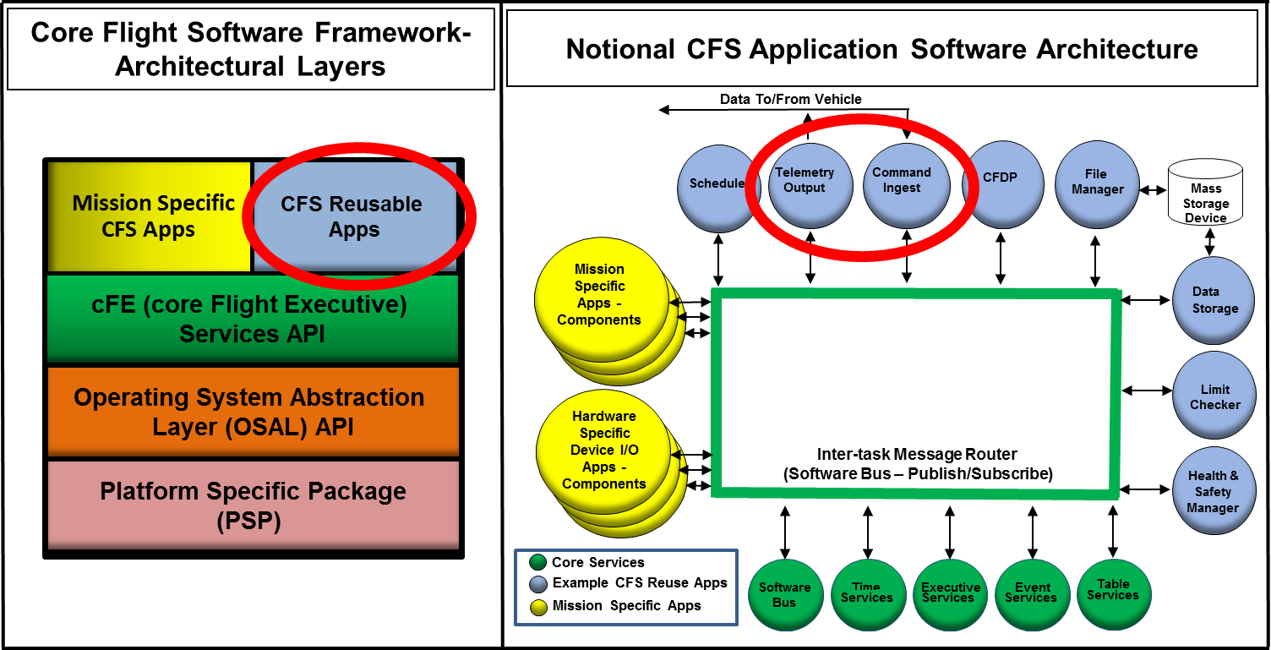
CI- TO Overview
What are the CI-TO Applications?
Two reusable, configurable, and extensible onboard applications for performing spacecraft command uplink and telemetry downlink within the core Flight Software (cFS) Framework
Command Ingest (CI) & Telemetry Output (TO)
Metrics
Command Ingest (CI) => 4100 SLOC, C code, Telemetry Output (TO) => 2200 SLOC, C code
Reusable Libraries (ioLib, c3ILib) => 13,500 SLOC, C code (includes unit tests)

Slide 14
CI/TO Component Design, Data Flow & Execution Architecture

Slide 15
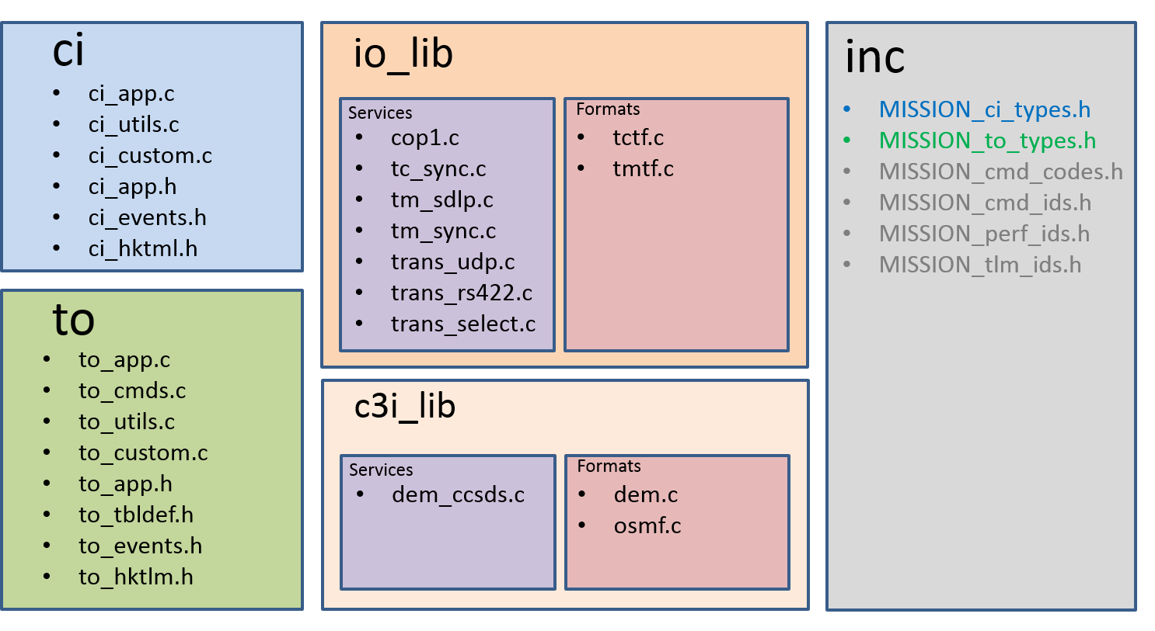
CI-TO Overview – Input/Output (IO) Library Components & File Structure
Application Program Interface (API) library “plug in’s” for communication services, protocols, transports
Format protocols:
TC and TM SDLP with their lower layer synchronization units
C3I/DEM protocol
Transport mechanisms:
RS-422
UDP
Protocol Services:
COP-1, for command sequence enforcement
Packet framing and multiplexing services for TM_SDLP,
frame pseudo-randomization for synchronization
DEM to Space Packet Protocol conversion
Built for modularity - sequential protocol stack through atomic calls
Compile in as necessary, only use what is needed for each specific mission
Easy extensibility through addition of new protocol libraries in custom layer

