Slide 1
Simulink Interface Layer (SIL)
Steve Lentine GSFC/591 Chesapeake Aerospace

Slide 2
History of SIL
Ames created original version for LADEE mission in partnership with Mathworks
GSFC-SIL forked from Ames-SIL version for use on NICER in 2013
NICER software development completed in 2015, waiting for launch
GSFC-SIL currently being used on GEDI
GSFC-SIL enhancements:
CFE GetTime support
Conditional Message sending
Model reference support
Multiple table support (coming soon)
Ames-SIL enhancements:
Telemetry/commanding database support
Usability improvements
Working towards merging Ames and GSFC versions in near future

Slide 3
GSFC Autocoding Workflow
Software requirements created by pointing team in partnership with FSW team
Pointing team knows needed functionality to meet mission requirements
Considered FSW requirements, tested and verified by FSW testers
Pointing team develops and tests algorithms in Matlab/Simulink environment
Advantages:
Use of existing GNC Simulink libraries
High code reuse between FSW and High Fidelity Simulations (HiFi’s) which pointing team already produces
Early end-to-end testing of models/code as they’re developed/implemented
Pointing team generates C code, delivers to FSW team for integration with FSW builds
CFE/SIL Autocoding workflow has been used on LADEE, NICER and GEDI
Notes:
Creating flight-software quality simulations does require additional effort from pointing team. Beneficial to have a specific FSW leision on pointing team

Slide 4
SIL in Operation
CFE
Simulink Application
Fetch Time
Spacecraft Time
cFE Time Services
Event Signals
Event Processing
cFE Event Services
Mission Ops
Tlm Data
Bus Out
Fault Flags
cFE Software Bus
House Keeping
Other Apps / Mission Ops
Queue
Cmd/TlmMessages
Provide Sequence Numbers
Error Check Messages
SIL
Bus In
SCH
Execute
Table Management
cFE Table Services
Mission Ops
App

Slide 5
Autocoding Components
Model
Contains task-specific code
Includes blocks from CSL library to access SIL functionality
Implemented by pointing team
Target Language Compiler (TLC) file
Generates (model-specific) headers files for integration with (generic) SIL architecture
Developed and maintained by Mathworks pilot engineers
Simulink Interface Layer (SIL)
Generic wrapper code which provides interfaces between autocode and CFE
Provides FDC reporting, CFE event generation, Message I/O handling, Table management
Notes:
TLC file developed and maintained by mathworks pilot engineers

Slide 6
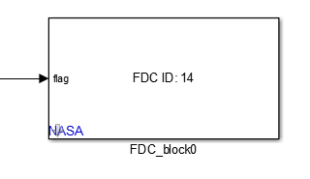
Model Development – CFE Interfaces
GetTime
In simulation: returns simulation clock + epoch
In generated code: calls CFE_GetTime to return FSW time
FDC reporting
Fills fields of message to Limit Checker

Slide 7
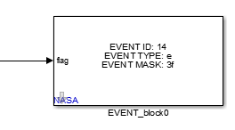
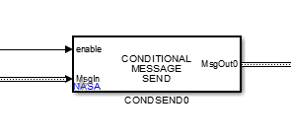
Model Development – CFE Interfaces
CFE Event
Generates event message
Conditional Messages
Pass through bus signal with conditional message to control
In simulation: only update signal when SendFlag is true
In generated code: message is only sent when SendFlag is true

Slide 8
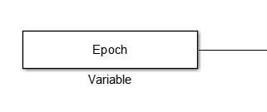
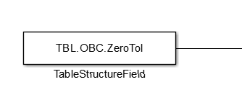
Model Development – CFE Interfaces
Table definition
Tunable Parameters
Models must not contains model references
Simulink.parameter objects
For models with/without model references
Simulink.parameter objects will be used to support multiple tables in GSFC-SIL
Referencing parameters:
Variables:
Structure Field (direct reference):
Structure Field (bus routing):

Slide 9
Code Generation
Initial Setup:
Configure code generation settings as specified in SIL users guide
System Target TLC
Use provided custom TLC template
Datatype size settings for hardware
Subsequent Builds:
Click ‘Build’
Deliver packaged code to FSW

Slide 10
App Compilation
Initial Setup:
Assign ApIDs
Add to scheduler
Add to Telemetry Output
(Optional) Define table validation function
Subsequent Builds:
Drag and drop new generated sources files
Compile

Slide 11
Software-In-The-Loop
With stubbed off CFE headers, can compile and run generated code in Simulink environment
Can also run software in real-time environments
Simulink RealTime

Slide 12
Autocoded Functionality
NICER:
Pointing Control Algorithms
2 axis gimbal controller
Sensor data conditioning
Generation of commands to hardware (Mechanism Electronics)
GEDI:
Data Ingest
Read raw data from sensors (ST, GPS, Mechanism Electronics, ISS Telemetry)
Variable format, fixed length packets
Pointing Control Algorithms
1 axis gimbal controller
Generation of commands to hardware (Mechanism Electronics)

