Slide 1
On the Combination of cFE/cFS and DDS for Distributed Space Systems
Dr. Alan George
Professor of ECE
Founder & Director of CHREC
University of Florida
Sanjay Nair
Patrick Gauvin
Daniel Sabogal
Chris Wilson
Antony Gillette
Research Students
University of Florida
12/12/2016

Slide 2

Outline
01
About Us
CHREC ▫ CSP Concept ▫ CSPv1
02
Background
cFE/cFS ▫ cFS SBN ▫ Raft ▫ DDS
03
Motivations and Goals
Motivation ▫ Future Solutions
04
Approach
SBN+DDS Comparison ▫ CoreDX/OpenDDS

Slide 3
About Us
CSM

Slide 4


What is CHREC?
NSF Center for High-Performance Reconfigurable Computing
  Pronounced “shreck” ☺
  Founded in 2007 and led by University of Florida
  Industry/University Cooperative Research Center (I/UCRC)
Role and contributions of CHREC
  Widely recognized as leading US research center in two major fields
    Space computing – most challenging and demanding place for computer engineering
    Reconfigurable computing – new paradigm that features adaptive hardware
Recognized by NSF as one of most successful R&D centers
  >30 industry & agency partners, 3 universities (UF, BYU, VT)
One of largest and most prominent R&D centers @ UF
  40+ grad students and 10+ undergrad students funded @ UF in Fa’16
  7 contributing faculty members at UF (plus 4 @ BYU and 3 @ VT)
NSF = National Science Foundation

Slide 5
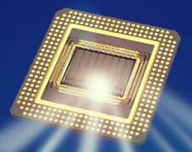

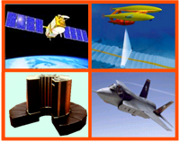
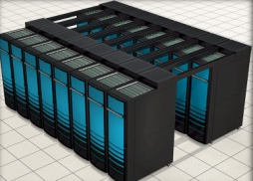
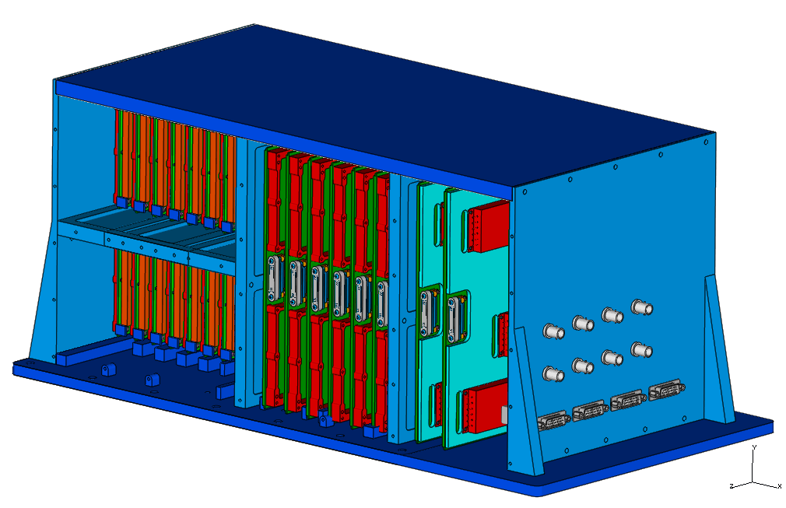
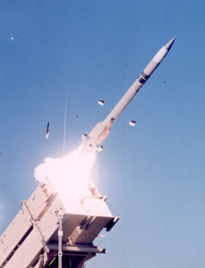
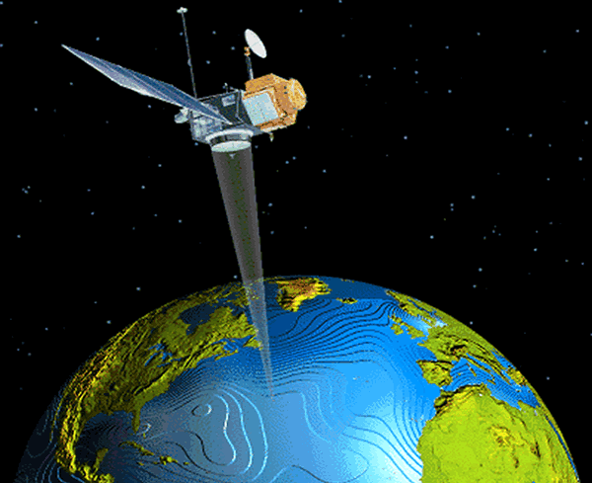
CHREC Mission
Mission
Basic and applied R&D to advance S&T in advanced computing in these
3 increasingly overlapping domains.
Many common challenges, technologies, & benefits, in terms of performance, power, adaptivity, productivity, cost, size, etc.
From architectures to applications
to design concepts and tools.
From satellites to supercomputers!
Reconfigurable Computing
CHREC
High-Performance Computing
High-Performance
Embedded
Computing
[aero]space computing

Slide 6
NSF Model for I/UCRC Centers
Universities
Basic Research
CHREC
Applied R&D
Industry & Government

Slide 7


CHREC Members
AFRL Sensors Directorate
AFRL Space Vehicles Directorate
Altera
BAE Systems
Boeing
Cisco Systems
Draper Laboratory
Emergent Space Tech [new in CY17]
Fermilab
Gidel
Harris
Honeywell
IBM
Innoflight
Laboratory for Physical Sciences
Lockheed-Martin Space Systems
Los Alamos National Laboratory
MIT Lincoln Laboratory
NASA Ames Research Center
NASA Goddard Space Flight Center
NASA Johnson Space Center
NASA Kennedy Space Center
National Instruments
National Security Agency
Office of Naval Research
Raytheon
Rockwell Collins
Sandia National Laboratories
Space Micro
SSE/PlanetiQ
Walt Disney Animation Studios
Xilinx

Slide 8
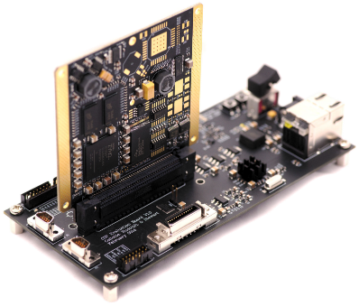
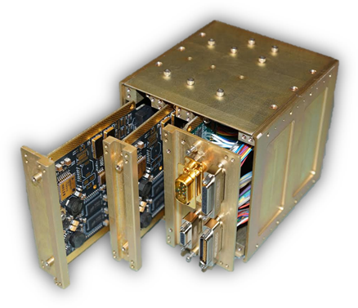
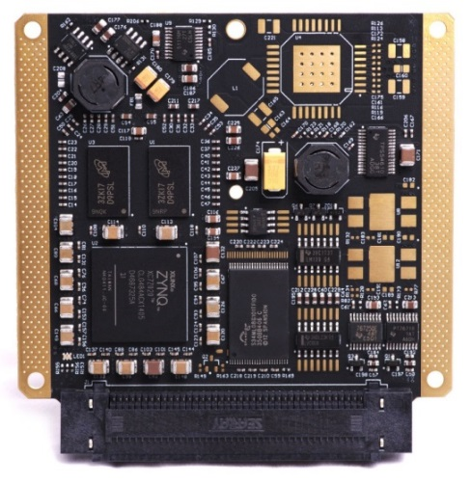
CHREC Space Processor (CSP)
Motivation
Example Flight Configuration
Create a scalable, high performance, lower power, and high reliability development system to meet future mission needs
Evaluation Board
Overview
CHREC Space Processor v1 (CSPv1) is first
design in family of CHREC developed boards embodying hybrid space computing concept
Unique selective population scheme supports assembly of Engineering Model (EM) or flight design
Flexible algorithm acceleration with hybrid architecture and cost-effective prototyping
CHREC Space Processor
· · · · · · · Keystone Principle · · · · · ·
  Commercial technology featured, for best in high performance and energy efficiency, but supported by radiation-hardened devices monitoring and managing COTS devices, and further augmented
  by fault-tolerant computing strategies

Slide 9

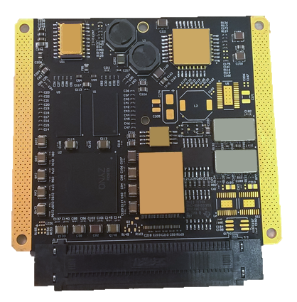
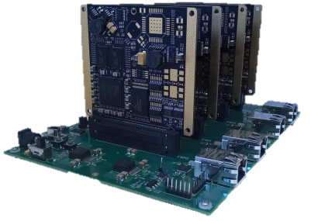
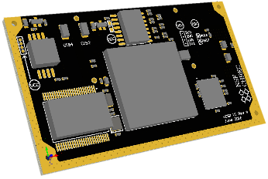
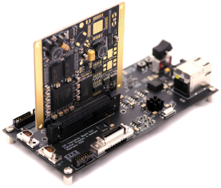

CSP Technologies
New Research Platforms
CSP team works to improve and develop our research platforms to make CSP and its related projects more reliable, cost-effective, and easy-to-use
New
New
CSPv1 Rev C
SuperCSP
µCSP
CSP Kit
More reliable fault-tolerant CSP for challenging
environments
Multi-node HPC experiment for demanding data rates and sensors
Smaller form factor and SWaP-C for Smart Modules and low-power CubeSats
Updated evaluation and USB-UART boards with usability upgrades

Slide 10
Background
CSM

Slide 11
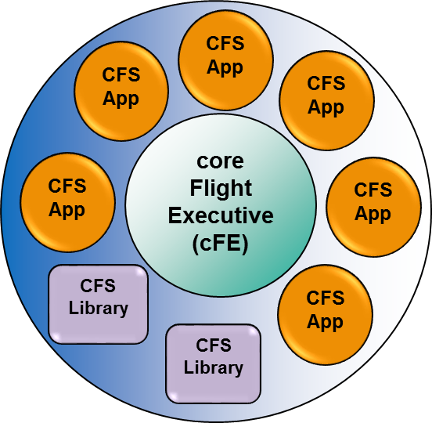
Core Flight Executive
Integrates with NASA Goddard’s reusable
flight software framework
  Open source version of cFE & cFS
  available at SourceForge
  Additional information at
  coreflightsoftware.org
  Perform local device
  management, software
  messaging, & event generation
Core Components
  Core Flight Executive (cFE)
    Mission-independent software services
  Core Flight System (cFS)
    Applications and libraries running on cFE
Notes:
Supporting abstraction and utility services
Connected via Software Bus
File Manager
Processes ground commands
Health and Safety
Application and event monitoring, watchdog servicing, execution counter reporting, CPU aliveness indication
Housekeeping
Packet-driven telemetry message builder
Stored Commands Task
Receives commands from ground
Scheduler
Generates messages when specified

Slide 12




Software Bus Network (SBN)
  Provides communication framework across processes, processors and networks
  Designed to run on Ethernet, Space Wire, CCSDS SOIS, and 1394 (FireWire)
Features
  Uses OS message queues with local processes and UDP/IP to communicate across nodes
  Requires no changes to existing cFE/cFS applications
SBN Messages
Example two-process system
Based on SourceForge Open Source cFS (not babelfish)

Slide 13

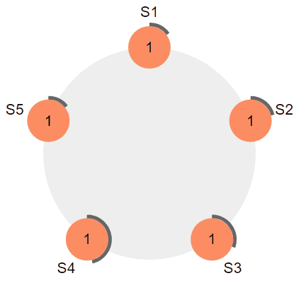
Raft Overview
Overview
  Raft is consensus algorithm designed to be easy to understand
  Consensus is multiple systems agreeing on specific values
Features
  Coordinator failover system
    Detects coordinator failure and elects new node as
    leader to keep health monitoring system intact
    Upon failure of coordinator, other servers
    waits for heartbeat for specific duration
  Ensures data consistency
    In terms of number of nodes that are healthy
    Heartbeat mechanism is repeated by new server to update itself with information about nodes that exist in network
  Handles split votes in system
https://raft.github.io/

Slide 14
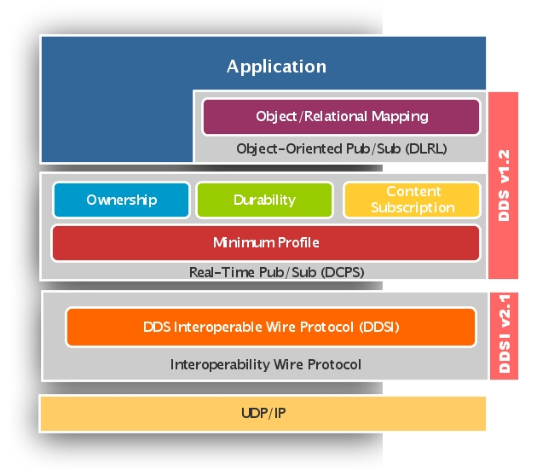
Data Distribution Service (DDS)
Overview
  Object Management Group (OMG) standard to enable scalable, real-time, dependable, high-performance, interoperable exchanges using publish-subscribe model for data, events, and command exchange
  Eliminates complex network programming for distributed applications
Main DDS entities
  Domain
    Conceptual container where entities communicate
    with each other only if they belong to same domain
  Topic
    Data object descriptor for naming logical channels
  Publishers
    Data producers
    Publishes data samples
  Subscribers
    Data consumers
    DDS delivers data samples to them

Slide 15

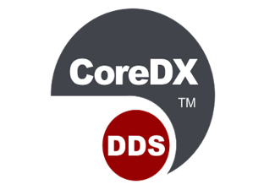
CoreDX DDS
Overview
  Leading small-footprint implementation of DDS
  Extremely full-featured, easy-to-use, flexible, and extendable
Features
  Automatic peer discovery
  Quality of service
  Low latency for low-packet size of data
  Reliable
  Previously developed cFS-DDS app
http://www.twinoakscomputing.com/coredx

Slide 16

OpenDDS
Overview
  OpenDDS is an open source C++
  implementation of the Object Management
  Group (OMG) Data Distribution Service (DDS)
System Components
  Contains DDS entities such
  as Domain Participant, Publisher,
  Subscriber, Topic,
  Data Writers & Readers
  Also contains OpenDDS
  specific DCPSInfoRepo
    Single, separate DCPS Information
    Repository (DCPSInfoRepo) process
    acts as central clearinghouse,
    associating publishers and subscribers
DCPSInfoRepo
(OpenDDS specific)
Domain
Domain Participant
Publisher
Topic
Subscriber
DataWriter
DataReader

Slide 17
Motivation
CSM

Slide 18
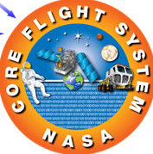
Motivation
  Strong need for space middleware
  services for future space missions and
  testbed platforms
  Previous studies indicated need to focus on
  integrating services into cFE and expanding out
  Establish reliable and responsive network for middleware services for flight system management
  Achieve cFE-DDS integration
  Establish reliable and robust communication
  system for cFS apps by replacing Software
  Bus internals with DDS

Slide 19
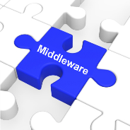
Why Middleware?
Middleware Defined
  Software services for reliable, interoperable, portable, reusable, efficient, and scalable discovery, management, and use of flight hardware and software resources
Strategic Questions
  What future needs are well met by existing tools?
    Flight Computer Management (cFE/cFS toolset)
  What future needs are beyond existing tools?
    Flight System Management
    Operating atop cFE/cFS, spanning multiple computers & modules
    Leveraging Data Distribution Service (DDS)

Slide 20
Flight System Management
Flight Computer Management (existing)
  Focus upon space computer with its attached units
  Core (cFE) and extended (cFS) services, API, apps
Flight System Management (notional)
  Focus upon system-wide resources and management
    Broader scope for higher reliability, performance, configurability,
    adaptability, and scalability w/ space computers and smart modules
    Variety of interfacing specifications, as defined in SOIS of CCSDS
    Improve efficiency of communication with DDS
  Multiple space processors and computers
    Spanning multiple devices, boards, chassis, and even spacecraft
    To enable dependable computing (redundancy), distributed computing (cooperation), and parallel computing (collaboration)

Slide 21
Why DDS?
SBN (SourceForge ver.) Limitations
  No user support and documentation
  Infrequent updates
  Does not work “out-of-the-box” and requires patch
DDS Added Features
  Quality of Service
  Dynamic Device Discovery
  Reliability

Slide 22
Approach

Slide 23
Approach Overview
Mission Statement
Extend cFS flight software for distributed and parallel computing by replacing SB/SBN with DDS bus equivalent to further benefit from best features of both DDS and cFS
Development Progression
01
02
03
04
Comparison
Studies
cFS-DDS App
(CoreDX)
cFS-DDS App
(OpenDDS)
SB/SBN
Replacement
Compare stand-alone
transfers between DDS
and SBN designs
Combined cFS with DDS
by adding CoreDX as
cFS app
Switched from CoreDX
to OpenDDS
Strategic effort to replace
SB with DDS equivalent
(Incomplete)

Slide 24
CoreDX vs SBN Comparison Study
SBN
  Limited packet size of 1500 bytes
  Order of data not guaranteed
  No native functionality for combining packet fragmentation (CCSDS has large max message length)
CoreDX
  Data transfers up to 1 MB without manual fragmentation were successful to worker from coordinator
  Data is also published with guaranteed order
  Native packet fragmentation

Slide 25

Testbed Development
Created “livesystem” of peers with implementation of Raft
Coordinator sends heartbeats and
waits for acknowledgments
Maintain table of known peers
and their health status
Demonstrate scenarios that require consensus
  Coordinator fails on connection loss
  Coordinator steps down on merged subnetworks
Application developed using CoreDX platform

Slide 26
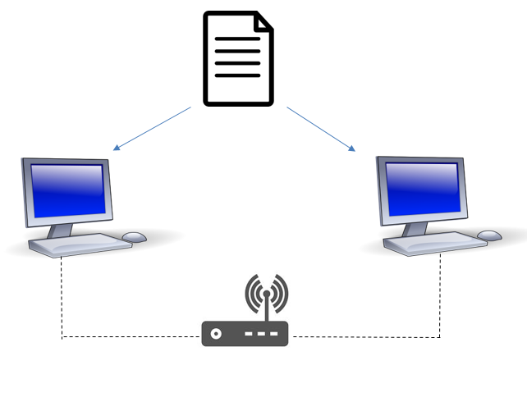
Testbed with SBN
Problem
  SBN does not support dynamic device discovery
  because network setup is defined by configuration
  file when SBN loads on startup
  This would disallow new satellites from joining pre-
  existing cluster or sending replacement spacecraft
  On all physical nodes, each system must
  have same configuration file
Work-around solution (cFS-DDS app)
  Lightweight application using CoreDX
  discovers new nodes added to system, updates SBN configuration file, and restarts SBN on all system nodes
  cFS-DDS app (needs bridge) requires applications to
  use additional API
SBN Configuration
Config file
SBN
SBN

Slide 27




Switch to OpenDDS
CoreDX is full-featured and easy-to-use
Fast to develop system using CoreDX
Previously developed cFS-DDS app
New cFS website to easily share and develop new cFS resources and applications
Any CoreDX app could not be used without license making collaboration difficult
OpenDDS developed applications can be shared easily
Many features missing compared to CoreDX

Slide 28
Modifications to SB
Using OpenDDS 3.9
implementation of OMG DDS
Subscribing to message ID creates
data reader and listener
  Message ID is used to create topic
  Listeners write into OSAL queues from SB’s
  original message buffering scheme
Sending message publishes it using
its message ID’s topic
Changes are transparent to cFE applications

Slide 29
Test Configuration
Two cFE instances
  One is time server (CPU1), other is time client (CPU2)
  Both run SAMPLE_APP (with same message ID)
  Only CPU1 runs command ingest
  x86_64 hosts
Local: Both instances run on same host
Networked: Each instance runs on different host
Functional Test
Command Ingest send commands to SAMPLE_APP
and both instances accept command and respond

Slide 30
Development Summary
Complete
"Livesystem" implementation with RAFT using CoreDX
Coordinator-worker system where coordinator keeps track of workers in the network. Also includes bridging of two subnets
"Livesystem" implementation with RAFT using OpenDDS
Same as above but with OpenDDS
Complete
Complete
Dynamic Discovery for SBN using separate DDS App
CoreDX app runs as daemon process, keeps track of peers added to network and populates SBNPeerData file. Upon addition of new node, CoreDX app rewrites SBNPeerData file new node and restarts SBN
Complete
DDS-cFS App (CoreDX)
“livesystem” runs as cFE application
DDS-cFS App (OpenDDS)
Development abandoned for SB implementation using DDS
Incomplete
Complete
SB implementation using DDS
Functionally complete cFE core application SB's communication backend replaced with DDS, planned stress and unit testing

Slide 31

Future Work
01
ZeroCopy functionality
to be reviewed
02
Conduct unit tests
for more validation
03
Data throughput experiments
04
Rebuild livesystem testbed

Slide 32
Conclusions
R&D underway on CHREC Space Middleware (CSM)
  Goals defined by group of CHREC members & sites
  Focus: Defining flight system management by
  extending cFE/cFS for enhanced spacecraft capability
    Target: Dependable, distributed, and parallel computing
    for space science missions and clustered spacecraft
Initial prototype in development
  Design decisions made for open source software
  to be shared with others just like cFE/cFS
  Novel mix of existing & emerging technologies
    cFE/cFS, DDS, CSP, Raft, et al.
  Planned deployment on future mission in 2018

