Slide 1
Core Flight System
Cryptography Library
John Lucas
John.P.Lucas@nasa.gov
www.ccsds.org

Slide 2
Overview
Why do we need security?
What is CCSDS?
Space Data Link Security
Extended Procedures
Cryptography Library
Application
Testing
Demonstration
Future Work

Slide 3
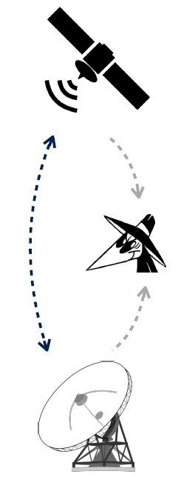
Why do we need security?
Spacecraft systems are a high-profile target
An attacker can cause considerable harm to a nation or company by compromising a spacecraft
Obscurity and uniqueness are not sufficient protection
The technology for spacecraft communication is more readily available
Use of public ground networks to transfer mission control and monitoring data has increased vulnerability

Slide 4
Consultative Committee for Space Data Systems
CCSDS
Founded in 1982 by the major space agencies of the world
Experts from 26 nations collaborate
Primary goal is interoperability between space agencies
More than 800 space missions flown
CFS was developed with these protocols in mind:
Space Packet Protocol (SPP)
CCSDS File Delivery Protocol (CFDP)
Communications Operation Procedure – 1 (COP-1)
Telecommand Space Data Link Protocol (TC-SDLP)
Telemetry Space Data Link Protocol (TM-SDLP)
Goal to evolve with Space Data Link Security (SDLS)

Slide 5
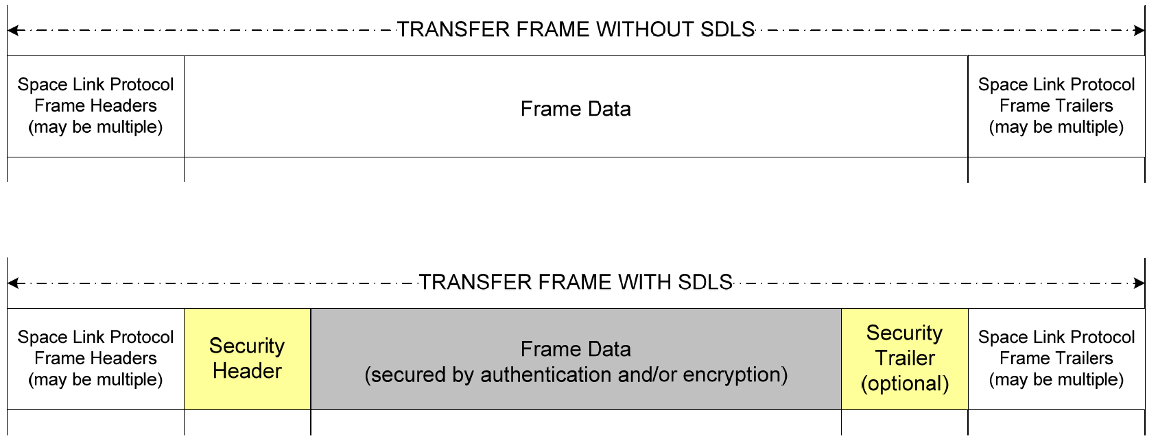
Space Data Link Security
Compatible with both the TC and TM protocols
Those used with the CI and TO applications
Structured method for applying data authentication and/or data confidentiality at the Data Link Layer
Applies a security header and trailer to the payload

Slide 6
Space Data Link Security
TC:
TM:

Slide 7
Space Data Link Security
Security Header:
Security Trailer:

Slide 8
Space Data Link Security – Extended Procedures
Extended Procedures provides three services:
Key Management
Ensures both communications endpoints are synchronized in terms of cryptographic keys and key states.
Over-The-Air-Rekeying can be used to update session keys.
Security Association (SA) Management
Provides a means to setup, activate, check status, and control an SA of the remote system.
As missions become more complex, dynamic management will be necessary.
SDLS Monitoring and Control
Ability to modify mission specific parameters
Maintains the status of the security processor as a whole.

Slide 9
Space Data Link Security – Extended Procedures
Key Management
Symmetric key management infrastructure
Scalable to meet mission needs
Master keys
Used to decryption session keys
Session keys
Used for all other message types
Over-The-Air-Rekeying (OTAR)

Slide 10
Space Data Link Security – Extended Procedures
2. Security Association (SA) Management
Anti-replay counter / window size
Authentication bit mask
Direction – TC or TM
Encryption cipher suite
Linked keys
Managed lengths of values

Slide 11
Space Data Link Security – Extended Procedures
3. SDLS Monitoring and Control
Commands
Ping
Manage Logs
Read Sequence Number
Reset Alarm
Self-Test
Logs and Reports
Frame Security Report (FSR)

Slide 12
Cryptography Library
Cross-platform codebase
Can be used by flight software and the ground system
Developed in C
Minimal to provide only necessary functionality
AES 128-bit block cipher
128-bit Galois/Counter Mode for Authenticated Encryption
128-bit CMAC authentication
Open-Source
Currently pending approval
Simple to implement
ApplySecurity(ingest, len_ingest)
ProcessSecurity(ingest, len_ingest)

Slide 13
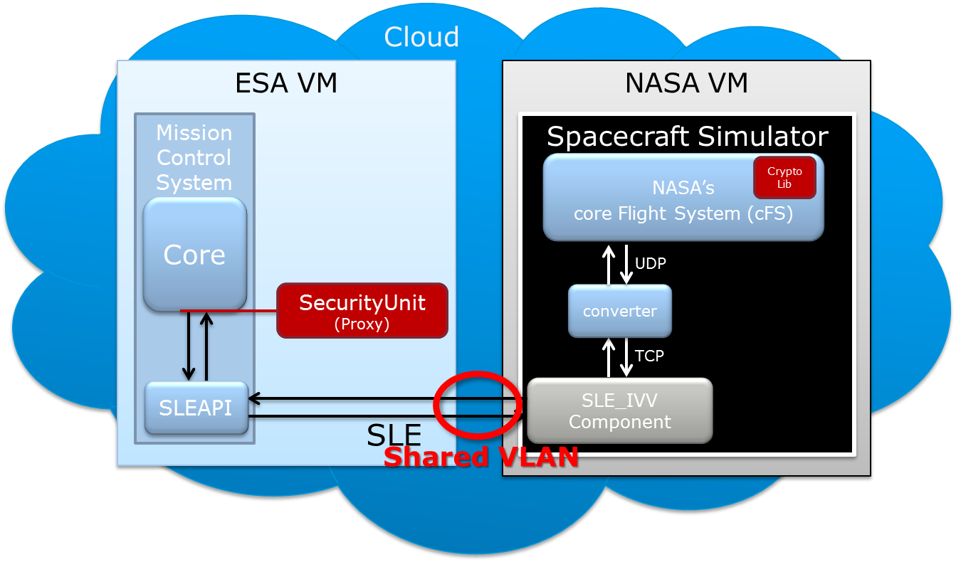
Inter-Agency Testing
Goal to implement SDLS-EP baseline mode for publication

Slide 14
Demo

Slide 15
Future Work
Additional Encryption Cipher Types
Advanced Orbiting Systems (AOS) Support
Ground System Integration
Utilizing COSMOS
Load Testing
Implementation on AVR32 flight computer
Improved separation / explanation and support of mission specific parameters
Inclusion into simulator platforms
NOS3
Integration into mission
Unit Tests

Slide 16
Questions?
A special thanks for attending and to our sponsors!
John Lucas
John.P.Lucas@nasa.gov
www.ccsds.org

Slide 17
Backup

