Slide 1
cFS-based Autonomy Requirements Tester (ART)

Slide 2
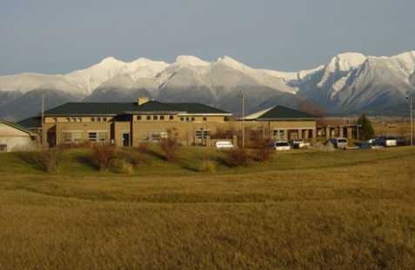
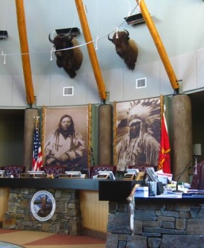
About S&K Global Solutions (SKGS)
S&K Global Solutions, LLC is owned by the Confederated Salish and Kootenai Tribes (CSKT).
Our corporate headquarters is located in northwest Montana on the Flathead Indian Reservation.
We are a member of the S&K family of technology-based companies that provide services to Federal Agencies and Civilian customers.
Affiliated with 4 year HBCU/MI Salish Kootenai College (SKC); with active internships and sponsored technical programs

Slide 3
Background: 2015 cFS User Survey
Summary: Major cFS Development Pain Points
Setting up cFS development environment*
Commands and telemetry – conforming to standards
Testing – all levels*
Documenting
* received scores over 4.0

Slide 4
cFS-based Autonomy Requirements Tester (ART) project: Phase I SBIR
Problem: System requirements for autonomy have proven difficult to define and test, largely due to the uncertainty in the environments with which those autonomous systems will interact, the need to interact safely with humans, and the need to adapt to novel situations.
Design eXtensible Markup Language (XML) schema to define cFS data models to support app-level testing
Describe potential approaches for semi-autonomous test generation
Design displays that support the management of autonomy requirements, test designs, and test results
Develop a Concept of Operations (ConOps) for the use of ART to capture autonomy requirements, generate test specifications, execute the test specs, and report results

Slide 5
Represent Data for Progression from Requirement to Test Results
Autonomy Requirement
When a person is near the robotic arm, its movements should be reduced in speed.
Test Input
IR sensor range
IR_range = 2.9 feet
Expected Results
Arm_Motion_Mode = slow
(Publish Msg)
IR_Range_To_Human
IR_range = 2.9 feet
Test Objective (Behavior)
When any sensor detects a range of 3 feet or less:
IF (range to human <= 3 feet)
THEN switch to slow arm motion mode (which reduces the highest arm speed to no greater than 0.5 feet per second)
(Subscribe Msg)
Arm_Mode_Change
(expect value to be: Arm_Motion_Mode = slow)
Test Input
Camera estimated range
Camera_Est_Range = 2.9 feet
Expected Results
Expect values of
Arm_Motion_Mode = slow

Slide 6
Test Runner Uses CFS Pub/Sub Architecture

Slide 7
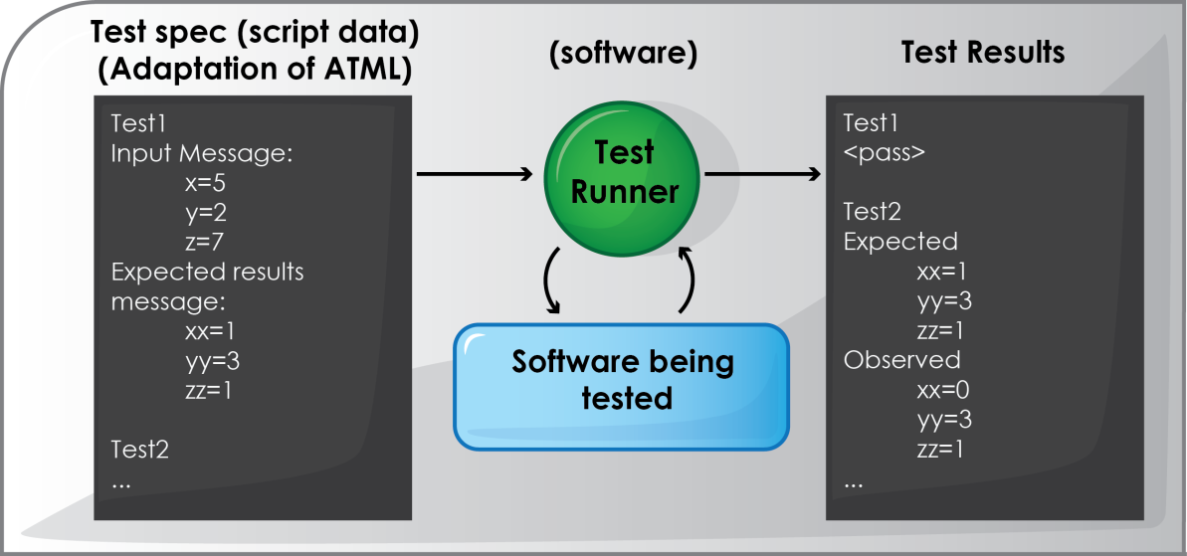
Test Runner Reads Test Spec, Produces Test Results

Slide 8
Generating the Test Plan from Requirements
Observation from Phase I exercise with APL Solar Probe Plus type autonomy requirements
Similarities from one requirement to the next
Often a tiered response, when first tier doesn’t correct the issue, go to the next tier
Rule based behavior: If {condition} then {response}
Similarities enable the formation of a template for generating the test
Some additional parameters are needed in addition to the template
Parameters illustrated on the next page

Slide 9
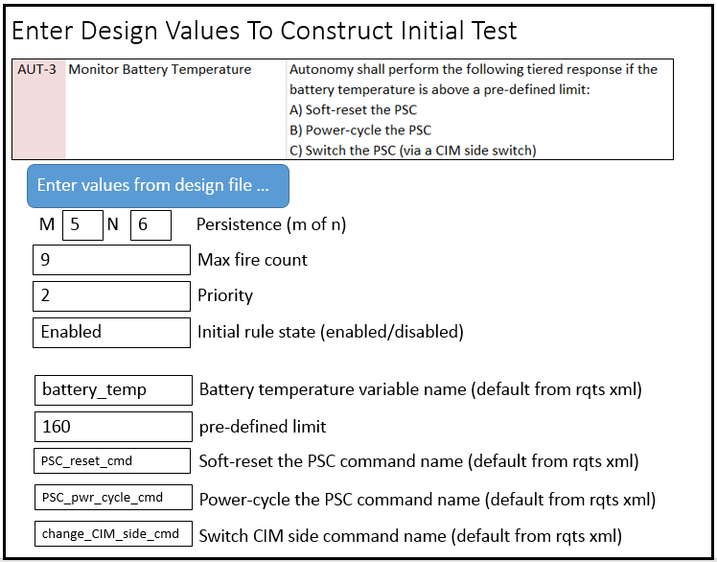
Data Entry to Enable Test Generation from Template

Slide 10
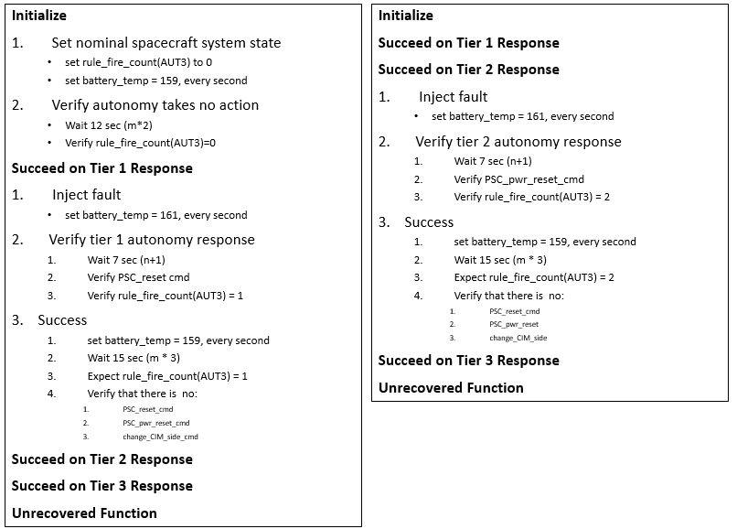
1st Part of Detailed Test Plan

Slide 11
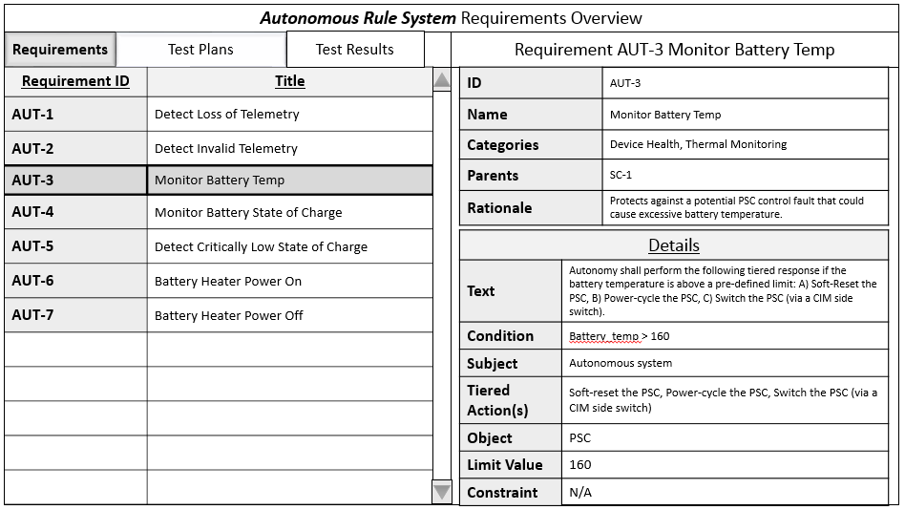
For Browsing Requirement

Slide 12
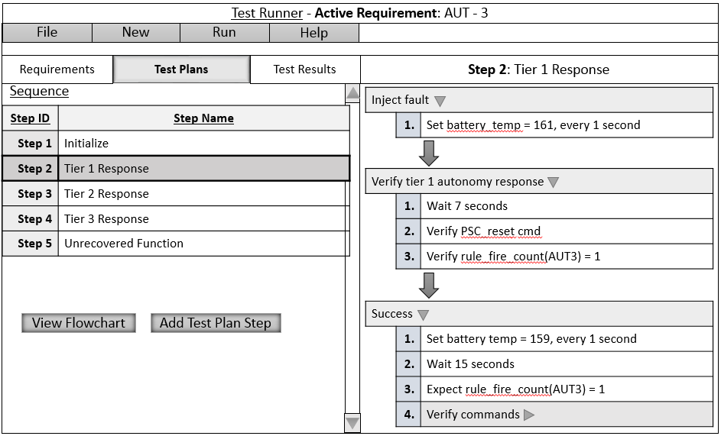
Viewing Details from Test Plan

Slide 13
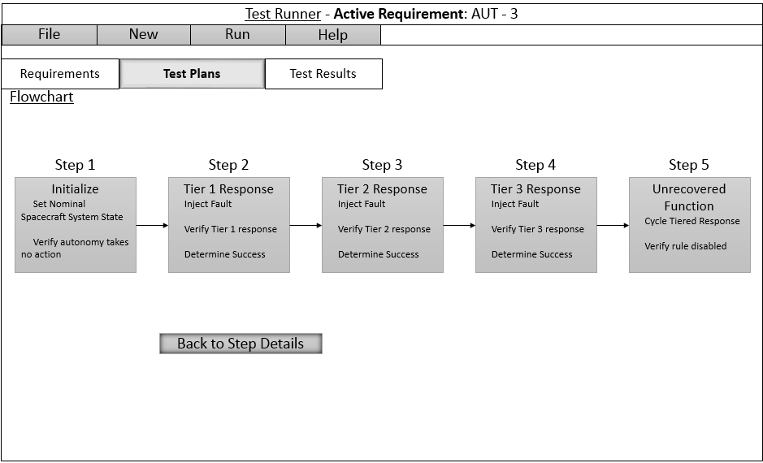
A Graphical View of the Test Plan

Slide 14
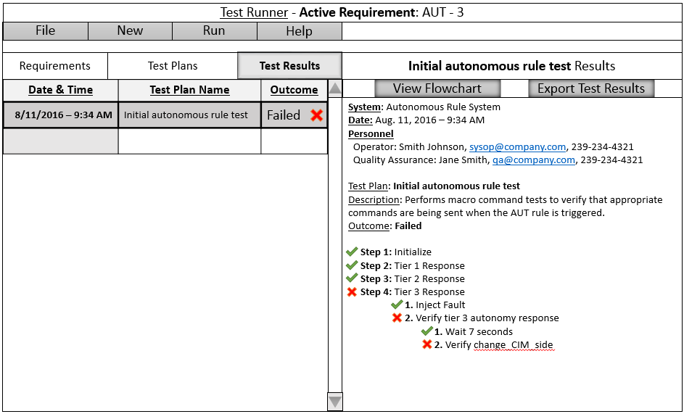
A View of the Test Results

Slide 15
ART Emphases
Focus of Phase I and initial Phase II
Hard, real-time autonomy (low level of autonomy) and cFS
Test-driven development
Unit test for app in publish-subscribe architecture
Phase II
Begin developing support for integration testing – higher levels of autonomy
Work with DOD partners (NUWC) and JHU/APL on model-driven testing methodologies
Build towards expressing higher levels of autonomy in testable terms
Consider a classification system for levels of autonomy and associated testing methodologies (i.e. unit, system integration, human competence)
Advantages of this approach
Start test driven development early
Ease the expression of autonomy requirements in terms of expected behavior
Support pre-integration testing
Make integration testing time more productive – no logic errors in software
During integration, if software changes are required
If software changes are required
Make the changes
Re-run the pre-integration test to ensure no errors were inadvertently entered
Resuming integration testing

Slide 16
Fault Management Viewer (FMV)
NASA SBIR Phase I Project
To address some of the difficulties of planning fault management for autonomous systems
Helps to collect relevant information into specialized views for key fault management analyses
One data model for the project – Multiple viewer/editors for the same data

Slide 17
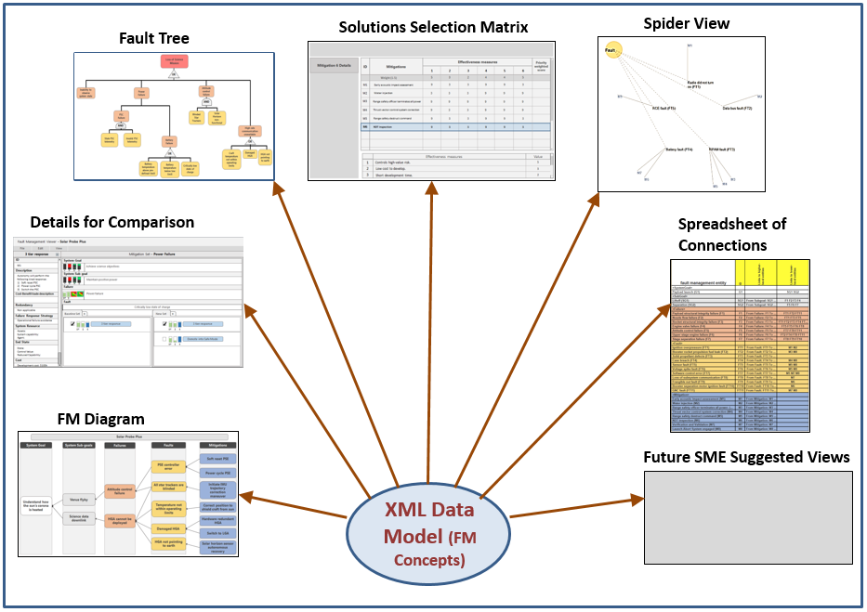
FMV System Concept

