Slide 1
Autonomous On Board Mission Planning
Garcia Franchi Gaston, Alonso Roberto, Pucci Nadia, Kuba Jose
Comision Nacional de actividades espaciales (CONAE)
Argentina

Slide 2
Table of Contents
Objective and Motivation
Main Functions
Geometrical View – Polytope
Software Design Overview
Applications to LEO Satellite
Extension to Constellation
Summary

Slide 3
Introduction
Current Mission Architecture
Satellite Executes the commands
Telecommands
The Mission Center computes the Telecommands
Telemetry
& Payload data
Teleommands
Telemetry

Slide 4
Motivation for a Change
Current status:
The satellite is controlled by ground commands.
The planning is done by sending the entry and exit times for each area of interest (polytopes).
Each instrument or equipment is set by the adjustment of their operational parameters.
Motivation:
The resources allocate for the on-board computing often exceeds the routine operation needs. Spare capability for extra computation is available for the planner.
Due to the limited time of access from the Ground Station (GS) the amount of commands to be uploaded is also limited. This is crucial in countries with reduced access to Ground Stations.
Modifications in the Mission Plan generate a significant set of actions on the Mission Center to generate new commands because of new scenarios. The amount of commands increases.

Slide 5
Proposal for Mission Improvement
Satellite generates the actions to accomplish the mission plan
The Mission Center monitors the automatism of the satellite

Slide 6
Main Functions for the Planner
Main Functions
Monitor instrument’s operational parameters on each scenario
Facilitate the incorporation / modification of scenarios
Allow operating the payload by conventional procedures and rules
Generate automatically the planning of the following orbits
Automate on-board planning for data transmission / reception (The ground station is considered a polytope)
Advanced Functions
Autonomous. Calculate independently the state vector
Perform a systemic control of failures and alerts

Slide 7
Functions of the Planner
Determination of the satellite position by independent information which is complementary to GPS. Available in case of being necessary.
Determination of the satellite attitude by independent information which is complementary to Star Tracker or Earth Sensor . Available in case of being necessary.
Determination of the sub satellite point or sub camera point.
Polytope construction by the uploading of a convex set of points which are defined by their latitude and longitude.
Determination of the position of the sub satellite point (or similar) on the Earth surface.
Generation of the events : Inside, Outside, Leaving or Entering of the polytope.
These events can execute commands, scripts, check status of instruments or equipment, generate alarms and reports.
The planner allows the addition o functions that are unique for each mission. Example: calculation of trends, determination of errors (position and/or attitude), memory allocation, etc.

Slide 8
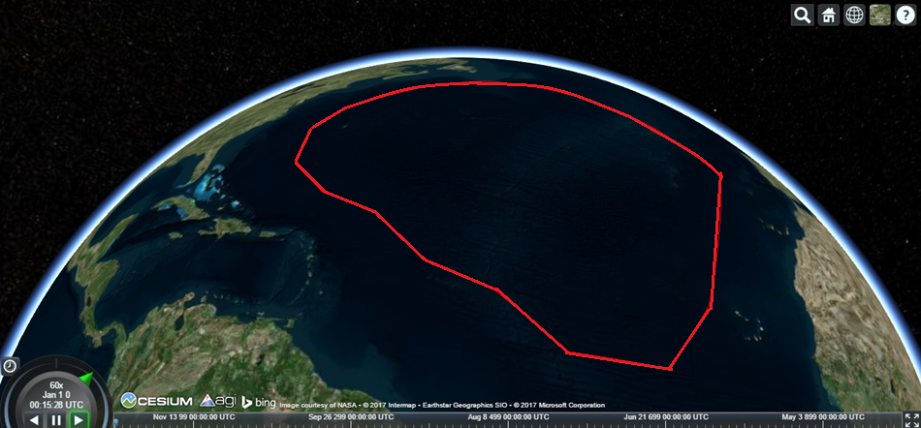
Example of Polytope : Calibration Area
Image displayed using the program Cesium Viewer

Slide 9
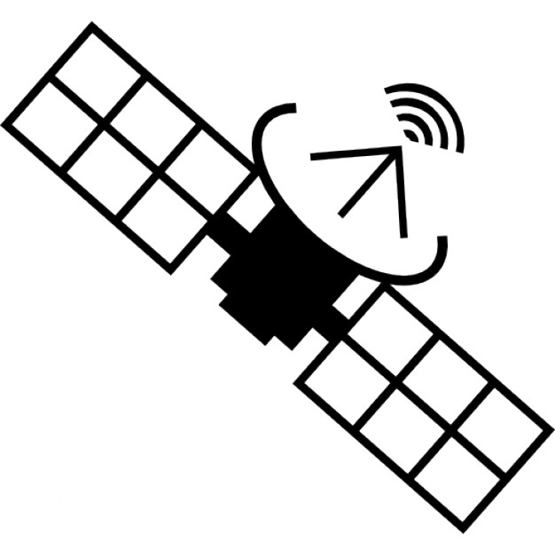
Geometrical View of the Polytope
Prediction of events and
trend analysis
Attitude
and
Orbit
Determination
Checking
Operational Mode
Instruments
Sub Satellite Point
(@Nadir)
Determination
Determination
Sub Camera Point
(outside)
Determination
Sub Camera Point
(inside)
Polytope
Mission Plan

Slide 10
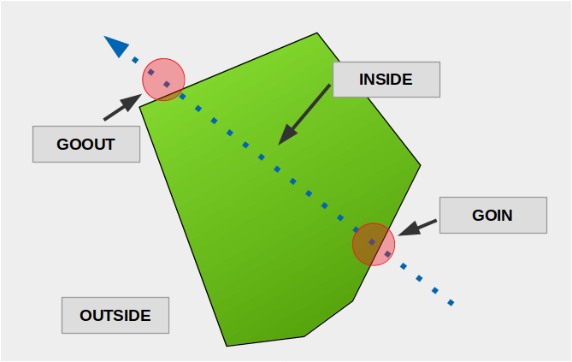
A Closer View of the Geometry
GOIN →
First step inside the polytope
GOOUT →
First step outside the polytope
INSIDE →
Inside the polytope
OUTSIDE →
Outside the polytope

Slide 11
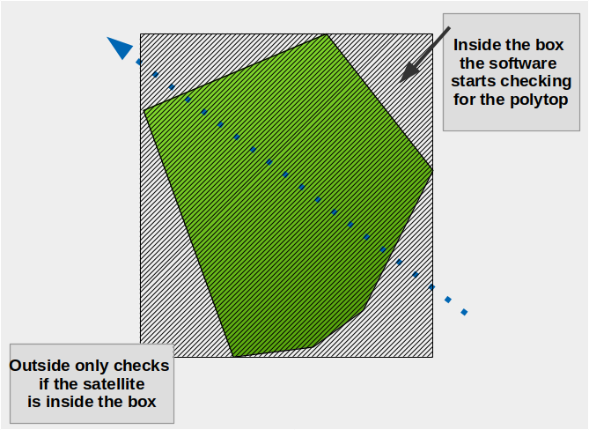
Box around the Polytope
Only executes the algorithm when the spacecraft is inside the box around the polytope
Polytopes inside polytopes!

Slide 12
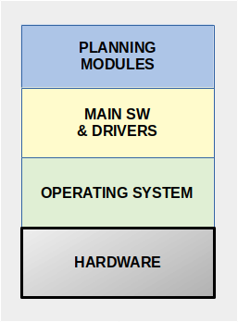
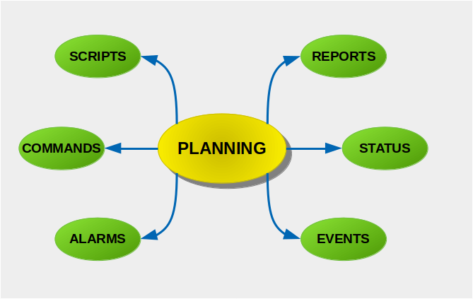
First Version of the Planner
Flexible
OS Independence
ANSI C
Keep It Simple
Trigger: Events / Alarms (Device Status, etc.)
Generate: Reports / Telemetry
Execute: Commands / Scripts /

Slide 13
Software Design – Other Functions
Extra functions:
Create new polytopes and new scenarios.
Change points in polytopes
Change devices, commands, scripts, etc, in scenarios
Change expected values of the devices
Change commands and scripts
Modify the planning table.
The planning table has two operating modes: Realtime and Time Tagged (event predictor).

Slide 14
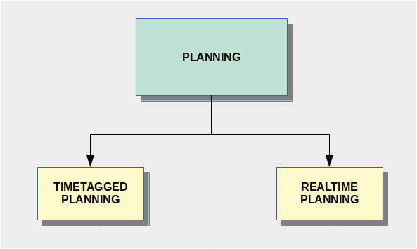
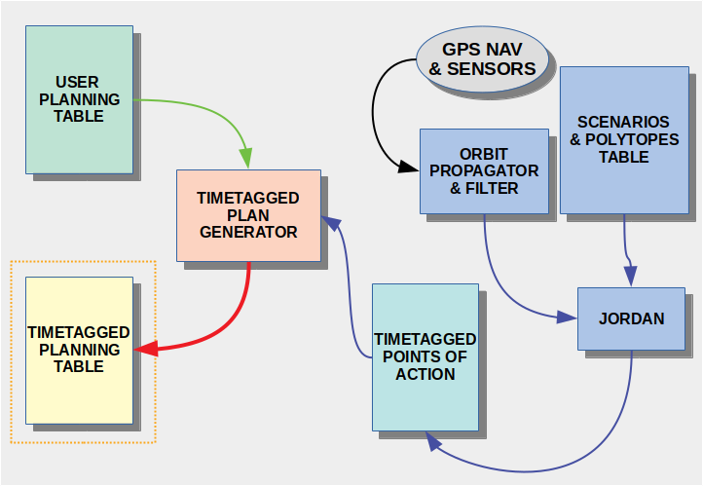
Software Design Simple Aproach
Operational Modes
Real time
Time tagged – or event predictor
GOIN, GOOUT, INSIDE, OUTSIDE

Slide 15
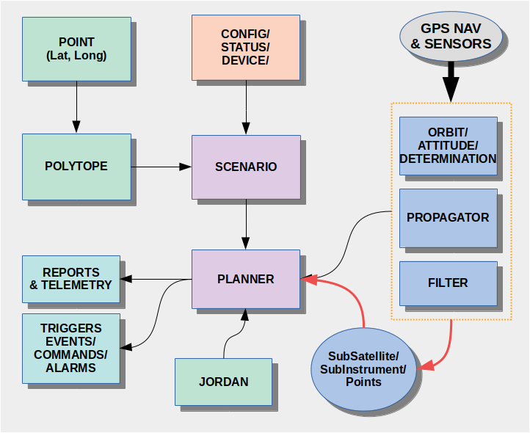
Software Design, cont’n

Slide 16
Advanced Design of the Planner
INPUT DATA
OUTPUT DATA
PLANNER
Range, Doppler, DOP
Determination of:
ORBIT,
ATTITUDE,
SUBSATELLITE POINT,
SUBCAMERA POINT
Polytopes Points
Generation of new Scenarios
Timetagged planning / Event predictor
Trend Analysis
Filtered Orbit
2 Orbits Propagation
Vectors: position & velocity
Robust Attitude
GPS Time & TLE
Sub Satellite Point
Sub Camera Point
Navigation Sensors
Attitude Sensors
Position respect to the polytope
Vectors: Magnetic Field & Sun
Stars Sensor
Eclipse Events
Instruments Telemetry
Alerts

Slide 17
Baseline Satellite
Telemetry
and
Commands
propulsion
State of
Health
Platform
+ Power+
Thermal
Payload
sensors
Platform
Computer
actuators
Power
Subsystem
Battery
Solar Array
Regulator
Instrument
Data
Storage
Payload
Computer
State of
Health
Instrument
Operability
Instrument
Instrument
Data
Transferring

Slide 18
SABIA Mar Mission: First Test Case
Ocean Color mission.
Sun Synchronous Mission (9 days for revisiting the same track).
Three main cameras covering from UV to LWIR spectral bands.
Several operational scenarios for ascending and descending orbit.

Slide 19
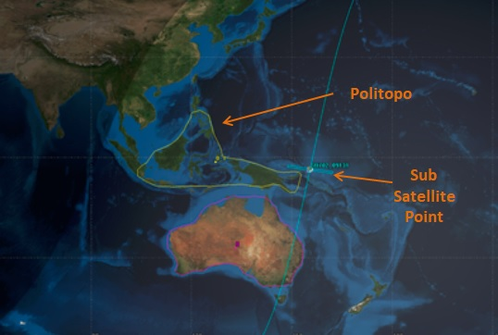
Simulation of the SABIA Mar Orbit
polytope
FOV

Slide 20
Extension to Constellation
Space
Polytope
Master
Satellite
x
v
q
w
slave_a = [ x ]
slave_b = [ x ]
slave_n = [ x ]
master
=
Ground
Polytope

Slide 21
Extension to Constellation, cont’n
The same algorithm used for
ground polytope is used for
space polytope
slave polytope
sub satellite spatial point
At each time the
algorithm computes if
the slave satellite is
Inside or outside the variant
space polytope. The
the same procedure than
for ground polytope is applied
master satellite
Minimum information is needed
[x v q w ] for the master satellite
[ x ] for each slave satellite
The spatial polytope represents the volume
where each slave satellite must be located
at t_A and t_B times in order to satisfy the requirements for a cooperative mission with the other constellation satellites
orbit
slave
satellite

Slide 22
Summary
The feasibility of incorporating this mission planner on LEO satellites is introduced in the presentation. A reduced version of this planner is applied to manage the payload module of the SABIA Mar satellite.
The Mission Control Center changes its role from being the activator of the mission to the supervision of the actions performed by the payload. It is a change in the current paradigm.
The mission plan becomes a dynamic document where changes are easy to make and the addition of new polytopes do not generate an extra effort in the control center.
The extension to constellation using the baseline concepts is also feasible. Minor changes in the software code.

Slide 23
Thank you for the opportunity to present our research during this workshop.
Any question?

Slide 24
Back Slides

Slide 25
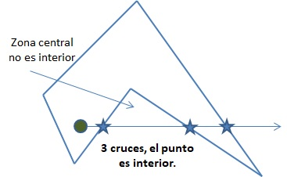
Function: I/O Polytope
The Jordan curve theorem is used to know if a
point is inside or outside the polytope.
In the central area a point is considered outside if
any ray cuts the star in an even number of edges.

