Slide 1
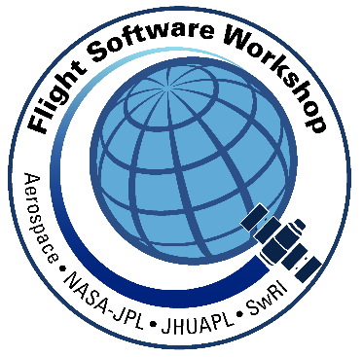
Autonomy Requirements Tester (ART): Reusing a CFS Test Runner in a Robotic Operating System (ROS) Architecture Flight Software Workshop (FSW 2017) Presented By: Ayman Qaddumi

Slide 2
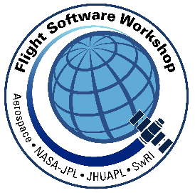
Outline
ART Team Members
cFS Developer Survey (2015)
SBIR (Testing Project - 2016)
Genesis and design of the ART Architecture by original authors
ART Test Runner in the cFS Architecture
ART Test Runner Prototype
Extension of project to ROS (Fall 2017)
Prototype Description
New Architecture
Potential Future work
Comments, Suggestions, Questions
Disclaimer: Presentation does not include US Export Controlled Information

Slide 3
ART Team Members
Dr. Carrol Thronesbery
Expertise in Human System Integration & Human Machine Interface
Work mainly focuses on applying human factors guidelines including displays, controls and testing procedures for autonomous systems
Eugene McMahon – Background in Shuttle Flight Software Requirements & Verification
Mike Monahan – Robotics & Autonomous Systems – SBIR project lead
Ayman Qaddumi - Robotics & Autonomous Systems
Background in Shuttle Flight Software & MCC Apps
Worked CFS-based Time-triggered Ethernet effort for Advanced Exploration Systems(AES)
Joined S&K in October 2016

Slide 4
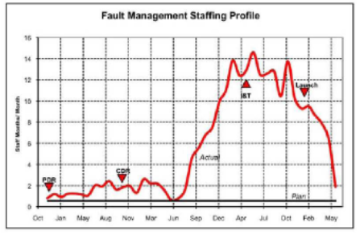
cFS Developer Survey (2015)
Summary: Major cFS Development Pain Points
Setting up cFS development environment
Commands and telemetry – conforming to standards
Testing – all phases of development*
Downstream Testing Crunch (Figure 1)
Manual construction of test cases
* received scores over 4.0 (on a 5pt scale)
Documentation
Figure 1. Planned vs. Actual Fault Management Staffing For a Workshop Case Study Mission
Notes:
Two years ago, we surveyed CFS developers and found that testing assistance is a strong need.

Slide 5
NASA Phase I SBIR (2016) Autonomous Requirements Tester
Main objective is to assist developers with the expression of autonomy requirements & automating the development of related test procedures.
Link requirements with intended behaviors for verifying it
Use of data models for requirements, behavioral expectations, test specifications, and test results
Use of templates to drive the elaboration of test plans and procedures
Support for test-driven development (early phase testing)
Integration of the testing mechanism with the operational environment to support (CFS) users
Reporting of test results – similar appearance to specifications, still linked to requirements
Notes:
No too long after that, S&K won an Small Business Innovation Research (SBIR) contract to develop a software tool with a main objective of assisting with the expression of autonomy requirements, automating the development of related test procedures.

Slide 6
Autonomy Requirements Tester Architecture
Test Procedure
(ATML data file)
Note: Automated Test Markup Language is a standard developed by
(National Instruments)
Requirements+
(XML)
Template
Requirements Handler
Test Handler
Test
Runner
feasibility prototype
Test Report
(XML)
Original team members We named the tool Autonomy Requirements Tester (ART).
Test Runner component of ART is an ‘Auto-tester’
It works on auto-generated support files (XML/ATML)
Runs the test cases, evaluates the results and saves the test results
Notes:
We prototyped the Test Runner portion of ART, which was implemented in the CFS architecture.

Slide 7
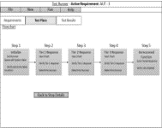
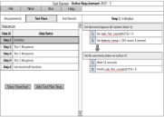
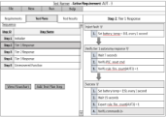
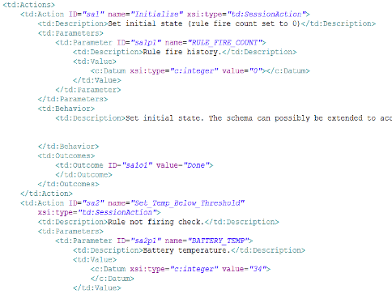
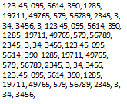
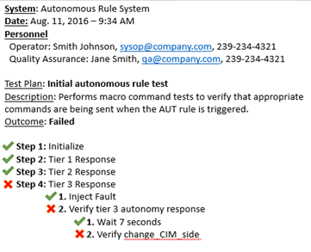
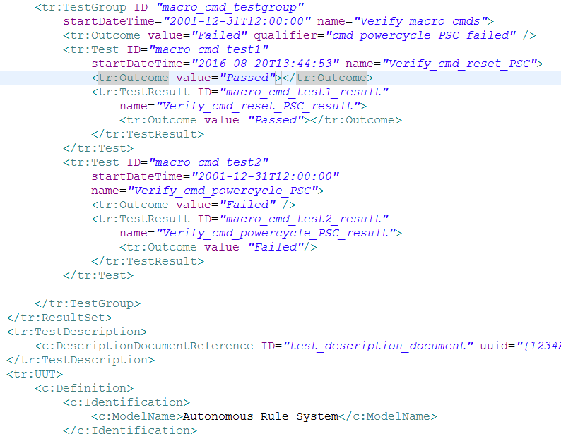
Information Flow for the TestRunner Component of ART
Test Plan Viewer
Test Procedure (ATML)
Test Sequence
ATML
Parser
CSV format
Test Results Viewer
Test Results (raw data)
cFS Flight computer
Test
Runner
SUT
(Autonomous
S/W)
CSV format
XML Test Results
CFE Bus Inter-task Message Router
(Publish/Subscribe)
XML
Encoder
An important feature of the prototype is that it behaves just like other CFS apps, publishing test conditions and subscribing to unit-under-test (UUT) responses.
The SUT requires no changes from its flight version to accommodate testing.

Slide 8
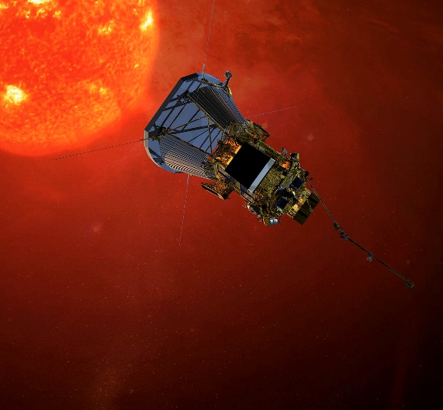
Reference Mission: NASA Solar Probe Plus
Designed & manufactured at Advanced Physics Lab (APL)
SPP is a good reference mission because of its use of autonomy (37 total days w/o communications with earth)
Mission running on Core Flight Software System (CFS)
A higher-level function of the Solar Probe Plus spacecraft is vehicle “safing.”
Fault Mgmt. app Based on a set of autonomy rules.
FM app chosen as SW Under Test (SUT)
Special Thanks to APL’s Justin Thomas, developer & tester of Fault Management system for his support in this effort
Notes:
We decided to use the Solar Probe Plus mission as our reference mission for the following reasons:

Slide 9
Testing SPP
Autonomous System Under Test
Health Mgmt. Data
RULES
Facility
Sensor data
Executable Set of Control Parameters
Mission Parameters
Testing is based on rule-based black box testing
Each rule employs conditional rules and a set of pre-determined autonomous responses to issue if the condition is true
Fault Management system is listening in on the BUS for test conditions and checks with the rules facility to determine if a fault has been detected and whether it needs to be remediated. (There are other values that are passed along, such as a timer, or an event trigger)
Notes:
Testing for traditional SW in theory, is a fairly straightforward activity.
For every input, there should be a defined and known output. We enter values, make selections, or navigate an application and compare the actual result with the expected one. If they match, we nod and move on. If they don’t, we possibly have a bug.

Slide 10
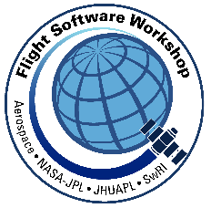
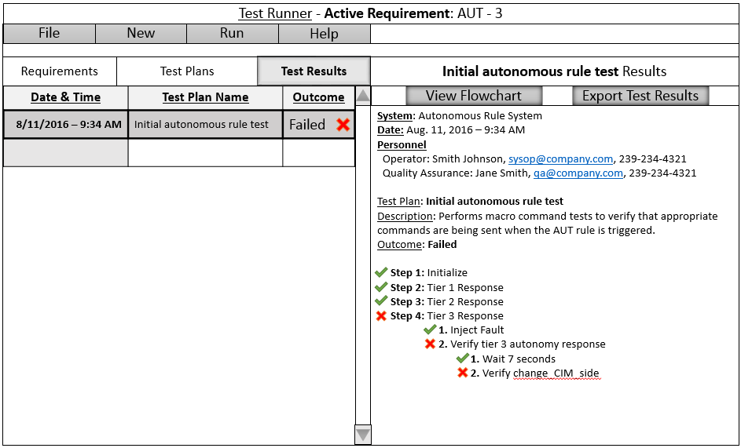
View Of Test Results
For each requirement, Test Handler generates a set of test scenarios
Each test scenario will have its own set of triggers, and based on triggers, test conditions are generated.
Test Runner evaluates the FM app responses

Slide 11
Extension to ART (Fall 2017)
In October 2017, we received funding from the State of Montana for ART follow-on work
NASA is using Robotic Operating System (ROS) as a development platform for various unmanned systems projects; convergence with CFS is inevitable!
Goal:
Extend ART Testing framework to ROS
Implement some Test Runner components outside of ROS framework
cFS Flight computer
Test
Runner
SUT
(Autonomous
S/W)
CFE Bus Inter-task Message Router
(Publish/Subscribe)
Notes:
With an internal follow-on project, we demonstrate that the Test Runner can be used in a straightforward manner to drive the requirements verification of a Robot Operating System (ROS) application.

Slide 12
Other Platforms Support Extension to ROS
The Robot Operating System (ROS) is a flexible framework for writing robot software.
ROS is a collection of tools & libraries that simplify the task of creating complex and robust robot behavior across a wide variety of robotic hardware and platforms.
ROS was designed specifically for groups to collaborate and build upon each other's work.
For example, experts in mapping indoor environments and experts at using maps for navigation, and another group with a novel computer vision approach can work with each other’s packages seamlessly. Data-centric

Slide 13
CFS/ROS Common Modeled Behaviors
“Data bus-centric"
ROS | CFS
Multiple Test Nodes run-time instantiation | Multiple Test Apps run-time instantiation
Create Topics (to hold messages) | Create Pipes (to hold messages)
Subscribe to & receive messages (data) | Subscribe to & receive messages (data)
Publish to & Send messages | Publish to & Send messages
Publish Data at a known rate | Publish Data at a known rate
Nodes can be added and removed at run-time | Applications can be added and removed at run-time

Slide 14
ROS Test Runner Design
Reqts Handler
Remote Computer
Windows/Linux/MAC
Autonomous System
Test Handler
ROS
Interface
Link
(Python)
ROS
GUI
(QT)
Execute Test
Test Executor
(Python)
Sockets
Tester Node
ROS Unit Under Test
Tester Node
ROS Unit Under Test
Tester) Node(n)
ROS Unit Under Test(n)
Pub / sub
Instantiate a
Tester Node
Test Executor
Driven by a UI that is platform-independent.
Communicates via sockets with autonomous system
Platform Interface Link
Platform-specific translation (ROS):
Runs outside of the platform
Tester Node
Runs on same remote device/computer as that of the SUT
Create instance of testing node
Architecture is entirely python

Slide 15
Testing a Robot’s Behavioral Control
Goal
Test the requirement that a robot’s behavior changes in response to appropriate sensory input.
Example Requirement
Validate that a robot does not reach surrounding Geo-fence based on a tightly coupled sensor-actuator control algorithm
Health Mgmt. Data
Control Algorithm
Sensor data
Executable Set of Control commands
Parameters

Slide 16
From Requirement to Test Condition
Goal: Test the requirement that a robot’s behavior changes in response to appropriate sensory input.
Example Requirement
Test that a robot does not reach surrounding interior wall based on IR sensor and camera measurements
Autonomy Requirement
When a robot is near a geo-fence, its movement should be halted.
(Publish Msg)
POSE
Pos(X) = 11.0
Pos(Y) = 11.0
Test Condition
IR_Range_To_Human
If( IR_range <= 0.2 meters)
&& (Camera_Est_Range <= 0.2 meters)
Expected Results
Arm_Motion_Mode = HALT
Test Objective (Behavior)
IF appropriate sensors detect a range of 0.2 meters or less, THEN motion mode is set to
HALT mode
(Subscribe Msg)
Arm_Motion_Mode = HALT

Slide 17
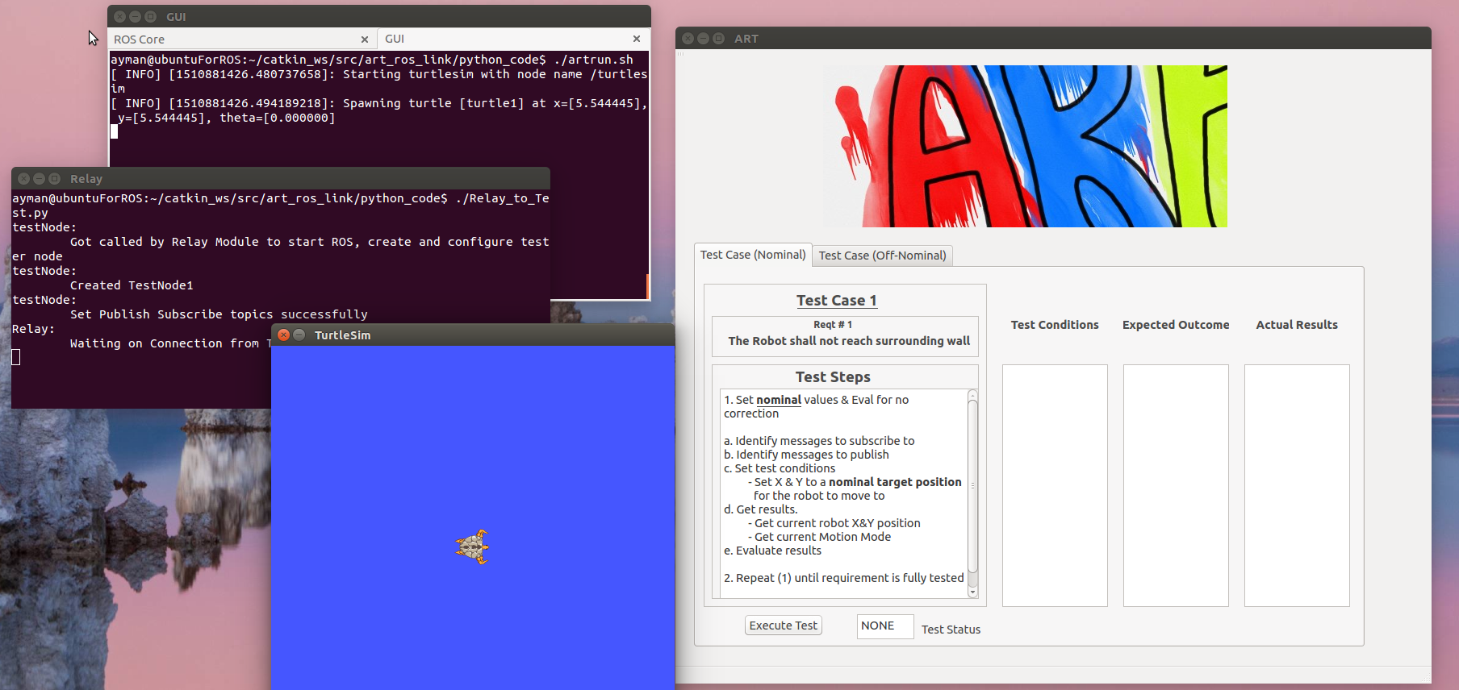
Nominal Scenario

Slide 18
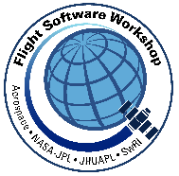
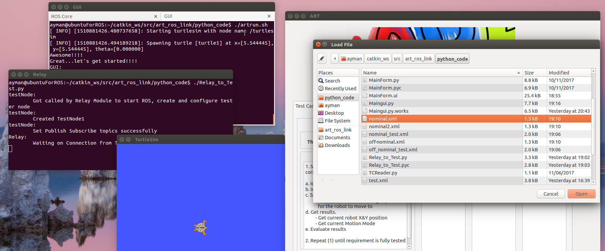
Nominal Scenario Load Test Procedure File

Slide 19
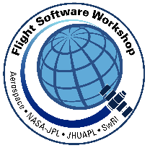
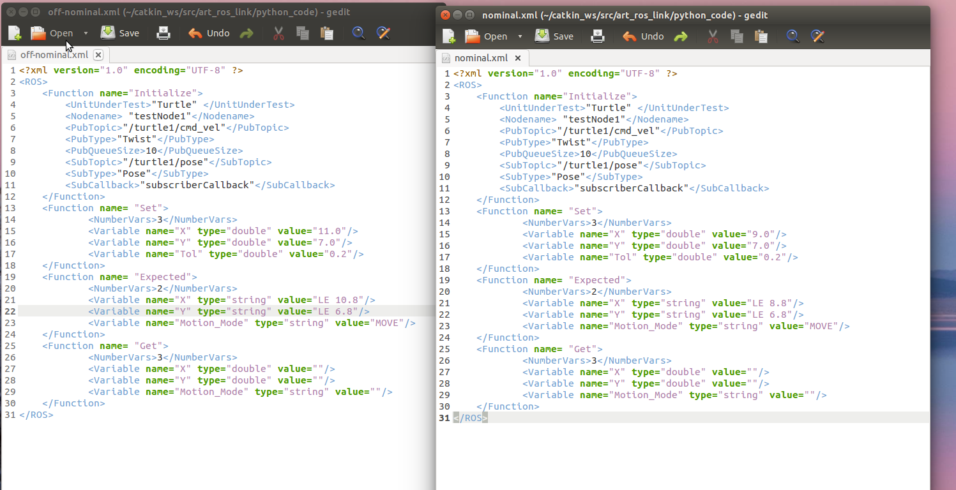
Nominal Scenario

Slide 20
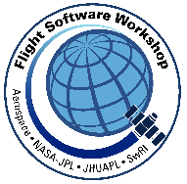
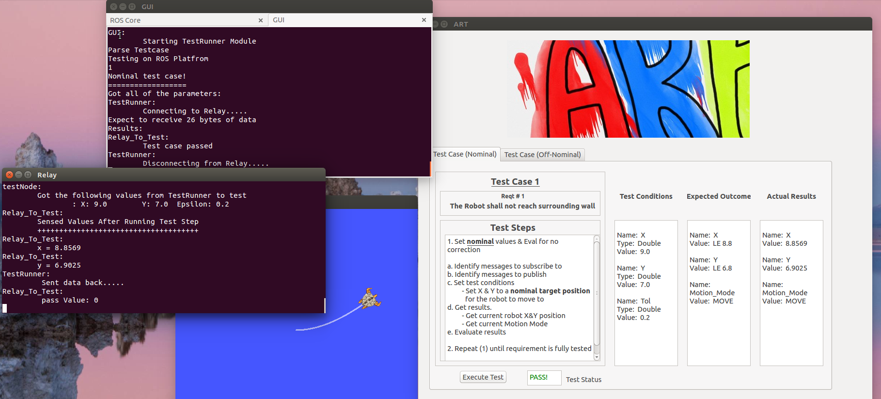
Nominal Scenario

Slide 21
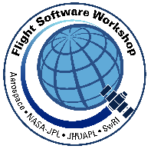
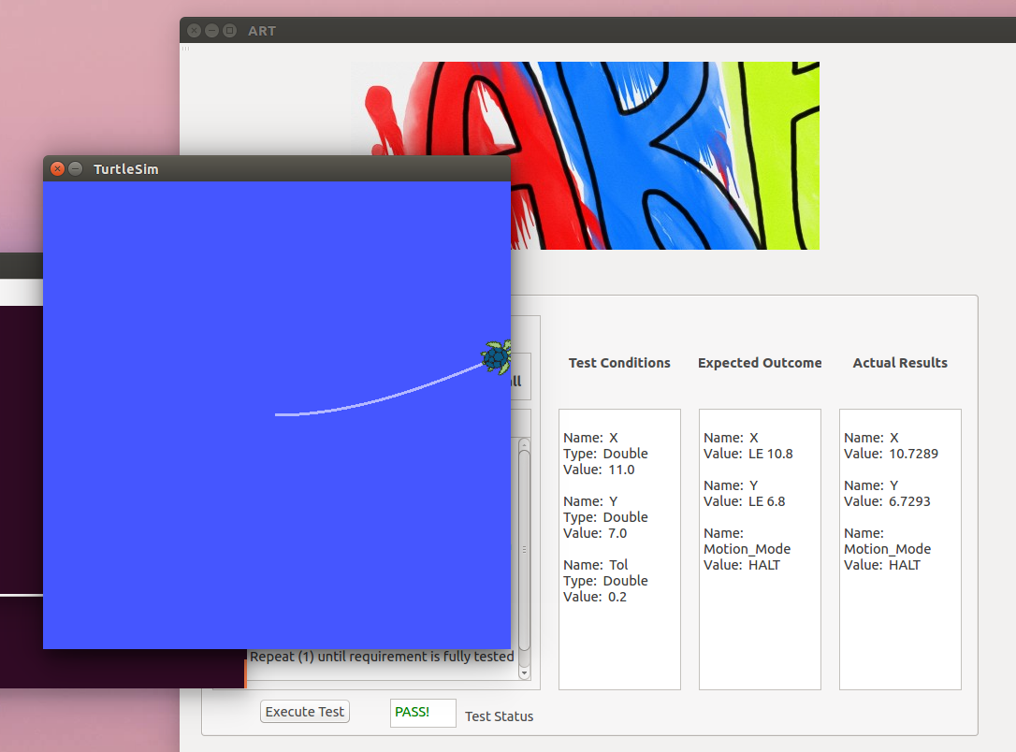
Off-Nominal Scenario

Slide 22
Potential Future Work For Test Runner
Autonomous System
ROS
Interface
Link
ROS
Tester Node
ROS Unit Under Test
Tester Node
ROS Unit Under Test
Tester Node(n)
ROS Unit Under Test(n)
Remote Computer
Pub / sub
Windows/Linux/MAC
Instantiate a
Tester Node
GUI
(QT)
Execute Test
Test Executor
(Python)
Sockets
Autonomous Onboard System
CFS
Interface
Link
CFS
Reqts Handler
Test Handler
CFS Unit Under Test
Tester App
CFS Unit Under Test
CFS Unit Under Test(n)
Pub / sub

Slide 23
Potential Future Work For Test Runner
ROS
Tester Node
ROS Unit Under Test
Tester Node
ROS Unit Under Test
Relay Node(n)
ROS Unit Under Test(n)
Create a bridge between a genuine flight software framework (cFS) and a robotic platform in a heterogeneous environment
Enables robots to communicate with spacecraft/habitat
Opens the possibility for using a large number of ROS sensor and actuator packages
With a few modifications, the interface link from our demo can be modified to become a translation node
Pub / sub
ROS_BRIDGE_SERVER
TCP
SBN
CFS
Tester Node
Tester Node
ROS Relay App
CFS App
Pub / sub

Slide 24
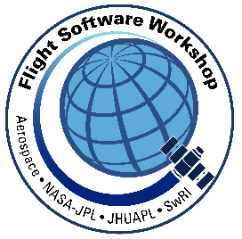
Potential Future Work For Test Handler
Machine learning and predictive analytics applications provide non-deterministic output
Testing practices have to change to accommodate these types of software applications
Apply machine learning techniques to testing
Help testers determine the most efficient test scenarios based on smart algorithms that can quickly detect failure-triggering patterns.

Slide 25
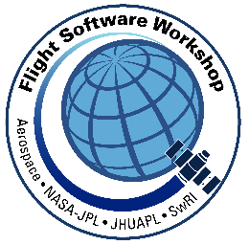
Discussion
Comments
Suggestions
Questions

Slide 26
Team Contact Info
Carrol Thronesbery
cthronesbery@skgs-llc.com
Eugene McMahon
emcmahon@skgs-llc.com
Mike Monahan
mmonahan@skgs-llc.com
Ayman Qaddumi
aqaddumi@skgs-llc.com

