Slide 1
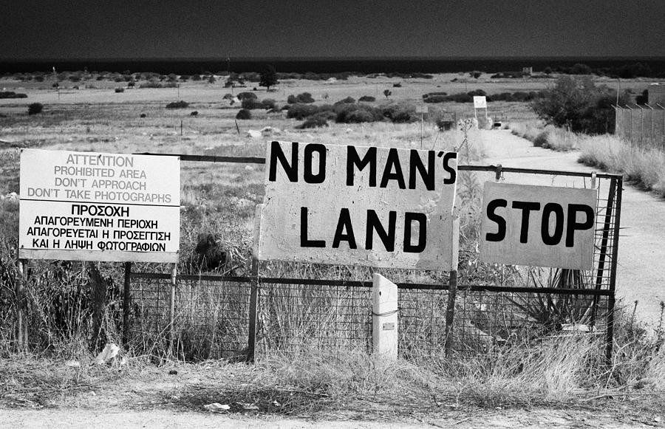
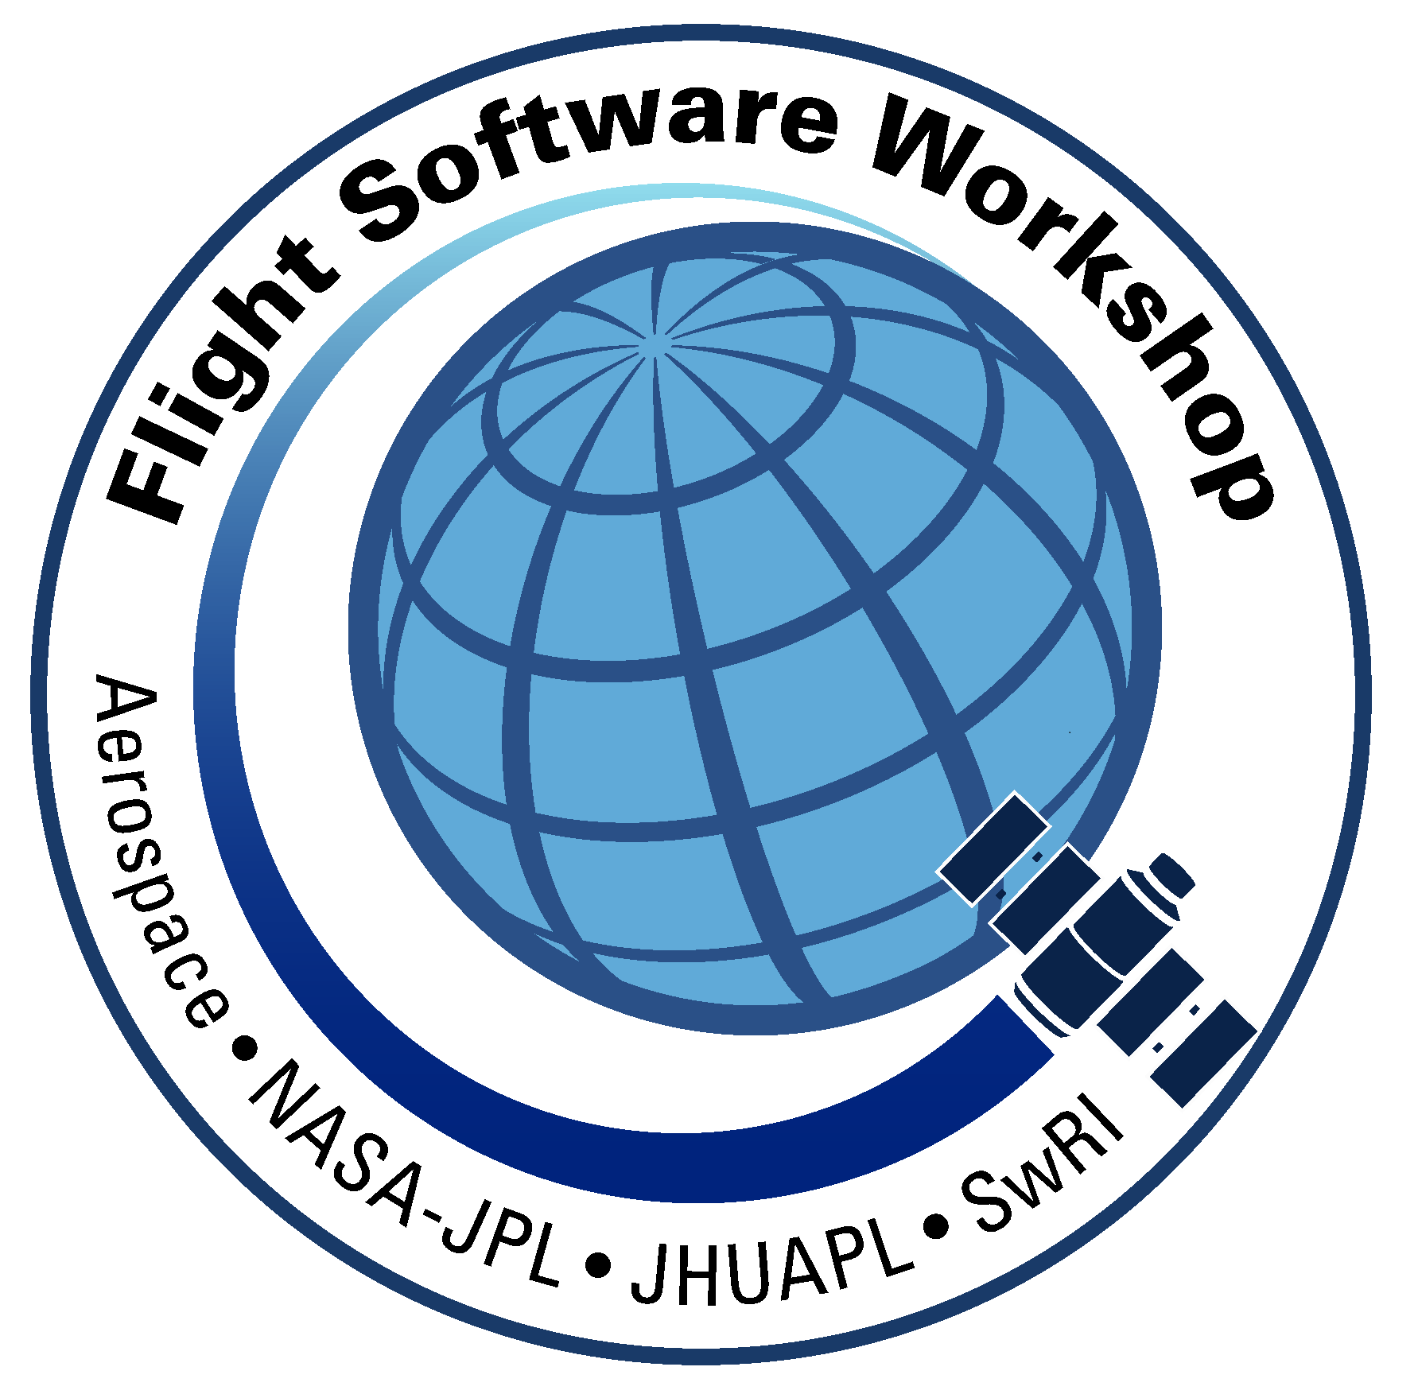
Is On-Board Fault Management the Anti-Dote to Low-Cost/Low-Heritage Components in Small Satellites?
Ronnie Killough
FSW Workshop 2017

Slide 2
CYGNSS Mission Overview

Slide 3
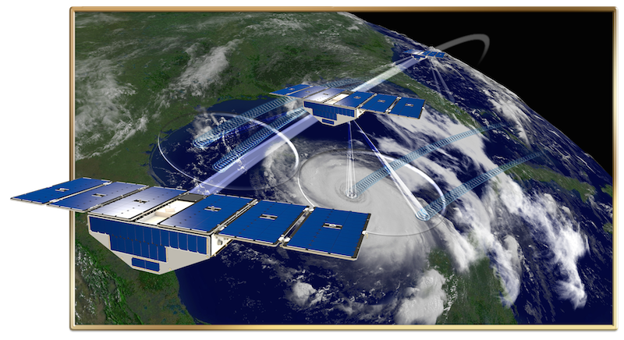
CYGNSS Mission
Constellation of 8 µSats
Low-cost Class D mission
Low Earth Orbit, 35° inclination
2 year primary mission duration
Investigating a new method for measuring and predicting the strength of tropical cyclones using GPS signals reflected off the ocean surface

Slide 4
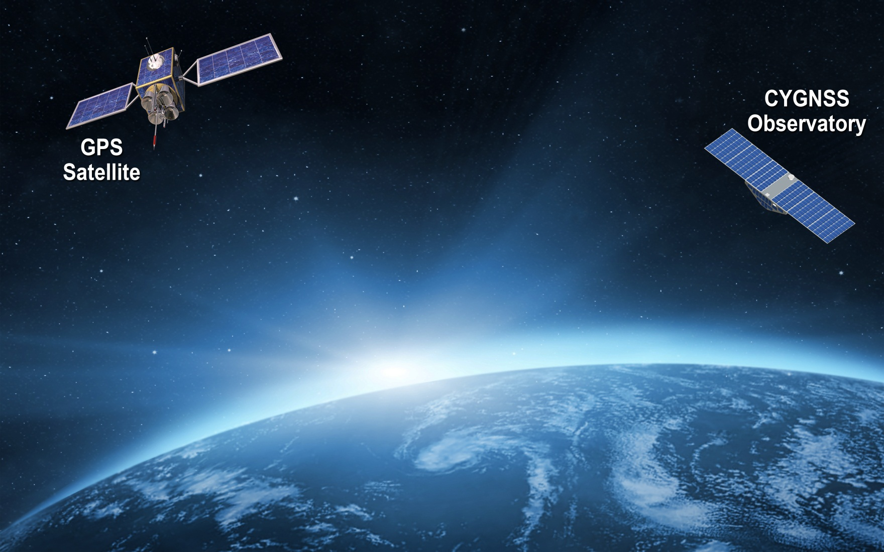
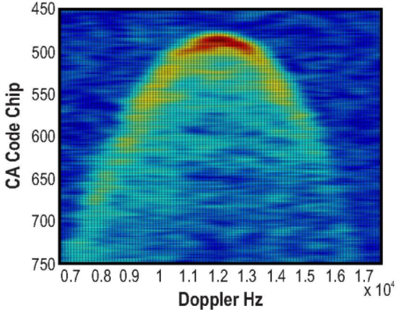
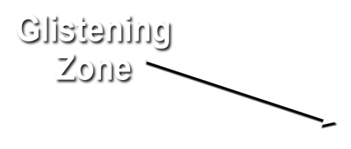
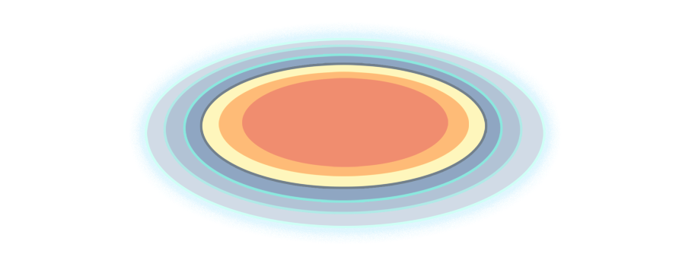
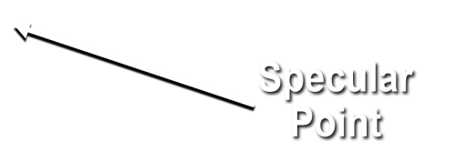
Notes:
Bi-static scattering geometry with GPS direct signal proving reference and quasi-specular forward scattered signal containing ocean surface roughness information
Animation illustrates – propagation and scattering geometries – GNSS bi-static scatterometry
quasi-specular forward scattered signal from the ocean surface -- received by nadir ant array
Ideal reflected signal (perfect ocean surface) -- mirror image of direct
scattered signal contains detailed information about surface roughness statistics
Glistening zone broadens from perfect surface to broad area given increase in surface wind speed.
Use example of Sun reflection while flying on airplane overwater to conference
direct GPS signal -- coherent reference for the coded GPS transmit signal – received by zenith ant
Inset: Image produced from data by the UK-DMC-1 demonstration spaceborne mission shows scattering cross-section
Two coordinates of the image:
Variable lag correlation (signal delay)
Doppler shift
The DDM enable the spatial distribution of the GPS signal surface scattering cross section to be resolved
Measurement of the ocean surface roughness and near-surface wind speed is possible from two properties of the DDM
The scattering cross-section can be related to surface roughness which corresponds to near surface wind speed
Wind speed can also be estimated from the shape of the scattering arc (the red and yellow regions)
The arc represents the departure of the actual bi-static scattering from the purely specular case that would correspond to a perfectly flat ocean surface

Slide 5
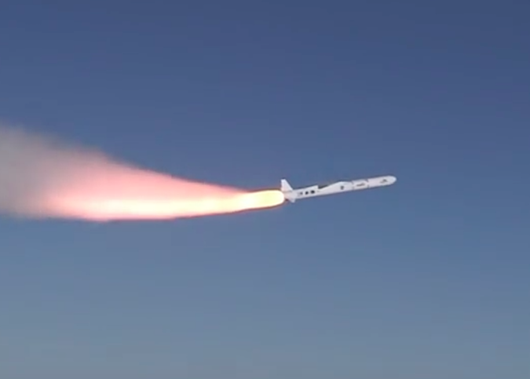
Success!
CYGNSS launch on December 15, 2017

Slide 6
Problem Statement

Slide 7
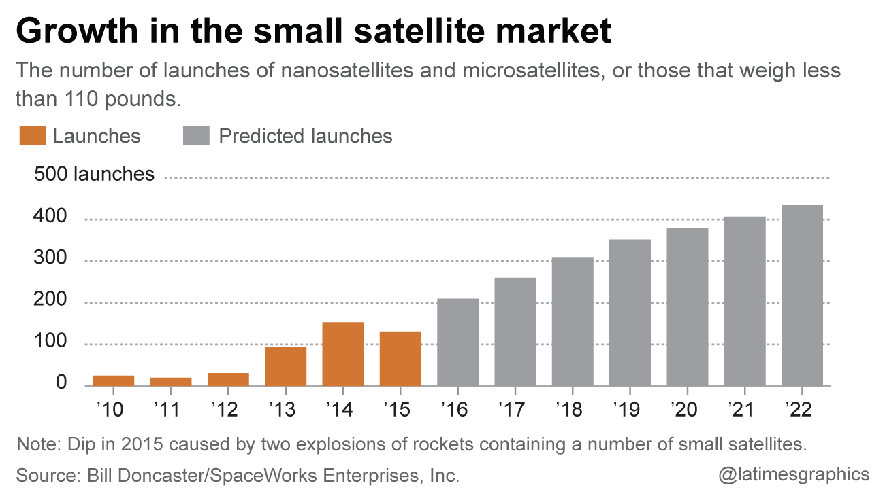
Growth in SmallSat Market
SmallSat market has experienced a near order of magnitude growth in the five year period 2012-2017
This growth has driven the need for smaller form-factor components
Designing, developing, manufacturing, testing and gaining on-orbit performance data takes time
Cubesat market has garnered the lion’s share of attention
Combined, this places the microsat in “no-man’s land”
Microsat programs often can’t afford high-reliability components
Component makers are focused on the higher-revenue cubesat market which has much lower reliability requirements and expectations

Slide 8
CYGNSS Illustrates Problem
Subsystem | Flight Heritage | Radiation Tolerance
C&DH | No | Good
Comms | No | OK
Power | Cells-Yes Power Mgmt-No | Good
ADCS | No | Low
Instrument | ESA Tech Demo Sat | OK
Current microsat proposal efforts demonstrate that the situation has not improved significantly since CYGNSS development began in 2013
Market is still growing quickly → new components/vendors popping up
Vendor focus on cubesat market

Slide 9
What Problems Can Appear?
Parts quality issues
Radiation performance
SEEs
TID
Unexpected behaviors
FSW can’t help with all of these problems but can help with some of them

Slide 10
Causes for “Unexpected Component Behaviors”
Lack of, or poor, operational documentation available to end user
New vendor and/or new component – documentation trailing
Can lead to misunderstandings in operational “envelope”
Undocumented “features”
Low-cost mission → Limited component-level testing (by vendor and/or during S/C I&T)
Inaccurate assumptions regarding the usage scenarios and types of testing done by the vendor
Lack of on-orbit data to show how the component behaves “for real”
SEUs
New vendors may not know how their component will (mis-)behave in event of an SEU

Slide 11
How Can FsW Help?

Slide 12
CYGNSS FDC Approach
FDC = Fault Detection & Correction
Initial fault approach on CYGNSS
Fault? Go to Safe Mode
CYGNSS is low-cost Class D
Changed philosophy in Spring 2015
Added full-featured autonomous FDC to FSW
Fault rule → Fault response → If fault continues
Decision made relatively late – around start of Phase D!
Created an FDC Subsystem Description Document
Defined overall FDC “philosophy”/guiding principles, fault rules, thresholds, rationales, and inter-rule relationships

Slide 13
Motivation for Change
CYGNSS has eight S/C, not just one
CYGNSS has very high science duty cycle requirement
Some S/C already planned to be out of science mode periodically to maintain spacing of S/C in orbit plane
CYGNSS design included several low- or no-flight heritage components
➔ Began to fear “Safe Mode whack-a-mole”
Needed to balance cost/simplicity of development vs. “constellation manageability”

Slide 14
Potential Issues with Low-Heritage/Lo-Rel Components
Potential Issue | Can FSW Help? | Example
Parts quality issues (e.g. infant mortality) | Yes ** | If GPS fails could failover to stored ephemeris with orbit propagation
Radiation - Frequent SEUs | Yes | Component begins producing bogus sensor values; apply FDC rule to reset component
Radiation - T.I.D. | No | Have to show design meets T.I.D. during mission design
Unexpected component behaviors | Yes | ST sun outage recovery not robust; reset search algorithm via FDC rule
** If failed part is non-critical with workaround; but does not address EEE parts requirements problem

Slide 15
Cost Assessment
Approach only works if cost of implementing the fault S/W is << cost of “better” components
Savings is not just in $, but also often in mass
Example: Star Tracker
CubeSat-Class Higher-Reliability Component
Cost: $50K-$80K ~$220K++
Mass: <0.5kg 1 kg+
In this single example the case does not seem terribly compelling, but
This is just for one component (add wheels, Xcvr, etc), and
In the case of constellations, you multiply all these #s by the S/C count – for CYGNSS is x8, if 2 STs per S/C then x16

Slide 16
Some Cautions
Be careful: it is easy to shoot your foot off when defining fault rules
Watch for inter-rule interactions and timing
Watch for timing vs. intra- component WDTs etc.
This problem is not unique to small sats but you have less budget to analyze & test them vs. larger missions
Be ready to tweak FDC rules and thresholds post-launch
Adjust thresholds to remove excessive conservatism
Add or change fault rules to adapt to on-orbit realities and “unexpected behaviors”

Slide 17
Conclusions
Low-class mission should not always imply low-class autonomy/fault management
Cost trade vs. cost of higher-reliability components must be considered
Case is much more compelling for constellations
Availability of components that fit mass and other constraints may force the issue even in single-S/C missions
Does not solve all low-heritage component problems
Does not help with EEE parts requirement nor T.I.D.
Need much better way to capture rationales for fault rules and thresholds, and inter-rule dependencies
CYGNSS FDC Subsystem Description Document was very valuable and thorough but hard to maintain

Slide 18
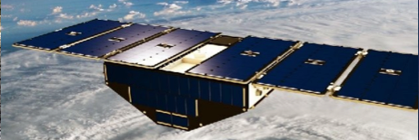
Questions
Ronnie Killough
rkillough@swri.org
FSW Workshop 2017

