Slide 1
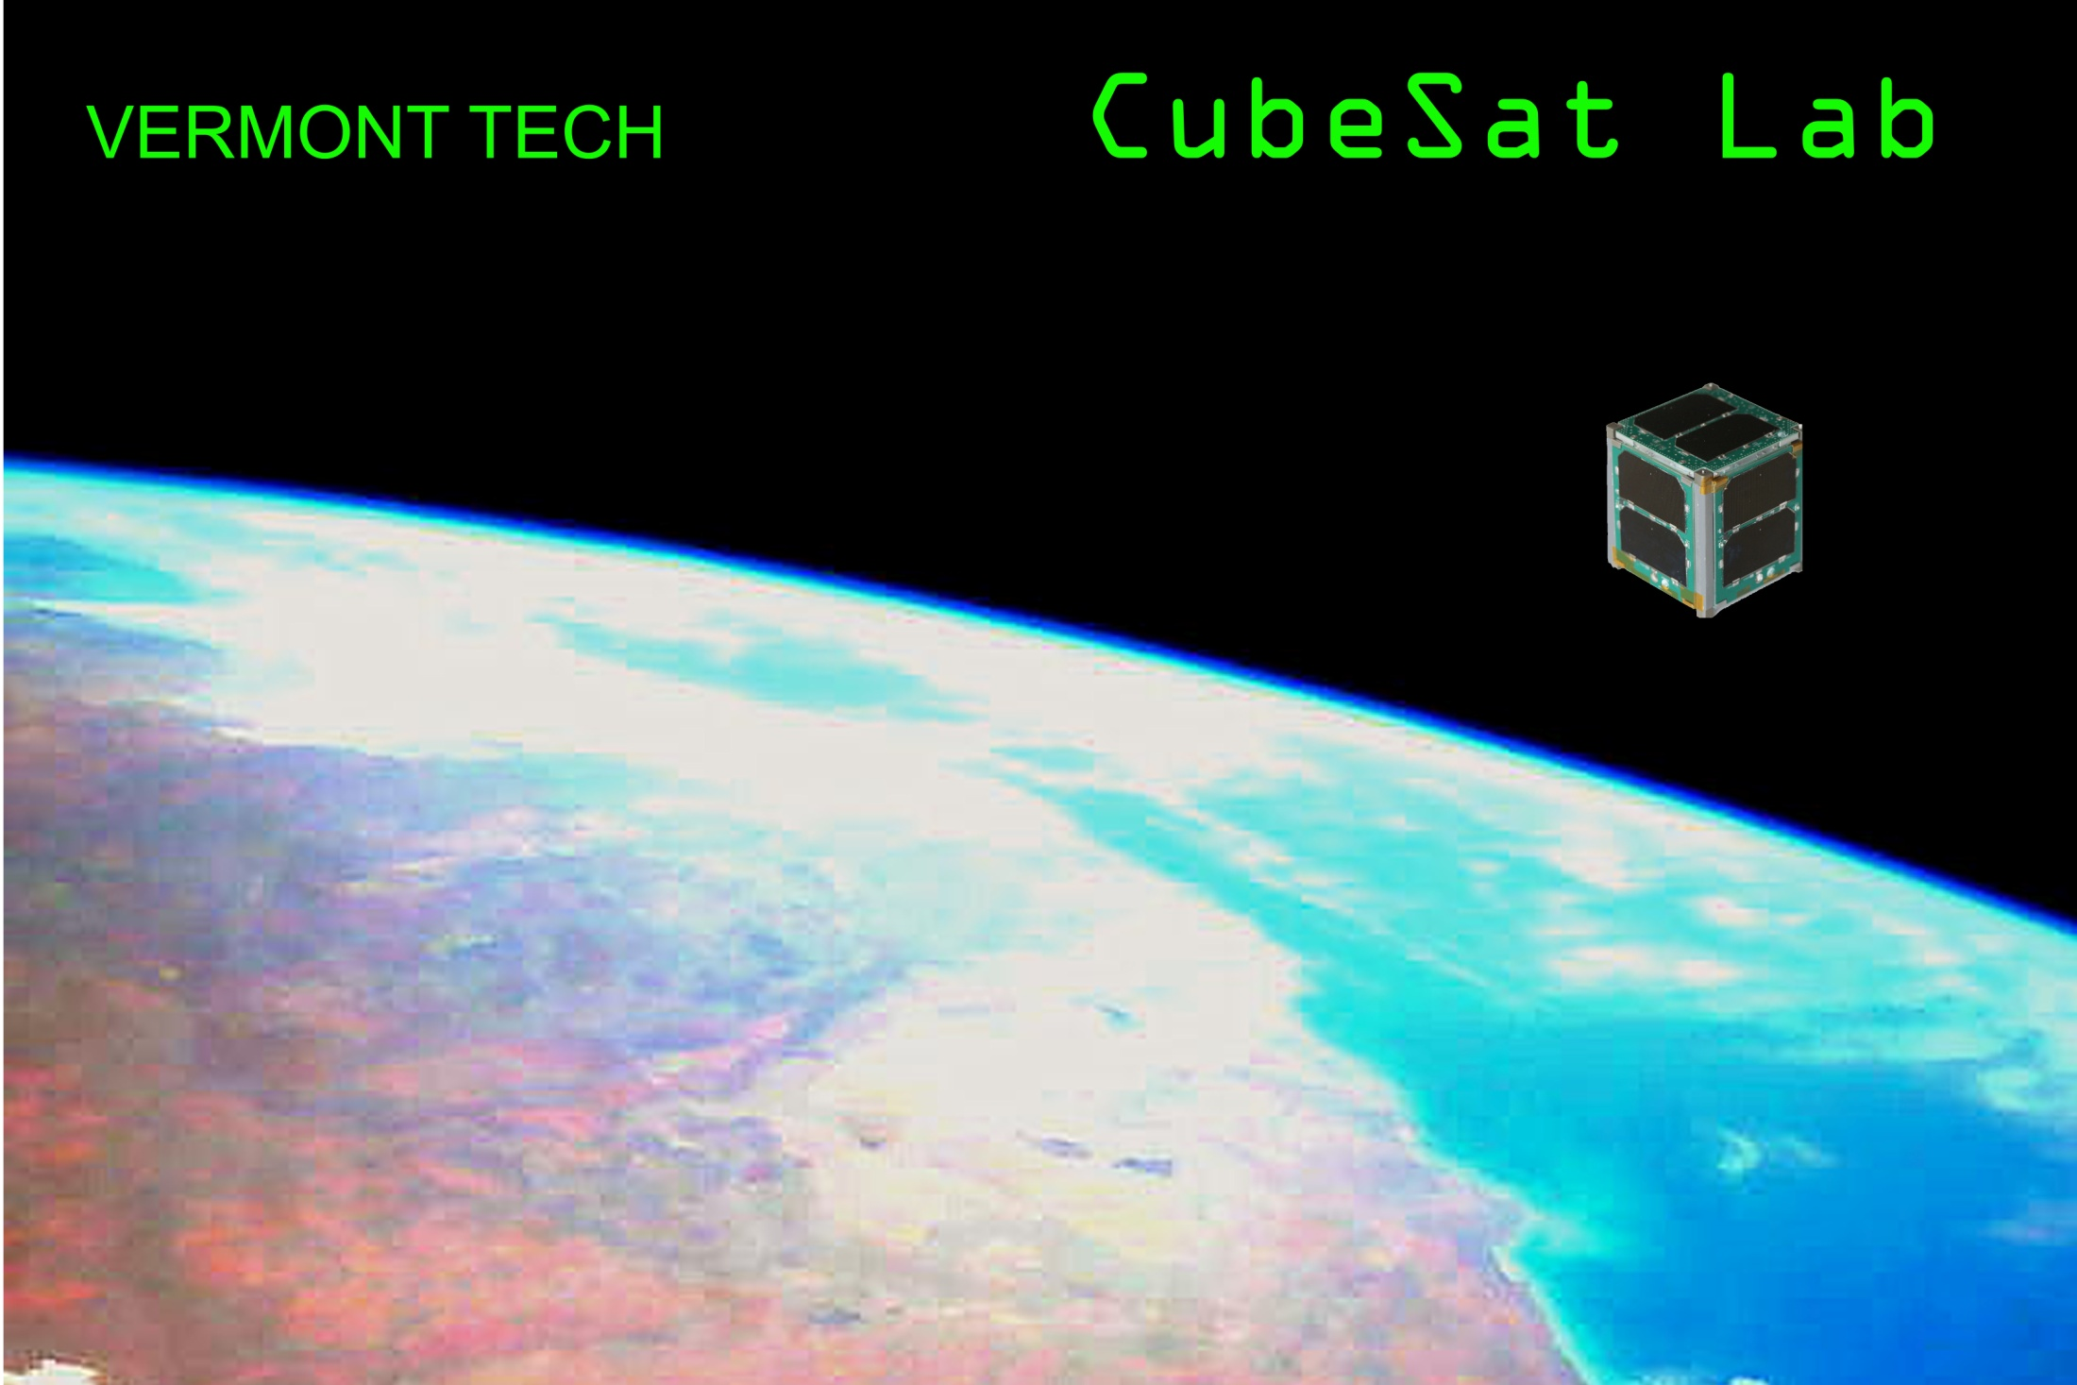
CubedOS Architecture and Design
Copyright 2017 Carl Brandon & Peter Chapin
Dr. Carl Brandon & Dr. Peter Chapin cbrandon@vtc.edu pchapin@vtc.edu
Vermont Technical College +1-802-356-2822 (Brandon), +1-802-879-2367 (Chapin)
025226763
Randolph Center, VT 05061 USA http://www.cubesatlab.org

Slide 2
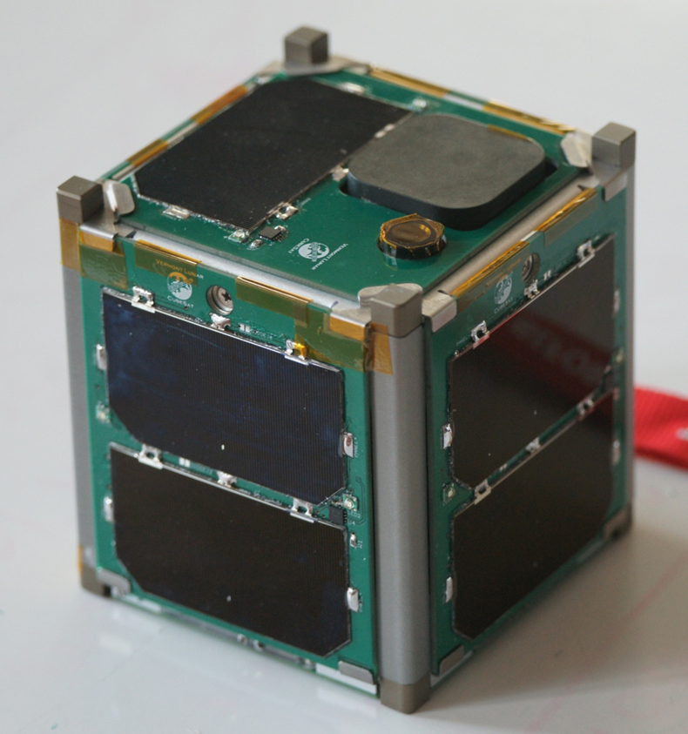

Slide 3
Vermont Lunar CubeSat
It worked until our reentry on November 21, 2015
We completed 11,071 orbits, travelling about 293,000,000 miles, equivalent to over 3/4 the distance to Jupiter.
Our single-unit CubeSat was launched as part of NASA’s ELaNa IV on an Air Force ORS-3 Minotaur 1 flight November 19, 2013 to a 500 km altitude, 40.5º inclination orbit and remained in orbit until November 21, 2016. It is the only one of the 12 ELaNa IV university CubeSats that operated until reentry, the last one quit 19 months earlier.
We communicated with it the day before reentry
We were the first university satellite from New England
We are still the only successful university satellite on the east coast

Slide 4
Software Development Environment
VxWorks 6.9 on PowerPC (test platform)
Windows 10 on Intel x64 (development)
GNAT Pro Ada
SPARK Pro 2014 with Ravenscar runtime
Current Development Team
VTC: 2 faculty, 4 students (2 MS, 2 BS)

Slide 5
Software Stack
Mission
SPARK
CubedOS
Ada Runtime
VxWorks/Linux/Windows
Hardware

Slide 6
Software Stack
Ada Runtime
File I/O using underlying OS
Device I/O using underlying OS (to the greatest extent possible)
Tasking using underlying OS and Ada runtime environment

Slide 7
Software Stack
CubedOS
General purpose application framework for flight software
Provides inter-module message passing
Provides services of interest to flight software
Can integrate existing Ada and C libraries
Similar to NASA’s cFE/CFS except written in SPARK and verified free of runtime error.

Slide 8
Software Stack (CubedOS)
Application as “modules” that pass messages
Each module reads messages from exactly one mailbox
Each module contains a message processing task
Modules all execute concurrently
Message parameters are XDR encoded
Application also includes libraries
Passively called from multiple modules

Slide 9
Software Stack (CubedOS)
Mailboxes
CubedOS
Messages
M1
M2
M3
M4
Modules

Slide 10
Software Stack (CubedOS Core Modules)
Tick Generator for timing services
Housekeeping “ticks”
One shot timing
Low resolution
Publish/Subscribe Service
Message broadcasting and multicasting
Implemented on top of CubedOS’s point-to-point system

Slide 11
Software Stack (Sample Mission)
“Main” Module
Control Modules
State Manager
File Server
Schedule
Spiral Thruster
Logger
Radio
…
Ion Thruster
ADACS
EPS
CubedOS
Driver Modules

Slide 12
Software Stack (Sample Mission)
Driver modules
Include a task for reading device asynchronously and a task for processing messages (and writing to device)
Provides low level (device specific) packet encoding/decoding as necessary

Slide 13
Software Stack (Sample Mission)
State Manager (“main” program)
Maintains overall spacecraft state machine
Executes actions associated with state transitions
Handles deployment activities
Coordinates science activities
Handles fault conditions

Slide 14
Software Stack (Sample Mission)
Storage Manager
Provides interface to persistent files
Backed by underlying OS
Scheduler
Stores pending uplinked commands
Dispatches commands at specified times

Slide 15
Software Stack (Sample Mission)
Logger
Gathers and buffers telemetry
Informs State Manager of fault conditions
Prepares telemetry downlink
Spiral Thruster
Processes ADACs information and drives ion thruster
Handles angular moment management

Slide 16
Multi-Domain Communication
Domain #1
Domain #2
mboxes
mboxes
1
2
3
1
2
3
Message Routers

Slide 17
Multi-Domain Communication
Message Routers
Messages are sent to mailboxes indirectly
Different transport methods possible
… local routing
… transport to a different process/spacecraft
Enables Distributed Computing
CubeSat swarms
… send messages to services on other spacecraft
Underlying network protocol: DTN?

Slide 18
Multi-Domain Communication
Message Addressing
(Domain_ID, Module_ID, Message_ID)
… routers handle message distribution
An area under current development

Slide 19
Why SPARK?
Finds Flow (and related) Errors
All uses of uninitialized variables
All computed values that are ignored (error codes)
All potential data races
All uses of aliased data

Slide 20
Why SPARK?
Finds Runtime Errors
All array bounds violations
All arithmetic overflow
All declared constraint violations (integers out of acceptable ranges)

Slide 21
Why SPARK?
Finds Pointer Errors
Pointers are prohibited in SPARK so errors associated with them cannot occur
No dangling pointers
No “double free”
No null dereferences
No pointer aliasing
Other features of SPARK/Ada still allow reasonable designs even without pointers

Slide 22
Why SPARK?
Enforces Contracts
Declared preconditions checked
Declared postconditions checked
Declared assertions checked
All of SPARK’s analysis is entirely static
No runtime overhead; no dynamic checks
Once SPARK is satisfied, runtime checks can be removed! This saves space/time.

Slide 23
Language Comparison
UK Ministry of Defense C-130J software study: The anomalies per 1,000 lines of code (average):
… for C was 97
… for Ada 95 was 25
… for SPARK/Ada 95 was 4
Newer Tokeneer project (for NSA)
… for SPARK/Ada 2005 was 0.4
Productivity of 38 lines of code per programmer day, compared with 10 to 12 lines of code when using C.
We are now using the even newer SPARK/Ada 2014

Slide 24
Language Comparison
If your student programmers do not know SPARK/Ada, it takes about two weeks to become productive
SPARK/Ada productivity of 38 lines of code per programmer day, compared with 10 to 12 lines of code when using C
After three weeks, the new SPARK/Ada programmer has caught up with the C programmer
For a 10,000 line program, the SPARK/Ada programmer would finish in 1.09 years (with 4 errors)
For a 10,000 line program, the C programmer would finish in 3.33 years (with 970 errors)

Slide 25
cubedos-lib-compressors.adb:32:46: medium: overflow check might fail (e.g. when C = (Operation_Count => 2147483647))
Example
cubedos-lib-compressors.adb:32:46: medium: overflow check might fail (e.g. when C = (Operation_Count => 2147483647))
procedure Compress
(C : in out Trivial_Compressor;
Data_In : in Uncompressed_Block;
Data_In_Size : in Block_Size_Type;
Data_Out : out Compressed_Block;
Data_Out_Size : out Block_Size_Type)
is
begin
Data_Out := (others => 0);
for I in 1 .. Data_In_Size loop
Data_Out(I) := Data_In(I);
end loop;
Data_Out_Size := Data_In_Size;
C.Operation_Count := C.Operation_Count + 1;
end Compress;

Slide 26
cubedos-tick_generator-api.adb:37:39: medium: range check might fail
Example
cubedos-tick_generator-api.adb:37:39: medium: range check might fail
Interval : constant Duration := Ada.Real_Time.To_Duration(Tick_Interval);
begin
Position := 0;
XDR.Encode(XDR.XDR_Unsigned(1000*Interval), Message.Payload, Position, Last);
Position := Last + 1;
…
end;

Slide 27
cubedos-tick_generator-api.adb:37:39: medium: range check might fail
Example
cubedos-publish_subscribe-api.adb:90:10: medium: precondition might fail
begin
Position := 0;
XDR.Encode(XDR.XDR_Unsigned(Channel), Message.Payload, Position, Last);
Position := Last + 1;
XDR.Encode(XDR.XDR_Unsigned(Message_Data'Length), Message.Payload, Position, Last);
Position := Last + 1;
XDR.Encode(Message_Data, Message.Payload, Position, Last);
Message.Size := Last + 1;
return Message;
end;

Slide 28
cubedos-tick_generator-api.adb:37:39: medium: range check might fail
Example
-- Encodes XDR fixed length opaque data into Data starting at Position.
procedure Encode
(Value : in Octet_Array;
Data : in out XDR_Array;
Position : in XDR_Index_Type;
Last : out XDR_Extended_Index_Type)
with
Global => null,
Depends => (Data =>+ (Value, Position), Last => (Value, Position)),
Pre =>
Position rem 4 = 0 and then
Data'Length > 0 and then
Data'Length rem 4 = 0 and then
Length_With_Padding(Value'Length) <= (Data'Last - Position) + 1,
Post => Last = Position + (Length_With_Padding(Value'Length) - 1);

Slide 29
CubedOS Mailboxes
Message parameters are encoded/decoded at runtime to/from octet streams using the XDR standard.
Encoding/decoding done by API packages currently hand written
We are working on XDR2OS3, a tool to auto-generate the encoding/decoding packages

Slide 30
MXDR Language
enum Series_Type { One_Shot, Periodic };
typedef unsigned int Series_ID_Type range 1 .. 2147483647;
typedef unsigned int Series_Count_Type range 0 .. 2147483647;
// Message sent to Tick Generator requesting ticks
-> message struct Relative_Request {
Time_Span Tick_Interval; // Interval or period
Series_Type Request_Type; // One_Shot or Periodic
Series_ID_Type Series_ID; // Requested ID number
};
// Message sent from Tick Generator containing the “tick”
<- message struct Tick_Reply {
Series_ID_Type Series_ID; // Identifies the series
Series_Count_Type Count; // Tick number of this series
};

Slide 31
CubedOS Mailboxes
generic
Domain_Number : Domain_ID_Type;
Module_Count : Positive;
Mailbox_Size : Positive;
Maximum_Message_Size : Positive;
package CubedOS.Generic_Message_Manager is
type Message_Record is
record
Sender : Module_Address_Type;
Receiver : Module_Address_Type;
Message_ID : Message_ID_Type;
Priority : System.Priority;
Size : XDR_Size_Type;
Payload : XDR_Array;
end record;
type Message_Array is array(Message_Index_Type) of Message_Record;
end CubedOS.Generic_Message_Manager;
Mostly for future expansion
XDR encoded message parameters

Slide 32
CubedOS Modules
Module communication is point-to-point
Sender names receiver explicitly
Receiver learns sender address from message header
Replies returned via (dynamically specified) ID
Publish/Subscribe service (a core CubedOS service) allows broadcast and multicast semantics
Server modules
Can be written without knowledge of clients
Provided by third party libraries

Slide 33
Software Verification (Proof)
Freedom from flow errors
We require 100% error free (or else special justification documented in the source code)
No pointer or memory management errors
No use of uninitialized variables
No error codes ignored “accidentally”
No computed values left unused “accidentally”
No data race conditions

Slide 34
Software Verification (Proof)
Freedom from Runtime Error (RTE)
Goal: 100% error free (testing can address unproved verification conditions)
No out of bounds array access
No arithmetic overflow
No out of range values
No division by zero

Slide 35
Software Verification (Proof)
Functional Properties
As time allows…
Not our intention to formally specify all functional properties, so proof of those properties is not possible
May specify some properties in special cases… will attempt to prove them in that case
Functional properties verified by conventional testing

Slide 36
Software Verification (Dynamic Analysis)
Stack Analysis
AdaCore’s GNATstack tool
Computes upper bound of stack space require by each task as tests are executed.
Allows us to set a stack size that is (likely) adequate
SPARK disallows dynamic memory allocation…
… with adequate stack space the program will never run out of memory unexpectedly.

Slide 37
Software Verification (Dynamic Analysis)
Coverage Analysis
GNU’s gcov tool
Computes execution coverage during.
Goal: 100% line coverage (although some fault handling states may be difficult to fully explore)

Slide 38
Software Verification (Testing)
Unit Testing
Low level unit tests on x86 (Windows) platform
GNATTest tool to help generate test cases
Emphasis on testing areas not covered by proof
RTE issues that are unproved
Functional issues
Testing done with all assertions enabled
Coverage analysis done during testing

Slide 39
Software Verification (Testing)
Module Testing
Exploratory test programs on x86-64 (Windows/Linux) and PowerPC (VxWorks)
Exercises complete modules and message passing
Each module (more or less) in isolation
Simulated fault injection as well as testing nominal operation

Slide 40
Software Verification (Testing)
Full System
Execute full system on Windows/Linux/PowerPC (VxWorks) using stub modules (or real modules) to simulate/monitor I/O

Slide 41
Questions?
http://www.cubesatlab.org/

