Slide 1
Secure Small Satellite Processing Platform
Jeff Brandon, Kyle Ingols
9 August 2017
DISTRIBUTION STATEMENT A. Approved for public release: distribution unlimited. This material is based upon work supported under Air Force Contract No. FA8721-05-C-0002 and/or FA8702-15-D-0001. Any opinions, findings, conclusions or recommendations expressed in this material are those of the author(s) and do not necessarily reflect the views of the U.S. Air Force. © 2017 Massachusetts Institute of Technology.
Delivered to the U.S. Government with Unlimited Rights, as defined in DFARS Part 252.227-7013 or 7014 (Feb 2014). Notwithstanding any copyright notice, U.S. Government rights in this work are defined by DFARS 252.227-7013 or DFARS 252.227-7014 as detailed above. Use of this work other than as specifically authorized by the U.S. Government may violate any copyrights that exist in this work.
Notes:
1
1
Introduce yourself, where you’re from, and your topic – working to leverage cFS for the next generation of highly secure smallsats

Slide 2
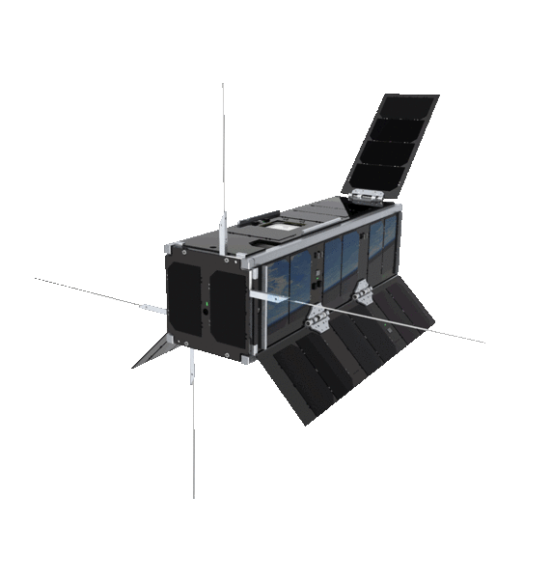
SmallSats are an Attractive Option …
Notes:
Quick chart – people love smallsats; you can fly one, or perhaps even a constellation of many, for less than the cost of a traditional large satellite.

Slide 3
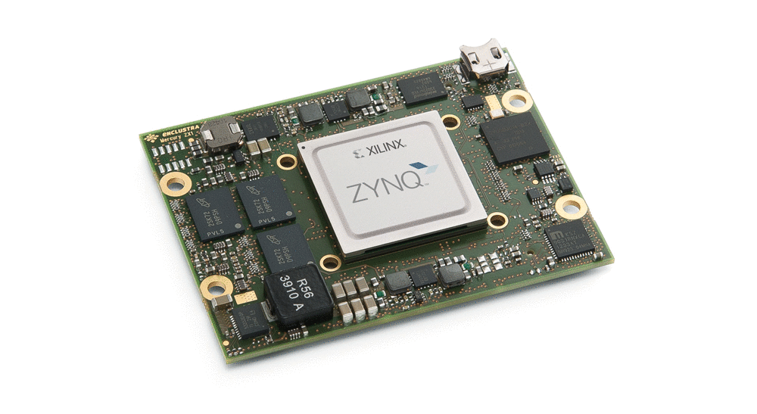
… to adversaries
Notes:
Attractive to adversaries, too … common HW and SW, and a “break once, break all” attractiveness. Hard to recover from an attack, too, because of how distant the equipment is if something goes wrong.

Slide 4
Adding a “Root of Recovery” to Satellites
Notes:
The big one is the inability to reassert physical control, and that’s what we keep coming back to … there’s a need for a root of recovery, and we need to find a way to build it in. It needs to be bulletproof, and it needs to be properly isolated from the rest of the satellite’s operation.

Slide 5
A Representative Software Stack
Application
Middleware
Adapter
Operating System
Board Support Package
Processor
Bus
Peripheral
Notes:
Showing how a typical satellite processor is set up, from the application driving the mission down to an example peripheral that one may wish to actuate on the spacecraft.

Slide 6
A Representative Software Stack
Application
Middleware
Adapter
Operating System
Board Support Package
Processor
Bus
Peripheral
Design Guidelines
Notes:
For security and ease of use, we provide design guidelines for either end of the processing chain, so we’re minimally disruptive to existing engineering.

Slide 7
A Representative Software Stack
Application
Middleware
Adapter
Operating System
Board Support Package
Processor
Bus
Peripheral
Design Guidelines
Technical Solution
Notes:
In the middle, we mandate a couple technical choices as a necessary foundation to our approach – namely, a secure OS coupled to a processor with sufficient HW support for the OS.

Slide 8
A Representative Software Stack
Application
Middleware
Adapter
Operating System
Board Support Package
Processor
Bus
Peripheral
Design Guidelines
Technical Solution
Familiarity by Adaptation
Notes:
… and we adapt other layers that interact with the green boxes on either end, so the familiar environment connects cleanly to the new one. This talk will focus on the middleware’s path to the Operating System.

Slide 9
Middleware and Adapter
Application
Middleware
Adapter
Operating System
Board Support Package
Processor
Bus
Peripheral
Notes:
Middleware: we are assuming the NASA cFS software stack. (Surprise!)

Slide 10
Operating System
Application
Middleware
Adapter
Operating System
Board Support Package
Processor
Bus
Peripheral
Notes:
For the OS, we are using the seL4 formally verified microkernel. [Discuss what “formally verified” means. Cite size: < 10kLOC. Cite dev time: 2 years for kernel, ~20 to prove correctness. Cite security benefits: no buffer overflows, race conditions, use-after-free bugs, etc.
This gives us the strong foundation on which to build our Root of Recovery, and clean separation of processes (not threads). This is going to be tricky, as seL4 is nowhere near as full-featured as the operating systems with which cFS is commonly used (VxWorks, Linux/POSIX, and rtems).

Slide 11
Design: OSAL-to-seL4
Miscellaneous
OS_API_Init
OS_printf
OS_printf_disable
OS_printf_enable
OS_Tick2Micros
OS_GetLocalTime
OS_SetLocalTime
OS_Milli2Ticks
Queue
OS_QueueCreate
OS_QueueDelete
OS_QueueGet
OS_QueuePut
OS_GetQueueIdByName
OS_QueueGetInfo
Semaphore and Mutex
OS_BinSemCreate
OS_BinSemDelete
OS_BinSemFlush
OS_BinSemGive
OS_BinSemTake
OS_BinSemTimedWait
OS_BinSemGetIdByName
OS_CountSemCreate
OS_CountSemDelete
OS_CountSemGive
OS_CountSemTake
OS_CountSemTimedWait
OS_CountSemGetIdByName
OS_MutSemCreate
OS_MutSemDelete
OS_MutSemGive
OS_MutSemTake
OS_MutSemGetIdByName
OS_MutSemGetInfo
Task Control
OS_TaskCreate
OS_TaskDelete
OS_TaskInstallDeleteHandler
OS_TaskExit
OS_TaskDelay
OS_TaskSetPriority
OS_TaskRegister
OS_TaskGetId
OS_TaskGetIdByName
OS_TaskGetInfo
Dynamic Loader and Symbol Lookup
OS_SymbolLookup
OS_SymbolTableDump
OS_ModuleLoad
OS_ModuleUnload
OS_ModuleInfo
Timers
OS_TimerCreate
OS_TimerSet
OS_TimerDelete
OS_TimerGetIdByName
OS_TimerGetInfo
Networking
OS_NetworkGetId
OS_NetworkGetHostName
File System
OS_creat
OS_open
OS_close
OS_read
OS_write
OS_chmod
OS_stat
OS_lseek
OS_remove
OS_rename
OS_cp
OS_mv
OS_ShellOutputToFile
OS_FDGetInfo
OS_FileOpenCheck
OS_CloseAllFiles
OS_CloseFileByName
OS_mkdir
OS_opendir
OS_closedir
OS_readdir
OS_rewinddir
OS_rmdir
OS_mkfs
OS_rmfs
OS_initfs
OS_unmount
OS_GetPhysDriveName
OS_fsBlocksFree
OS_fsBytesFree
OS_chkfs
OS_GetFsInfo
Interrupts
OS_IntAttachHandler
OS_IntEnable
OS_IntDisable
OS_IntLock
OS_IntUnlock
OS_IntAck
Exceptions
OS_ExcAttachHandler
OS_ExcEnable
OS_ExcDisable
OS_FPUExcAttachHandler
OS_FPUExcEnable
OS_FPUExcDisable
Mission Software
STF-1
cFS
cFS Services
cFS Services
cFS Services
Flight Software
OSAL API
OSAL
Operating System
seL4
Processor
Xilinx Zynq
Peripherals
Simulated GPS, EPS, radio, …
Notes:
cFS supplies a nice OS Abstraction Layer (OSAL). We are working to port cFS to seL4, via OSAL. In this talk, we’ll focus on the semaphores and mutexes, as they’re one of the more challenging tasks.

Slide 12
OS_BinSemCreate
int32 OS_BinSemCreate (uint32 *sem_id, const char *sem_name, uint32 sem_initial_value,
uint32 options)
{
int Status;
pthread_mutexattr_t mutex_attr;
pthread_mutex_t mutex;
pthread_cond_t cond;
/* ... */
Status = pthread_mutexattr_init(&mutex_attr);
Status = pthread_mutexattr_setprotocol(&mutex_attr, PTHREAD_PRIO_INHERIT);
Status = pthread_mutex_init(&mutex, &mutex_attr);
Status = pthread_cond_init(&cond, NULL);
/* ... */
}
Named and created dynamically, at runtime
Unused Argument
Standard POSIX Construction
Notes:
This is a slightly edited, highly clipped version of the POSIX implementation of the OSAL call to create a semaphore. Note that the “options” argument is unused here, and it’s pretty standard under the hood.
It’s created dynamically, however, and differentiated by name. This is more challenging in seL4, at least at the outset; it is far easier to statically allocate resources like this, though we are also looking into dynamic allocation for the future.

Slide 13
Semaphores in seL4: Native Construction
/* Allocate and initialise a managed binary semaphore
* @param vka A VKA instance used to allocate a notification object.
* @param sem A semaphore object to initialise.
* @param value The initial value for the semaphore. Must be 0 or 1.
* @return 0 on success, an error code on failure. */
static inline int sync_bin_sem_new(vka_t *vka, sync_bin_sem_t *sem, int value) {
…
/* Edge Case Handling */
…
int error = vka_alloc_notification(vka, &(sem->notification));
if (error != 0) return error;
else return sync_bin_sem_init(sem, sem->notification.cptr, value);
}
Notes:
show how a mutex is created in seL4 – diagram, showing processes, IPC calls, states, etc.
TODO: explain what caMKes does for you in setting something like this up

Slide 14
Semaphores in seL4: CAmkES Interconnect
component myComponent {
has mutex m;
provides Lock lock;
}
component component2 {
control;
uses Lock lock;
}
assembly {
composition {
component myComponent c;
component component2 c2;
connection seL4RPCCall con(from c2.lock, to c.lock);
}
}
Component 2
seL4 RPC
myComponent
Mutex
Notes:
show how a mutex is created in seL4 – diagram, showing processes, IPC calls, states, etc.
TODO: explain what caMKes does for you in setting something like this up
Because caMKes requires static mutexes and OSAL expects dynamic allocation

Slide 15
Instrumenting OSAL Mutex API
However, caMKes requires statically defined mutexes at compile time while OSAL expects to allocate mutexes dynamically at runtime.
int32 OS_CountSemCreate(uint32 *sem_id, const char *sem_name, uint32 sem_initial_value){
…
/* Error checking */
…
/* Success case */
#ifdef SEM_INSTRUMENTATION
print_sem_data(*sem_id, "created", COUNT);
#endif //CONFIG_SEM_INSTRUMENTATION
…
}
{'type':'mut', 'id':'4', 'creator_task_id':'0', 'verb':'given', 'acting_task_id':'64'}
{'type':'mut', 'id':'11', 'creator_task_id':'0', 'verb':'created', 'acting_task_id':'64'}
{'type':'mut', 'id':'3', 'creator_task_id':'0', 'verb':'given', 'acting_task_id':'64'}
{'type':'mut', 'id':'3', 'creator_task_id':'0', 'verb':'taken', 'acting_task_id':'0'}
Notes:
Added a basic logging function that tracks semaphore id, the action taken on the semaphore, and the type of semaphore. Acting process is found using OS_findCreator()

Slide 16
Emulating Dynamism … Statically
[
...
{"name":"1",
"taken": ["mut3", "mut6", "mut7"] ,
"given": ["mut3", "mut6", "mut7"] } ,
...
{"name":"9",
"taken": ["mut10", "mut3", "mut6",
"mut7", "mut8", "bin2"] ,
"given": ["mut10", "mut3", "mut8",
"mut6", "mut7"] ,
"created": ["bin2"] } ,
...
Notes:
The raw output generated by the logging instrumentation is then parsed using python to produce a condensed json representation of mutex usage by processes.
We use this with the caMKes ADL tool to generate just about everything to build a running seL4 image.
Discuss instrumenting OSAL and running in NOS3 to collect calls, and also to collect access patterns – so in the future, we can “lock down” who can get to which resources. For now, we just use the list.

Slide 17
Emulating Dynamism … Statically
Autogenerator(.py)
def main():
app_name = "nosgen"
app_dir = "./{0}/".format(app_name)
components_dir = app_dir + "components"
with open("usage.json", 'r') as f:
process_file = json.load(f) #reads json into python dict
d, creator_by_mutex = build_graph(process_file)
gen_camkes(process_file, d, app_dir, "gen.camkes")
write_component_files(process_file, d, components_dir, (True, creator_by_mutex))
write_Kbuild(app_name, app_dir)
write_Kconfig(app_name, app_dir)
write_Makefile(app_name, process_file, app_dir)
Notes:
… and once we have that, we can autogenerate the necessary static mutex creation, and then simply look it up based on sem_name at runtime.

Slide 18
Emulating Dynamism … Statically
Autogenerator(.py)
Reads in mutex usage data and uses it to:
Generate “gen.camkes” describing process mutex relationships
Generate component c files
Generate Kbuild Kconfig and Makefile for seL4 build system
Notes:
… and once we have that, we can autogenerate the necessary static mutex creation, and then simply look it up based on sem_name at runtime.

Slide 19
Generating CAmkES
Sample Code
/* Stub code to write component headers */
…
for mut in creates:
#Handle provides interface
out(f, 1, "has mutex {};".format(mut))
for user in d[process_name][mut]:
out(f, 1, "provides Lock l{0}{1};".format(user, mut))
“creates” is a set of mutexes a given process has created.
“d” maps from process name to another dictionary with keys that are mutex names said process creates.
Those mutex name keys map to processes that use said mutex.
This code generates a unique lock for each process that accesses the mutex.
The process is repeated for mutexes a process takes (and gives).
Notes:
Generate CAmkES components from json

Slide 20
Generating CAmkES
Making Connections in CAmkES
count = 0
for creator in d:
for mut in d[creator]:
for user in d[creator][mut]:
out(f, 2, "connection seL4RPCCall connection{0}(from p{1}.l{1}{3}, to p{2}.l{1}{3});".format(count, user, creator, mut))
count += 1
Notes:
Generate CAmkES assembly, utilizes caMKes defined seL4RPCCall connection type which will handle ipc with a remote procedure call.

Slide 21
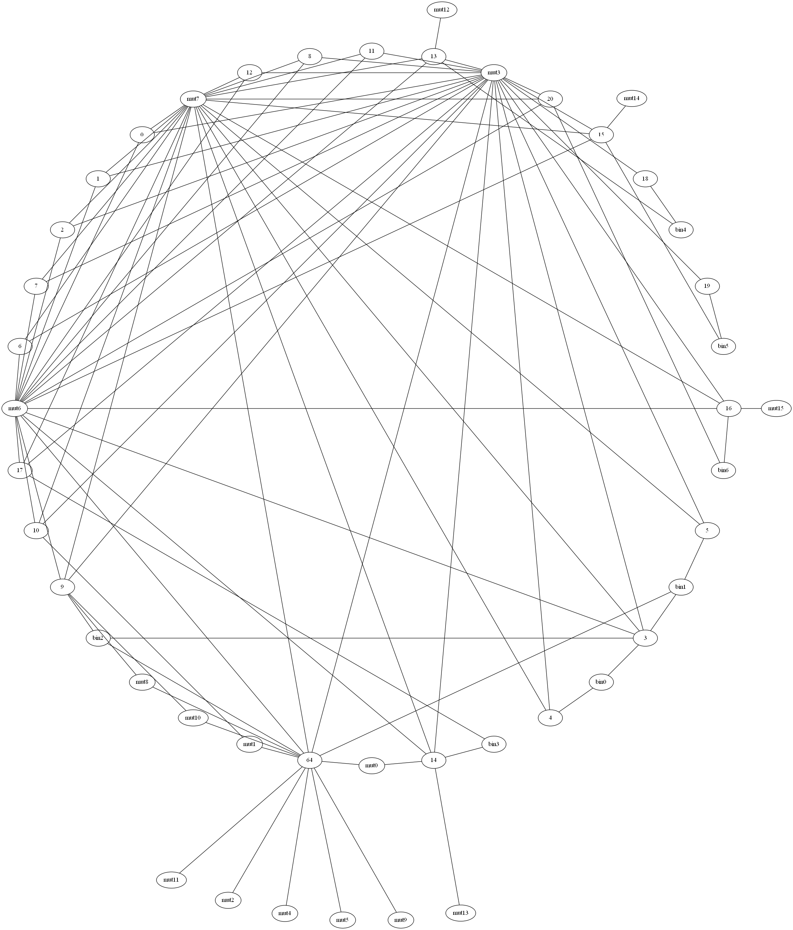
Generating CAmkES
Sample Output CAmkES
component P1 {
control;
uses Lock l1mut3;
uses Lock l1mut6;
uses Lock l1mut7;
}
component P0 {
control;
uses Lock l0mut3;
uses Lock l0mut6;
uses Lock l0mut7;
}
…
connection seL4RPCCall connection0(from p18.l18bin4, to p13.l18bin4);
connection seL4RPCCall connection1(from p19.l19bin5, to p15.l19bin5);
connection seL4RPCCall connection2(from p17.l17bin3, to p14.l17bin3);
connection seL4RPCCall connection3(from p20.l20bin6, to p16.l20bin6);
…
Totals:
Mutex: 22, Processes: 22 Connections:70

Slide 22
Generating CAmkES
Sample generated Output C File
#include <camkes.h>
#include <sel4/sel4.h>
#include <stdio.h>
int run(void){
const char *name = get_instance_name();
printf("%s: Started\n", name);
while(1){
l15bin5_lock();
l15mut3_lock();
l15mut6_lock();
l15mut7_lock();
l15mut14_lock();
printf("p15: got all locks!\n");
l15mut14_unlock();
l15mut7_unlock();
l15mut6_unlock();
l15mut3_unlock();
l15bin5_unlock();
}
}
…
void l15bin5_lock(void){
(void)bin5_lock();
}
void l15bin5_unlock(void){
(void)bin5_unlock();
}
void l19bin5_lock(void){
(void)bin5_lock();
}
void l19bin5_unlock(void){
(void)bin5_unlock();
}
void l15mut14_lock(void){
(void)mut14_lock();
}
void l15mut14_unlock(void){
(void)mut14_unlock();
}
Notes:
Generates run function that accesses all mutexes, and lock and unlock functions for each of the mutexes hosted in the process

Slide 23
Emulating Dynamism … Statically
Show test application that uses OSAL
Show example output when run using your CAmkES-based solution
Notes:
We wrote a small sample program using the OSAL mutex API – namely [list functions] – to verify proper functionality. When run under seL4, we got the expected interleaved input (show), and observed no deadlocks or critical section collisions.

Slide 24
Next Steps
Application
Middleware
Adapter
Operating System
Board Support Package
Processor
Bus
Peripheral
Notes:
Next steps are to complete the port, and validate that we can ”fly” the STF-1 test asset in NOS3 using seL4. Once that’s done, we can implement our “root of recovery” alongside the cFS stack, secure in the knowledge that no matter how badly the cFS-based software misbehaves, we can recover. That isolation strategy, and the way we manage device drivers in seL4, is another topic perhaps for another year.

Slide 25
Conclusion
Application
Middleware
Adapter
Operating System
Board Support Package
Processor
Bus
Peripheral
Our Goal: Dramatically simplify the job of building secure small satellites by providing straightforward, practical to implement guidelines and ready-to-use components.

Slide 26
Thank You!
Mr. Jeff Brandon jeff@ll.mit.edu

Slide 27
Backup

Slide 28
Implementing OSAL API
Mutex Buffer
Binary Semaphores
Counting Semaphores
Mutex Semaphores
BIN_MIN
BIN_MAX
COUNT_MAX
MUT_MAX
COUNT_MIN
MUT_MIN
Notes:
Ongoing work, using array of all mutexes organized and bounded by mutex type to serve mutexes as they are requested dynamically from the statically allocated list

