Slide 1
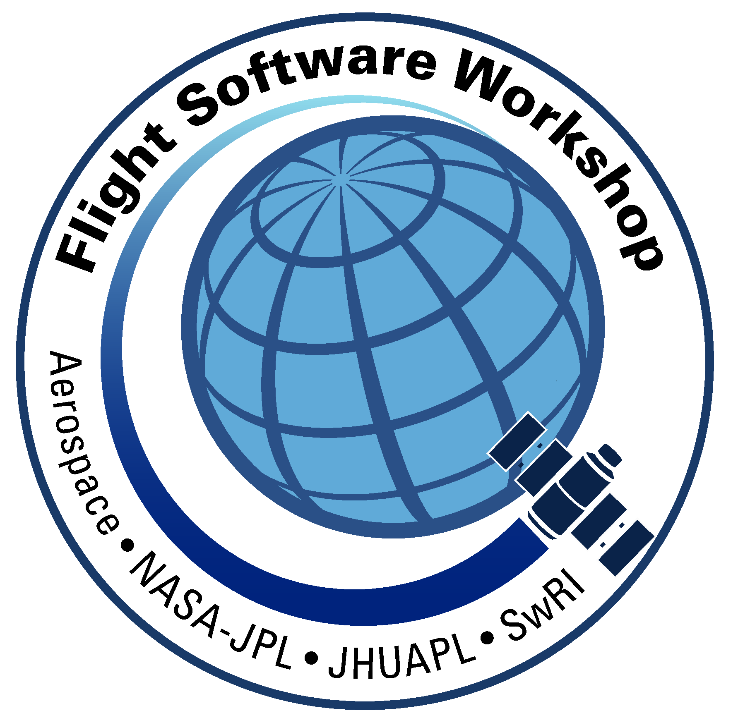
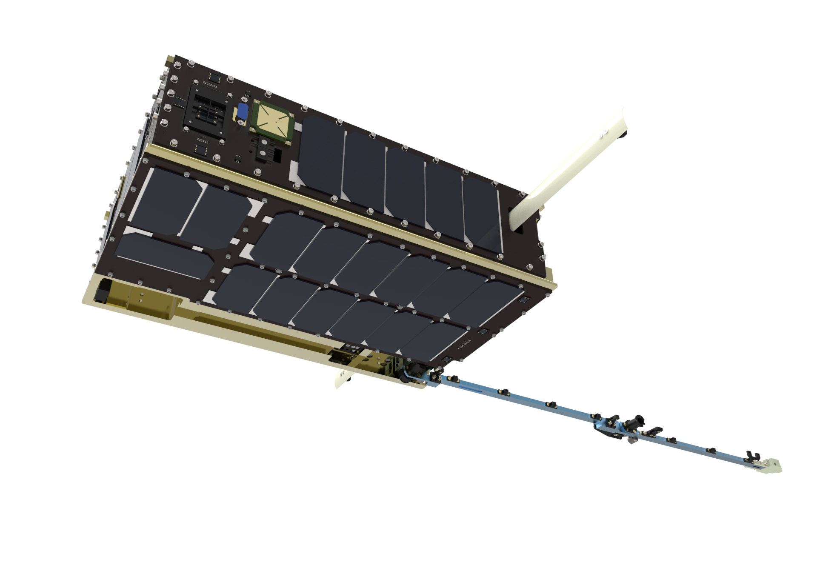
Porting the core Flight System to the Dellingr Cubesat
Alan Cudmore
Code 582
NASA Goddard Space Flight Center

Slide 2
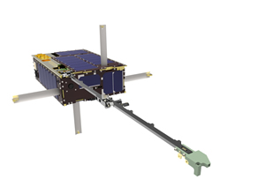
Agenda
Background
Overview of the Dellingr Cubesat
Hardware Overview
Flight Software Overview
Simulation on a Budget
Flight Software Challenges
Port Details
Lessons Learned
Conclusion
Mission Status

Slide 3
Background
Dellingr is a Heliophysics 6U Cubesat developed at GSFC
“Dellingr” is named after the mythological Norse god of the dawn
Originally planned as a one year ”skunkworks” effort
1 person/year for all flight software (FSW) including the Attitude Control System (ACS)
Selected Gomspace Nanomind A712 platform for a 32 bit Central Processing Unit (CPU) with minimal power consumption
After a preliminary design review, I volunteered to port the cFS to the platform
After cFS port to a development board, project decided to use the core Flight System (cFS)
Revised plan
Original developer continued to work on the ACS
I worked on the cFS implementation and created mission app templates
Others worked on integrating device code, developing mission specific apps, and developing ground software

Slide 4
Dellingr Cubesat Hardware Overview (1)
DAGR:
Science
Magnetometers
(Internal and Boom Mounted)
Power:
Clyde Space EPS and Batteries,
SolAreo ZTJ body mounted cells
CPU:
Gomspace Nanomind A712d
ARM processor
INMS:
Ion Neutral Mass Spectrometer
instrument
Tech Demos:
Thermal Louvre
Deployment Camera
Dellingr Facts:
6U Cubesat
Delivered to ISS August 2017
Deployed from Nanoracks Deployer On November 20, 2017
Comm:
L3 CADET Radio
3 Mbits down/9600 up
4 Gbytes packet Storage
(antenna by home depot)
ACS:
MEMS Gyro, Fine Sun Sensors, Coarse Sun Sensors, GPS, Magnetometers,
Reaction Wheels,
Torquers

Slide 5
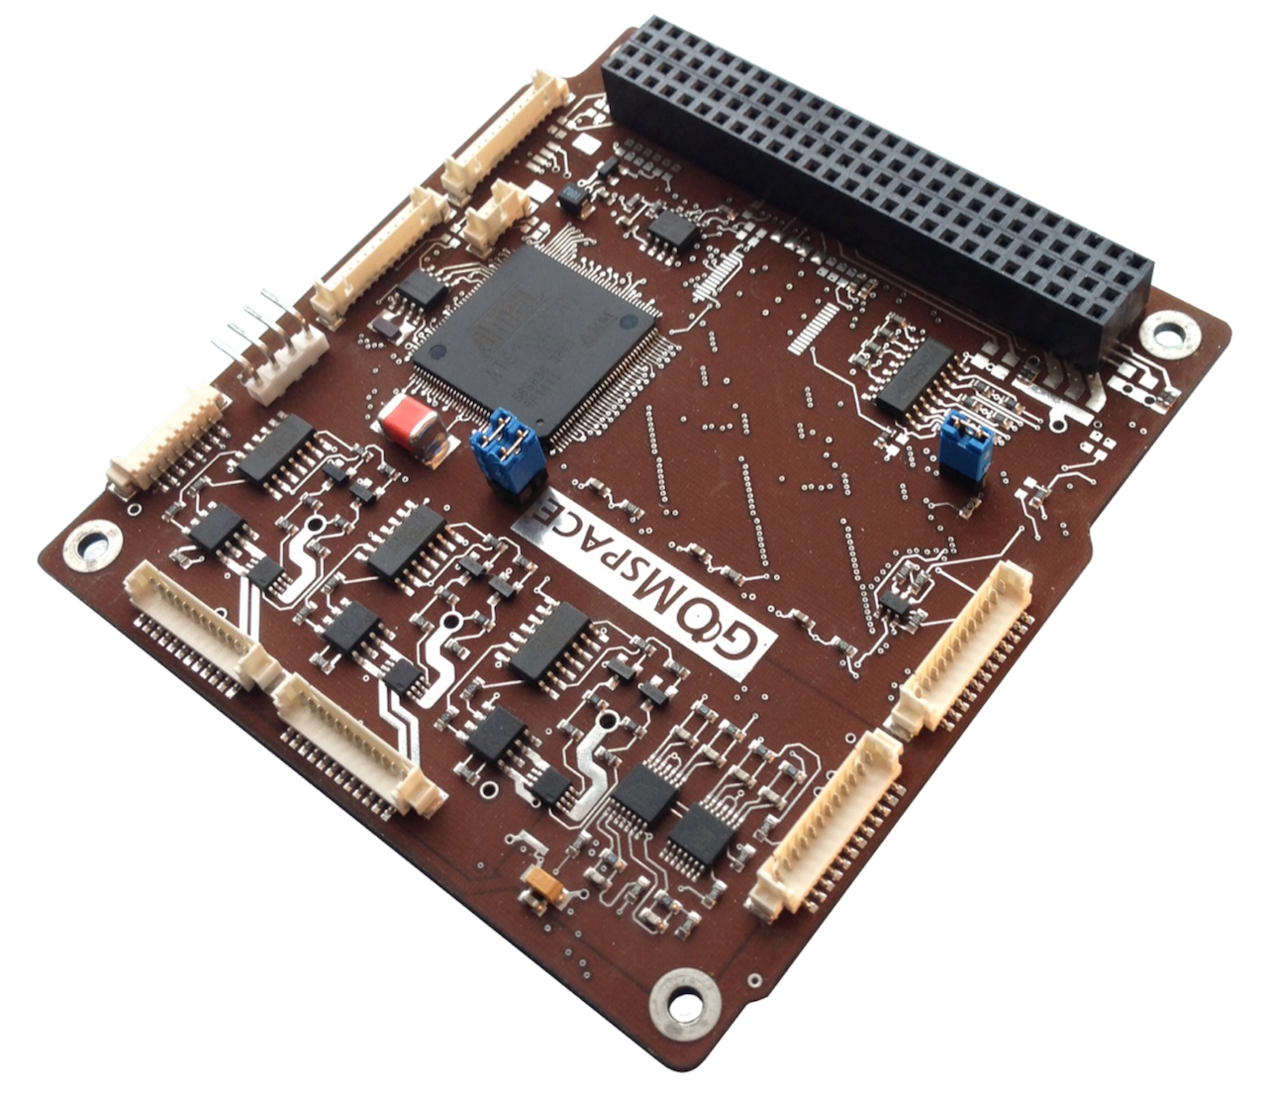
Dellingr Cubesat Hardware Overview (2)
Processor Card - Gomspace Nanomind A712d
Atmel ARM7 CPU @ 40Mhz
2 Megabytes SRAM
2 x 4 Megabytes Flash Memory
Micro Secure Digital card
I2C, SPI, UARTs
Real Time Clock
Magnetometer, PWM, Analog Inputs

Slide 6
Dellingr Cubesat Flight Software Overview (1)
cFS
Reuse
Apps
Dellingr
ACS
App
Dellingr
INMS
App
Dellingr
DAGR
App
Dellingr
SHK
App
Dellingr
CADET
App
cFE/cFS
Reuse
core Flight Executive (cFE)
Dellingr Hardware Library
Dellingr FSW
Apps and Libs
OS Abstraction Layer
(FreeRTOS)
Platform Support Package
(Nanomind)
Dellingr FSW
Porting Layer
FreeRTOS
Operating System
Gomspace Nanomind Firmware
Device Drivers, Shell, File Systems
Vendor
Supplied
Legend:
Vendor Supplied
cFE/cFS Reuse
New on Dellingr
Gomspace Nanomind Hardware / ARM CPU

Slide 7
Dellingr Cubesat Flight Software Overview (2)
Vendor Software | Reuse Software | New Software
FreeRTOS OS | cFE Core | FreeRTOS OSAL Layer
Bootstrap/Startup Code | cFS Scheduler | cFE Platform Support Package
Device Drivers | cFS Stored Commands | Dellingr Hardware Library
File Systems | cFS Health and Safety | DAGR Instrument App
C Library | cFS Checksum | INMS Instrument App
 | cFS Limit Checker | CADET Radio App
 | cFS File Manager | ACS App
 | cFS Memory Dwell | Ephemeris/GPS App
 | cFS Memory Manager | Reaction Wheel App
 | Static Loader (MMS) | File Downlink App
 |  | File Downlink App
 |  | Spacecraft Housekeeping App

Slide 8
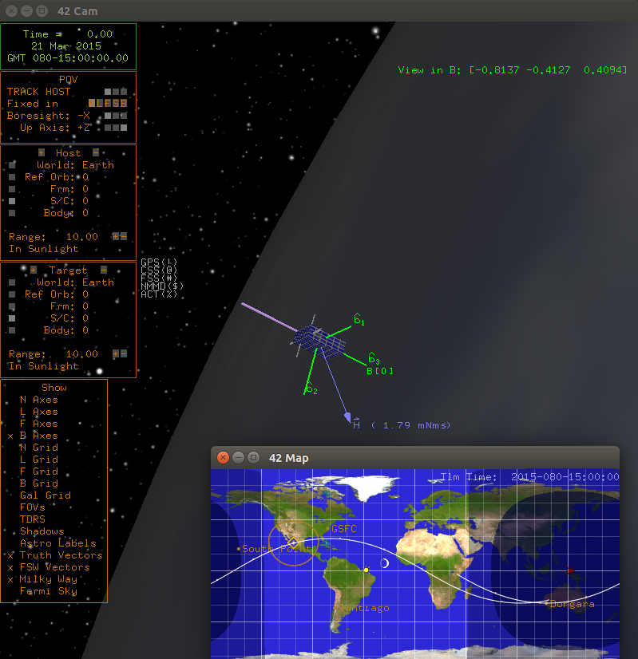
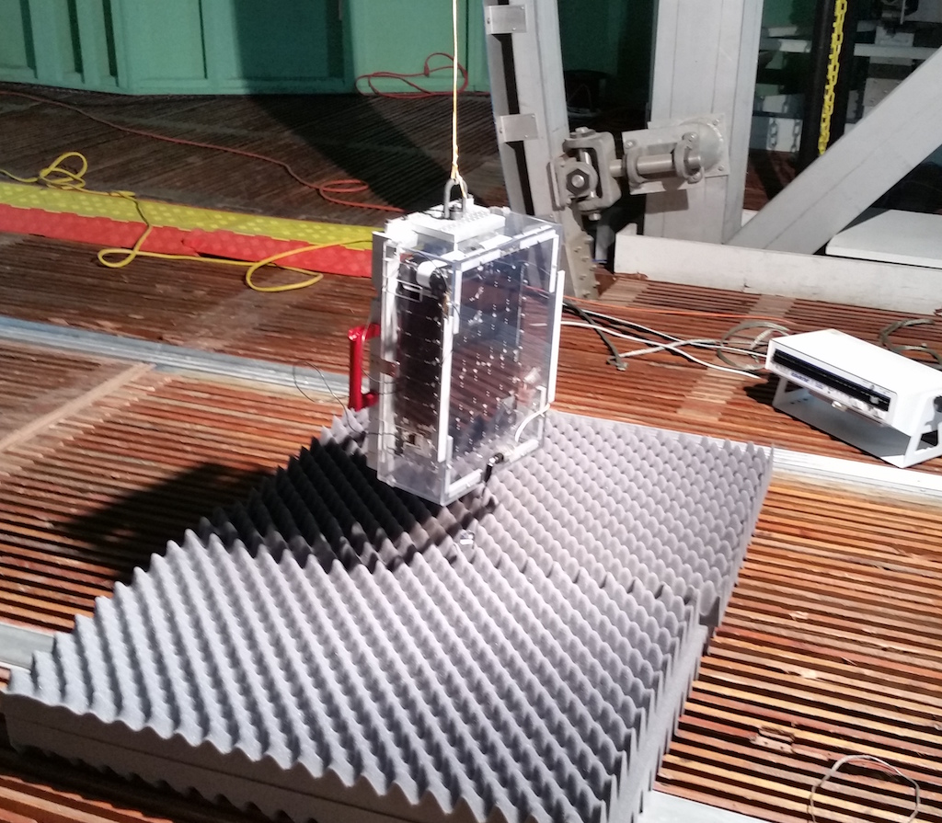
Simulation on a Budget (1)
Dellingr did not have dedicated dynamic simulator such as the Goddard Dynamic Simulator (GDS) for ACS testing
Simulation is accomplished with a combination of:
The open source dynamic simulator ”42” developed by GSFC Code 591
The “Dellingr Hardware Library” with an interface to the ”42” simulator
Most of the ACS app debugging was done on cFS/Linux with 42
When the Satellite was complete, we were able to do a spin test using the reaction wheels and sun sensors

Slide 9
Simulation on a Budget (2)
Dellingr Hardware Library Details
A cFS Library that abstracts all mission specific hardware
Focus is on the ACS Hardware
Allows FSW to run in the following configurations:
On-board computer with real hardware devices
On-board computer talking to 42 Simulator over a serial port
Linux computer talking to 42 Simulator over TCP/IP Socket
The ability to run the Dellingr Flight Software on Linux with the 42 speeds up ACS development and test
This model worked well and will be used for future efforts
Hardware Gyro
ACS
FSW
Dellingr
Hardware
Library
Gyro Data
Simulated Gyro on “42”

Slide 10
Flight Software Challenges (1)
New Operating System: FreeRTOS
Required a port of the Operating System Abstraction Layer (OSAL)
Once the OSAL was working, the cFE core and portable cFS apps worked without modification
On-board computer only has 2 Megabytes of RAM
The cFS code has to run in Flash, since 2 Megabytes of RAM is not enough
Some cFS applications had to be left out to save room (CFDP file transfer, Housekeeping)
Flash file system is limited
Only holds 64 files, not enough for all of the mission stored command sequences
Workaround is to “bundle” multiple stored command sequences into a single file
This is a generic solution that could be used on other missions
Cadet Radio Subsystem
Half Duplex, not ideal for real time telemetry and commands
Very low data rate between on-board computer and radio/recorder limits amount of data spacecraft can produce at one time

Slide 11
Flight Software Challenges (2)
Limited Schedule and Budget
The traditional FSW development lifecycle does not work here
Framework of the cFE/cFS provided a model to follow for new software, saving us from re-inventing the wheel
No ETU or Flat-Sat
There is only one copy of the satellite hardware, and it was not always available for FSW development
FSW changes had accumulated right before Thermal Vacuum testing leading to last minute integration bugs and troubleshooting
Significant time spent working with device drivers and interfaces
A Typical large mission has a limited set of known interfaces (1553/Spacewire, Serial)
Dellingr uses Serial, I2C, SPI, Analog, GPIO, and I2C extended interfaces
Multiple problems encountered with I2C and SPI interfaces that just needed more troubleshooting time and effort
Engineers end up being multi-discipline ( FSW, Hardware, Mechanical, I&T )

Slide 12
Port Details: OS Abstraction Layer
Kernel
Basic FreeRTOS port was fairly straightforward
All of the OS primitives are present
FreeRTOS has a configurable set of priorities (used 256)
Using FreeRTOS 8.x
File Systems
FreeRTOS does not include a File System
Gomspace integrated firmware that included:
The “fatfs” open source Filesystem
UFFS filesystem for the flash memory
A POSIX API Virtual Filesystem Layer (VFS)
Network interfaces
FreeRTOS does not include a network stack in the base kernel, but this was not needed for Dellingr
The Gomspace Cubesat Space Protocol (CSP) was used to transfer files to the flash over the serial port
Dynamic Loader
Used a combination of MMS Static Loader and linking apps directly with the cFE Core and base OS image
Most mission apps were loaded from the file system

Slide 13
Port Details: Platform Support Package
PSP / Startup code
Wanted to leverage the Gomspace Nanomind firmware
Modifications made to facilitate cFS port
The original Gomspace Shell was used for a diagnostics console
With only 2MB of RAM, the cFE/cFS code had to run in Flash
Only selected mission apps could be dynamically loaded to RAM
1HZ Time Source
There was no 1hz time source for this system (GPS is not always powered)
The FreeRTOS 1000hz timer tick is used as the 1hz source
File Systems, Volume Table
The /ram and /boot file systems are directly mapped to the OSAL
No path translation is needed
Restart Code
Ties to the Gompace firmware reset function
Watchdog
Uses the CPU watchdog feature
Flash/Nonvolatile access
Due to time and schedule, the flash is readable via memory map for checksum, but not writeable outside of the file system

Slide 14
Lessons Learned (1)
Positive cFS Lessons:
The cFS brought a development environment, FSW framework, and process to the project
Work could be broken up in to modules or cFS apps for developers to focus on
The modularity of an app helped isolate the code
The cFS allows you to focus on mission specific code and start to work on that immediately
The cFE and cFS functionality added a lot to the mission with little effort
FDC, stored commands, Limit Checker, Table Services, saved a lot of time in re-inventing software
The cFS cross platform capability allows us to develop and run on desktop Linux, Raspberry Pi, and other targets
Very useful for getting high level application logic working
Negative cFS Lessons:
The cFS was a poor fit for Gomspace Nanomind Processor card due to the limited amount of SRAM
Experience was used to work around limitations of the processor card – This was not a recommended port for cFS beginners
cFS experience helped with the selection and configuration of apps – Learning the cFS is beneficial before trying to develop a system

Slide 15
Lessons Learned (2)
The 42 Simulator interface to the cFS enabled ACS development and debug
ACS algorithm checkout would have been very hard without it
Not having a Flat Sat or second copy of the hardware was difficult
Having the cFS and simulation capability from day 1 would ease this problem, but not eliminate it
Hardware devices were hard to work with, and hardware/software integration was time consuming
This was unavoidable no matter what the framework
I2C , SPI, UART interfaces are all “Finicky”
Used Standalone diagnostic code and even Arduino to test out devices
It was often easy to get a device working with a test program by itself but harder when in a multitasking environment with multiple devices operating

Slide 16
Conclusion
Was the cFS the right choice for the Dellingr Cubesat?
Yes : There were compromises, but valuable lessons were learned that can immediately be applied to the next generation of Cubesats
We were able to leverage cFS experience and expertise to make up for shortcomings
What would we do differently if starting over today?
If using the cFS, influence the hardware selection to take advantage of an existing port, or at least an easier port
Start defining mission specific applications and building a version of the FSW that runs on Linux or similar desktop board
Simulate hardware interfaces and integrate 42 simulator from early in the development
Consider the ground system earlier

Slide 17
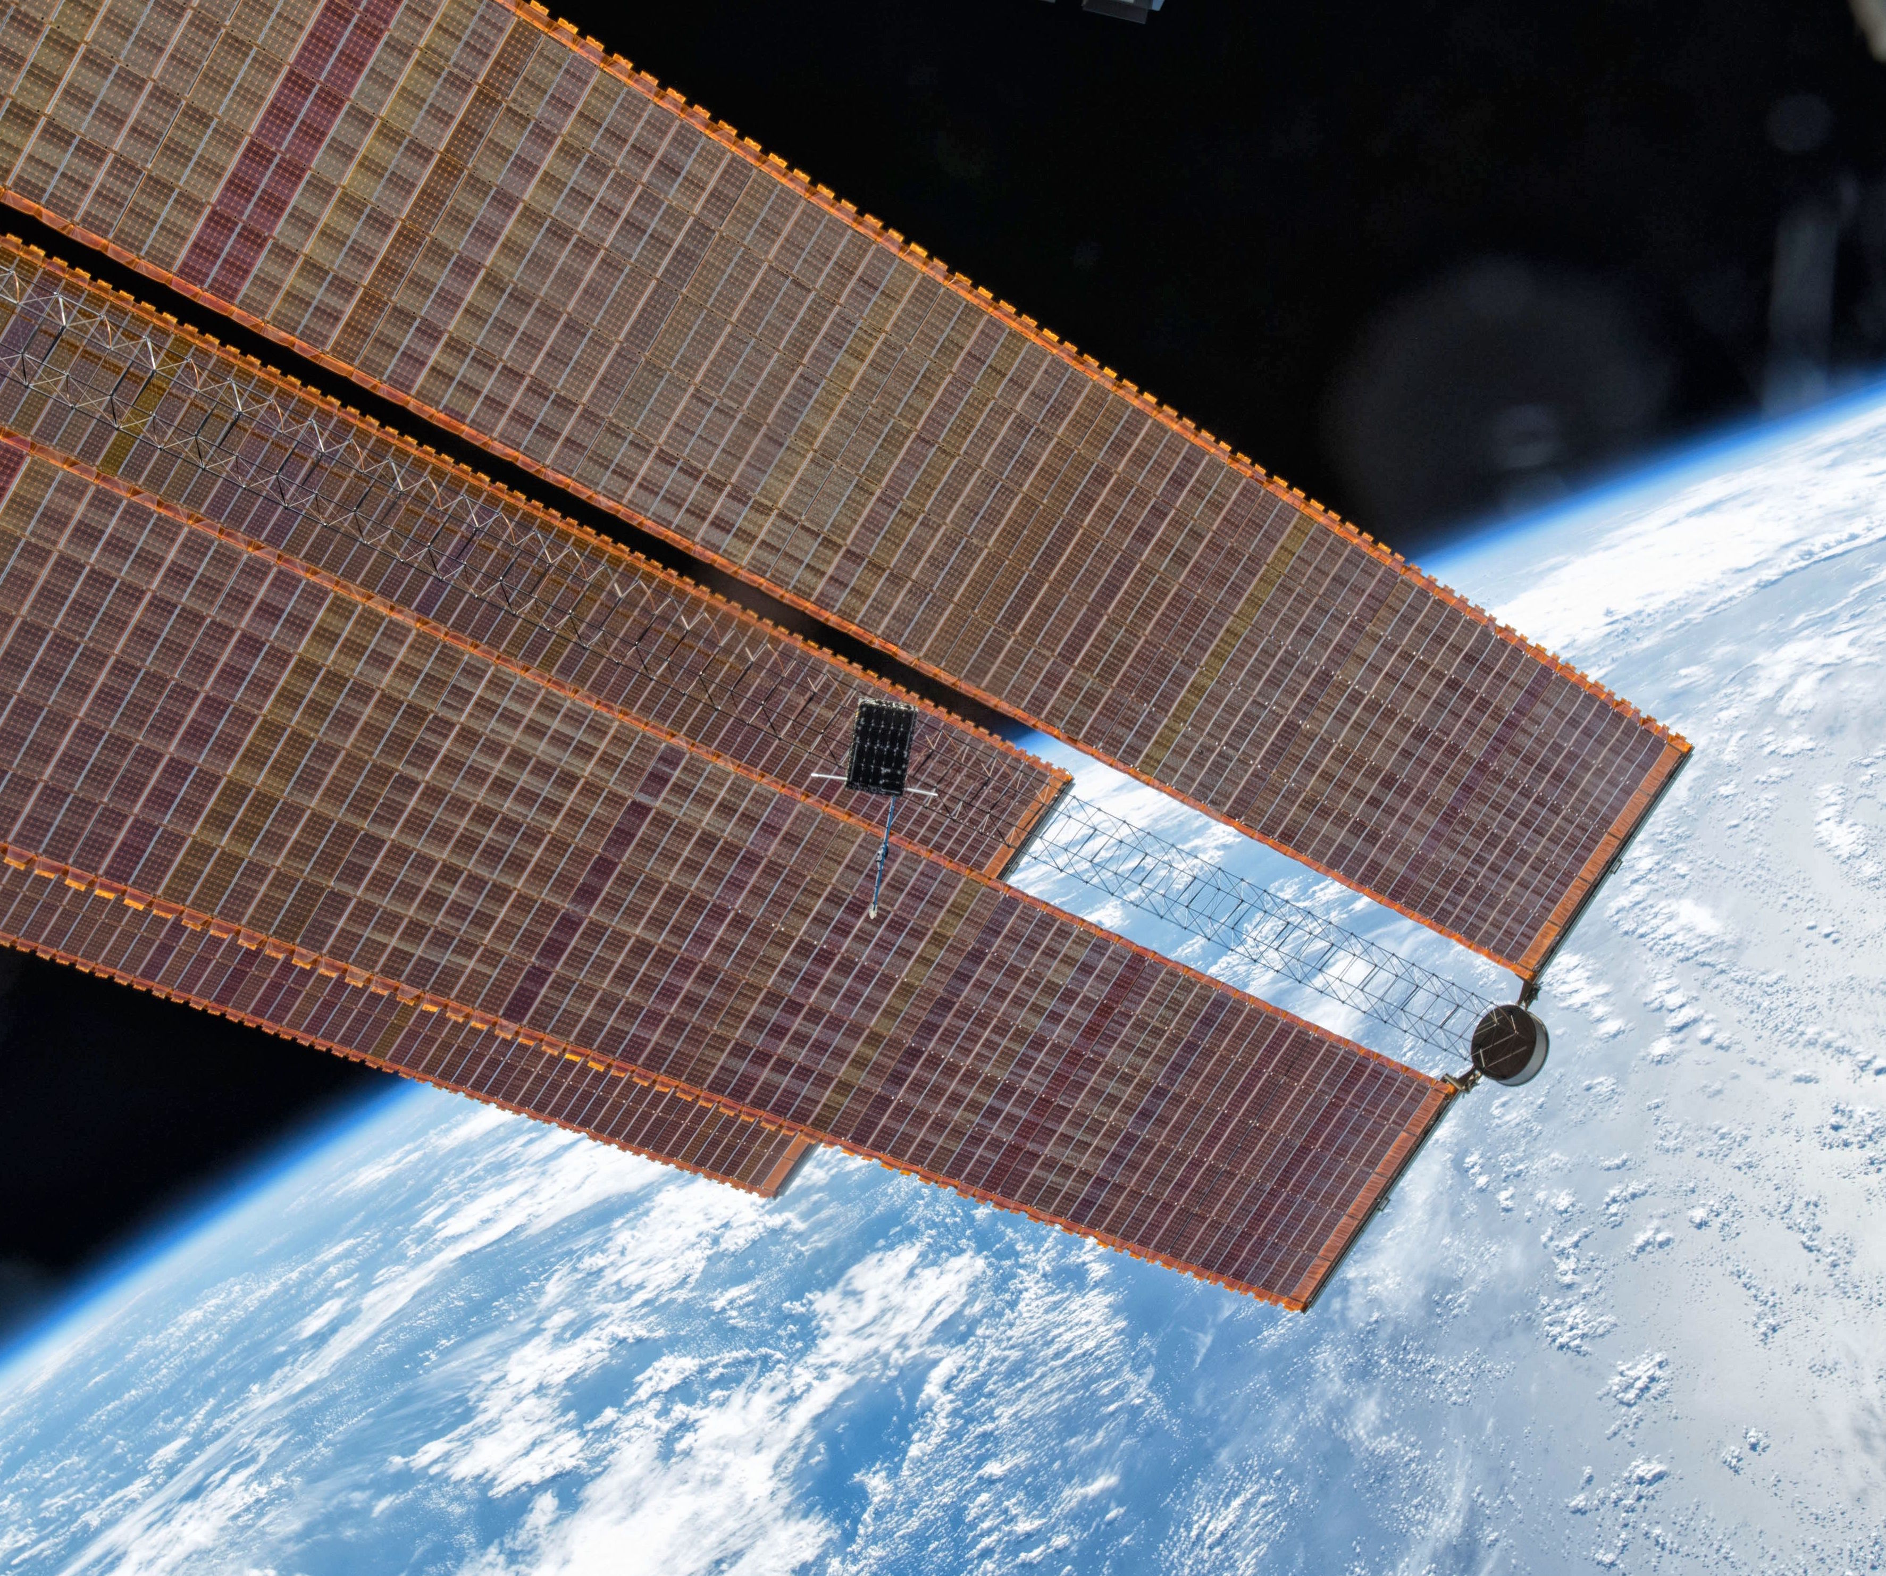
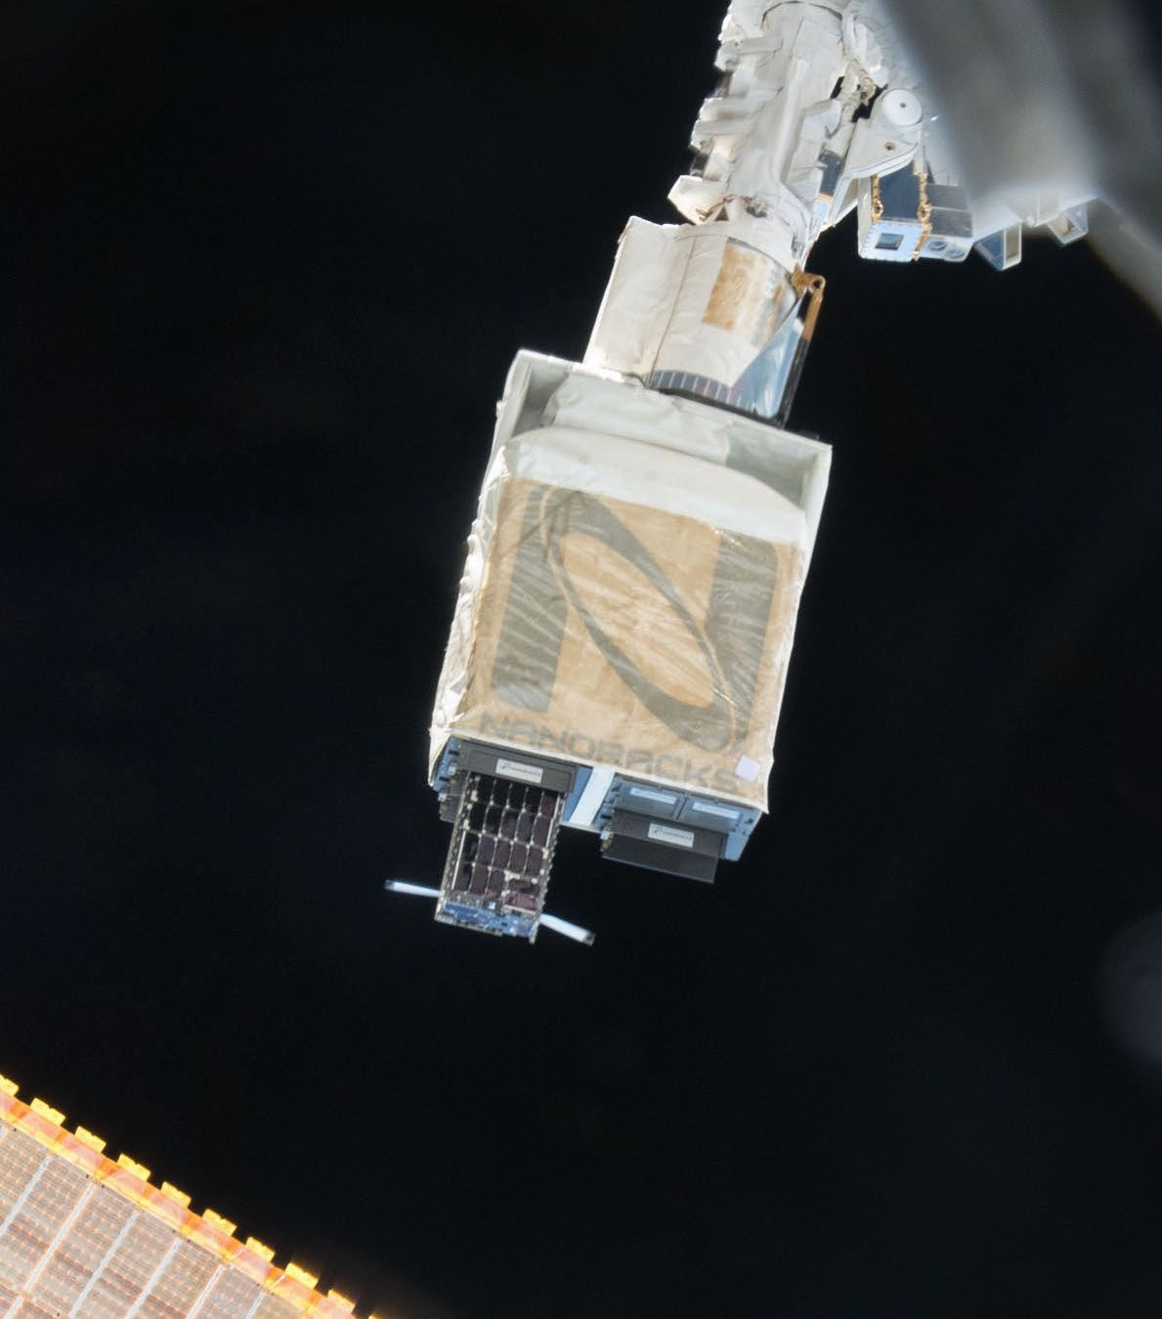
Mission Status
Dellingr was deployed from the International Space Station (ISS) on November 20, 2017 and is currently going through commissioning and checkout

Slide 18
Acronyms
Acronym | Meaning
ACS | Attitude Control System
CCSDS | Consultative Committee for Space Data Systems
CFDP | CCSDS File Delivery Protocol
cFS | core Flight System
cFE | core Flight Executive
CPU | Central Processing Unit
GDS | Goddard Dynamic Simulator
GPIO | General Purpose Input Output
GPS | Global Positioning System
GSFC | Goddard Space Flight Center
INMS | Ion Neutral Mass Spectrometer
ISS | International Space Station
OSAL | Operating System Abstraction Layer
PSP | Platform Support Package
PWM | Pulse Width Modulation
RTOS | Real Time Operating System
SHK | Spacecraft Housekeeping (cFS app)
SPI | Serial Peripheral Interface (bus)
SRAM | Synchronous Random Access Memory
UART | Universal Asynchronous Transmitter-Receiver

