Slide 1
A Cubesat-based alternative for the Juno Mission to Jupiter
FSW-17

Slide 2
Authors
Patrick H. Stakem, Johns Hopkins University, Capitol Technology University.
(pstakem1@jhu.edu)
Rodrigo Santos Valente Da Costa, Universidade Federal do Rio Grande do Sul, Johns Hopkins University, Capitol University of Technology.
Aryadne Rezende , Department of Computer Science of the Federal University of Uberlandia, Minas Geraiz, Brazil; Capitol Technology University.
Andre Ravazzi, Department of Computer Science of the Federal University of Uberlandia, Minas Geraiz, Brazil; Capitol Technology University.
Vishnu Chandrasenan, Graduate Student, Telecommunications Program,
Department of Electrical and Computer Engineering,, A. James Clark School of Engineering, University of Maryland-College Park.

Slide 3
Complexity of the problem
Jupiter has 67 known moons, and perhaps 1 million Trojans of 1 kilometer or larger. These tend to congregate at L4 and L5. The largest has a diameter of several hundred kilometers.
And then there’s the ring system. It’s made of dust. 4 distinct rings.
The one-way light time for Jupiter is 33-53 minutes.

Slide 4
The Project
A Summer Cubesat course in Summer, 2016 at Capital Technology University, as part of the Brazilian Scientific Mobility Program.
Continuing as a collaborative project over the Internet.

Slide 5
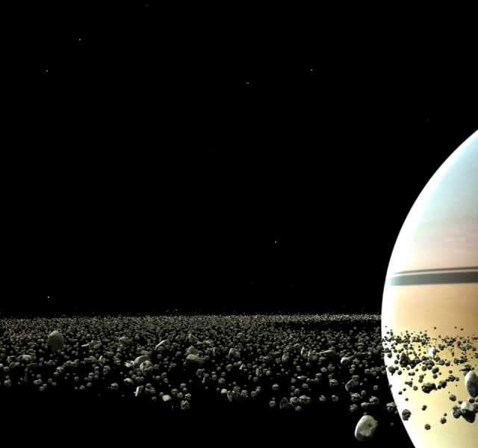
It’s crowded

Slide 6
Juno Mission
The Juno mission to Jupiter arrived after 5 years of travel. This project was launched in August of 2011, and arrived in July 2016. It was placed in elliptical polar orbit for 5 years, and will be de-orbited into Jupiter in February 2018. This is to avoid any biological contamination of Jupiter or its moons. It is scheduled to make 37 orbits of 53 days each. The orbit was chosen to minimize contact with Jupiter's intense trapped radiation belts. It's sensitive electronics are housed in “the Juno Radiation vault,” with 1cm titanium walls. It will have available to it some 435 watts of power, from the solar arrays.
The spacecraft has a launch mass of 3625 kg. It uses 3 solar panels of 2.7 x 8.9 meters long These will be exposed to about 4% of the sunlight at Earth. It left Florida on an Atlas-V vehicle. The perijove, or closest distance to the planet, was planned to be 4,200 km. The highest altitude at apojove is 8.1 million kilometers.

Slide 7
Juno
He spacecraft includes infrared and microwave instruments to measure the thermal radiation from Jupiter's atmosphere, being particularly interested in convection currents. It's data will be used to measure the water in Jupiter's atmosphere, and measure atmospheric temperature and composition, and track cloud motions. The mission will also map Jupiter's magnetic and gravity fields. It is expected to probe the magnetosphere in the polar regions and observe the auroras.
Communications uses X-band to support 50 Mbps of data. The spacecraft is constrained to 40 Mbytes of camera data per 11-day orbit period.
Juno uses a bi-propellant propulsion system (for insertion maneuvrers) and a monopropellant system for attitude control.)

Slide 8
Overview
A multi-cubesat mission within the envelope of the Juno Mission to Jupiter. Given size, weight, and power, how many Cubesats can we accommodate?
The “mothership,” a Cubesat dispenser, serves as a store-and-forward relay node to Earth.
Guesses on the number?

Slide 9
Cubesats accomodated
999 1-U
Actually, we decided to use 333-3U.
That allows for more battery power, and means each 3U will take up a dispenser, and not block other Cubesats.
Mothership is named “Pinesat” due to its appearance. It dispenses Cubesats radially.

Slide 10
Reuse
We tried to use as many components from the Juno mission as possible, to take advantage of the TRL.

Slide 11
Key software components
All flight computers including the RAD-750’s run Linux.
The RAD-750 in the Mothership hosts a relational database.
Each Cubesat node has a lightweight database.
All housekeeping data is in the form of Electronic Data Sheets, with dynamic and static data.

Slide 12
Communications
Communication between the mothership and the cubesats is wired or short range radio, before deployment.
Communications between deployed Cubesats and the mothership is probably S-band.
Inter-satellite link (ISL) – probably UHF.
Communications between the mothership and Earth is probably a bundle protocol, over X-band.

Slide 13
Mission scenario
During cruise, the Cubesats are switched off. Periodically, the Mothership turns them on, one at a time, and has them run a functional self-test. The database is updated accordingly.
Within the mothership, the Cubesats are networked with the Rad-750.
Upon arrival in the Jovian system, the mothership enters orbit, and assumes a gravity-gradient orientation.

Slide 14
On-site operations
The Mothership selects a Cubesat for the current observation, and has it run self-diagnostics. If it passes, it will be deployed.
The Cubesat is dispensed fully charged, but will have a limited lifetime.
The Mothership has at least the same sensor suite as the Cubesats. We have 334 sensor platforms.
All the Cubesats have the same bus, but varying instrumentation. This allows for a wide variety of phenomena-specific sensing, as well as multiple points-of-view.
Cubesat “suicide missions” plunge into the atmosphere and return data as long as they can.

Slide 15
Cluster of convenience
Within the Mothership, all of the Cubesats are networked to the main computer.
Using the Beowulf software or similar, a cluster computer can be formed with up to 334 nodes.
This would allow a software-based Probabilistic Neural Network (PNN) or similar to sort patterns in data, on site.

Slide 16
EDS
The electronic data sheets are instantiated in a relational database, with an imposed structure.
SQL in the mothership, SQL-lite in the Cubesats.
The advantage to this approach is, the position of a data item is also a piece of information. Data can be static or dynamic.
Mothership: 7? Cubesat: 5.1 (volts)

Slide 17
Mothership
Cubesat carrier and dispenser.
9.2 meters long by 1.8 meters in diameter.
Dry weight of 2,764 kg, assuming 333 Cubesats.

Slide 18
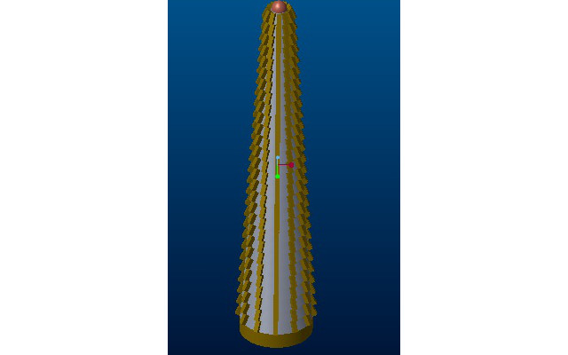
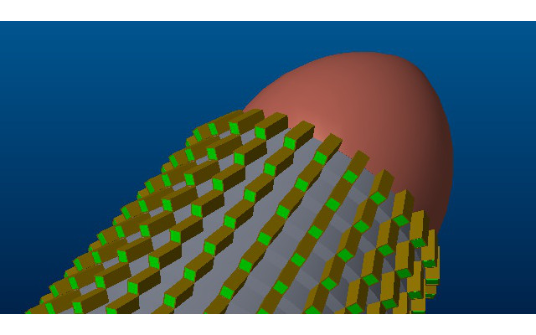
Pinesat dispensers

Slide 19
Cubesats
3U
Can have propulsion.
Similar to GSFC Pi-Sat.
Running Linux, CFE, CFS, SQL-lite.
Beowulf clustering software.

Slide 20
Cubesats
Explore, request help from mothership when needed.
Can do radio-occultation studies.
Observe same phenomena simultaneously from different points of view.
Conduct “suicide missions” plunging into the ring systems, or the planetary atmosphere.
Be able to address targets of opportunity, as Galileo s/c did for comet Shumaker-Levy.

Slide 21
Key software components
Open Source
Linux OS
NASA/GSFC CFE/CFS
SQL relational database
Beowulf, Message Passing Interface, Parallel Virtual Machine.
“Rad-hard software.”
Clustering software - Beowulf
Probabilistic Neural Network – classification and pattern recognition.

Slide 22
Rad-Hard Software
A vigorous suite of self-test and monitoring software.
Passive, like CRC’s and monitoring the current draw.
Active, like memory scrub and reset.
Test and remediate, if possible.
From collected best practices, and failure case studies.
Can add to, or change after launch, based on
Trending data and experience during flight.

Slide 23
Cubesat behavior
The Cubesats act as members of a co-operating Swarm. The collective behavior emerges from interactions between members.
This results in a diverse and agile architecture.
Reactive to local conditions, and targets of opportunity.
All units are peers.

Slide 24
What’s next?
We are expanding on this idea for a Asteroid Belt Mission. Here, the Cubesats would have their own solar arrays, and could use light sails for positioning. More Cubesats could be accommodated.
The Swarm approach is defined in:
Truszkowski, Walt; Clark, P. E.;, Curtis, S.; Rilee, M.; Marr, G. “ANTS: Exploring the Solar System with an Autonomous Nanotechnology Swarm,” J. Lunar and Planetary Science XXXIII (2002). Is being considered.

