Slide 1

Integrating CCSDS Electronic Data Sheets into Flight Software
Jonathan Wilmot
Jonathan.J.Wilmot@NASA.gov

Slide 2
CCSDS Electronic Data Sheet Definition
An Electronic Data Sheet (EDS) is a formal specification of a device, system, or software interface in a machine readable format
  Unambiguous and machine verifiable specification
  Delivered with the device, system, or software
  It is not an Interface Control Document (ICD) in that it does not specify how a system or mission will use the device or software
EDS specifies black box view of interfaces
  Data formats, conversions, limits, exchange protocols, and state machines, …
A CCSDS Spacecraft Onboard Interface Services (SOIS) EDS (SEDS) is an EDS defined using the SOIS Dictionary of Terms and the SOIS EDS XML schema
  Electronic Data Sheets and Common Dictionary of Terms - Overview and Rationale (Green 870.1)
  XML Specification for Electronic Data Sheets for Onboard Devices and Software Components (Magenta 876.0)
  Specification for Dictionary of Terms for Electronic Data Sheets for Onboard Components (Blue 876.1)
  SEDS schema and dictionary of terms are keep in SPACE ASSIGNED NUMBER AUTHORITY(SANA) REGISTRY http://sanaregistry.org/r/sois/sois.html

Slide 3
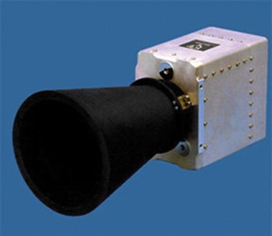
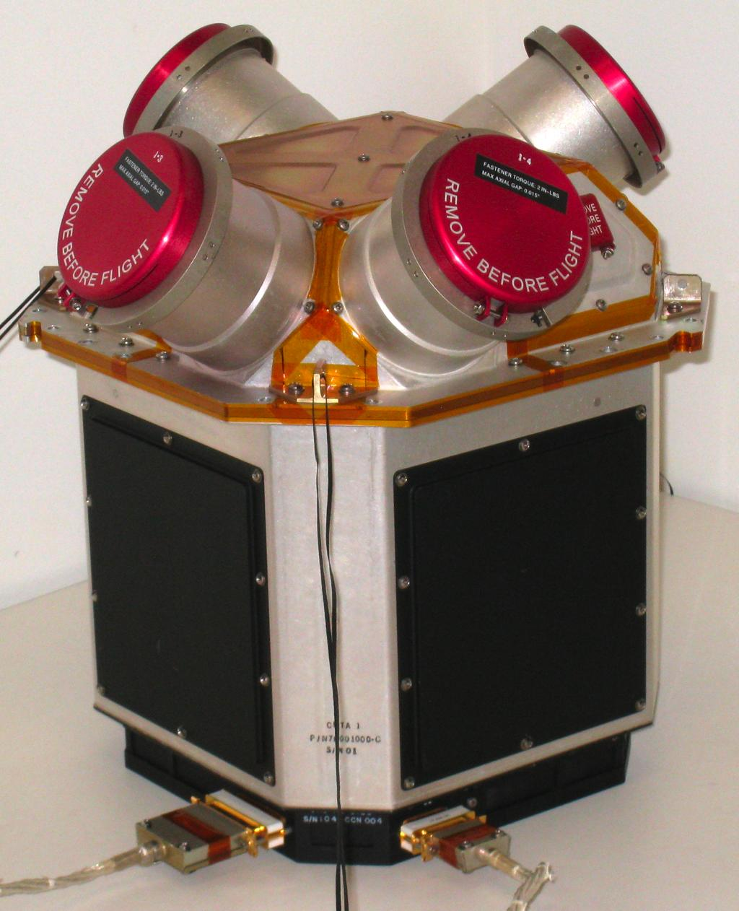

Device and Software Component EDS
Software Component
Software Component
Software Component
Star trackers
Thrusters
Sun sensors
EDS
EDS
EDS
EDS
EDS
EDS
Software tools
Vision: device manufactures provide an EDS with each component

Slide 4
Use in Early Mission Design
Automated tools used for device selection based on mission parameters
  Orbit, lifetime, performance…
Automated tools can generate system specs and cost estimates
Mission designers review specs and cost estimates and adjusts mission parameters
US Air Force Research Lab (AFRL) created prototype tools for this use case, Spacecraft Plug and Play (SPA)
EDS
EDS
EDS
Mission
parameters
EDS
database
Designer and/or tools
System specifications
Cost estimates
4

Slide 5
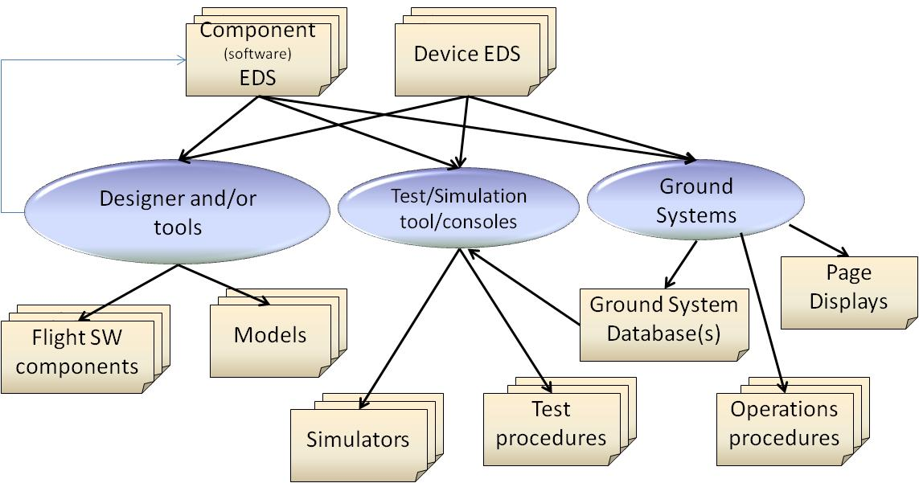
Development and Operations Use Cases
Models
Models
System
Models

Slide 6
Existing and Upcoming/proposed Tools
C headers
Flight
Software
ITOS
Database
ESA TASTE
Models
LUA Scripts
Device Drivers
JSC Cmd/Tlm CCDDT
COSMOS
Database
EDS
Component
tests
ASIST
Database
ITOS Page Displays
XTCE
Models Based Systems Engineering tools
JSON
demonstrated
Simulink
Data interfaces
Onboard Control Procedures
Proposed
6
This is a non-ITAR presentation, for public release and reproduction from FSW website.

Slide 7

EDS Use in NASA’s core Flight System (cFS) software
Free, open source, reliable
flight software

Slide 8
cFS Overview
Layered Architecture
Pub/Sub Messaging
Common Services
  Executive
  Time
  Message Bus
  Events
  Tables
  Files
Distributed systems
Time/Space Partitions
Applications and libraries can be stopped, restarted, removed, and reloaded dynamically at run-time
Go get it at https://cfs.gsfc.nasa.gov/
8

Slide 9
cFS Software Component
Each cFS component will have an associated SEDS
  Included in next release(6.6) of cFE and selected applications
SEDS specifies the data formats, conversions, limits, commands, telemetry, and exchange protocols in terms of the cFS Software Bus
  Protocols are in terms of command and response state machines
The SEDS will be included in the component directory structure and be Configuration Managed with the component
EDS
Software Component
9

Slide 10
EDS Is In Reference To What?
An EDS is in reference to the “on the wire” spec from the point of view of the publisher
A CFS Component EDS is written in terms of Big (Network) Endianness
  Run-time tools used to convert to other architectures
Big Endian
System
EDS
Software Component
EDS
Software Component
Network
interface
EDS
EDS
Software Component
Converter
Big Endian
System
Little Endian
System
10

Slide 11

Standardization along Communication Stack
EDS Referenced
Comm. Protocols
Cable
Hardware
or
squirrels
Comm. Cntrl.
Comm. Cntrl.
Connector
Electrical I/F
EDS Described
Function | Example
Software tasks communication (software architecture specific) | publish/subscribe, etc.
Data representation (EDS describes) | Counts to units conversion
Software drivers (EDS describes) | Hardware-to-software I/F
Box-to-Box comm. Protocols (EDS reference) | SpaceWire; 1553, etc.
Conn./cable & electrical I/F | 9 pin MDM, Cat5, LVDS
Application(s)
Application
Support
Message
Transfer
Service
Device Virtualization
Service
Device Access
Service
Data Link
Physical
11

Slide 12
Current cFS View of SEDS End to End
Mission
configuration
XTCE
database
Telemetry
monitors
comm
EDS
EDS
EDS
Ground Systems
EDS
Software Bus
EDS
Reaction
Wheel
File
Manager
Star Tracker
EDS
EDS
RTU driver
EDS
EDS
EDS
Command
EDS
Telemetry
CFDP File
Transfer
comm
EDS
SOIS
Stack
EDS
HW
EDS
RTU
Mass
Storage
File meta data
EDS
EDS
EDS
HW
thermistor
thermistor
1451
HW
1451
12

Slide 13
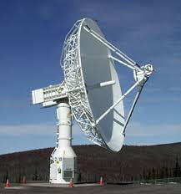
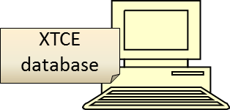
Components and Build Time Parameters
Each device and software component includes an associated SEDS
SEDS specifies the data formats, conversions, limits, commands, telemetry, and exchange protocols in terms of the message bus and/or hardware interface
Some parameter values in the message packet EDS are determined at build time
  The original component EDS author does not know these values
  Values are defined in mission deployment files
  The values will be set by a tool that reads the mission files and creates a software component header file at build time
  The EDS Schema has mechanisms for this
EDS
Hardware Component
EDS
EDS
Hardware device
Hardware device
EDS
Library
Software Component
Software Component
Tools
Software Component
Mission
Configuration
Control center
13

Slide 14
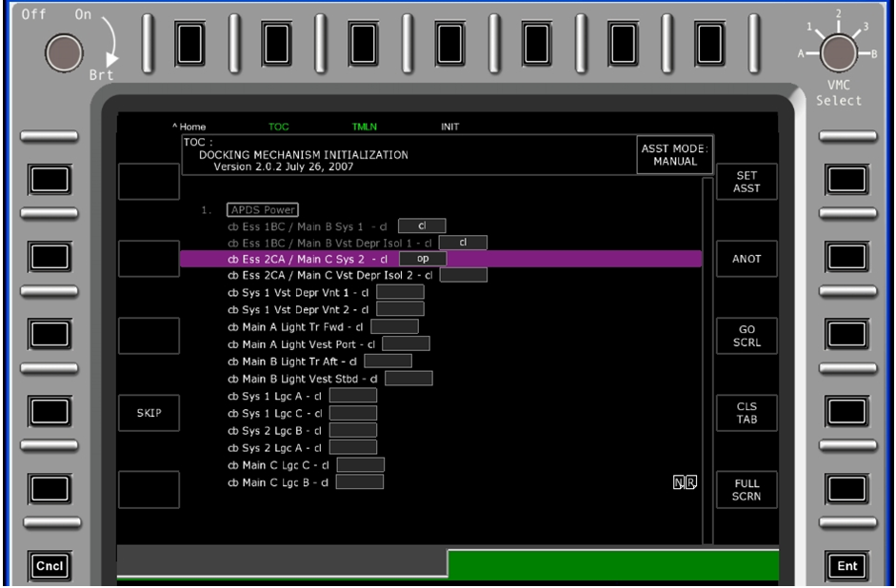
Run-time use of an EDS
Assume a common and generic portable crew command and display console with a network interface
Connect the console to a system or subsystem port, perform a a system query and retrieve the command and telemetry EDSs for the system
  Use proper security, no R2D2 shenanigans
User can now:
  Send commands
  Receive and view telemetry
  Run electronic procedures
Console interface can be common to
  habitats, landers
  surface systems, rovers
  Any other subsystems
13

Slide 15
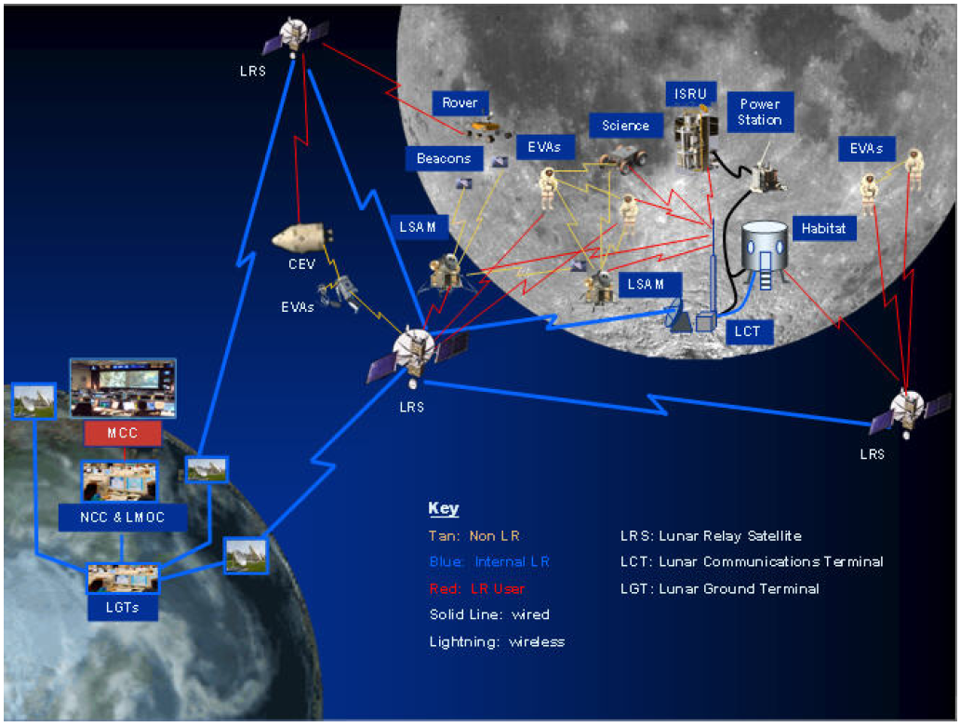
CCSDS SOIS EDS provides a standard mechanism to exchange interface & data definitions and automate many aspects of system development

Slide 16
Thank You.
Questions?

Slide 17
Acronyms

