Slide 1
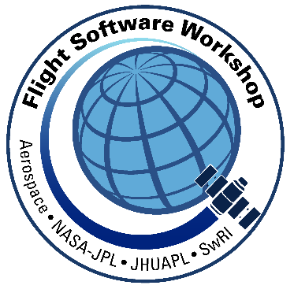
Flight Software Metrics Assessments

Slide 2
Flight Software Verification Metrics
Security
  Example rules, test scenarios, file format, and documentation are normally unmarked and openly accessible. Verification the development and deliverables meet security requirements is currently undefined.
Coding Standard
  “Utilization of static code analysis tools to verify compliance with coding standard.”
Maintenance and Documentation
  In addition to coding standard, what coding practices can be required and verified by analysis tools?
Static Code Analysis
  All of the above can be verified manually, however, tools and automation increase the quality and efficiency of verification.
Randomized Testing
  “Monte Carlo” stress testing of critical components.
Formal Model (SPIN)
  A formal logic modeling to verify critical logic.
Verification Coverage
  Instrumented code to determine quality of verification of software through software system test.
This is a non-ITAR presentation, for public release and reproduction from FSW website.

Slide 3
Security Issue
What security is necessary for…
the data format and rule protocol documentation?
the tools used to generate, validate, and verify the rules?
the rule file itself?
the transmission/deployment of the rule file to the flight system?
The response received from the developers indicated this security was outside the scope of the software; security issues were the responsibility of hardware and software external to the software.
However, example rules, test scenarios, file format, and documentation was unmarked and openly accessible.
Verification Metrics?
This is a non-ITAR presentation, for public release and reproduction from FSW website.

Slide 4
Lack of Critical Software Coding Standard
Recent recommendations from CCP and the NESC:
  The Commercial Crew Program (CCP) software failure tolerance interpretation letter: “Utilization of static code analysis tools to verify compliance with coding standard.”
  NESC alternative software development: “For human-rated software certification, an industry-recognized safety coding standard should be applied that can be independently verified by automated analysis tools to reduce the risk to LOC/LOM [loss of crew/loss of mission] that unsafe coding sequences exist within the code.”
The Software Design Document:
  "Though C++ is a suboptimal language for use in safety critical systems, deficiencies in the language are mitigated to an acceptable level by adherence to the MISRA C++:2008 coding standard, testing, and IV&V of the software."
What is “acceptable level”?
MISRA C++ language compliance and independent verification and validation (IV&V) techniques can remedy the weakness to some extent, but when C++ is used for safety critical code one often sees much stronger types of restrictions imposed to reduce risk and improve test-thoroughness. For example, one often disallows the use of C++ exception handling, the use of multiple/virtual inheritance, the use of runtime type information (RTTI), and one restricts the use of the Standard Template Library (STL) instantiations and template elements. It does not appear that similar restrictions were imposed on the C++ code for CASS, which makes the code harder to analyze than would have been possible.
This is a non-ITAR presentation, for public release and reproduction from FSW website.

Slide 5
Critical Software Coding Standards
DO-178B and C Software Considerations in Airborne Systems and Equipment Certification, a guideline dealing with the safety-critical software used in certain airborne systems. Although technically a guideline, it is considered a standard for developing avionics software systems: 216 Objectives
JSF C++ Joint Strike Fighter Aircraft: 154 Rules
MISRA C / MISRA C++ MISRA coding guideline was originally defined for the development of embedded code in automobiles, but is today used broadly for safety critical applications: 143 / 229 Rules
SEI Cert-C / Cert-Cpp, provides rules for secure coding in the C/Cpp programming language. The goal of these rules and recommendations is to develop safe, reliable, and secure systems, for example by eliminating undefined behaviors that can lead to undefined program behaviors and exploitable vulnerabilities: 99 / 82 Rules
JPL Institutional Coding Standard for the C Programming Language, coding rules that primarily target the development of mission critical flight software written in the C programming language. This means that the rules are focused on embedded software applications, which generally operate under stricter resource constraints than, e.g., ground software: 120 Rules
Power of Ten, these guidelines state how software should be structured and which language features should and should not be used: 10 Rules
Goddard Flight Software Branch coding standard, Coding standard for the GSFC Code 580 Software Branch: 200 Rules
Common Weakness Enumeration (CWE™) is a list of software weaknesses types - https://cwe.mitre.org/data/index.html
This is a non-ITAR presentation, for public release and reproduction from FSW website.

Slide 6
Conformance to Critical Software Coding Standards
The following quote from the author of the second edition of the CERT C Coding Standard for software security issues describes what static analysis for conformance can imply:
“While the application of these rules and recommendations does not guarantee the security of a software system, it does tell you a great deal about the quality and security of the code. It tells
you that the software was developed to a set of industry standard rules and recommendations that were developed by the leading experts in the field. It tells you that a tremendous amount of time
and effort went into producing code that is free from the common coding errors that have resulted
in numerous vulnerabilities that have been reported to and published by the CERT Coordination
Center over the past two decades. It tells you that the software developers who produced the
code have done so with a real knowledge of the types of vulnerabilities that can exist and the
exploits that can be used against them, and consequently have developed the software with
a real security mindset.”
The CERT C Coding Standard for software security copies numerous rules from the MISRA C Guidelines, and adds specific security rules. The implications stated above could apply, just as well, to code quality and code safety.
This is a non-ITAR presentation, for public release and reproduction from FSW website.

Slide 7
Static Program Analysis
Static program analysis is the analysis of computer software that is performed without actually executing programs (analysis performed on executing programs is known as dynamic analysis). In most cases the analysis is performed on some version of the source code, and in the other cases, some form of the object code.
It has been found effective manual code inspections were limited to about 300 lines of code per inspector per day. Any more than this line count rate resulted in ineffectual reviews that resulted in an increase of missed defects. As project code size increased (2,300,000 LOC in Orion, 24,000,000 LOC in the JSF F-35) manual inspections were limited in effectiveness.
The software discipline has now progressed to automated code inspections where an analysis program can be used to look for coding defects that were previously detected by manual inspection. Applying these tools, defects can be identified early in development, including defects that are commonly missed in the verification of the software during simulation and testing.
Commonly, these tools report issues that reduce the manual inspection effort. For example, a program consisting of 25,000 lines of code might be analyzed by these tools in a matter of hours. The tool report might specify 500 issues. These 500 issues would then be reviewed and analyzed by the development team to determine if any action is required for each issue.
This is a non-ITAR presentation, for public release and reproduction from FSW website.

Slide 8
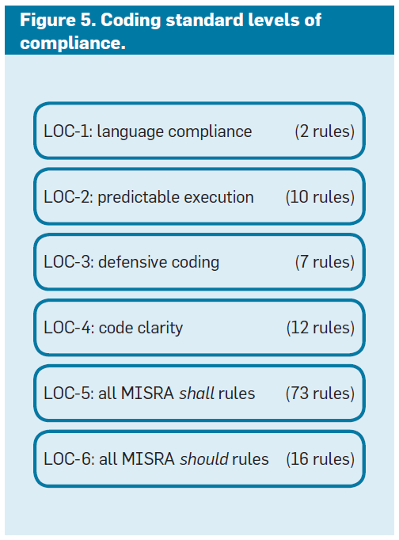
MSL Peer Reviews and Tool Reports Metrics
In 145 code reviews held between 2008 and 2012 for MSL flight software, approximately 10,000 peer comments and 30,000 tool-generated reports were discussed. Approximately 84% of all comments and tool reports led to changes in the code to address the underlying concerns. There was less than 2% difference in this rate between the peer-generated and the tool-generated reports. Explicit disagree responses from the module owner occurred in just 12.3% of the cases. The responses
were overruled in the final code review session in 33% of those cases, leading to a required fix anyway. A discuss response was given for just 6.4% of all comments and reports, leading to a change in the code in approximately 60% of those cases.
These statistics from the MSL code review process illustrate that the large majority of comments and tool reports led to immediately agreed-upon changes to the code and did not require discussion in the code review close-out meetings. The time saved allowed us to push the code-review process further than would have been possible otherwise. Critical modules, for instance, could now be reviewed multiple times before the code was finalized for launch.
http://spinroot.com/gerard/pdf/cacm_2014.pdf
This is a non-ITAR presentation, for public release and reproduction from FSW website.

Slide 9
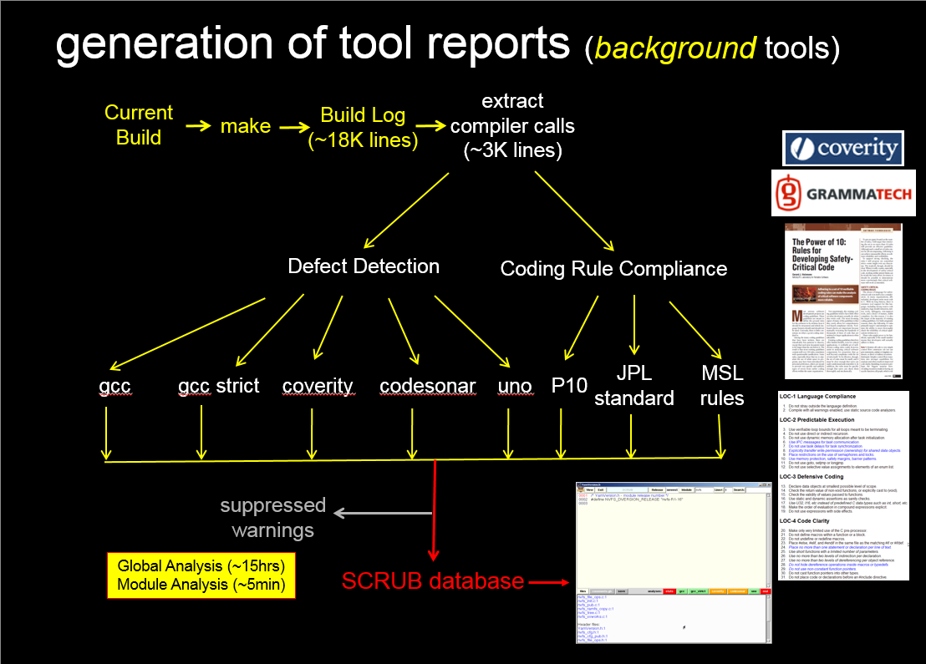
SCRUB (Source Code Review User Browser) Tool
This is a non-ITAR presentation, for public release and reproduction from FSW website.

Slide 10
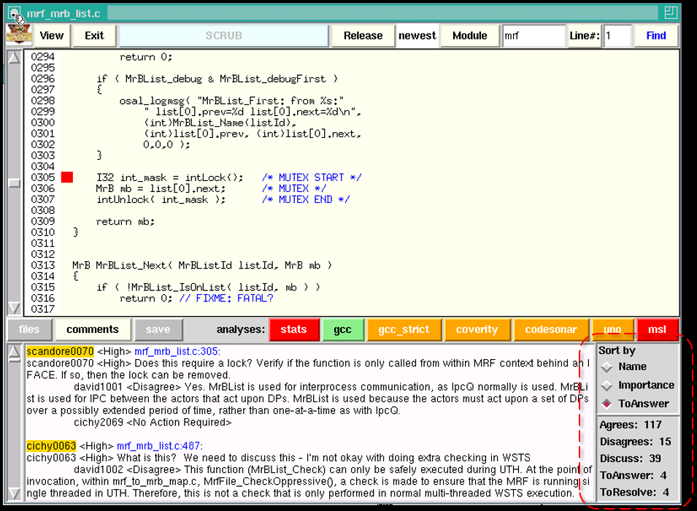
Mars Science Laboratory (MSL) SCRUB Tool Process
Tool-based analysis reports are generated for each version of the code checked into the version management system, so no separate step to generate these reports is required: they are always available, and archived for every version of the code.
The code review process supported by the SCRUB tool consists of three phases.
Review: peer reviewers study the code and enter their comments and observations into the SCRUB tool.
Response: the developer responds to all reports, indicating agreement, disagreement, or the need for more information.
Resolution: a resolution is reached on all pending issues, specifically on disagreements between the developer and the peer reviewers’ comments and tool reports.
Innovations in Systems and Software Engineering, 2010, Vol. 6, No. 4, pp. 311-318.
This is a non-ITAR presentation, for public release and reproduction from FSW website.

Slide 11
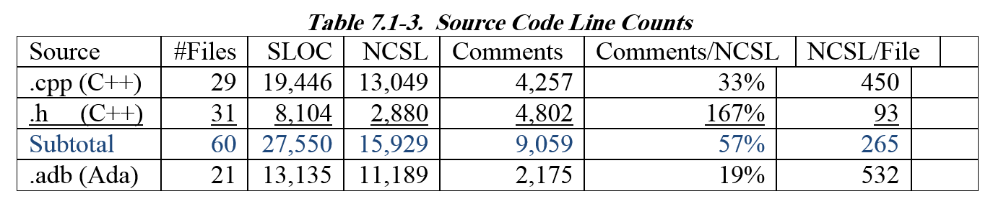
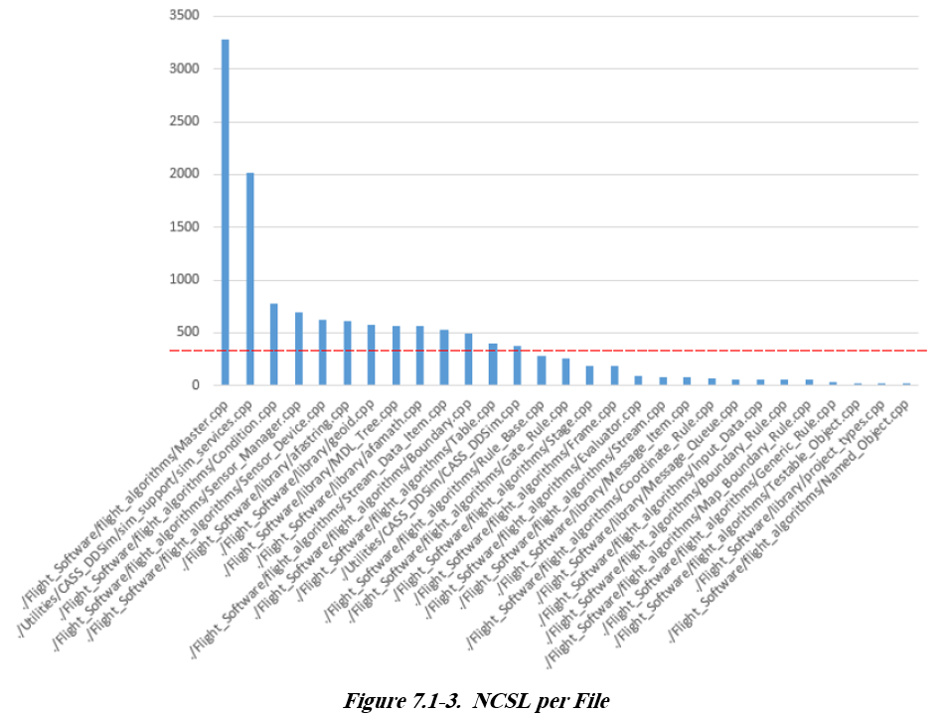
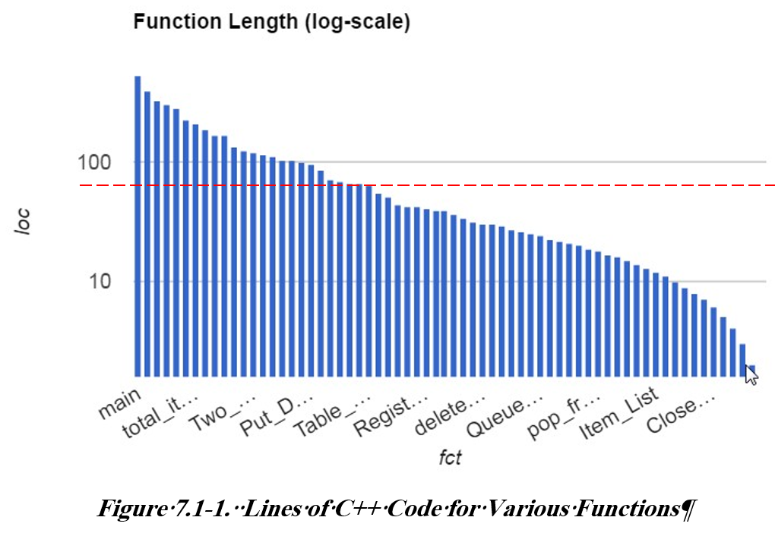
Other Checks and Metrics
Percentage of comments per executable lines of code less than recommended for safety critical code.
Lines of code in each file exceeds recommended maximum.
Lines of code in each function exceeds recommended maximum.
Test assertions per lines of code less than recommended density.
Variable exceeds necessary scope.
Function/Procedure is not documented with Doxygen template
This is a non-ITAR presentation, for public release and reproduction from FSW website.

Slide 12
Randomized Testing
Example:
The data.txt file from the demo directory included an input data example. As an input demonstration, this file cannot necessarily be used to assess the FSW behavior during flight inputs, but it was used to stimulate the software under stress conditions.
Randomized tests were defined by modifying the example position or velocity data, and checking whether the FSW handled the modified values appropriately. The modified file was created using a script that randomly selected data columns of positions or velocities, and replaces values between liftoff and end of mission with different linearly interpolated nominal or randomly chosen off-nominal values. This was in essence a Monte Carlo technique to stress the FSW.
In this manner, 17,744 random tests, simulating nominal and off-nominal flight conditions, were input to the FSW. The FSW behavior was verified against five invariant conditions for each run.
One discrepancy was an apparent violation of an invariant condition. The check failed in 37 of the 17,744 runs. According to the FSW documentation, When in the DISABLED state, no state transitions should occur. A log of the sequence of internally commanded transitions from the state machine listed a transitioned from ARM ON, set earlier in the sequence, to ARM OFF, while in the DISABLED state.
This is a non-ITAR presentation, for public release and reproduction from FSW website.

Slide 13
Formal Model Analysis by SPIN
SPIN is a generic verification system that supports the design and verification of asynchronous process systems. SPIN verification models are focused on proving the correctness of process interactions.
As a formal methods tool, SPIN aims to provide:
An intuitive, program-like notation for specifying design choices unambiguously, without implementation detail.
A powerful, concise notation for expressing general correctness requirements.
A methodology for establishing the logical consistency of the design choices from 1) and the matching correctness requirements from 2).
The following describes the process of building a formal model of the sensors variables and rules. The termination rules, as defined in the .xml file, were rewritten as a formal SPIN verification model. To do so, all relevant variables (i.e., sensor outputs/states) on which the rules depend were modeled in a non-deterministic environment model.
The model non-deterministically assigns valid values in the smallest possible number of relevant ranges to fully exercise the conditionals defined in the rules. This is similar to Monte Carlo analysis used in verifying physical models. Independent Boolean values that were not explicitly set in the rules were non-deterministically given true or false.
In this manner, all possible modeled states for the system inputs were exercised. The integer values, selected from within their boundary ranges, and the Boolean variables, set true or false, covered all possible value combinations.
If specific invariants were documented about invalid or incorrect rule states, then any set of safety rules could be verified by the model checker. These invariants were not available for this assessment. The model checker could answer general queries of the type, "Is it possible to reach a state where X is true?" or "Is there a scenario where X is always false and Y eventually becomes true?"
This is a non-ITAR presentation, for public release and reproduction from FSW website.

Slide 14
Statement Coverage, Decision Coverage
4 key benefits of structural coverage (statement coverage, decision coverage) for DO-178B systems
Each requirement has one or more tests to prove that it has been implemented correctly. Structural coverage (according to DO-178B this will be statement coverage, decision coverage) is used to prove that these tests exercise all of the code
If you don’t get 100% coverage:
There’s a requirement missing. The code that hasn’t been covered is performing an essential activity, but no requirement indicates that this should be done.
  Action: need to add a new requirement (and associated tests).
There’s a test missing. The code that hasn’t been covered relates to an existing requirement, but no test was implemented for it.
  Action: add a new test.
Extraneous/dead code. The code that hasn’t been covered is not traceable to any requirement and isn’t needed by the application.
  Action: remove the code.
Deactivated code. The code that hasn’t been covered isn’t traceable to any requirements for the current system, but is intended to be executed in certain configurations.
  Action: show that a configuration exists in which the code will execute.
This means that in the context of requirements-based testing (like DO-178B requires), performing structural coverage has four key benefits:
  requirements are complete (with respect to the code);
  tests are complete;
  no code is deployed that shouldn’t be there;
  code for use in other configurations is clearly identified.
This is a non-ITAR presentation, for public release and reproduction from FSW website.

Slide 15
Static Analysis Documentation/Metrics Summary
Security
  Static analysis tool to verify security of flight and ground code. Secure marking for code that exposes security operations. Security of code itself. Security of uploads from development through deployment.
  Metrics: Pass/Fail
Coding Standard
  Well defined rules or guidelines selected from industry accepted coding standards.
  Manual Review Metrics: Compliance, deviations, actionable issues, missed issues (can be added to the existing rules and guidelines)
Maintenance
  Well defined rules or guidelines viewed as valuable to the mission. Maintenance, clarity, unit testing, documentation, constraints, can also be defined.
  Metrics: Comment percentage, assert percentage, file size, function/procedure size, missing Doxygen template, memory allocation, exception processing, defects per function/procedure,...
Static Code Analysis
  Specific rules or guidelines selected from one or several coding standards. Verification through commercial or in-house analysis tools.
  Tool Metrics: Tool reported issues, actionable issues, missed issues (can be added to the existing rules and guidelines)
Randomized Testing
  Non-Realtime “Monte Carlo” analysis of critical code. Stress testing of critical code.
  Metrics: “Monte Carlo” runs, pass/fail, failure recreation, ...
Formal Model (SPIN)
  A formal logic model analysis of critical code to test assertions of the design, such as “Armed and Safed can never be asserted in the same state”.
  Metrics: Paths analyzed, pass/fail, assertions tested, failed assertion recreation, ...
Verification Coverage
  Path Coverage, Decision Coverage, Unit test coverage, Component test coverage, Software system coverage.
  Metrics: Coverage percentage, dead code, missing requirement, missing verification, configuration specific code.
This is a non-ITAR presentation, for public release and reproduction from FSW website.

Slide 16
NESC Forward Work
Access to Static Analysis Tools
  SWAMP Portal behind NASA Firewall
    ARC, GFSC, IV&V installations are up.
    https://continuousassurance.org/
  Fortify Static Analysis Tool Licenses are available
    https://nen.nasa.gov/documents/1532799/2021073/ToolNotes_Fortify_v0_1.pdf/498afdbd-4836-4ad0-ad59-c24552ba14b8
  SCRUB Tool source code in the works
  Static Analysis Expertise at IV&V
Access to Code Coverage Tools
  Code Coverage Tool Expertise
  Allow Instrumented Code!
Documentation from Source Code (Doxygen)
  Doxygen Expertise
This is a non-ITAR presentation, for public release and reproduction from FSW website.

