Slide 1
Autonomous Vehicles Commonalities in state of the art Cars and Spacecrafts
Christian Fidi Product Manager
2017/05/12
Flight Software Workshop 2017

Slide 2
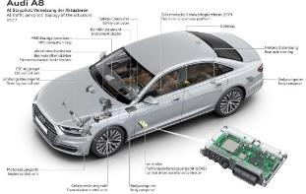
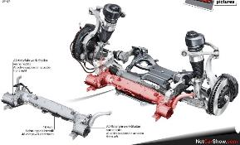
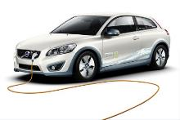
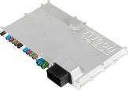
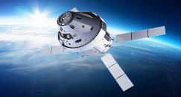
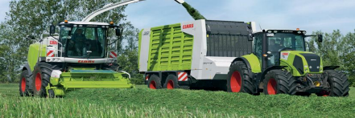
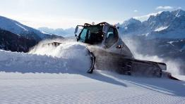
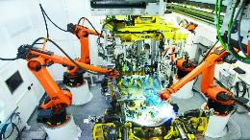
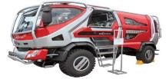
Safety Control and Networking Reference Projects
Audi/VW zFAS: First Level 3 Autonomous Driving System
Audi A8 eABC: ECU for first Electro.-mech. active chassis
Volvo C30 electric: Inverter safety control
Level 4/5 automated driving projects
NASA Orion; Network
Ariane 6:
SoC
Boeing 787: Network
Airbus A380: Network
Embraer E2: Fly-by-wire
Vestas: Safety Control Platform
Morita Fire fighter: ECU
Claas: Ethernet Controller, Firewall
Automated driving for farming machines
Prinoth Snowgroomer
Kuka: Edge/Fog Computing

Slide 3
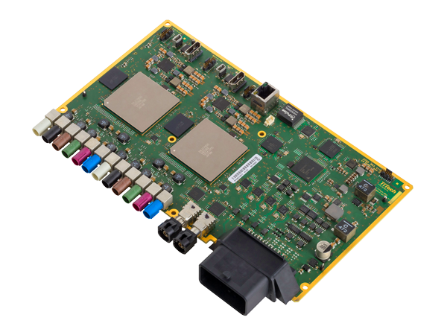
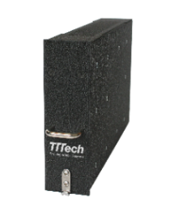
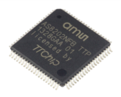
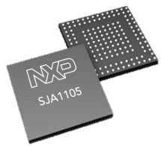
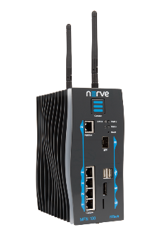
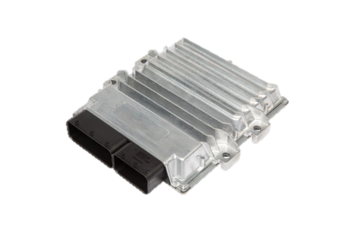
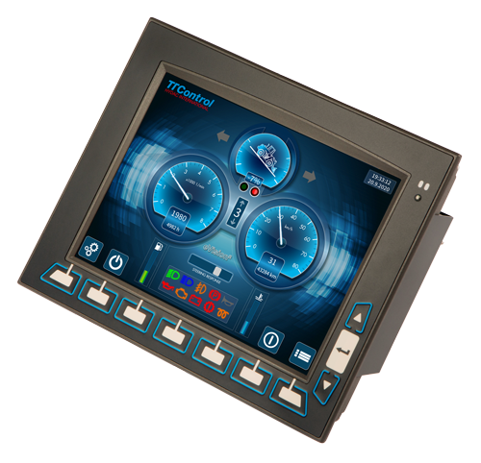
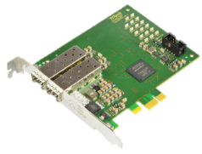
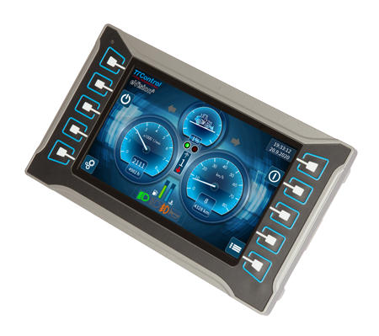
Cross-industry synergies
Highest safety and certification
Safety and
high-volume
TTEthernet ARINC 664 switch
Communication controller
Advanced Driver Assistance Systems platform
Switch IP design for Ethernet
Aerospace
Automotive
Networking
and Controls
Flexibility and
reliability
Reliability and robustness
Fog
computing
Network interface card
for industrial PCs
High-end ECU
Industrial
Off-Highway
Notes:
Farbgebung? Bunt oder grau/blau

Slide 4
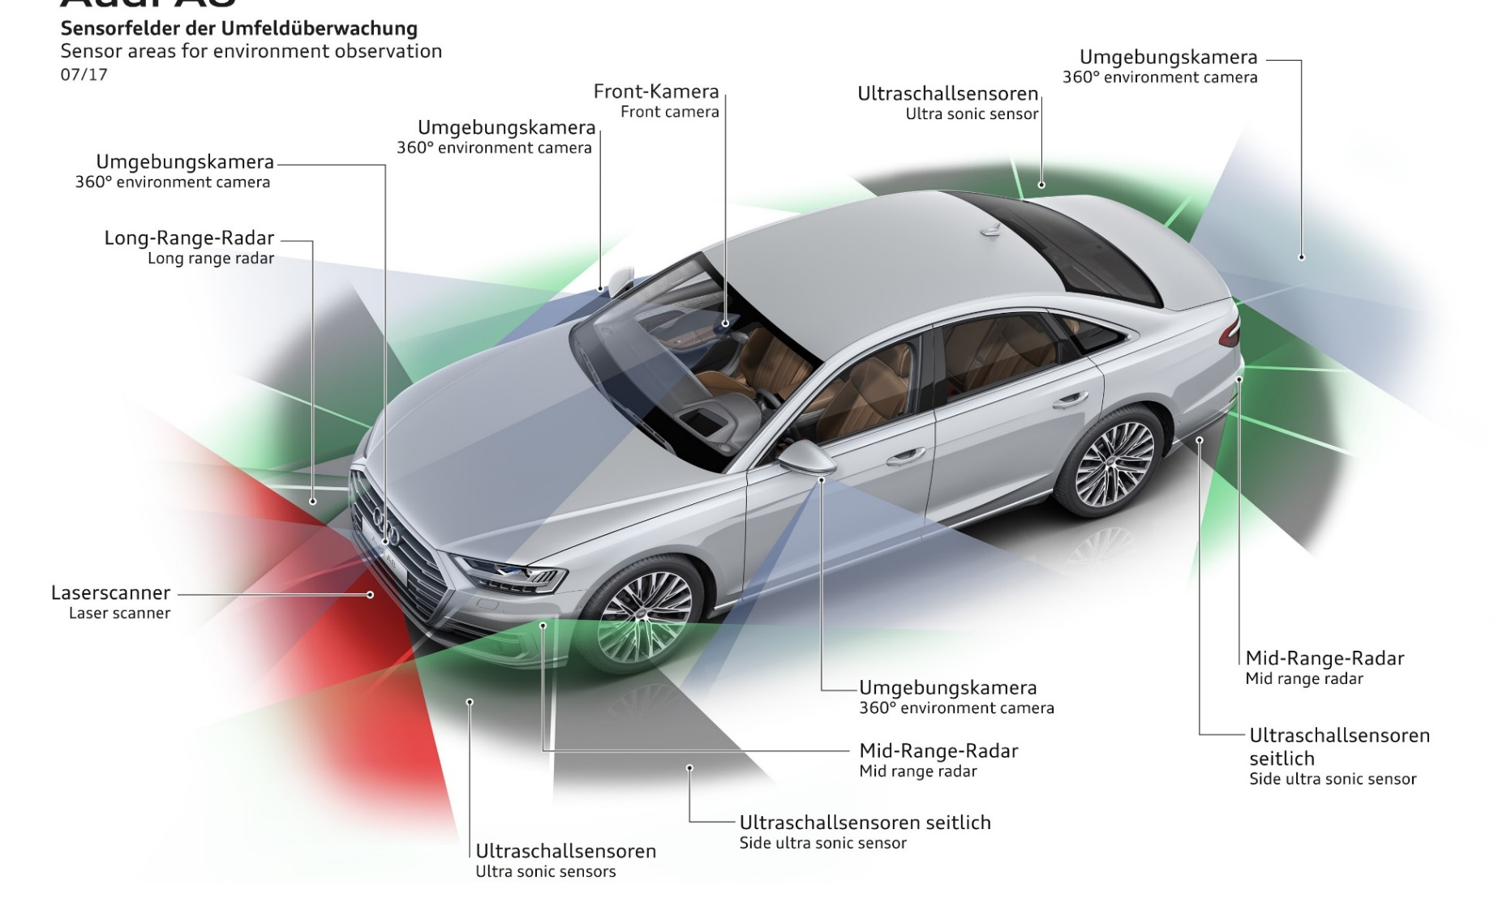
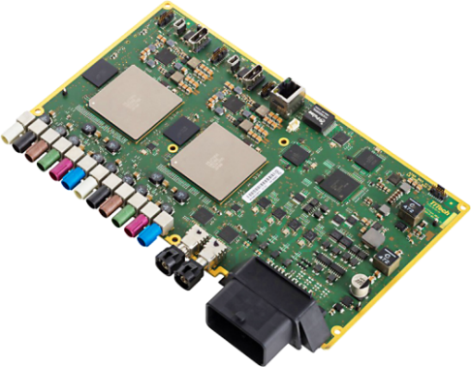
TTTech provides the safe software and communication platform for the new
Audi A8 where all sensory data are processed and driving
decisions are taken
First Level 3 Automated Driving System

Slide 5
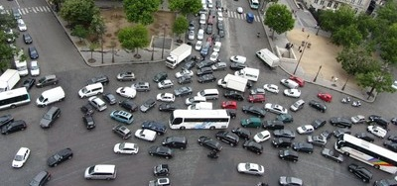
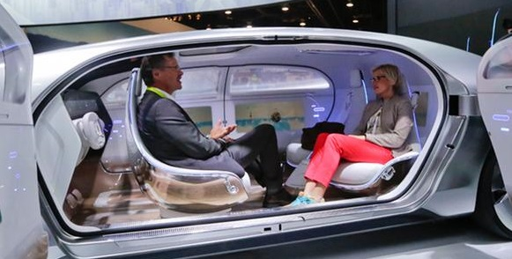
The need for Safety and Fail-Operational
Functionality
Customer Acceptance
Legislation
Cost
Compute Performance
Safety

Slide 6
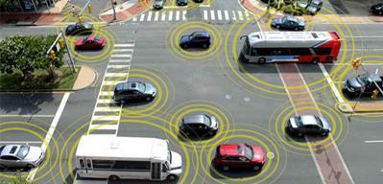
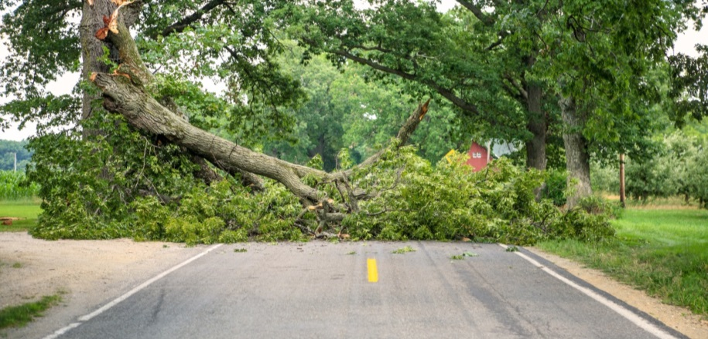
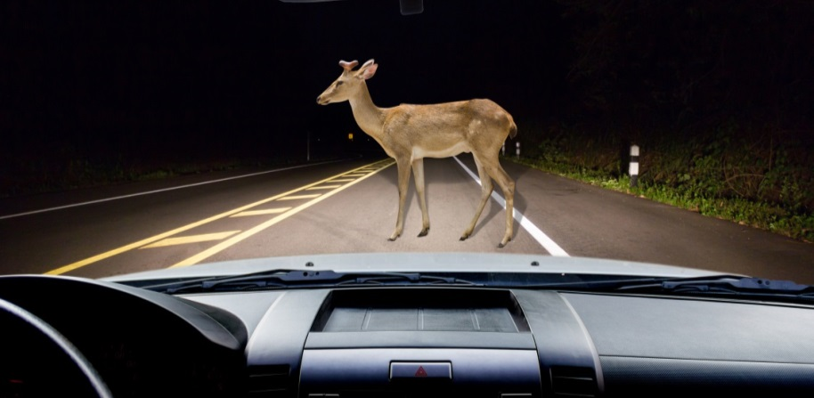
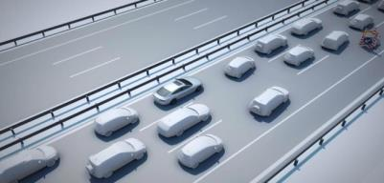
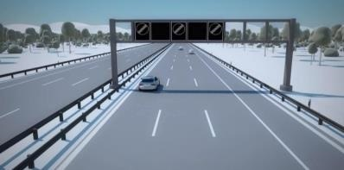
The need for Safety and Fail-Operational
Safe Operation in normal scenarios
… and in rare scenarios
Lane change to the side and stopping
Stop the car avoiding obstacles

Slide 7
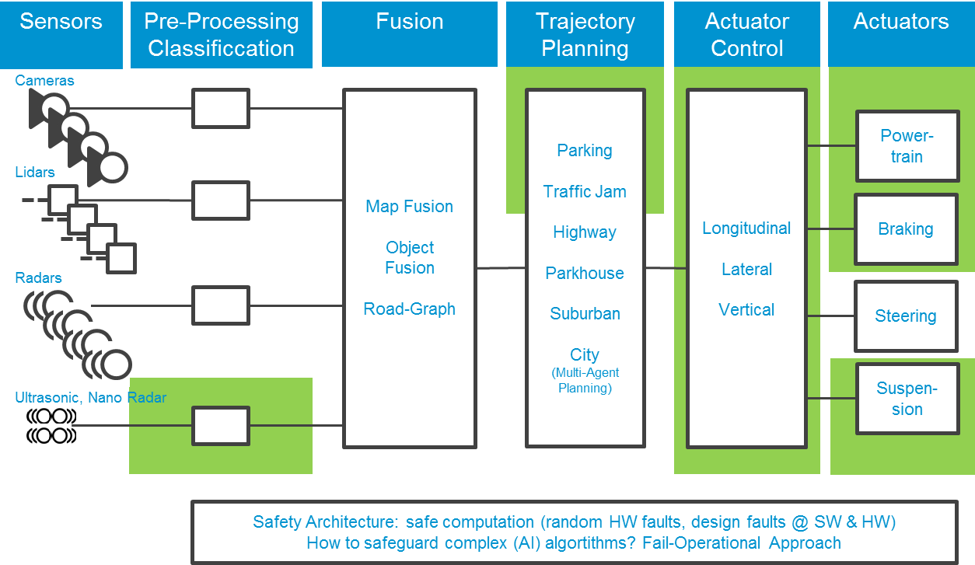
The Autonomous Driving Challenge Heatmap
12/5/2017
7

Slide 8
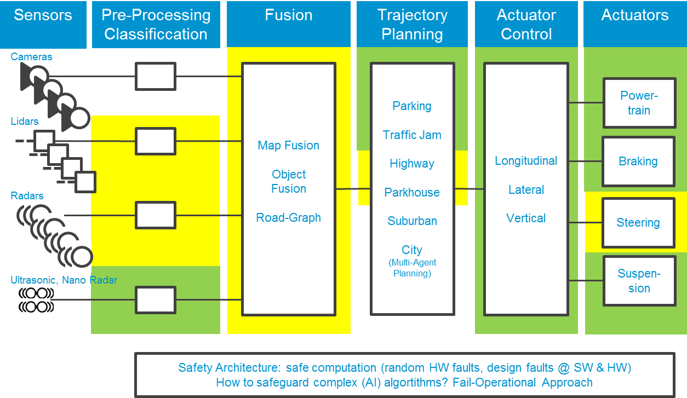
The Autonomous Driving Challenge Heatmap
12/5/2017
8

Slide 9
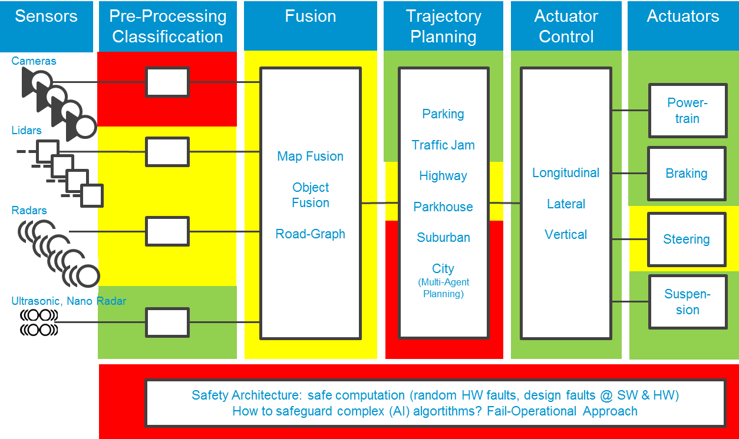
The Autonomous Driving Challenge Heatmap
12/5/2017
9

Slide 10
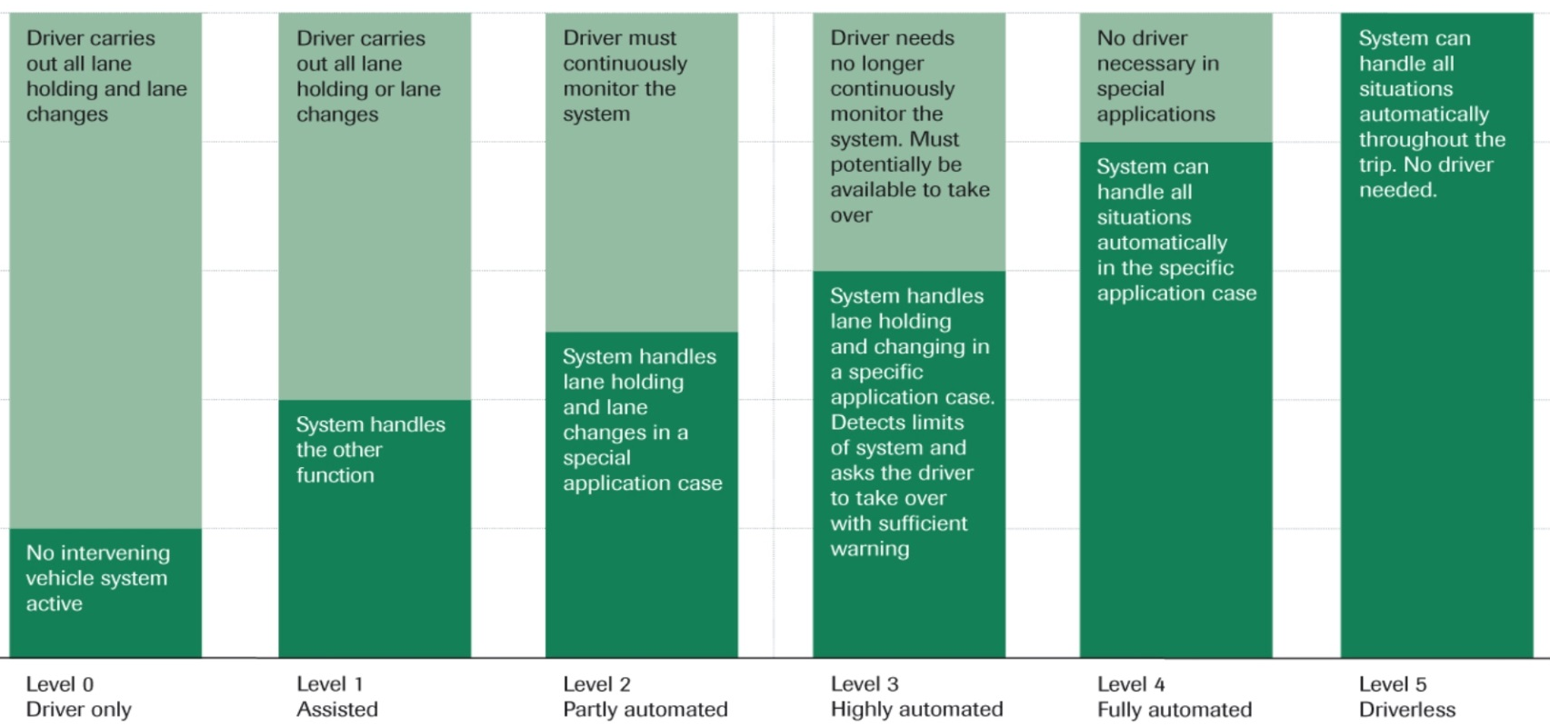
System Classification by VDA
SOP 2017
e.g. Audi A8
Planned for 2020+
Delegation of responsibility from driver to the car
On the market today
12/5/2017
10

Slide 11
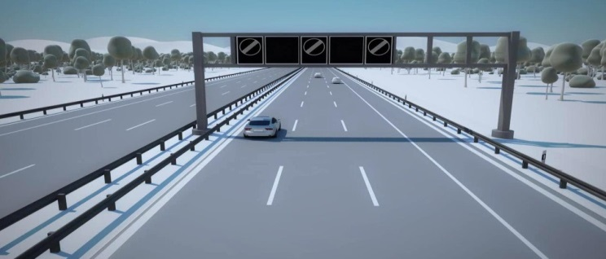
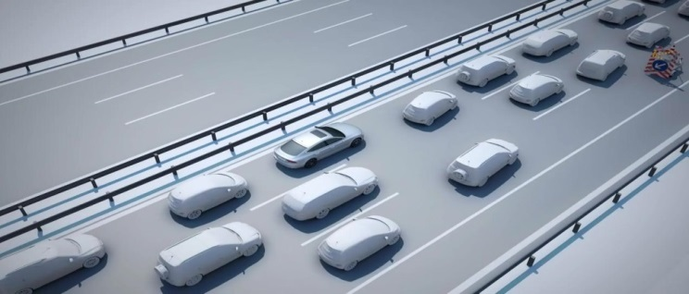
The Fail-Operational Requirement
Level 4: “System can handle all situations automatically in the specific application case” [VDA] → Even in the case of component failures!
Lane change to the side and stopping
Lane change to the side and stopping
Stop the car (avoiding obstacles)
12/5/2017
11

Slide 12
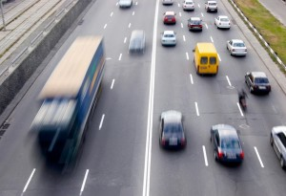
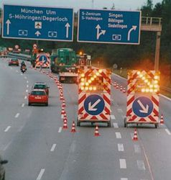
Safety assumptions
A fault can occur in an arbitrarily complex situation
Today’s Level 2/3 systems
Driver shall take over within 10s error reaction time
Reduced speed and limited complexity of driving situation (e.g. traffic jam pilot) allow fail-silent approach based on pre-calculated safety trajectory if driver fails to take over.
Assumed safety requirement for ADAS ECU: no commands shall be sent on the car network in case of an error
Level 4 systems
Highway speed 130 km/h (= 361 meters in 10 seconds)
Other vehicles changing lanes, braking, …
If driver fails to take over need to reach a safe place to stop (breakdown lane) (a few minutes)
Therefore appropriate computational power and situational awareness is needed also in the fault scenario to continue operating (for ~5minutes up to full driving cycle)
➔ Redundant configuration required!
12/5/2017
12

Slide 13
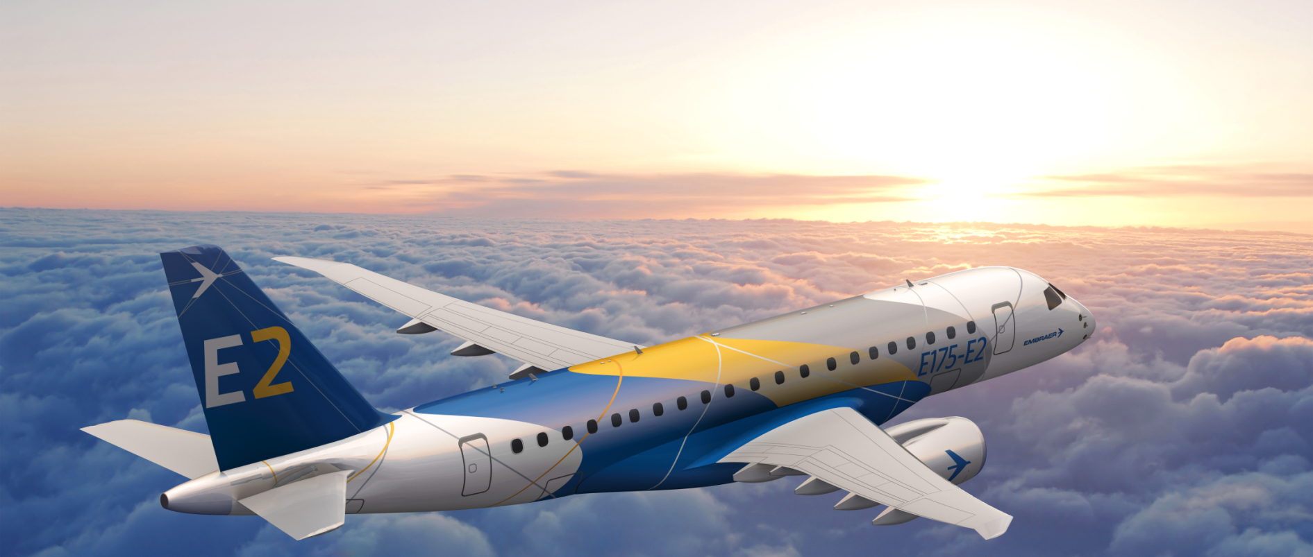
Why is it Difficult?
Airplanes are fly-by-wire and fail-operational …
… but they use triple or more redundant diverse electronics
TTTech provides the fly-by-wire network for Embraer E-Jet E2 Family
12/5/2017
13

Slide 14
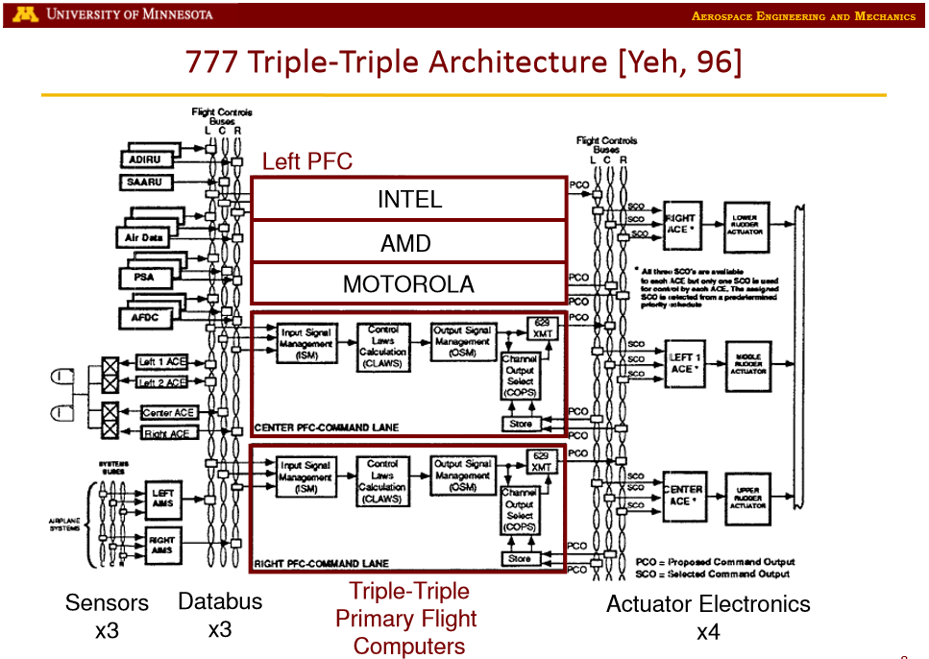
Why is it Difficult?
Boeing 777 Flight Computer
3 x 3 Architecture
HW Diversity
TTTech provides the fly-by-wire network for Embraer E-Jet E2 Family
12/5/2017
14

Slide 15
ISO 26262 Approach
Fault avoidance according to ASIL
ASIL D
ASIL C
Systematic Faults
Random Faults
ASIL B
ASIL A
QM
Software
Processes more strict for higher ASIL
Examples
Strict traceability
MC/DC test coverage
Formal methods
Hardware
Processes more strict for higher ASIL
Examples
Formal reviews
Fault injection tests
Analysis
Hardware
Lower fault probability for higher ASIL
Examples - self checking design
Dual core lockstep
ECC
Clock supervision
ASIL: Automotive Safety Integrity Level
12/5/2017
15

Slide 16
System and Network Partitioning
virtual machine
virtual machine
virtual machine
virtual machine
Safety
Apps
Control Apps
IT / Media Apps
Security Apps
compute level virtualization
Safe OS
RTOS
Rich OS
Secure OS
Hypervisor
Core 0
Core 1
Core 2
Core 3
Network virtualization
TTEthernet based
Memory partitioning on the host interface
Memory partitioning in the switch
Time-partitioning on the network
Cache
Virtualized Network Interface
Scheduled DMA
Partitioned memory
Deterministic Ethernet
TTEthernet
12/5/2017
16

Slide 17
TTEthernet – Traffic Classes
Quality of Service
SAE AS6802
Time-Triggered
synchronous/periodic
very small jitter (< 1μs)
known latency
SAE AS6802
synchronous
jitter < 1 μs
known latency
ARINC664p7
AFDX
asynchronous
low jitter (< 500μs)
latency typical 1-10ms
IEEE802.3
Ethernet
best effort Ethernet
no performance guarantee
12/5/2017
17

Slide 18
Fault-Tolerant Synchronized Global Time
Fault-tolerant synchronization services are needed for establishing a robust global time base in the sub-microsecond area
12/5/2017
18

Slide 19
Time-triggered Traffic Timing
Full control of timings in the system
Defined latency and sub-microsecond jitter
Minimum memory needs
Fault-containment regions
I’ll expect M between 11:05 and 11:15
I’ll accept M only between 10:40 and 10:50
I’ll accept M only between 10:55 and 11:05
M
M
M
I’ll forward M at 11:00
M
I’ll transmit M at 10:45
I’ll forward M at 11:10
Let’s see if I can receive M
…a switch
12/5/2017
19
Notes:
…but sender and receiver still only do “I’ll transmit M at…” and “I’ll expect M at…” – the added complexity is in the network, not in the nodes

Slide 20
Fault-Containment Regions
TTEthernet defines Switches and End Systems as two kinds of Fault-Containment Regions. Frame loss is mapped to the respective sender.
Depending on cost and reliability targets, switches and or end systems may be implemented with standard or high-integrity in order to be able to scale from single to dual fault tolerance.
Protocol mechanisms can be configured to handle Strictly Omissive Asymmetric switch faults (HI) and fully Transmissive Asymmetric end system faults (SI).
12/5/2017
20

Slide 21
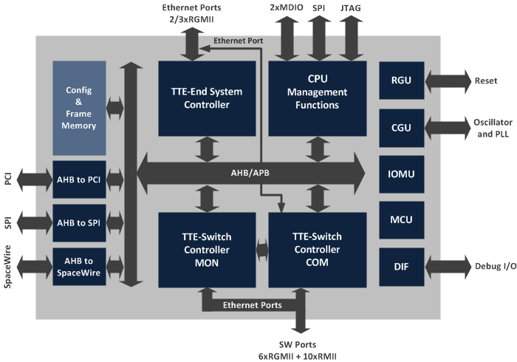
TTE-Controller
❶ Switch Controller COM
❷ Switch Controller MON
❸ End System
For the connection of the CPU to the switch controller
❹ CPU
Management &
Diagnostics
Switch Commander (COM)
6 x 10/100/1000 RGMII/RMII
19 x 10/100 RMII (PBGA) 12x10/100 RMII (CQFP)
1 x 10/100 on-chip (for E/S in management mode)
4096 VLs (messages)
1MB frame memory
12/5/2017
21

Slide 22
TTE-Controller
❶ Switch Controller COM
❷ Switch Controller MON
❸ End System
For the connection of the CPU to the switch controller
❹ CPU
Management &
Diagnostics
Switch Dual-Core Lock-Step (COM/MON)
Same parameter set as COM
Delayed clock between the COM and MON
Share the same frame memory
Separate configuration memory
Internal comparison of output
Separate silicon area
Observation of clock
12/5/2017
22

Slide 23
TTE-Controller
❶ Switch Controller COM
❷ Switch Controller MON
❸ End System
For the connection of the CPU to the switch controller
❹ CPU
Management &
Diagnostics
End System
3 x 10/100/1000Mbps ports (RGMII/RMII)
256 send VLs, 512 receive VLs
IP/UDP/ARINC653 support
IP fragmentation/defragmentation (8kByte)
Diagnosis and status registers
PCI, (Q)SPI, SpaceWire interface
12/5/2017
23

Slide 24
TTC - Communication
Interfaces Layers:
UDP-COM (TT & RC)
IP-COM (TT & RC)
MAC-COM (TT, RC & BE)
MAC-RAW (TT, RC & BE)
Via:
Sampling or
Queuing ports
12/5/2017
24

Slide 25
TTC – Partition Sync State
The TTC supports up to 8 independent partitions for input and 8 partitions for output traffic.
A partition is defined as:
an independent address space with
a configured size separated for
input or output traffic with
defined communication ports (sampling, queuing or SAP)
12/5/2017
25

Slide 26
TTE-Controller
CPU for Management and Diagnostics
Leon2FT @ 125MHz
Simple SNMP functions
Simple TFTP data loading
Bootloader
Switch driver
End System driver
User tasks
❶ Switch Controller COM
❷ Switch Controller MON
❸ End System
For the connection of the CPU to the switch controller
❹ CPU
Management &
Diagnostics
12/5/2017
26

Slide 27
Conclusion
Automotive:
Higher Integration needed to handle high data-rates and processing
Cost shift from ECU hardware to SW function development and validation – reuse mandatory
Cost and Complexity of Integration is growing rapidly
Fail operational architecture required for Level 4 autonomous driving
High bandwidth and determinism demands requires upgrade of communication backbone
AeroSpace:
Recent developments for space are applying automotive concepts to space products e.g. high integration and high integrity
Shifting redundancy management and communication into the hardware to reduce complexity and software overhead
Reduce cost by cross industry approach essential to support the space domain
Provide a standard solution to support all future needs from standard Ethernet – non safety critical to deterministic redundant Ethernet – safety critical to decrease the costs

Slide 28
Vienna, Austria (Headquarters) | USA | Japan | China
Phone +43 1 585 34 34-0 office@tttech.com | Phone +1 978 933 7979 usa@tttech.com | Phone +81 52 485 5898 office@tttech.jp | Phone +86 21 5015 2925-0 china@tttech.com
www.tttech.com
Copyright © TTTech Computertechnik AG. All rights reserved.
Notes:
altbacken

