Slide 1
Challenges Of On-Orbit Integration And Test
2017 Workshop On Spacecraft Flight Software
December 4-7, 2017
Brian Engelkemier
Sr. Advisory Engineer – FSW Architect
Northrop Grumman Mission Systems
Baltimore Md.
This presentation does not contain ITAR restricted information
Copyright ©2017 Northrop Grumman Systems Corporation

Slide 2
How We Want To Deliver Capabilities
We Want To Be Tesla
Tesla Delivers New Versions Overnight
  Next Morning, You Have Autopilot
  Or A Faster Car
How Can They Do This?
  Test Beds That EXACTLY Match Delivered Product Variations
  Beta Tester Network That Covers Product And Usage Variations
    Beta Versions Can Roll Back As Needed
Even With This Testing Environment Problems Still Occur
  Apple Pulled iOS 9.03 Update Because Of Problems
  Lexus Over-the-air Update Bricked Infotainment System

Slide 3
Why We’re Different From Tesla
No Test Beds Match Delivered Product
  Incomplete Hardware
    Simulators Have Software Emulation Of Most Boards
    Anomaly Resolution Unit (ARU) Does Not Have Complete HW
  Production Test Facilities Not Available
  Can’t Test Like We Fly
No Beta Testers
  Have To Treat Customer As Beta Tester On Real Flight System
Like Tesla, We Can Roll Back As Needed
  Multiple Versions Stored On Board
  Proven On Other Flight Systems
Only FSW Version Verified On Full Flight System Is Shipped With Flight System

Slide 4

Setting Customer Expectations For On-Orbit Integration & Test
Previous Slides Beginning Of Conversation With Customer About On-Orbit I&T
Had To Put On-Orbit I&T Issues In Context
  Customer Usually Only See Final Delivery Of Software
Customers Main Concern Was Health Of Payload And Impact To Operations
  New Builds Need To Ensure No Damage To Hardware
Our Systems Support Multiple FSW Versions On The Payload
  < 6 Commands To Recover To Previous Version
  Extensive Verification Performed To Show Can Always Recover Payload
    Virtual System Integration Lab Instrumental
    Verification Of FSW And ROPs

Slide 5
Why On-Orbit Integration & Test Is Needed

Slide 6
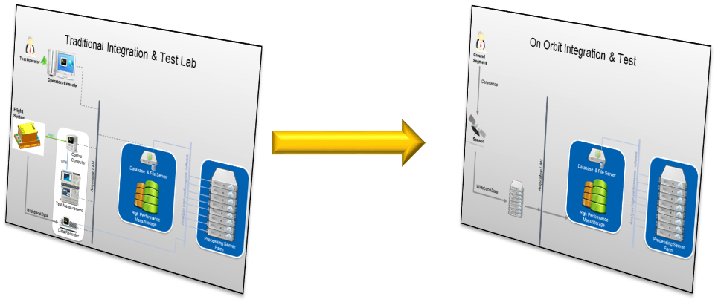
Increased Customer Demand For New Features Drives Need For On-Orbit I&T (OOI&T)
Not Minor Tweaks To Existing Capabilities But Entirely New Features
Features Delivered After Payload Delivered Or Launched
Integration And Test Cannot Be Performed In Traditional Labs
  I&T Assets Not Same As Delivered Payload
Requires Change In
  Developers Thinking
  Customer Thinking

Slide 7

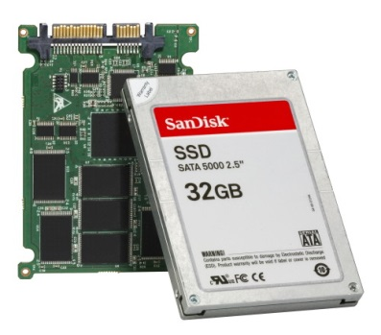
On-Orbit Integration And Test Is Here To Stay
Increased Single Board Computer Resources Available In Space
  Faster CPUs, More RAM, Flash Drives
Flight Software Architecture Changes
  Change From State Machine Architectures
  Component Based Architectures
  OFP Dynamically Linked, Not Statically Linked
  No longer patching to fix problems, update components
  Higher Level Commanding
Switch From ASIC to FPGAs For Space Systems
  FPGAs Can Be Changed Post Delivery
  Same Increased Capabilities As Seen In SBCs
Space Qualified System-On-A-Chip Will Increase On-Orbit Capabilities

Slide 8

OOI&T Problem Caused Customer To Limit Scope Of New Capabilities
First Attempt At Major Capability Change To Flight System
  Involved FSW and FPGA Changes
Capability Required Change To Power Control Timeline
  Flight System Failed To Meet Timeline 3 out of 10 Times
  Couldn’t Reliably Replicate On Anomaly Resolution Unit (ARU)
  3 Months to Discover Root Cause
  1 Day To Fix
Why Did It Take So Long
  New Capability Test On Non-Interfering Basis With Regular Operations
    Average Of Less Than One Run Per Day
  Worked 9 Out Of 10 Times On ARU
    Never Failed During Verification Before On-Orbit Tests
  Finally Someone Smart Thought About It Being An ARU
  VxWorks WindView Used To See CPU Contention Between Two Tasks
    Those Tasks Control Hardware That Make ARU a Miniature Payload
  Configuration Change To Timeline Fixed Problem

Slide 9
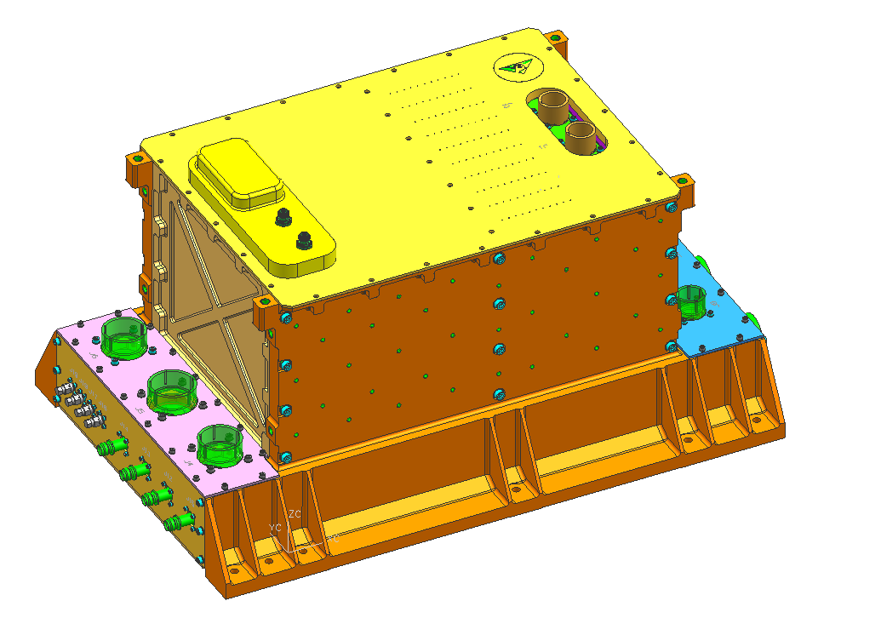



Sometimes Timing Is Everything
A Different Program Was Asking For Post-Delivery Capabilities
  Payload Was Still Being Built And Integrated
This Forced A Hard Look At What Is Needed For Success
  Looked Across Programs At Existing Integration, Test and Verification Toolsets
  What/How Can We Replicate On Orbit?
    Think Of Answers Tool Provides
  Series Of Recommendations
    Some Tied To Specific Capabilities Being Developed
    Some Are Universal
  Flight Hardware Being Built Meant We Could Not Change Hardware
    Afford Time To Get Tools In
Customer Now Sees How The Sausage Is Made
  Work With Customer To Understand Process
  Explain Why Things Take Longer Than On Ground
  Explain Why Existing Capabilities May Break
  Explain Why Changing Working Code Now
Flight System

Slide 10
Pre-Launch Factory Tools and Process Support
Hours, Days Or Months Turnaround
Development Process Established
  Mature Tools And Resources
Resources Available
  Virtual Systems Integration Lab
  Partially Populated Test Benches
  Full Flight System
Experts and Assets Co-located
Capability To Instrument Hardware
  Bus Analyzers
  Test Connections From The Hardware
Specialized Test Equipment Available
Changes Made And Tested In Minutes
  Build → Load → Test → Analyze Results
Functional Test
Process
Factory I&T
Tools/Process
Test
Preparation
Test Scripts
Commands
Test
Execution
STE
UUT
Data Acquisition
ATLAAS
Hours/Days
Turnaround
Data Processing
Server Farm
Analysis & Evaluation
Analysis Tools
Corrective Action
CM Process
Build
Deploy

Slide 11
On-Orbit I&T Tools And Process
Turn Around Time Greatly Increases
Limited Insight Into Operations Events
Support Information Requires Gathering
Involves Multiple Space/Ground Parties To Coordinate
Additional Testing Requires Coordination With Ops And Greatly Constrained For Mission Safety
  Show Build Cannot Break Payload
Laborious Change, Test, And Verification Process
  Build → Deploy → Schedule Collection (test) → Data downlinked → Data Delivered To Flight System Factory → Analyze results
Functional Test
Process
On-Orbit I&T
Tools/Process
Test
Preparation
Space/Gnd Coord
Tasking
Planning
Test
Execution
Mission Review
CMD Upload
Flight System Ops
Data Acquisition
WB Downlink
Factory Transfer
Weeks/Months
Turnaround
Data Processing
Server Farm
Analysis & Evaluation
Analysis Tools
Root Cause
CM Process
Rehearse
Corrective Action
Build
Deliver to GS
Unit Test
GS PL Sim
ARU Test
Upload
Patch Build
Incorporate

Slide 12
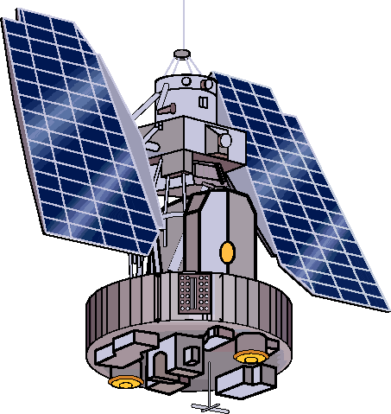
Resources Available For Integration & Test
Anomaly Resolution Unit (ARU)
  AKA Mini-Payload
  Does Not Have A Complete Set Of Hardware
Space Vehicle Test Bed (SVTB)
  Collection Of Simulators That Allow Testing Of (Mainly) Software Interfaces
Flight System
  Really Expensive Test Asset
  Arrives Late In Integration & Test Effort
  Delivered To Customer
Integrated Satellite
  Even More Expensive Test Asset

Slide 13
Last Version Of FSW To See Complete Payload Is Delivered With It
 | SVTB | ARU | Flight System | Integrated Satellite
Intra-Flight System Interfaces
Flight System/Ground Interfaces
FPGA Functional Testing
FPGA Performance Testing
Flight System Interfaces Software
Flight System2Bus Interfaces Hardware
Flight System2Bus Interfaces Timing
Mode Functional Testing
Mode Performance Testing
Used For OOI&T

Slide 14
Our FSW Tools Investigation

Slide 15

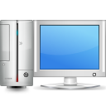




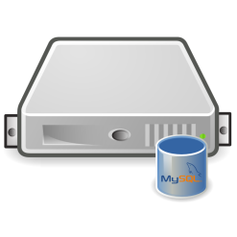
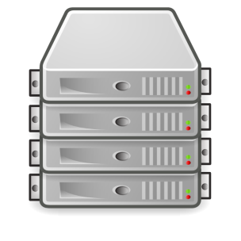



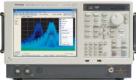
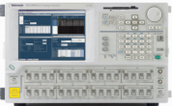
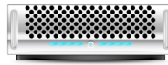
Pre-Launch I&T Environment
Provides Many Tools For I&T
Capabilities Used By Development Teams
Event Log File Monitored In Real Time
Data From STE Monitored In Real Time
  Stored For Analysis
Bus Analyzer For Real Time SW/HW Interaction
FSW Debugging Tools
  Performance & Timing Monitoring
SBC Console Access
Test Operator
Operators Console
ATLA²S
Administrators
Flight System
1553
Control
Computer
Database & File Server
GPIB
Analysis high performance network
Acquisition LAN
High Performance
Mass Storage
Processing Server
Farm
Test Measurement
Wideband Data
Data Recorder

Slide 16
Post-Launch I&T Environment
Full Set Of Tools, Hardware Limited
Capabilities Used By Development Teams
Event Log File Monitored In Real Time
Data From STE Monitored In Real Time
  Stored For Analysis
Bus Analyzer For Real Time SW/HW Interaction
FSW Debugging Tools
  Performance & Timing Monitoring
SBC Console Access
Test Operator
Operators Console
SIMICS Model or ARU
1553
Control
Computer
Database & File Server
GPIB
Analysis high performance network
Acquisition LAN
High Performance
Mass Storage
Processing Server
Farm
Test Measurement
Wideband Data
Data Recorder

Slide 17
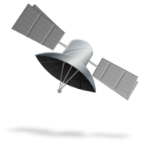
On-Orbit I&T Environment
Limited Tools, Full Set Of Hardware
Capabilities Used By Development Teams
Event Log File Monitored In Real Time
Data From STE Monitored In Real Time
  Stored For Analysis
Bus Analyzer For Real Time SW/HW Interaction
FSW Debugging Tools
  Performance & Timing Monitoring
SBC Console Access
Ground
Segment
Commands
Sensor
Database & File Server
Analysis high performance network
Acquisition LAN
Wideband Data
High Performance
Mass Storage
Processing Server
Farm

Slide 18
Constraints To Our Solutions
Had To Build Solutions Quickly
  Cannot Delay Launch To Add Integration and Test Tools
Solutions Needed To Be Added To Launch Critical Baseline
  Cannot Break Launch Critical Baseline Functionality
  Some Of Changes Exist At Lowest Level Of Code
  Want As Mature As Possible
Work On Existing Hardware
  Flight System Being Built
Flight System

Slide 19
On-Orbit I&T Environment
Targeted Capabilities
Capabilities Used By Development Teams
Event Log File Monitored In Real Time
Data From STE Monitored In Real Time
  Stored For Analysis
Bus Analyzer For Real Time SW/HW Interaction
FSW Debugging Tools
  Performance & Timing Monitoring
SBC Console Access
Ground
Segment
Commands
Sensor
Database & File Server
Analysis high performance network
Acquisition LAN
Wideband Data
High Performance
Mass Storage
Processing Server
Farm

Slide 20

Timing Information
Performance Monitoring
Early In Program Added Code To Gather Timing Information
  Think Of A Stop Watch
  Begin/End Blocks For Tracking Activities
  Tracks Per Task And Activity
  Gathers Wall And Optionally CPU Time
  Turn On/Off Via Config File
  Reported in microseconds
  Produces CSV File
Code Not Removed “Just In Case”
FSW Always Checks Interrupt Response Timing Met

Slide 21
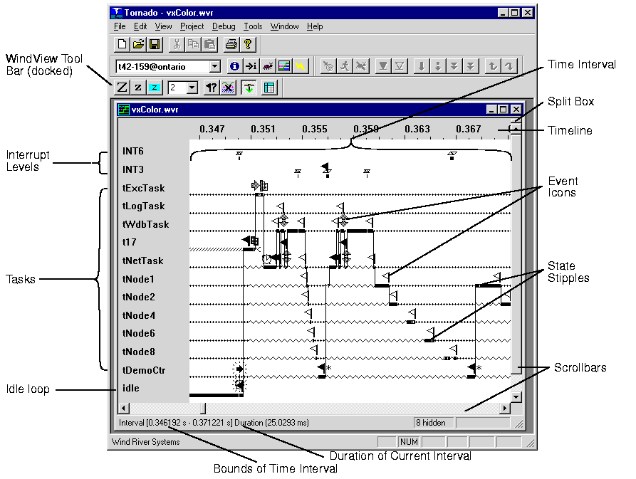
Timing Information
WindView
Another Valuable Tool is VxWorks WindView
  Ultimately Found Original Problem
WindView Allows
  See Task Switching
  Tracking Of System Level Tasks
  See System Events
  See Semaphores
Added Ability To Run By Command
Output Sent To RAM Drive File
Maintenance File Dump Used To Get File
Verified Capability On Full System To Find A Timing Problem

Slide 22
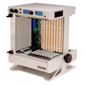
Bus Analyzer Replacement
Legacy Debugging Code
Before VSIL, Early Development Done On SBCs In Rack
  No Payload Hardware
  Early Development Of Infrastructure
  Easy Check Out Of Plumbing Instead Of Using Valuable Resources
PCI Library Support Built With Logging Capability
  Only Available If Board Not Present
  Wrote Reads and Writes To Text File
  “Easy” Verification Of Writes Without Hardware
Code Was Left In After VSIL Models Working
  NG Standard Library
Changed To Work On-Orbit By Command
Digital Team Developed Tool To Read File To Use With Simulation

Slide 23
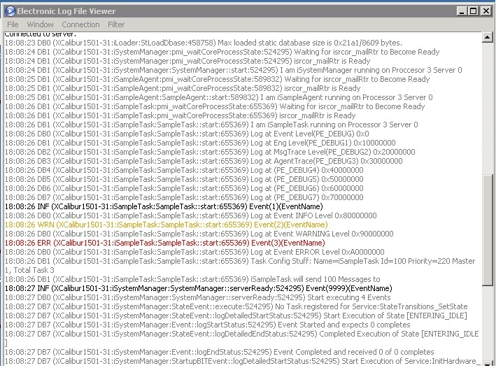
Event Log File (ELF) Access
Persistent Event Log File
Developers Watch ELF In Real Time
Normal CONOPS Dumps ELF Before Payload Powered Off
Event Log File Stored RAM Drive
SBC Reboot Loses Entire ELF
  Leave Bread Crumbs Around As To Cause
Changed To Allow ELF To be Written To Flash Drive
  Only Written On Reboot
  Allows Operations To Dump To Data Storage Unit At Later Time
  Capability Must Be Turned On

Slide 24

Single Board Computer Console Access
Need To Run Command Line Tools Without Console Access
Developed Ability To Run Secure Scripts
Scripts Stored On RAM or Flash Drive
Output Captured To RAM Drive File
Maintenance Command Used To Download Output

Slide 25
All Involved Parties Must Change Thinking For Successful On-Orbit I&T
First Delivery Of New Capability Will Not Work
Code Not Needed For Mission Requirements Should Not Be In Baseline
  If You Are Doing OOI&T, It Is A Mission Requirement
Timing Measurements, Tracing, Logging
  Need To Be Automated And In Operational Code
Needs To Be Priority For ALL Involved Parties
  User Segment, Ground Segment, Space Segment
OOI&T Needs Continue To Grow As You Gain Experience
  Plan For New Tools As Experience Grows
    Always Fixing The Last Problem
  Test Software And FPGA Needs Considered As Well

Slide 26
In Summary
I Don’t Always Test My Code
But When I Do, I Test On-Orbit

