Slide 1
RTEMS Status and Roadmap
Joel Sherrill, Ph.D.
Joel.Sherrill@oarcorp.com
OAR Corporation Huntsville Alabama USA
December 2017

Slide 2
Overview
RTEMS Version Numbering Changes
RTEMS 5.1 Highlights
Discussion of Tiering Strategy
RTEMS libbsd TCP/IP and USB Status
Tools Status
Documentation Status
Qualification Activities
Deos/RTEMS

Slide 3
RTEMS 5 Explanation
Architectural changes significant enough to justify changing the first digit from 4 to 5
SMP support is mature and optimized
If you have updated RTEMS recently, it would have told you to build new CPU-rtems5 tools
Also changing from 3 digit to 2 digit release version numbering scheme (like GCC)
Versions will be 5.1, 5.2, etc.
Release series after 5 will be 6

Slide 4
Highlights of RTEMS 5.1
Burndown list of remaining issues:
https://devel.rtems.org/milestone/5.1
Help is appreciated
C, C++, Ada and FORTRAN available via RSB
System initialization via constructors
results in even smaller executables
POSIX APIs now enabled by default
POSIX synchronization objects are self-contained
POSIX header files now in newlib
Sixty-four bit time_t
Sixty-four bit PowerPC support
Support for QorIQ DPAA including 10 Gbit/s Ethernet

Slide 5
More Highlights of RTEMS 5.1
Scalable timer support for SMP systems
Priority queues for timers (e.g. red-black trees)
Timer expiration distributed across processors
Fine grained locking
Big Kernel Lock removed
Locking Protocols for Mutual Exclusion
Transitive priority inheritance
priority inheritance tracked across multiple resources
Priority ceiling
O(m) Independence-Preserving Protocol (OMIP)
extends priority inheritance to clustered scheduling
Multiprocessor Resource-Sharing Protocol (MrsP)
extends priority ceiling to clustered scheduling

Slide 6
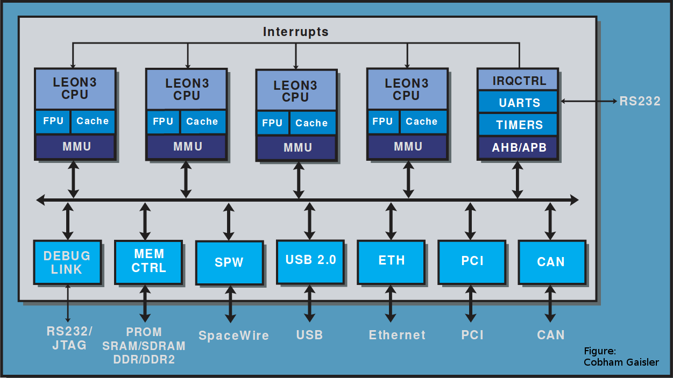
LEON3 Clustered Scheduling Example
Architecture
N single core blocks
L1 cache per block
Cache coherence across cores
Scheduler config
CPU0: IRQs and IO threads
CPU1: Critical thread set
CPU2-3: Worker threads
Focus on schedulability and predictability
I/O
Priority
Critical Tasks Priority
Workers
SMP Priority
Category
Scheduler
Figure: Aeroflex/Gaisler

Slide 7
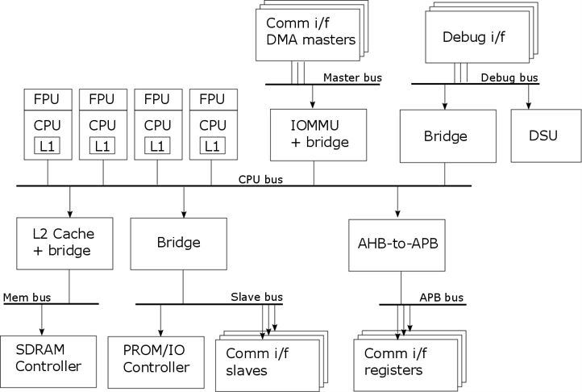
GR740 Clustered Scheduling Example
Architecture
N single core blocks
L1 cache per block w/configurable L2 cache
IOMMU can protect memory or bridge IO
Scheduler configuration
Asymmetrical with SMP and uniprocessor instances
First RTEMS Application (3 core SMP)
CPU0: IRQs and IO threads
CPU1-2: Worker Threads
Second RTEMS Application (Uniprocessor)
CPU3: Critical algorithm (may fit in L1 cache)
Use IOMMU to avoid L2 cache pressure
Focus on schedulability, predictability, and minimizing CPU bus contention with DMA block oriented IO
First RTEMS App
Second RTEMS App
I/O Priority
Worker Threads
Figure: Aeroflex/Gaisler
https://www.rtems.org/

Slide 8
Architecture and BSP Highlights in 5.1
Added:
Architectures: RISC-V 32 and 64 bit
BSPs: atsamv, imx7, qoriq_e500, qoriq_e6500 (32 and 64 bit), at697f, gr712rc, gr740, ut699, ut700
BSPs supporting SMP:
SPARC (1-4 cores): GR712C and GR740
PowerPC (1-24 cores): QorIQ (e.g. P1020, P2020, T2080, T4240, etc)
ARMv7-A (1-4 cores): Altera Cyclone V, Xilinx Zynq, Raspberry Pi2
Removed
Architectures: AVR, H8/300, M32R
BSPs: gba, gp32, nds, Edison, gen68302, idp, mvme136, od368302, sim68000, simcpu32, genmongoosev, ep1a, mbx8xx, sis

Slide 9
Releases
4.11 Series
4.11.3 is planned and includes some bug fixes
Important 5.1 Activities Remaining
Reorganize header files to eliminate “preinstall”
Progress on elimination of bsp_specs
Barrier to supporting non-GCC compilers
Hope to complete elimination before branching

Slide 10
A Few Desirable Improvements
Conversion of RTEMS to waf build system
Build time will go from minutes to seconds
PC BSP support EFI bootloader, non-legacy hardware, and a clean “non-legacy BSP”
Pi3 working: UART configuration is different
More SMP capable BSPs: Pi3 and PC
x86 needs context switch algorithm fix, APIC, and APCI support
Pi3 needs someone to make it work
Microblaze port
Improvements occur only when the community supports the project

Slide 11
Tiers for BSPs and Architectures
Historically, the RTEMS Project has had no formal definition indicating BSP or architecture status
Subjectively knew some BSPs which were heavily used
Provides an objective view on BSP usage and status
BSP tiering implies tier of associated architecture
Four tiers defined:
Tier 1: Tested on real hardware
Tier 2: Tested on simulator
Tier 3: Known to build
Tier 4: Fails to build
Looks obvious and easy… right?

Slide 12
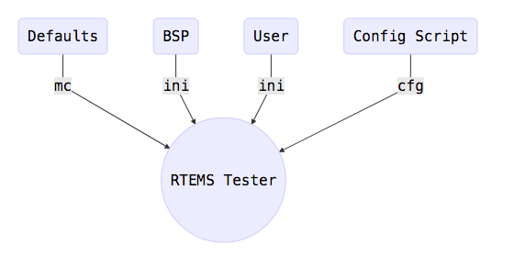
Infrastructure to Support Tiering
Place to record results
https://lists.rtems.org/pipermail/build/
rtems-test automates running tests and reporting results to build mailing list
Supports simulators and real target hardware
Can run multiple instances of simulators in parallel
Supports end user testing on their hardware!
Configurable because of number of BSPs and unique nature of each user’s setup
rtems-run eases running executables on simulators and hardware

Slide 13
Current BSPs and Architectures by Tier
Tier 1:
Arm: beagleboneblack, xilinx_zynq_zedboard, imx7
PowerPC: qoriq_e500, qoriq_e6500_32, qoriq_e6500_64
I386: pc
Tier 2:
MIPS: jmr2904
PowerPC: psim
RISC-V: riscv_generic, riscv64_generic
SPARC: er32c, leon2, leon3
Tier 3: 12 architectures, 71 of 83 BSP families, 165 of 178 BSP variants
Tier 4: None
Need community help to move BSPs up to higher tiers

Slide 14
libbsd TCP/IP Stack Status
Currently based on FreeBSD 12
BSPs supported
ARM: Realview, Zynq, atsamv, Cyclone V, LPC24xx, BeagleBone
M68K: genmcf548x
PowerPC: QorIQ
x86: pc386 (multiple families of PCI NICs)
Optimizations to RTEMS improved performance
Consistent configuration and use as in FreeBSD
Uses FreeBSD commands to configure (e.g. ifconfig, route, etc.)
FreeBSD kernel tuning mechanisms (e.g. sysctl)
Many features including IPV4, IPV6, packet filtering, OpeSSL, tcpdump, USB mass storage, and more
Includes basic support for Wifi

Slide 15
libbsd Wifi Status
Basic unencrypted WiFi support: Works
WEP support without wpa_supplicant (config using ifconfig): Works
WPA2 support using wpa_supplicant: Works, although the wpa_supplicant is not cleanly integrated
WPA2 is already patched against KRACK
Multiple WiFi interfaces: Untested. Unencrypted and WEP would most likely work. WPA2 may not.
Supported drivers: Currently rtwn is ported. Tested with RTL8188CUS and RTL8188EU. Porting any other FreeBSD drivers should be possible as with wired NICs.
Tested using USB Wifi dongles on ATSAM and BeagleBone Black
performance is limited by USB in these configurations
Ready for users to work with and provide feedback and improvements!

Slide 16
RTEMS Tools
RTEMS Users
RTEMS Developers
Continuous
Integration Testing
CLI
GUI
RTEMS Source Builder (RSB)
RTEMS Tester
RTEMS
LD
RTEMS
Trace
Linker
(TLD)
Capture
Trace
Coverage Testing and Reporting
Config
Macro Expansion
ELF/
DWARF
Symbol Management
RAP
INI
lzma

Slide 17
RTEMS Tools Status for 5.1
RTEMS Source Builder to build cross development tools, supporting tools, and target libraries
provides source and reproducible results for configuration control
RTEMS Tester enables testing on user hardware or simulators
5.1 includes initial release or significant update of
RTEMS Trace Linker
RTEMS Dynamic Loader and RTEMS LD
RTEMS Capture Engine
Improvements made to coverage testing but results are not being automatically posted
Active community help needed to integrate trace results with Eclipse visualization

Slide 18
Qualification Support
NASA has provided recommendations for “RTEMS Software Engineering Guide” (SWEG)
Outline has sections which should be recognizable from DO-178 and NASA Quality standards
Much can be populated from existing content
Need fully tested, traceable requirements set
Discussion mailing list exists but is not active
Anticipate next RTEMS release branch will be used as basis for next flight version by NASA and ESA
Active community help needed to evaluate and improve supporting technical data

Slide 19
New Sphinx Documentation
Sphinx
Used by Python and recently adopted by Linux kernel
Simple ASCII markup
sphinx-doc.org
New:
General User, RSB, and POSIX Compliance Guides
Advice on Obsoleted APIs
Wanted:
Inline programming examples
BSP Specific Howtos
Guides to common tasks and problems
Inclusion of newlib documentation
Easy to contribute!

Slide 20
RTEMS.org Hosting
Hosted at Oregon State University’s Open Source Lab (http://osuosl.org/)
Dedicated servers, switches, etc. for RTEMS
All hardware purchased using donations
All system administration and maintenance is volunteer
Underappreciated shared resource
Donations are needed to update aging hardware and have a part-time admin

Slide 21
Deos/RTEMS
Commercial integration of RTEMS and Deos aligned with FACE Technical Standard Safety Base profile
Combination of POSIX and ARINC 653
Deos has 25+ years as Level A time and space partitioned RTOS
Provides RTEMS run-time services in a time and space partitioned environment
Multiple architectures: ARM, PowerPC, x86
Undergoing verification as a FACE Safety Base conformance Operating System Segment (OSS)

Slide 22
Deos/RTEMS Architecture
RTEMS POSIX Partition
Deos 653 Partition
Deos RMA Process
POSIX User Executable
RTEMS Config
ARINC 653 User Executable
ARINC 653 Config
Deos RMA User Executable
RMA Process Config
RTEMS POSIX
Thread Scheduler & POSIX API Library
ARINC653 Process Scheduler & 653 P1 API Library
Deos API Library
IOI Config
TCP/IP (LWIP)
IOI Lib
IOI Lib
IOI Config
IOI Lib
IOI Config
Shared Memory
Shared Memory
User Mode
Kernel Mode
Deos Kernel
Deos Registry with WAT
PAL
Target System Hardware and CPU

Slide 23
Thank You!
All of the improvements that have been made are thanks to the community supporting the project via:
Funding core developers
Contributing new features and fixes
Plenty of opportunities to contribute
Help Make RTEMS Better!

Slide 24
Contact Information
Joel Sherrill, Ph.D.
OAR Corporation Huntsville Alabama USA
Joel.Sherrill@oarcorp.com

