Slide 1
SpaceWire DB Analysis Tool
Using SQL to investigate anomalies on Parker Solar Probe
David Edell <david.edell@jhuapl.edu>
JHU/APL

Slide 2
Overview
Parker Solar Probe uses SpaceWire as the primary data interconnect between components.
Key SpaceWire Design Features:
High bandwidth interface
Time synchronization
Majority of traffic is RMAP initiated by primary SBC
Analysis of traffic (when available) can provide valuable insights especially when telemetry is insufficient or disabled.

Slide 3
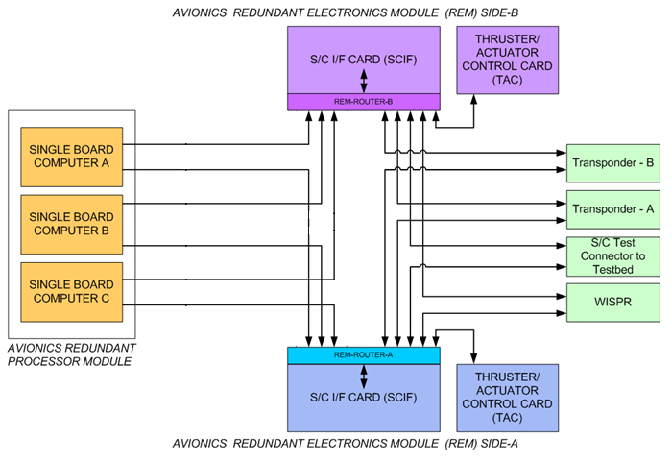
Overview
Links:
2x redundant 8-port Routers
3x Single Board Computers with direct SpW interconnects
19 total SpaceWire links
Packets
Over 1000 packets per second on primary link
Multiple SpaceWire protocols
Many user-data formats
If issues arise, SpaceWire analysis is often the only tool available
Parker Solar Probe kept recorders in I&T as long as possible to aide anomaly investigations
For some issues, analysis is simple (ie: traffic stopped)
Typically analysis requires sifting through a large volume of traffic to find the packet(s) of interest
Analysis can be of events days, weeks, or even months in the past.
Finding a specific data point, or pattern of data over time, is at best difficult to identify by hand.

Slide 4
SpaceWire Analysis
Fault analysis & debugging often requires analysis of SpW traffic
SpaceWire Data Recorders allow traffic to be monitored without interfering with the system
Star Dundee Link Analyzer
Monitors a single connection
Provides a UI with header (including RMAP) decoding
PSP has one in each testbed on our busiest link to aide developers
Limited to recording a few seconds of data on high-traffic links when commanded.
Documented C API Available
4Links SpaceWire Recorder
Monitors up to 8 connections
Suitable for continuous recording
Currently configured to automatically start a new file every 6 minutes
Developers can retrieve archived log files for any time to match reported anomalies.
Command line tools to parse binary files (can be slow to decode)
Periodically splitting files is necessary to ensure practical analysis
Each manufacturer has custom data formats & tools to view the data

Slide 5
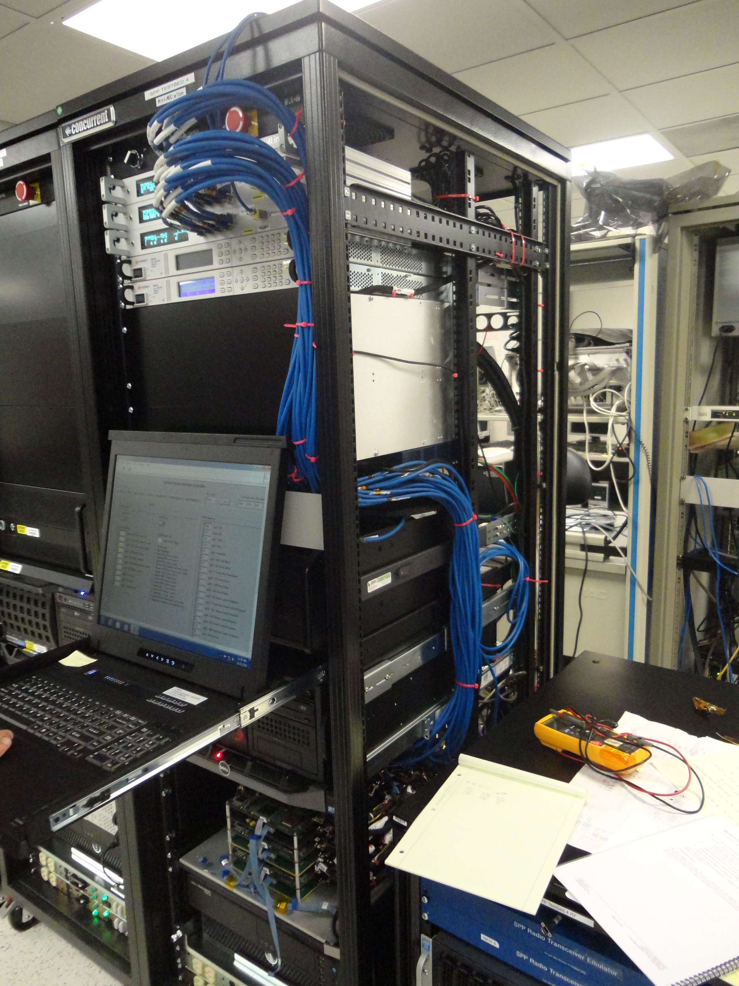
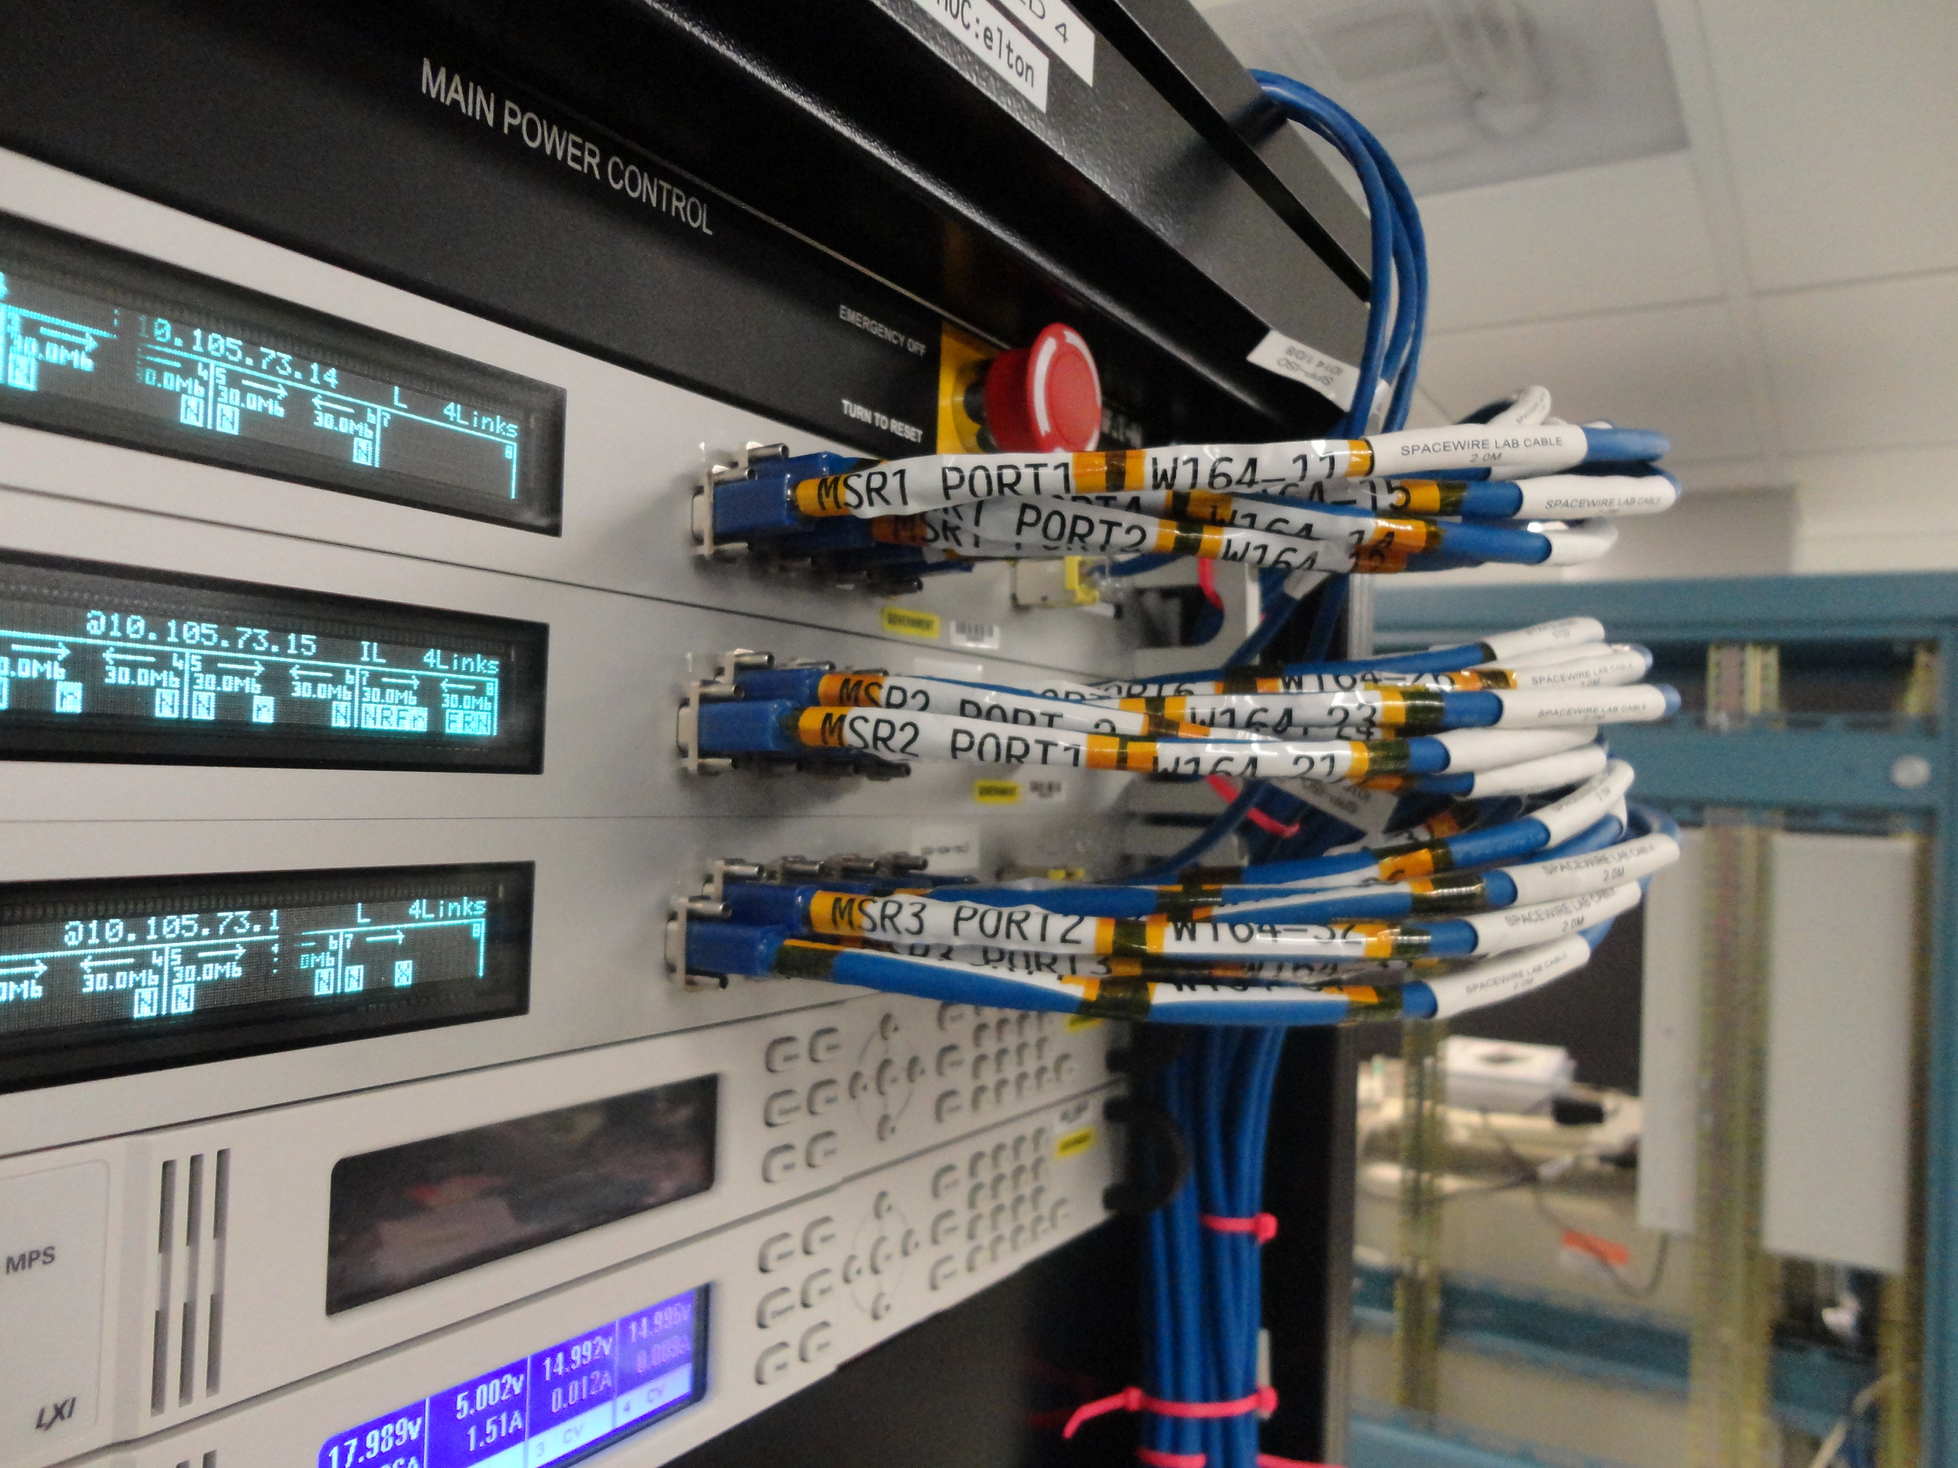
Recorders in action
4Links SpaceWire Recorders with continuous recording used for I&T, Stress Testing, and other complex scenarios.
Data is automatically recorded 24x7
File timestamps can be correlated with ground system
Star-Dundee tool used primarily for development.
Greater availability than 4Links Recorders

Slide 6
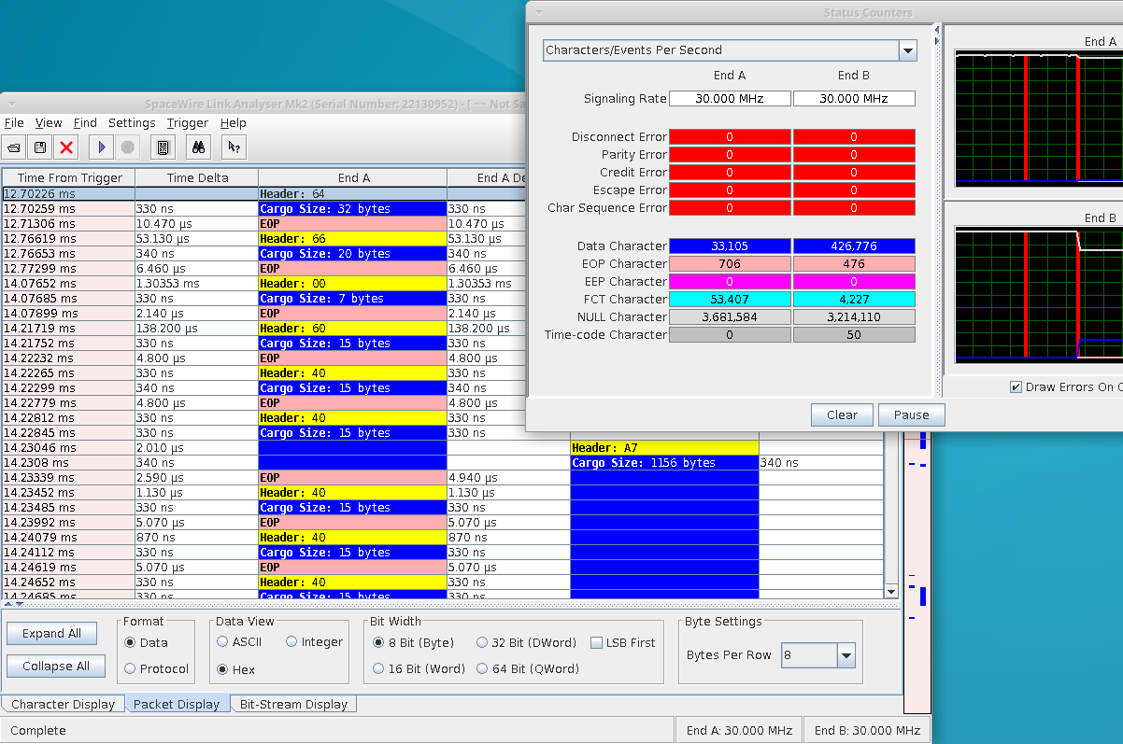
Raw Data Logs
Star Dundee Link Analyzer:
RMAP Headers can be decoded in the UI.
Data can be viewed at the packet or character level
Counters are useful for high level debugging.
Data can be exported as a CSV file.
4Links SpaceWire Recorder:
These are the first few entries in an ASCII log file that can approach a GB in size.
Notes:
Speak to the type of data and complexity of analysis

Slide 7
A better way
Repetitive analysis tasks are ideal for automation
For complex analysis, the ability to query datasets is important
How many packets per second meeting select criteria?
Is packet type X always followed by Y?
Show only RMAP messages for a given LA when the data contents match some criterion.
SQL Databases are the ideal tool to allow such queries to be quickly built against a large dataset.
For developer usage, any SQL administrative tool can be used to quickly query the database
For “end-user” usage, developing UIs around a SQL database is simple should the need arise.
Basic Data Ingest: Use a script to parse existing ASCII log files and insert the data into a database.
Better Method: Directly parse binary log files or access device API

Slide 8
Implementation
4Links
A Perl script was provided by 4Links to directly parse the binary log files and output to the shell
The script was modified to insert into the MySQL database instead.
Testbeds with 4Links Recorders in place configured to automatically record traffic at all times.
Files can be correlated with ground system timestamps
Data is archived for future analysis
Star-Dundee
The C API was leveraged to directly capture data and insert it into a MySQL database.
Application can be configured to, for example, capture exactly 1 second worth of data as measured by a set number of timecodes.
Quick and easy to use for developers.
It takes a few seconds to complete parsing upon completion.
Requires manual setup to record
Not suitable for long duration analysis
For advanced triggering options, the official UI can be launched to configure the device. If not overwritten using the C API, those settings will persist.

Slide 9
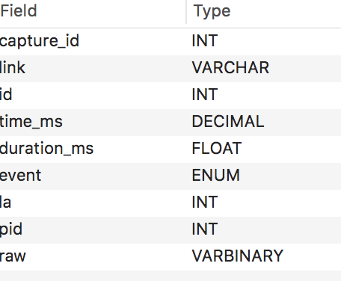
Common Schema
A simple database schema:
spw_capture - Contains a unique ID and timestamp for each log set, along with optional label and other identifying information
spw_events – Log each event seen.
disconnects and timecodes logged directly
Data is combined into a single packet and output on the first EOP or EEP.
Common SpW Header fields pulled out for optimum indexing.
Additional tables provide mapping of links and logical addresses to user friendly names.
Table views are used to consolidate lookups and save common queries.
This schema was built for developer convenience, not speed.
Table views created to extract RMAP and CCSDS headers, as well as application-specific data.
These views use non-indexed binary substring queries that are highly inefficient.
No effort was made to optimize queries by extracting common data (views) into discrete tables.

Slide 10
Usage Examples
Analysis of generic issues
Identify & import logs into database.
On select testbeds, the 4Links recorders are continuously logging in the background.
Select COUNT(*) to estimate link activity
Filter on DIS events to identify timestamps of unexpected behavior
Filter the full log based on anomaly time to fine-tune analysis.
Debug source of data anomaly
Identify & import logs into database
Construct one or more queries to
extract a specific message type (by logical addresses and/or internal data flags)
pull out specific data points into user-friendly fields.
Optionally filter results based on values of interest.
For example, only show DISTINCT values
Export results to CSV file for offline analysis in Excel for non-SQL users
Theoretically, a web UI could allow any user to do this directly.

Slide 11
Future Enhancements
User interface for analysis without requiring SQL expertise
Ideally, one of the many open source tools can be configured to serve this purpose.
Automatic import of SpaceWire recorder logs
Continuous recording may not be practical due to processing time.
A UI could provide a simple framework to queue parsing of data for a given time period and testers can be instructed to do so when logging a new issue.
Database schema optimizations
Automated analysis tools or techniques to find potential issues
Can “Big Data” analytics or machine learning algorithms play a role in discovering subtle issues?

