Slide 1
Real-Time & Linux
Bill kahn

Slide 2
Our Value Proposition
50 years of real-time OS expertise
  real-time Unix and Linux OS
  tools, compilers, simulation and data acquisition software
One stop shop for hardware/software integration
  Complete turn-key integrated real-time systems
  Custom COTS integrated systems
  Rigorous tested systems before release
  ISO 9001:2001 certified
Support and maintenance
  Long-term program support
  Professional Services
  Worldwide presence

Slide 3

Partial list of RedHawk / iHawk™
Customers & Projects

Slide 4

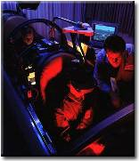
REAL-TIME CUSTOMER EXAMPLES – U.S.
Johns Hopkins
  Hardware-in-the-Loop (HIL) missile testing for the
  US Department of Defense (DOD)
    RedHawk used in classified HIL application
Draper Labs and General Dynamics
  Graphics processing in the simulation environment
  Trident Controls Development - HILS

Slide 5


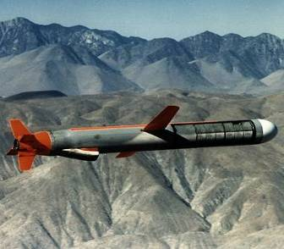
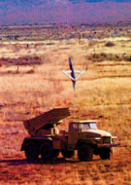

RedHawk at Raytheon
Simulation/test of Sonar arrays
for Collins submarine
Patriot Program – Guidance Testing, Radar Stimulation
Joint Standoff Weapon (JSOW)
  Real Time Hardware In the Loop (HIL) Testing
Small Diameter Bomb (SDB)
  Real Time Hardware In the Loop (HIL) Testing
Tomahawk missile program
  Real Time Hardware-in-the-Loop
  (HIL) testing

Slide 6

Northrop Grumman
Melville, NY – Navy Spook 9B Radar
  Embedded using VME cards
  Selected RedHawk Embedded over MRG, Montavista

Slide 7
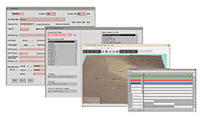
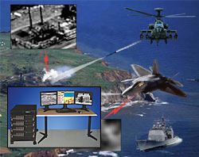
Northrop Grumman
NGC Amherst, NY – replaced SGI with ImaGens, iHawks
  F-35 Joint Strike Fighter
  Real Time Infrared Electro Optic Simulator
    infrared and electro-optic sensor systems.
  Synchronization and Control
    integrated avionics testing
  Image Generation

Slide 8











Lockheed Martin
Aegis – CR2 weapons system
THAAD – Missile Program
Deep Water – Radar, Tracking Systems
AMDR – Air Defense Missile Radar (SPY)
LCS – Radar and Weapons
LRASM – Long Range Anti Ship Missile
MH-60S – Helicopter Simulator
LAMPS – Vehicle Simulation Lab
EA-6B – Weapons Training System

Slide 9
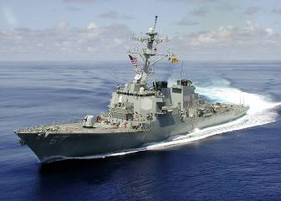
AEGIS, US Navy Program - Lockheed Martin
Lockheed Martin, Moorestown is the Prime
Concurrent hardware and software are currently in
use in the Aegis Weapons System. Concurrent
selected in 1992 and will provide support through 2012:
  6 Phase 3
  7 Phase1 and 7 Phase 1R
Concurrent Linux Real-Time Operating System was recently
selected for COTS Refresh 2 (CR2) next generation Aegis
Dr. Jim Briggs, Chief Scientist from the LM Moorestown Aegis Team, has stated:
  “Concurrent equipment is a core part of the success of the Spy Radar and Weapon Control systems”
  “Concurrent has long-term support, technical expertise and is responsive to the customer’s needs”
  “Concurrent equipment is deployed tactically interfacing with a variety of sensors and devices in a real-time multiprocessor environment

Slide 10
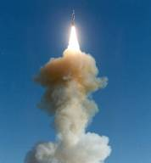
THAAD Missile Program- Lockheed Martin
Lockheed Martin, Sunnyvale is the Prime
  Theater High Altitude Air Defense (THAAD) Missile System
Rene Cheng, SimLab Manager, stated:
  “Software moved with ease from SGI”
  “Excellent platform stability and performance”
  “Unlike embedded systems, you can take
  non-real time proficient programmers and
  make them productive with the iHawk and
  NightStar Tools”

Slide 11
Presentation Agenda
Introductions – Bill Kahn & Mark Slater
CCUR overview, application profiles
Supported Intel, AMD platforms
RedHawk Linux
NightStar development tools
Summary

Slide 12

Supported Hardware
X86 based SBCs/Systems
Real-Time Multiprocessing Systems

Slide 13


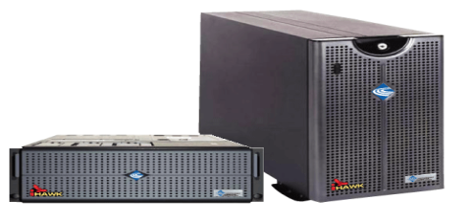
iHawk Systems
Features…
Commercial-off-the-Shelf (COTS)
Real-Time Linux and Tools
Support for a broad range of device drivers
Variety of packaging options (tower, rackmount)
Choice of Intel or AMD-based systems (includes dual & quad-core CPUs)
Integrated Real-Time Clock & Interrupt Module (RCIM) with GPS capability
Key Benefits…
Cost-effective systems
Increased engineering productivity
Fixed cost solution
Quick time to market
System investment protection

Slide 14

CPCI, PC-104 and VME iHawks
CPCI, PC-104 and VME iHawks
X86 based Single Board Computers
Concurrent Technologies - Various models
Mercury VC-120 (existing)
Curtiss-Wright Controls - SVME/DMV-1901
GE Fanuc VMIC - VME-7865RC
Acrosser PC 104
Concurrent Technologies Compact PCI

Slide 15
RedHawk
Low Latency
Real Time Linux
Real-time
Linux®

Slide 16
RedHawk Linux environment
Comprehensive solution for multi-core embedded computing.
Satisfying both real-time and non-real-time requirements.
Provides high reliability.
Incorporates best of class software development tools with embedded OS.

Slide 17
RedHawk Linux
RedHawk Environment includes:
  RedHawk Linux operating system
  RedHawk “Architect”™ tool for customizing and building the target environment
  NightStar multi-core debugging and analysis tools
  Professional Engineering Services
  Customer Service and Support
Notes:
RedHawk is a SINGLE Linux kernel that provides deterministic performance for entire environments. It is not the RTLinux model which provides a Real-Time kernel that runs Linux as a process.

Slide 18
What is RedHawk?
True real-time low-latency version of the Linux kernel
RTOS Kernel totally compatible with the popular Red Hat® or CentOS
Optimized for real-time determinism and performance
Libraries for Tool integration and some Real-Time Features
POSIX-compliance of Linux
2017 celebrated 15 year anniversary for RedHawk
Based on a combination of open source patches and 15 years of our real time expertise in Unix applied to Linux
Notes:
What we are offering with Red Hawk is a true Real-Time version of a Linux kernel running on an Intel SMP system.

Slide 19

RedHawk is built on Red Hat, CentOS, Umbuntu
Includes the complete Red Hat distribution content
  Command set
  Utilities
  Libraries
RedHawk 7.X co-resides with RHEL or CentOS. It adds:
  A (Debug) Rtkernel
  A (Trace) Rtkernel
  A (RunTime) Rtkernel
  PRTkernel (Implemented Prempt RT Patch)
  Libraries for NightStar Tool Integration
  Libraries for some Performance Enhancements
  Libraries for Concurrent Compatibility
RedHawk often provides transparent performance enhancements
RedHawk contains everything in Red Hat/CentOS plus our real-time kernels
Standard Linux vs. Performance Linux….
Concurrent delivers high-performance, Real-Time Linux
Notes:
Just to emphasize that Red Hawk is Red Hat with a Real-Time kernel.
Defacto std because of market share.
Support for 3rd parties that had spotty availability with PowerMaxOS:
Oracle , Matlab
StarOffice, Soft Reality
LabView, Ximian – Gnome desktop Windows like office
Easy5, Objective Interface (Korba)

Slide 20
RedHawk and kernel.org
We have a system in place for keeping RedHawk current with kernel.org
Merging of RedHawk with new Kernels as they are supported
RedHawk 7.3.X based on RHEL 7.3, 4.9 kernel
RedHawk 7.2.X based on RHEL 7.2, 4.1.x kernel
RedHawk 6.5.X based on RHEL 6.5, 3.10.x kernel
Automated Nightly Test System (ANTS)
  Nightly testing and fully automated Test reports
  Complete kernel build from source
  Complete kernel install
  Component Tests, System Tests and Benchmarks
  Automated Testing of NightStar Tools
  Performed on every platform supported
Notes:
Both Open Source and Concurrent Features
(Top 3) We talked about preemption, SMP etc but Red Hawk will also support CPU shielding and load balancing.

Slide 21
Shielded CPUs and Shielded Memory
An approach for obtaining the best performance on any (Real Time or non-Real Time) system
Real-time processes can be assigned to specific CPUs in an SMP system for maximum determinism in execution times
Shielded CPUs are sheltered from background interrupts, kernel daemons or other user tasks that can cause non-determinism
Minimize effect of cross processor interrupts
Uses industry-accepted mpadvise() system call
Dynamically settable (while the system is running)
Ability to Disable all Interrupts
Result is Max latency of 5 usec on certified platforms
Notes:
(Elaborate on shielding, emphasize dynamic ability vs static shielding with PowerMaxOS.)
Hardclock = local interrupt

Slide 22
GPU Workbench
RedHawk real-time CUDA enhancements
Minimizes PDLs of typical CUDA apps
Provides better overall performance by RT Optimization of nVidia Driver
Automatic Instrumentation of CUDA API provided by NightTrace

Slide 23
CUDA Support under RedHawk
Parallel processing technology developed by NVIDIA
Allows use of high-performance graphics cards as low-cost parallel processors
Provides access to up to 448 processing units per graphics card
Parallelizable applications can run hundreds of time faster
CUDA libraries allow C++ developers to conveniently access the processing units
Useful in applications such as matrix math, radar data analysis, orbital calculations, medical image processing and financial market analysis
NVIDIA Tesla cards – a graphics card with large memories
RedHawk real-time CUDA enhancements
Minimizes PDLs of typical CUDA apps (typically from 100s of usecs to 20 usecs).
Provides better overall performance by RT Optimization of nVidia Driver
Automatic Instrumentation of CUDA API provided by NightTrace™

Slide 24


NightStar
A suite of debugging and analysis tools supported
on standard Linux distributions
RedHawk Linux
CentOS
Red Hat Linux Enterprise
NightView Source-Level Debugger
NightTrace Event Analyzer
NightSim Periodic Scheduler
NightProbe Data Monitor
NightTune System & Application Tuner

Slide 25
NightStar Benefits
Reduce Project Test Time
Increase Developer Productivity
Lower Program Costs
Solve Difficult Problems Quickly

Slide 26

SIMulation Workbench
A framework which enables the cyclic execution of simulation models in real-time.
Connect the inputs and outputs of the models with external hardware and interact with the model signals and parameters via program and operator interfaces in real-time.
SimWB is based on Concurrent's Frequency Based Scheduler (FBS) and fully supports multiprocessor architectures.

Slide 27
SIMulation Workbench
Leverage Simulink and other tools for rapid prototyping and HIL/MIL simulations.
Leverage RedHawk real-time features including CPU shielding and scheduling on multi-processor platforms.
Ability to change/tune/override input, output, and parameters in real-time.
Capture, store, and visualize simulation data.

Slide 28
SIMulation Workbench
COTS hardware
Multi-Core support
Thousands of I/O points
Multiple models on different cores
32 and 64 Bit MATLAB®/Simulink® Support
32 and 64 Bit real-time Linux environment support (SimWB32 & SimWB64)

Slide 29
SIMulation Workbench
SimWB Feature Highlights
Platform independent Control Panel (Java based graphical user interface).
User access control for resources.
Data logger viewer tool (DL Viewer).
Execute multi-rate Simulink models on different cores.
Simulink Model Referencing support.
Simulink Concurrency support.
Change CPU affinity of models (including multi-rate Simulink models) at run-time for improved CPU load balancing.

Slide 30
Summary - Value Adds
Real-Time Software - real-time Linux operating systems, tools, compilers, simulation and data acquisition software
Complete, turn-key integrated real-time computer systems: “One stop shop”
50 years of real-time expertise
Concurrent Special Systems for design and engineering of customized integrated systems
ISO 9001:2001 certified
Long-term program support
Worldwide sales and support infrastructure

