Slide 1
Model-Based Design: Software Engineers Wanted
Ossi Saarela
Space Segment Manager, MathWorks

Slide 2
Software Engineers are a critical part of Model-Based Design.
Organizations who use them well, will be more successful.
While this may seem painfully obvious, sometimes it is not.

Slide 3
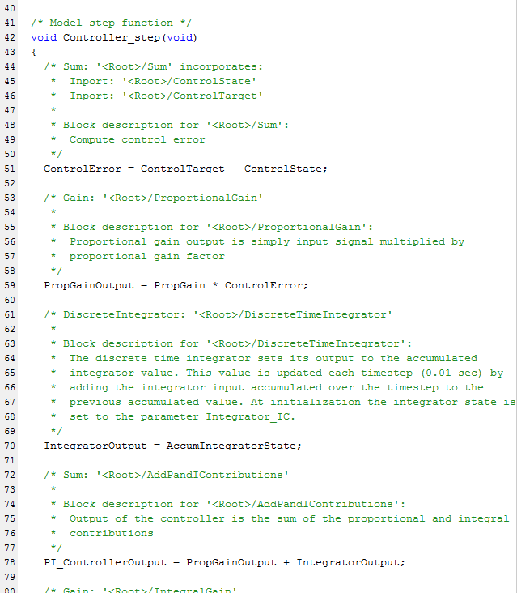
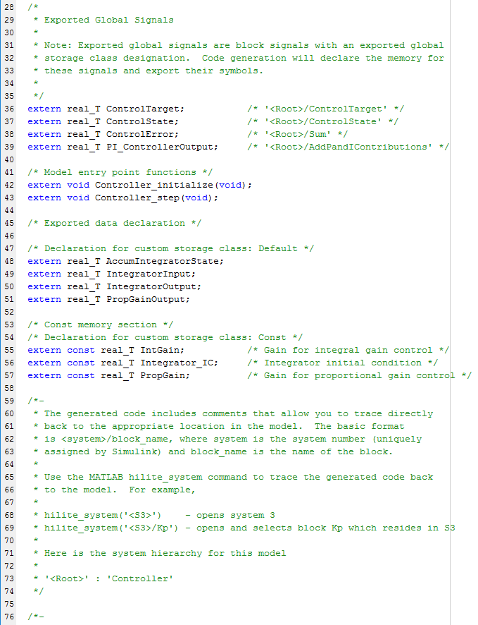
The (Perceived) Process for Many Decades
Requirements Development
Clear handoffs!
Requirements Document
Systems Engineer
Design
Algorithm Design Description
Subsystem Engineer
Implementation
Software Code
Software Engineer
Integration & Test
Defects are found late and incur high cost
Software/Test Engineer
Qualified Software

Slide 4
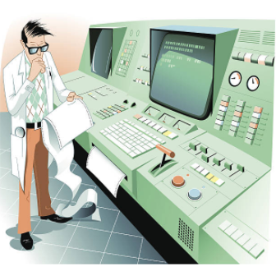
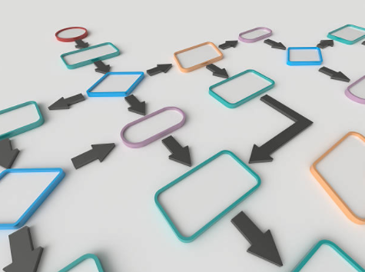
Challenges
Cost of Testing Software
Budget
Complexity

Slide 5
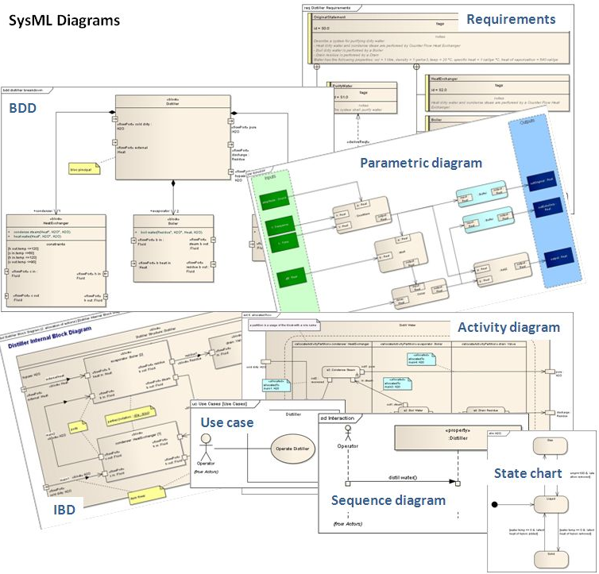
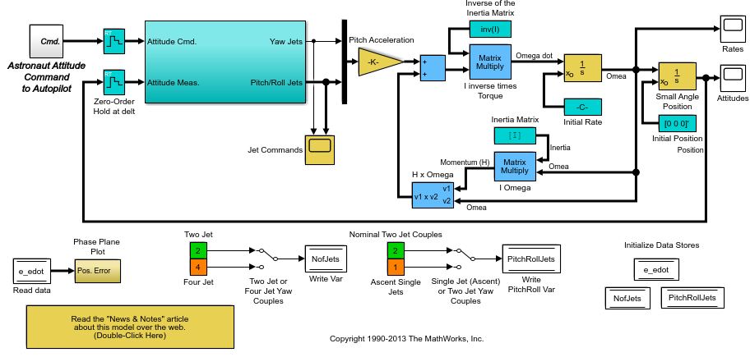
Today’s Landscape
Requirements Development
Clear handoffs → Grey areas
Systems Engineer
Focus of the presentation
Design
MBSE
Correct requirements
Consistent requirements
Clear functional decomposition
Well maintained interfaces
Subsystem Engineer
Implementation
Model-Based Design
Early and continuous testing
Early requirements validation
Reduced defects in production code
Software Engineer
Integration & Test
Software/Test Engineer
Qualified Software

Slide 6
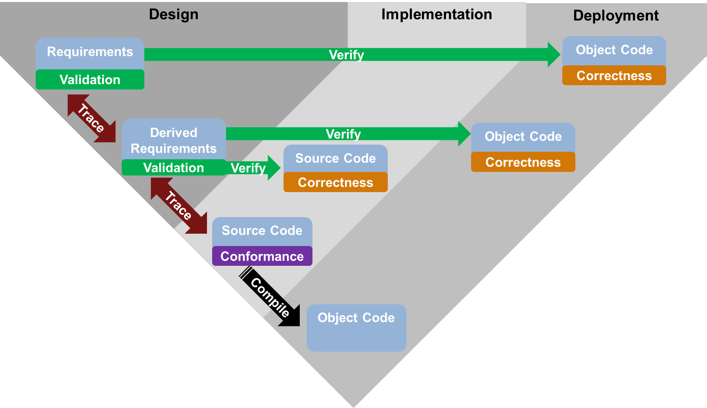
V
Traditional Process

Slide 7
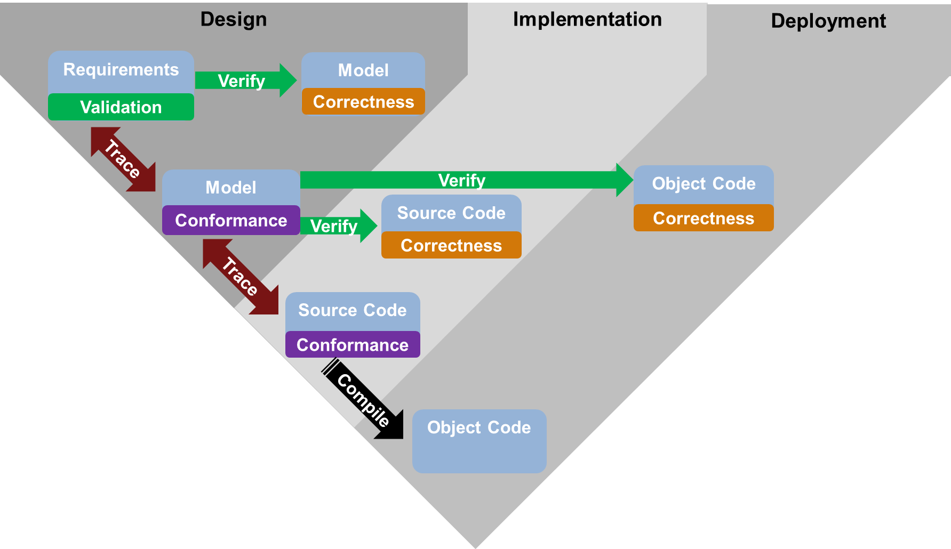
Revised V
Model-Based Design
Earlier ☺

Slide 8
Great, let’s try it!
Subsystems
Generate Code
Software
Gripe About Code
Subsystems
Generate Code
Software
Gripe About Code
Subsystems
Modify Model
Modify Model
Build Model
Software
Gripe About Code
Modify Model
Generate Code
Generate Code
Subsystems
Software
Gripe About Code

Slide 9
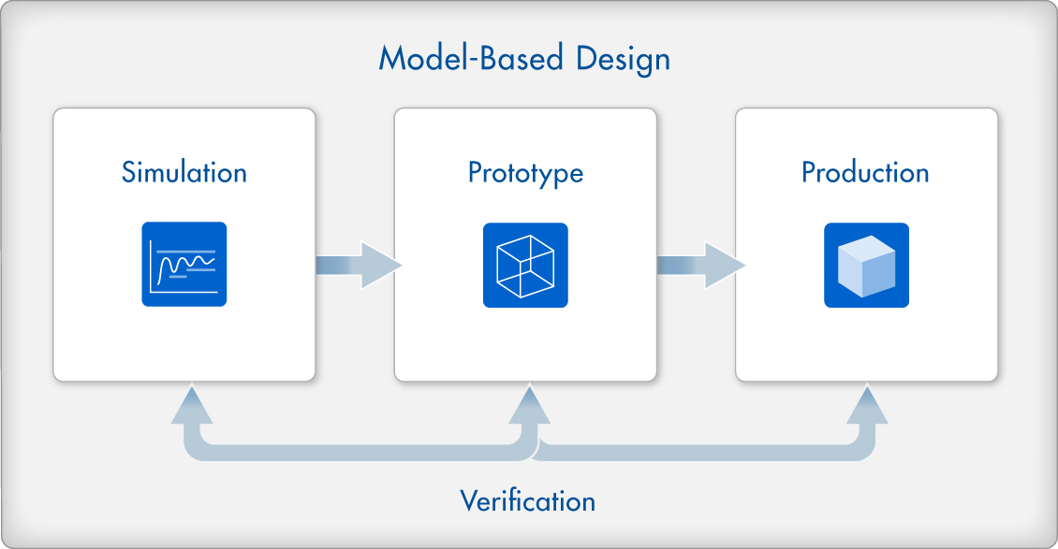
Who has the Domain Expertise?
Requirements
Production Code
Subsystems engineers
Software engineers
Domain Expertise

Slide 10
Joint Ownership = Combined Domain Expertise
Subsystems
Simulink
Software
Organizations most successful with Model-Based Design have at least 1 software engineer embedded with the subsystems team(s)

Slide 11
But what’s in it for software engineers?
Stake in the quality of the code
Less frustration
Code is refactored for you
Traceability is built in
Automated reporting and artifact generation
Automated standards checking
Fewer issues to resolve during static code analysis

Slide 12
Putting it all together…
Subsystems
Functionality
Requirements Compliance
Requirements Validation
Simulation Performance
Design Documentation
Software
Software Architecture
Component Interfaces
Coding Standards
Security
Maintainability
Software Performance
Modeling Standards
Modeling Standards
Good Code

