Slide 1
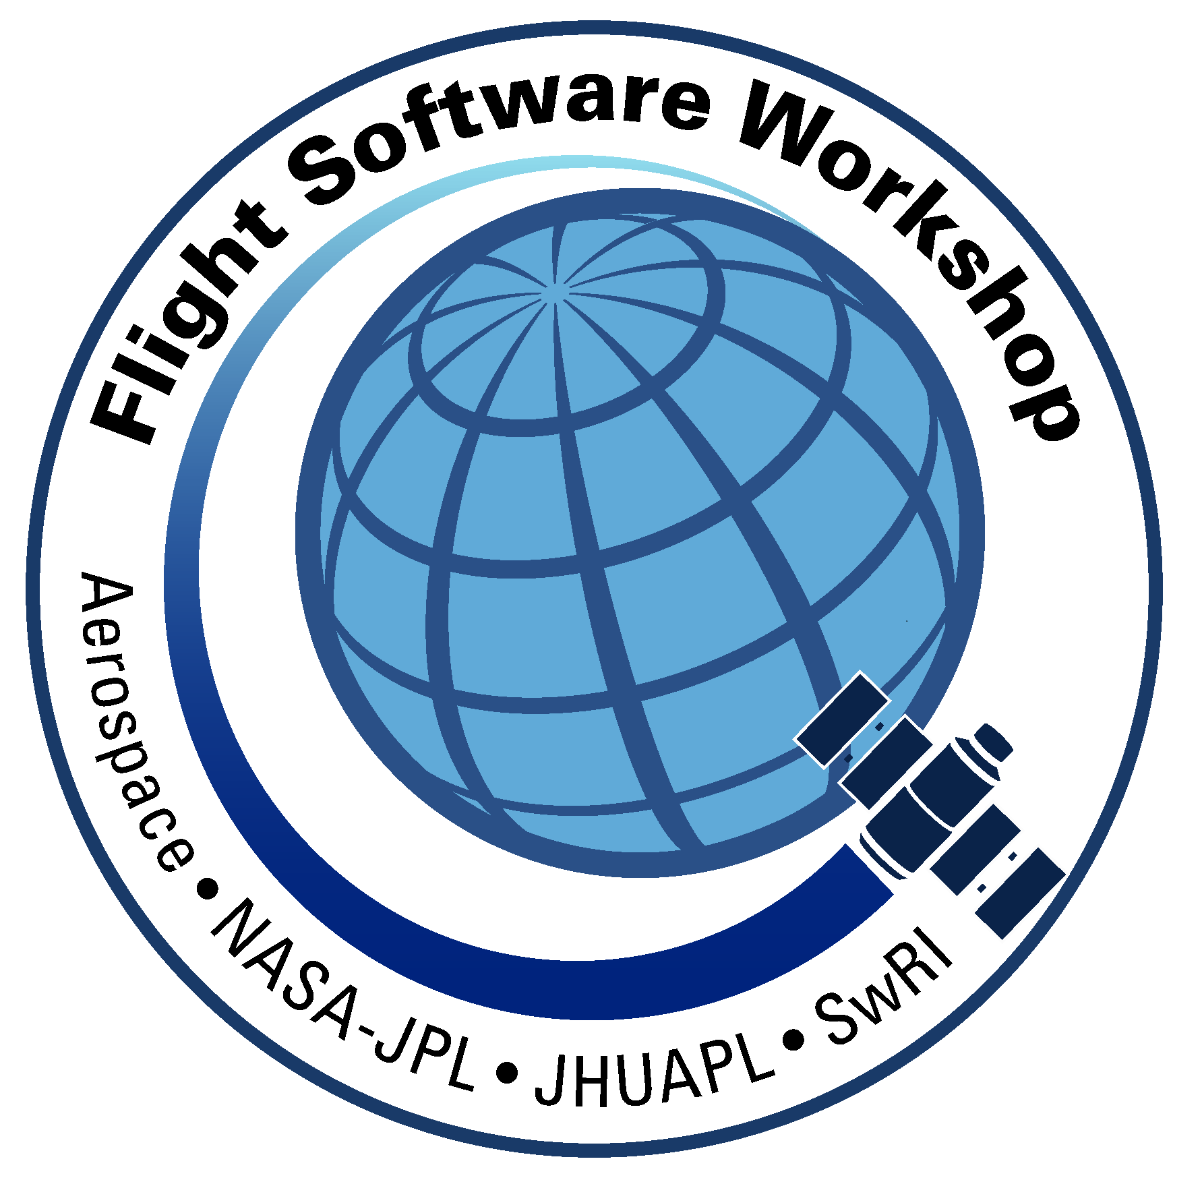
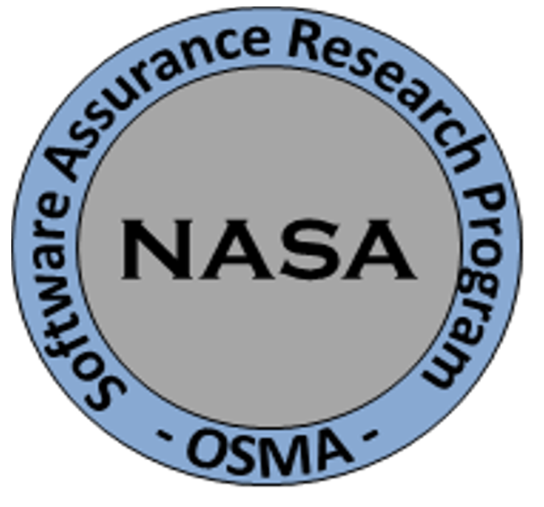
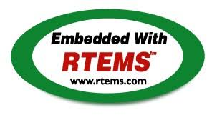
Open-Source RTOS Space Qualification An RTEMS Case Study
Scott Zemerick
Systems Engineer
TMC Technologies
NASA’s IV&V Program
Image Credit: NASA/JHU APL

Slide 2
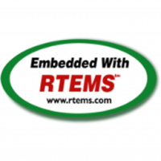
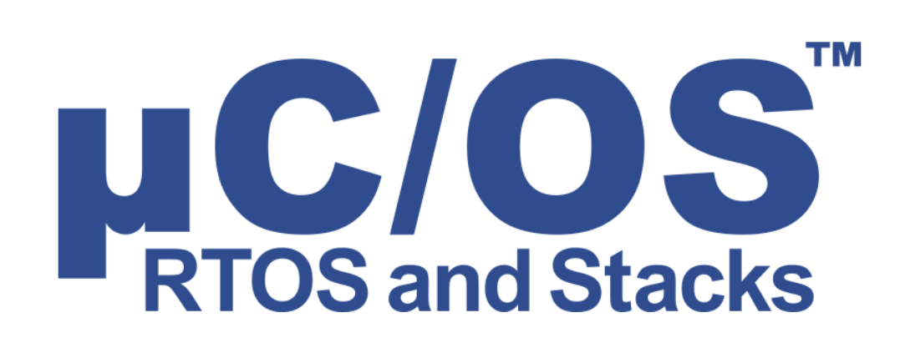
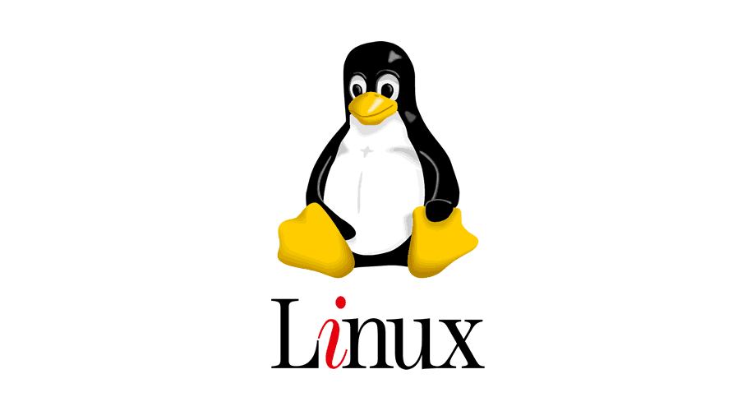
NASA RTOS Usage

Slide 3
Open-Source RTOS Considerations
Open-Source Advantages
Projects desire to own/control all source code forever
Not locked into specific vendor/version for many years
Not locked into proprietary build environment / tools
Don’t have to pay third-party for upgrades / new features
Successful heritage and flight experience
No budget for purchases
Open-Source Barriers
Unable to be (easily) flight qualified
No artifacts, little or limited documentation, no test cases
Lots of internal development / testing may be needed
Example: custom drivers
Nothing is guaranteed to work “out of the box”
Could require more testing than COTS
Many forks, no central/core version, fixes/features not fed back to project

Slide 4
Terminology
Qualification vs Certification
The process of developing and documenting quality software by utilizing a formal process and artifact generation
Pre-Qualification is jump start on qualification with core artifacts and processes
Final “Flight” Qualification
Performed on specific flight board/system
Qualified to a chosen standard
Examples: DO178-B/C, NASA 7150.2B
Tested and documented

Slide 5
Open-Source Qualification Example
Core Flight System (CFS) Class A Certification
Performed by JSC for the Orion Program
LEON3/VxWorks
Certification Included
Full coverage UT-assert unit test cases
API unit tests
Vertical integration tests
Test matrix, test plan, procedures, test report
VDD, User’s Guide
Code inspections, static analysis
Coverage analysis results
Lorraine Prokop, Ph.D.
Software Manager, Advanced Exploration Systems Avionics & Software Project NASA Johnson Space Center (JSC)
October 2015

Slide 6
Research Goals
Increase the quality and maturity of open-source RTOS by identifying a lean, mean, PRE-qualification process
Process should be driven by standard(s)
Process has to be simple, not overwhelming, leverage existing / free tools, and not scary
Processes are scary for open-source projects
Limited resources
No time, money, expertise, or manpower
Not agile – too rigid for open-source paradigm
7150.2B

Slide 7
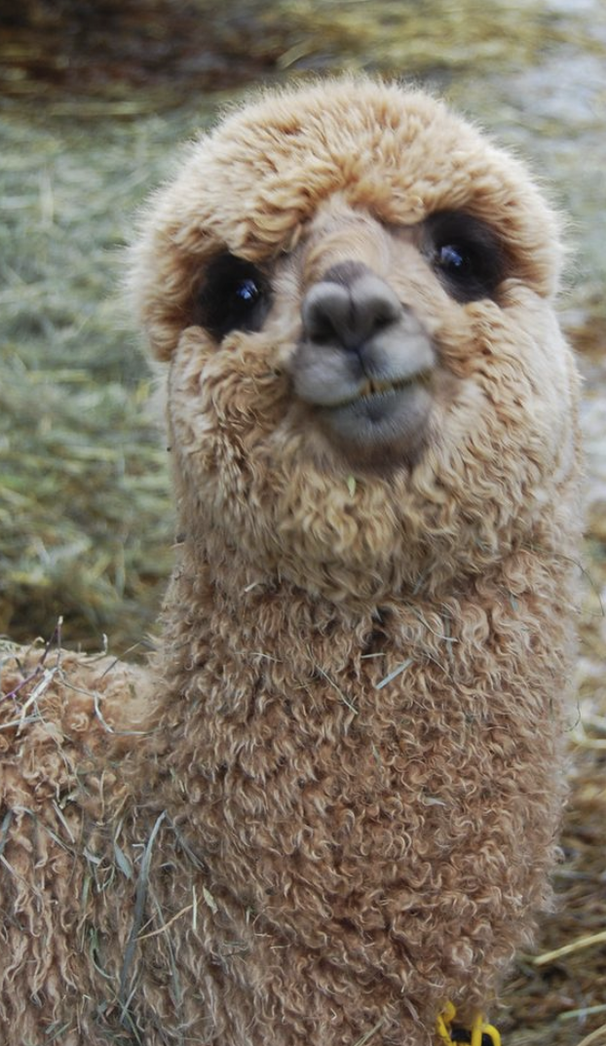
Research Goals
Imagine: FSW Lead on New Mission
What RTOS? Open-source or COTS?
IF Open-Source:
Flight heritage?
Hardware profiles? LEON3/4, RAD750?
Maturity?
Flight Qualification Possible?
Maturation Metrics
How to measure maturity?
How to measure software quality?
Choose open-source RTOS that is pre-qualified
Ease and jump-start the qualification process
Review state of the open-source RTOS
What is complete? Tested?
What holes are missing? What needs tested?
Pre-Qualification Provides a Warm-and-Fuzzy RTOS Choice

Slide 8
Research Goals
GSFC Flight Software Open Source Flight Software Stack
Completely Open Source Flight Software
“Qualifiable” due to this research
Applicable to both small and large NASA missions
NASA Mission Flight Software
Mission Specific
Artifacts
Core
Tests
Open Source
cFS
RTOS Pre-Qualification
OSAL
RTEMS

Slide 9
Research Tasks
Task 1: Find DO-178B and 7150.2B Overlap
Task 2: Review Overlap and Trim to Core Artifacts
Task 3: Generate Core-Artifacts-List
Task 4: Apply Core-Artifacts-List to Open-Source Project
DO-178B
7150.2B
Core Artifacts

Slide 10
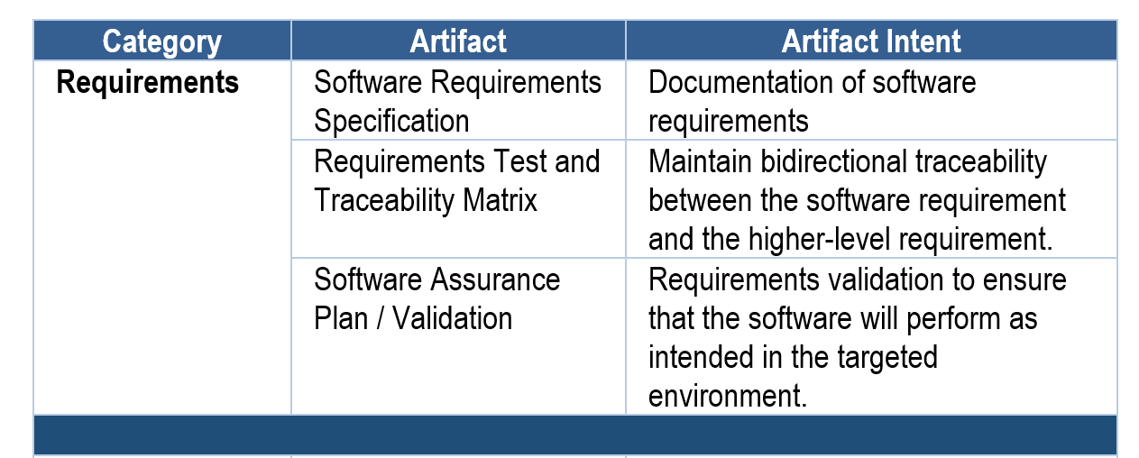
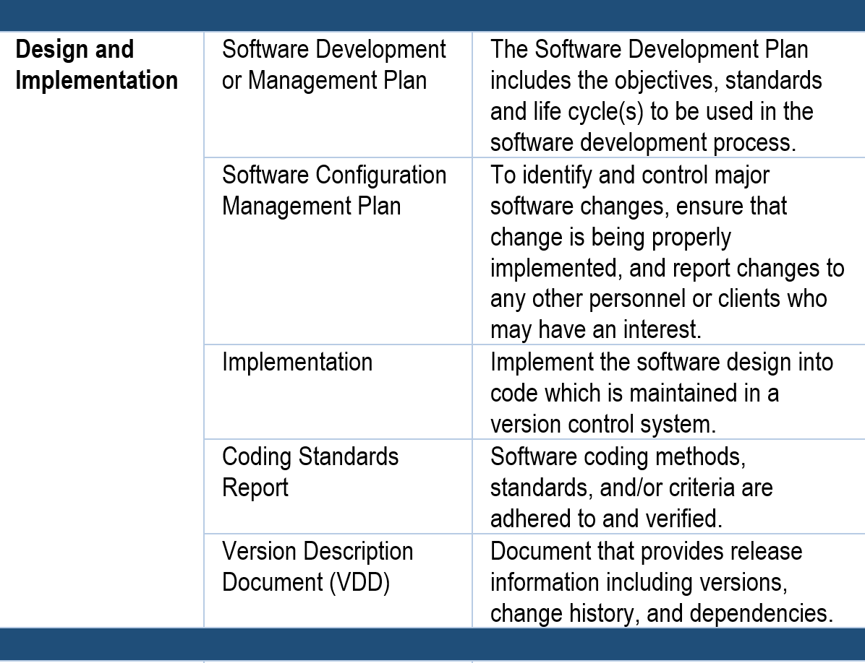
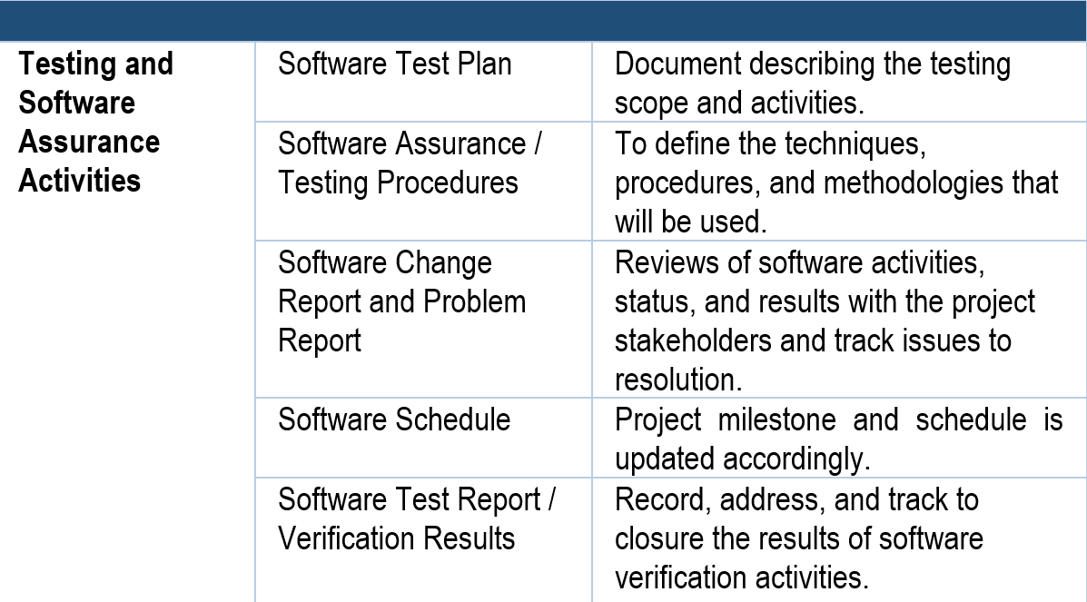
Core-Artifacts-List
Provides a pre-qual starting point
Friendly names
Should not be surprising
Category-based
“Hidden” pre-qual with focus on process and testing

Slide 11
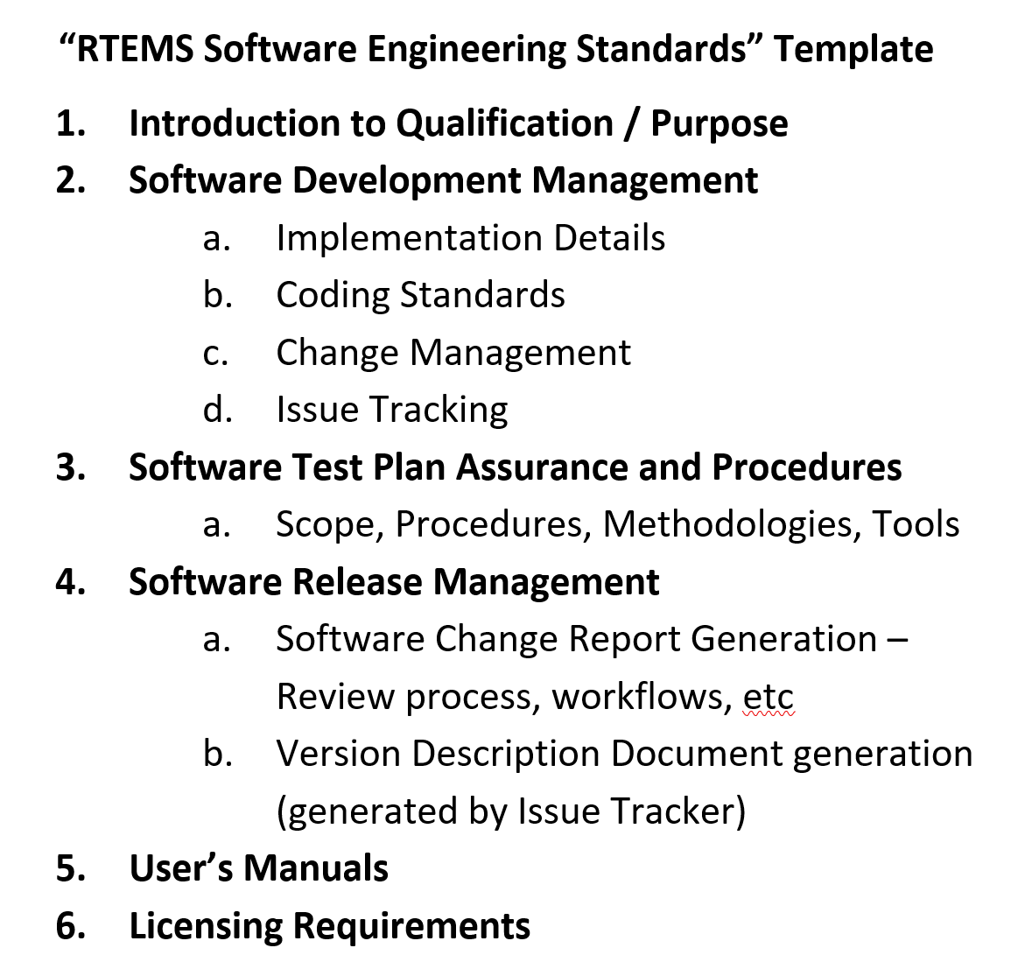
Applicable to RTEMS
Task 4: Apply Core-Artifacts-List to Open-Source Project
Chose RTEMS
Significant NASA / ESA flight heritage
Professional, well-managed open-source project
Desires to incorporate pre-qualification into their open-source process – but can’t be a burden – wants a lightweight process
Has some existing processes, tests, documentation in place
DO-178B
7150.2B

Slide 12
Applicable to RTEMS
Next Steps
Dive into more details
Provide scorecard on areas that can be improved
Leverage open-source tools to generate artifacts
Think about requirements more

Slide 13
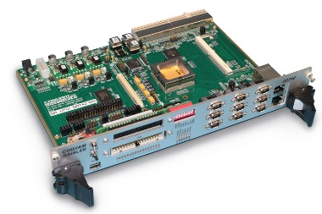
RTEMS Space Qualification
Test Bed (REST)
REST is a virtual environment with LEON3 instruction set simulator
Goal will be a basic set of checkout tests and suitable for pre-qualification testing
Repeatable test results
Pre-Qualification Space Profile
LEON3
(WFIRST uses LEON4)
LEON3
Xilinx Spartan6
TSIM2
QEMU
JSTAR Hardware
Virtual
Virtual

Slide 14
Ongoing FY18 Work
Continue working with RTEMS community on pre-qualification
Investigate RTOS security and how to assess
How much should we care about embedded RTOS security?
What characteristics of security apply to an RTOS?
Mature cFS CryptoLib and Release
CryptoLib implements SDLS procedures and allow for easy integration into existing CFS command ingest and telemetry output applications
Integrate into NOS3 – http://www.nos3.org

