Slide 1
Performance Analysis of Standalone and In-FPGA LEON3 Processors
10th Workshop on Spacecraft Flight Software
Dmitriy Bekker
Embedded Applications Group
Space Exploration Sector
December 7, 2017
This is a non-ITAR presentation, for public release and reproduction from FSW website.

Slide 2
Overview
Choosing a Processor
Benchmarks and Test Targets
LEON3 Processor Family
RTG4 RadTolerant FPGA
APL CORESAT SBC
Test Configurations (HW)
Performance Results
Benchmarks, Tests, Applications, Resource Utilization, Power
Design Considerations
Cache, Clocking, Instructions, Multicore
Processing Capability – The Big Picture
Conclusions
The bulk of the talk

Slide 3
Choosing a Processor
When considering a new processor for a mission, one of the questions that comes up is: “How does this processor compare with what we have used in the past?”
Does the manufacturer provide benchmark data? Is per-MHz performance presented?
Does the data have key parameters (compiler, build options, memory type, etc.)?
Is power consumption considered?
What is the achievable max frequency of the compared processors?
If it’s a soft-core FPGA implementation:
Is resource utilization tracked?
What IP is instantiated?
Are timing / max frequency limitations of the FPGA technology known?

Slide 4
Choosing a Processor
Consider this: Many C&DH systems have an FPGA
“Modern” space-ready FPGAs are fairly large:
Have many logic resources, and also carry embedded RAM blocks, DSP slices, etc.
Often have room to host one or more embedded soft processors
Some advantages of hosting a soft-processor inside an FPGA:
Possibly can get rid of hard processor (lower total SWaP)
Easier integration with IP internal to the FPGA
Flexibility in processor configuration
But…
Max frequency is typically much lower
IP may not have gone through as much testing as hard processor
This presentation compares performance of soft and hard processors of the LEON3 family using carefully tracked benchmarks, applications, and architectural design options.

Slide 5
Benchmarks and Test Targets
Synthetic benchmarks – industry standard
Dhrystone (integer performance, popular, has some flaws)
CoreMark (integer performance)
Whetstone (floating-point performance)
Testing applications – our own small subsystem testers
Memcpy-bench (time the performance of memcpy)
Nandfctrl-test (time the performance of NAND Flash interface)
End-to-end application – a real-world example
Terrain Relative Navigation
LEON3 Test Targets
Hard uP
UT699
SRAM
Hard uP
UT699
SDRAM
Hard uP
UT700
SDRAM
Soft uP
RTG4
DDR3
Hard uP
UT700
SRAM
Soft uP
RTG4
SRAM
DevBoards
APL SBC

Slide 6
LEON3 Processor Family
32-bit processor, SPARC V8 instruction set
AMBA 2.0 AHB bus interface
On-chip debug support
RTEMS, Linux, VxWorks support
Single-core hard processors evaluated (fault tolerant):
UT699 (66 MHz): FPU, 8KB D-cache, 8KB I-cache, 4x SpW, etc.
UT700 (166 MHz): FPU, 16KB D-cache, 16KB I-cache, 4x SpW, etc.
Single-core soft processor (configurable fault tolerance):
Fully customizable: FPU, cache size, mem ctrl, IP selection, etc.
Can build multi-CPU systems (subject of FY18 R&D effort)
Max frequency depends on FPGA target technology and complexity of entire design

Slide 7
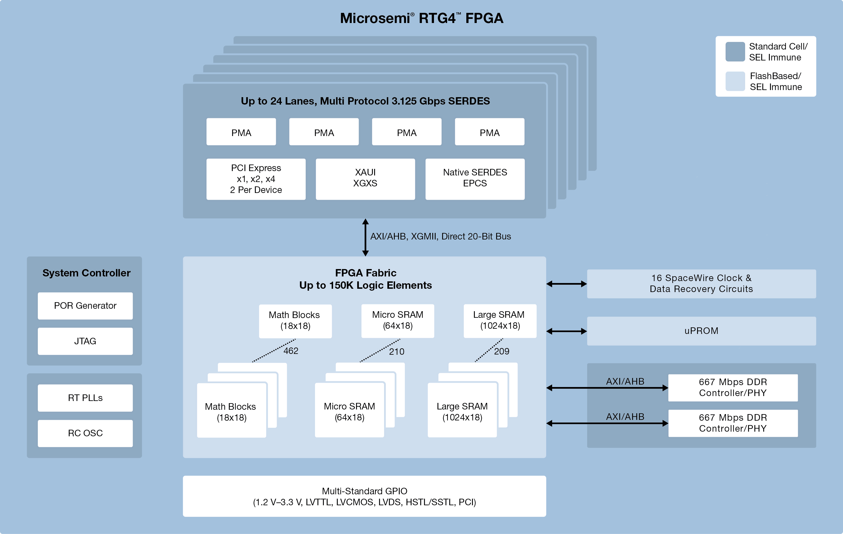
RTG4 RadTolerant FPGA
Relatively large, reprogrammable flash FPGA, with embedded RAM blocks, DSP slices, SpW interfaces, uPROMs, SERDES, etc.

Slide 8
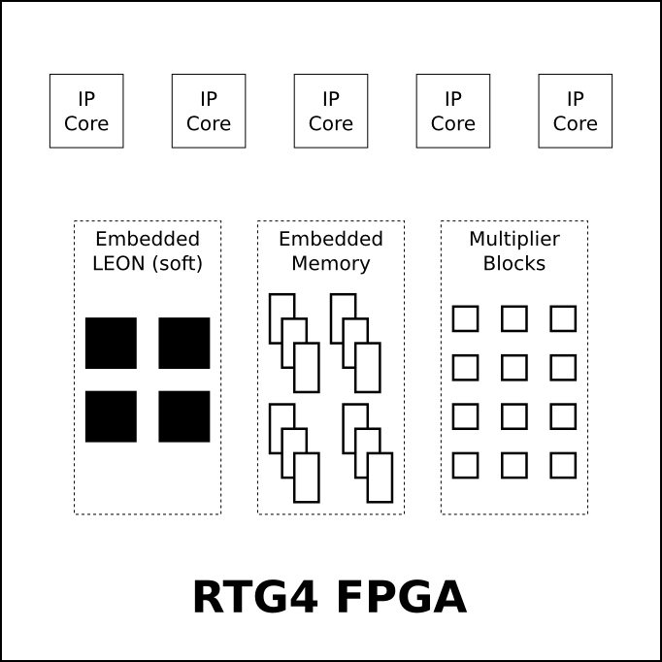
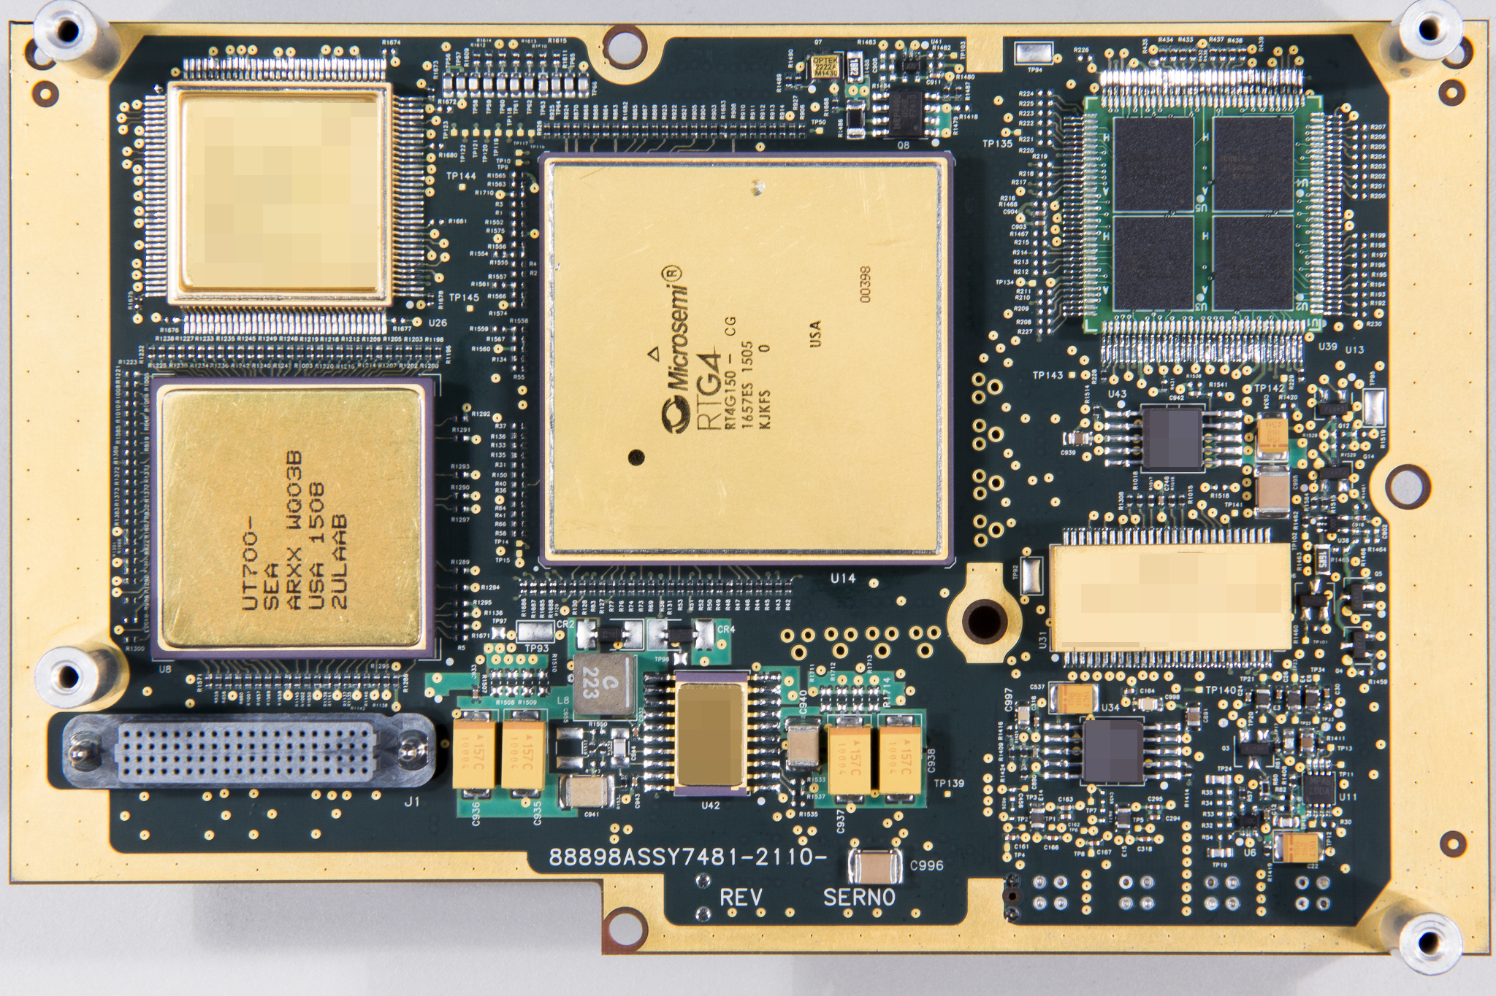
APL CORESAT SBC
Specifications
Volume: 400 cm³ (15.2 x 9.7 x 1.8 cm; 0.33 U)
Mass: 0.22 kg (excludes chassis)
Pwr I/F: 3.3V, 1.2V, remote V sense, F sync
Pwr: 0.6W (Stand-By) / 4.0W (typ, est.)
Memory: Two 16MB SRAM, 8MB MRAM
SSR: 16 GB
Data I/F: 4-port SpW router, 8 discrete I/O, SERDES in/out, 2 analog or IF inputs and outputs, JTAG
Missions: DART (1st user), others planned
B. Bubnash

Slide 9
Test Configurations (HW)
UT699 DevBoard (66 MHz):
SRAM Waitstates: RD=1, WR=1
SDRAM Parameters (in cycles): T_{RP}=2, T_{RFC}=5, CAS=2
UT700 DevBoard (100 MHz)
SDRAM Parameters (in cycles): T_{RP}=3, T_{RFC}=8, CAS=3
CORESAT SBC UT700 (100 MHz)
SRAM Waitstates: RD=1, WR=0
CORESAT SBC Soft LEON3 (50 MHz)
SRAM Waitstates: RD=0, WR=0
Benchmark chart figures reported as per-MHz
Full-capability performance values also presented
All soft LEON3 builds were for non-FT, commercial version

Slide 10
Performance Results
Benchmarks, Tests, Applications, Resource Utilization, Power

Slide 11
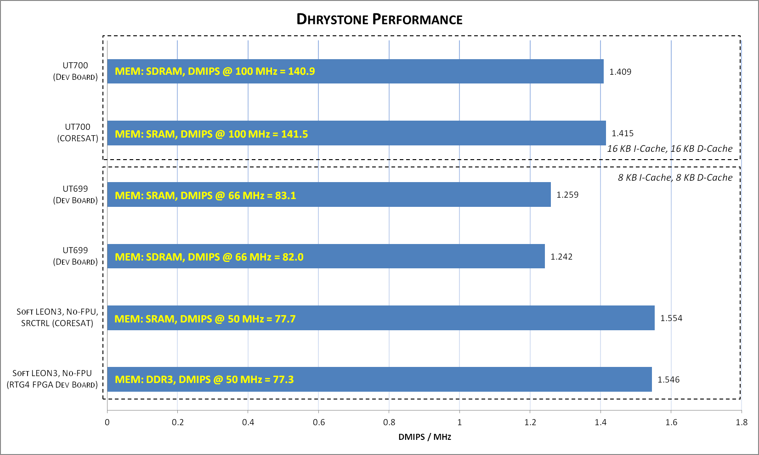
Benchmark: Dhrystone
Compiler: BCC v4.4.2, release 1.0.45
Options: -O3 -mcpu=v8 -msoft-float

Slide 12
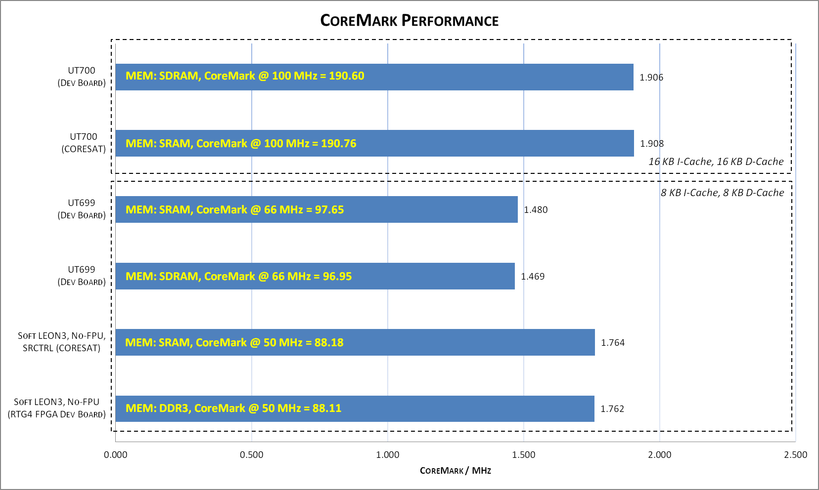
Benchmark: CoreMark
Compiler: BCC v4.4.2, release 1.0.45
Options: -O3 -mcpu=v8 -msoft-float -funroll-loops -fgcse-sm

Slide 13
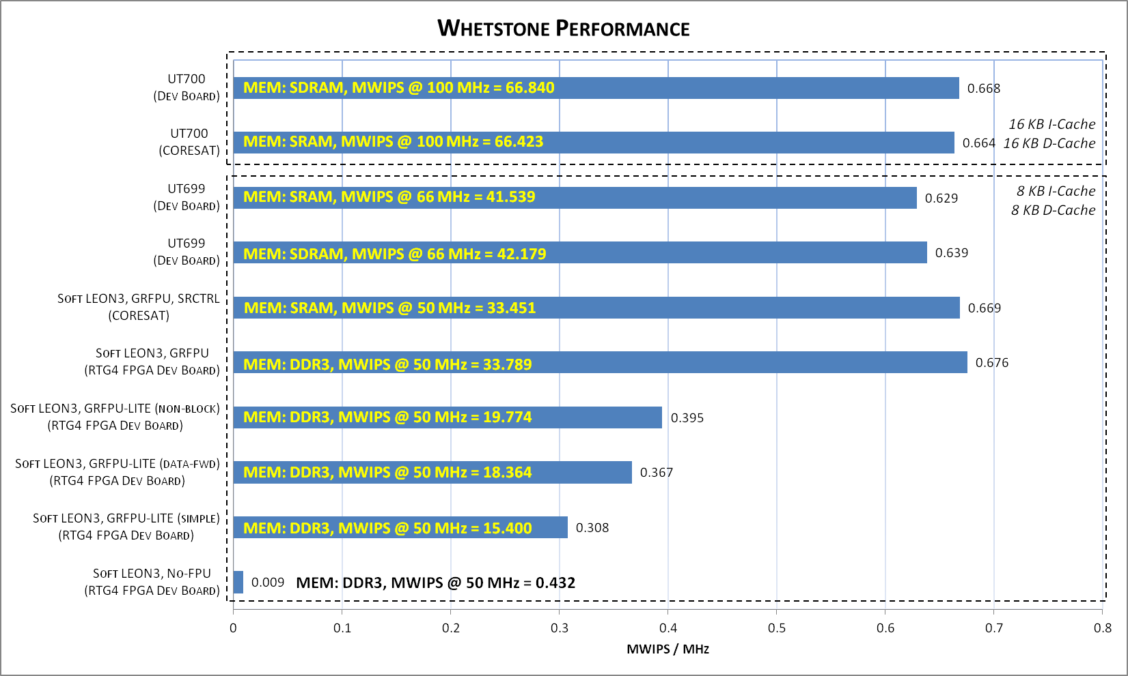
Benchmark: Whetstone
Compiler: BCC v4.4.2, release 1.0.45
Options: -O2 -DDP -mcpu=v8 (add -mtune=ut699 for UT699, add -msoft-float for No-FPU test)

Slide 14
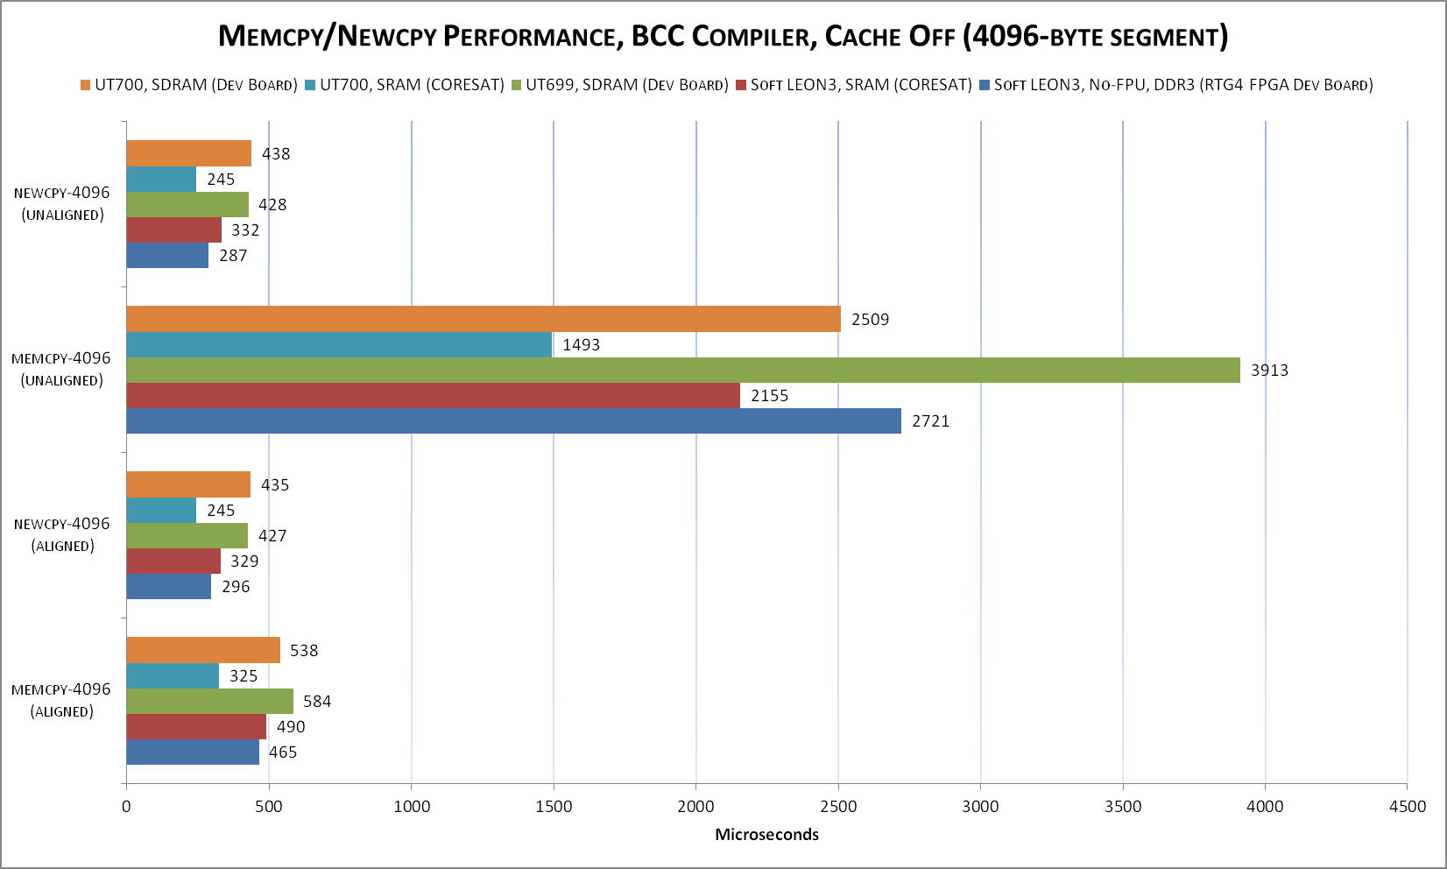
Test: Memcpy
Compiler: BCC v4.4.2, release 1.0.45 • Options: -O2 -mcpu=v8 -msoft-float
SPARC optimized “newcpy”: https://github.com/torvalds/linux/blob/master/arch/sparc/lib/memcpy.S

Slide 15
Test: Flash Memory Performance
NAND Flash offers some benefits over NOR Flash:
Higher density, faster program time
Generally better radiation performance
But…
NOR is easier to interface with (on LEON3, can use memory bus)
NAND requires a communication protocol (commands + data)
NAND flash requires a controller IP core, and therefore can only be attached to a soft-core processor implementation / FPGA logic
ONFI 2.0 Timing Mode | Read Page (us) | Erase Block (us) | Program Page (us) | Program Cached
 |  |  |  | 2-Pages (us) | Lead-Out (us) | Est. Throughput
0 | 491 | 570 | 730 | 1061 | 187 | 65.1 Mbps
1 | 267 | 570 | 557 | 714 | 187 | 96.8 Mbps
Target build: Soft LEON3 / RTG4 / 50 MHz / CORESAT SBC
Compiler: RCC v4.10, release 1.2.19
Options: -O2 -mcpu=v8 -msoft-float
(assuming back-to-back program cache performance sustained)

Slide 16
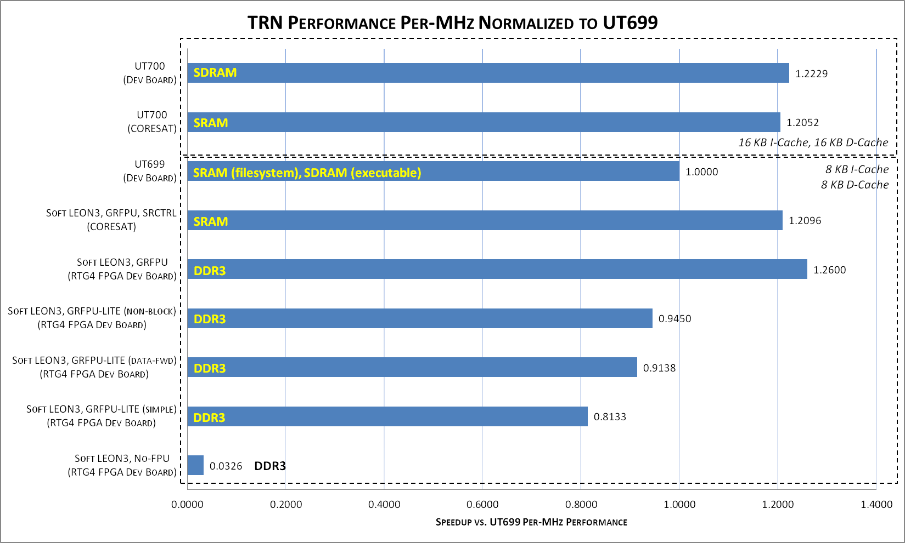
Application: Terrain Relative Navigation
Compiler: RCC v4.10, release 1.2.19
Options: -O2 -mcpu=v8 (add -mtune=ut699 for UT699)

Slide 17
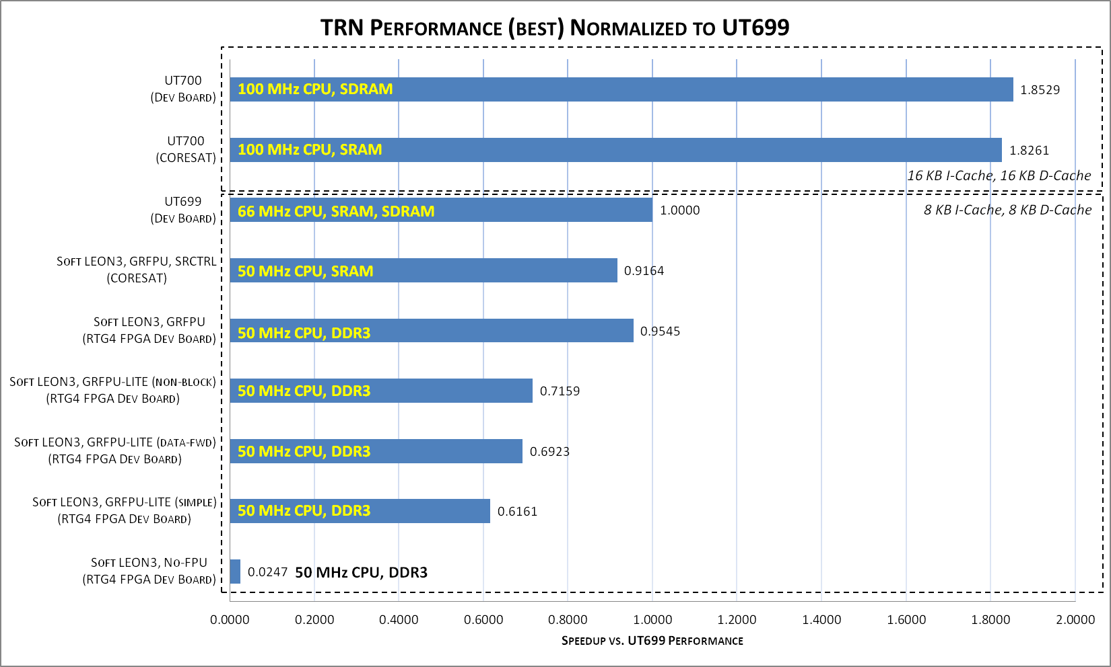
Application: Terrain Relative Navigation
Compiler: RCC v4.10, release 1.2.19
Options: -O2 -mcpu=v8 (add -mtune=ut699 for UT699)

Slide 18
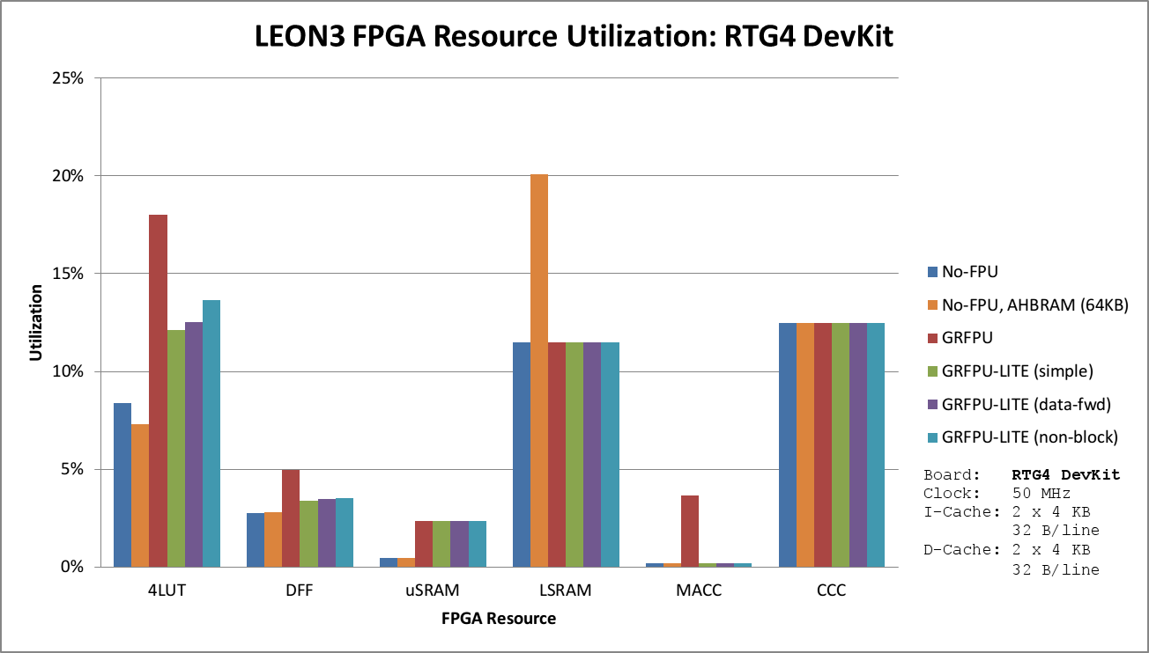
Resource Utilization: RTG4 DevKit

Slide 19
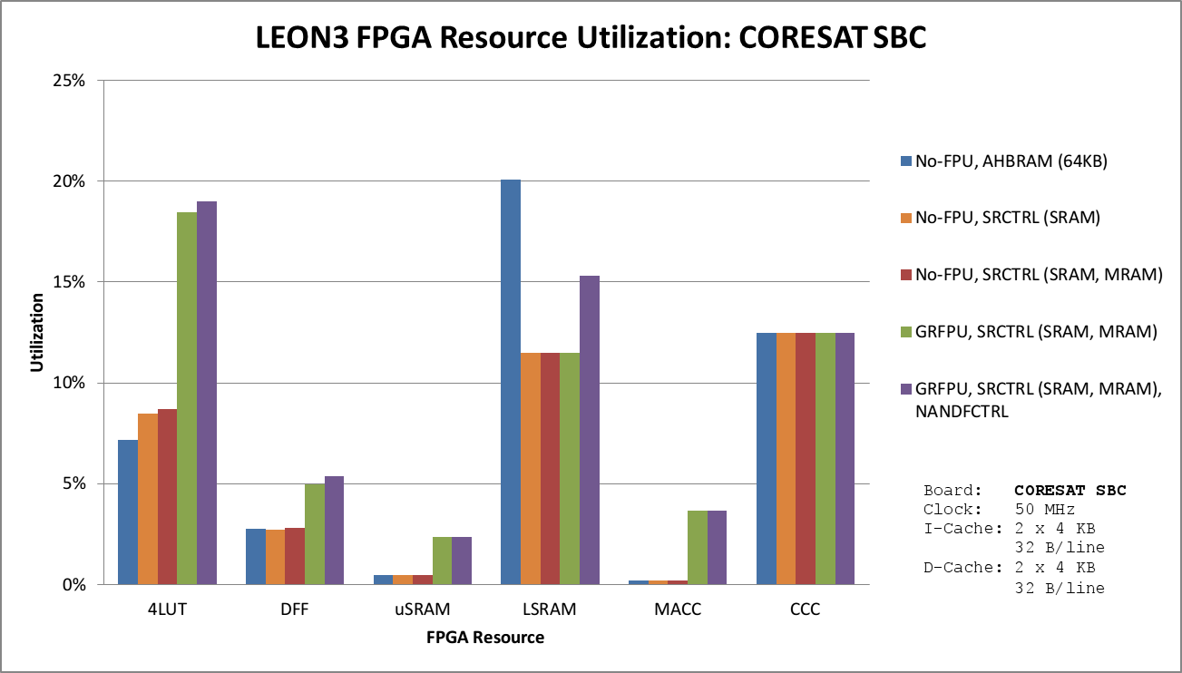
Resource Utilization: CORESAT SBC

Slide 20
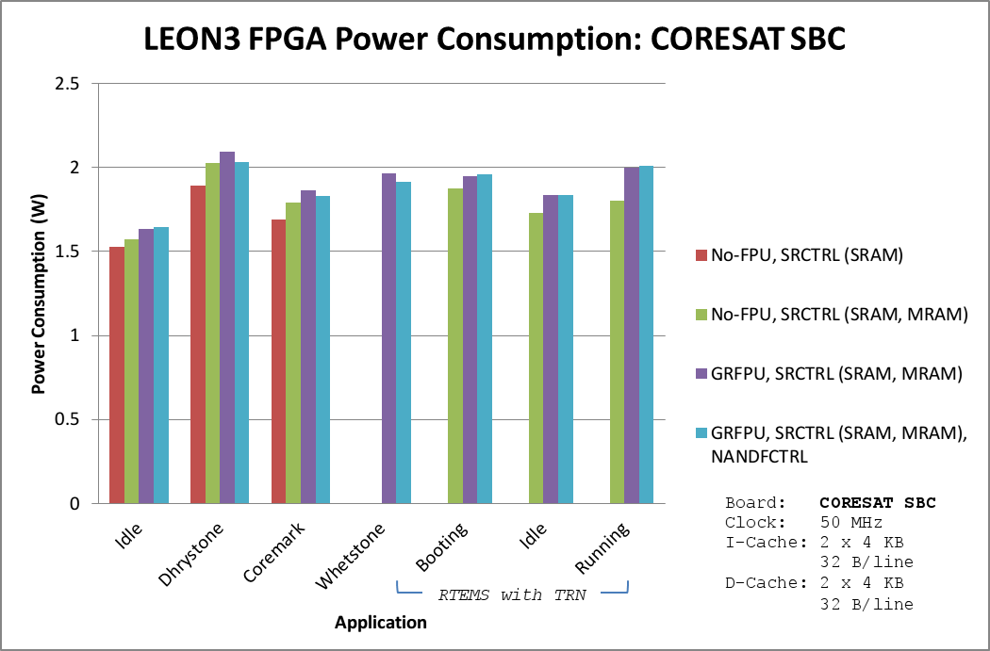
Power Consumption: CORESAT SBC

Slide 21
Design Considerations
Cache, Clocking, Instructions, Multicore

Slide 22
Cache Design Considerations
Actual resource utilization data for RTG4 builds
Miss rate is theoretical, from reference below
Note the LSRAM resource cost for different associativity
From:
"Computer Architecture: A Quantitative Approach" by John Hennessy & David Patterson (5th Edition)

Slide 23
Clocking and Instructions Storage
A couple beneficial soft-core LEON3 design options were studied as part of this work
CLK2X design:
Run CPU at 2x AHB bus frequency
CPU will achieve higher performance when executing out of cache
Save power vs. running both CPU and AHB at the same higher clock frequency
Unfortunately, this only makes sense for target FPGA technology that can meet timing at higher CPU frequencies (not for RTG4)
For memory constrained systems, consider REX extension:
More compact code: 16-bit instructions (vs. standard 32-bit)
~7% size reduction vs. GCC compiled code (greater for LLVM)
Instruction cache miss rate reduction
New BCC2 compiler handles encoding
Soft-core processor must have REX decoding engine enabled
REX Presentation: https://indico.esa.int/indico/event/146/contribution/3/material/1/0.pdf

Slide 24
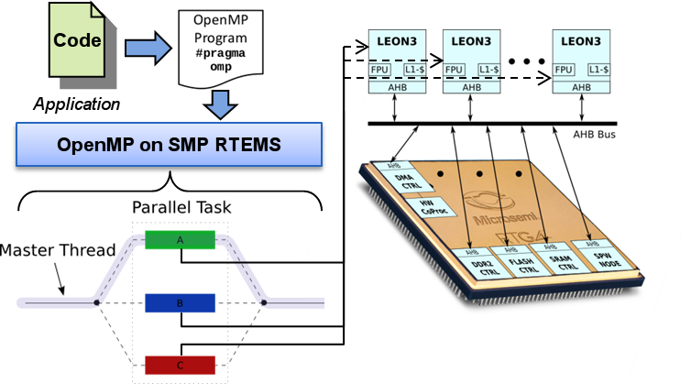
Multicore / Parallel Programming
In FY18, we’re looking into SMP RTEMS with OpenMP support
Profile code execution
Insert parallelization pragmas in key code segments to farm out execution out to multiple CPU cores
Goal: reduce total application execution time

Slide 25
Processing Capability
The Big Picture

Slide 26
What is the Technology Tradespace?
Target | Effort | Perform. | Gen. Purpose Design | Power Req. | RadHard
Single-core | Low | Low | High | Low | Yes
Multi-core | Medium | Medium | High | Medium | Yes
FPGA | High | High | Low | Medium | Yes
GPU | Medium | High | High | High | No
Neuro-morphic | High | High | Medium | Very Low | No
CORESAT SBC
coexist
Our FY18 multicore work
Multiple FY18 efforts in this area
Highest performance option on current RadHard technology
The future in space?

Slide 27
Conclusions
A soft-core LEON3 processor can be configured to meet or exceed the per-MHz performance of a hard LEON3 processor
Max frequency of a hard LEON3 processor is higher than what is achievable with RTG4 FPGA technology for a soft processor
A single hard LEON3 processor will outperform a single soft processor
Most missions have a dense FPGA as part of DSP / logic functions
If there is room, adding a soft-core processor (or two…) may augment the total processing capability or even make an additional hard processor unnecessary
Integration/test of IP cores can be simpler with the flexibility offered by having a soft processor on the same chip
SPARC optimized memcpy is better performing than standard memcpy (especially for unaligned memory accesses)
For soft-core designs, consider FPU performance, resource utilization, cache config., and power impact (don’t overdesign!)
Current efforts are looking at multi-core systems / parallel programming targeted at soft-core processor designs

