Slide 1
cFS Systems Technology Roadmap
The Johns Hopkins University Applied Physics Laboratory
core Flight System Workshop
Jonathan Wilmot
December 04, 2017

Slide 2
Near Term Roadmap Activities
From the 2015 workshop
  Increasing the message name space (6.6 build option)
  Electronic Data Sheets (6.6 build option)
  Software Bus Network (Covered later by Chris Knight)
  Multicore (Partial implementation in 6.6)
  Modeling/autocode (Covered later Pat Castle, Steve Lentine)
  Real-time Linux (Demonstrated on Xenomai)
  Partitioning (Demonstrated on ARINC 653 and Xenomai)
  Cmake build environment (covered later by Joe Hickey)
New activities
  Onboard file transfer
  Revamp Time services
  Time triggered Scheduling
  64 bit implementation

Slide 3
Increasing the message name space

Slide 4
Extending the CCSDS Message Header
cFS uses CCSDS Space Packet Protocol format for onboard messages
In cFE 6.6, projects can turn on and additional 32 bits to the CCSDS Space Packet secondary header to increase the name space
  Increasing the potential APID name space from 2¹² to 2³⁷
  For practical/efficiency reasons cFS will limit to 2³²
Changes are isolated to cFS SB and SBN
  Applications subscribe to a 32 bit number instead of 16bit number
  Change is transparent to applications after a recompile
Near term infusion
  GSFC Restore Servicing Payload mission(s) (Distributed system with 16 processors)
  AES Habitat prototyping efforts
  Other missions?

Slide 5
Proposed Updates to CCSDS SPP

Slide 6
cFE 6.6 Implementation
The MsgId is a mission defined message identifier to publish or subscribe to
  Must be unique within the system(s).
CFE_SB_MsgId_t is a uint32 that can be created from any combination of bits from the primary header SID (StreamId) and the secondary header APID Qualifiers
Define MESSAGE_FORMAT_IS_CCSDS_VER_2 in cfe_mission_cfg.h
As defined in cfe_sb_msg_id_util.h/c the default setup will combine
  1 bit for the command/telemetry flag
  7 bits from the primary header APID
  0 bits from the Playback flag
  8 bits from the secondary header APID qualifier (Subsystem)
  0 bits from the secondary header APID qualifier as the System
The APID qualifier System field is populated with the Spacecraft ID but will be ignored in the default case for SB/SBN routing purposes

Slide 7
Updated cFS Message ID Terms
StreamId
  First 16 bits of CCSDS Space Packet Protocol (SPP) 133.0-B.1c2 Blue Book packet primary header. It contains the 3 bit Version Number, 1 bit Packet Type ID, 1 bit Secondary Header flag, and 11 bit Application Process ID. It was used in earlier cFS implementations and defined here for historical reference. It is NOT exposed to user applications
MsgId
  Unique numeric message identifier within a mission namespace. It is used by cFS applications to the identify messages for publishing and subscribing It is used by the SB API and encoded in a mission defended way in the header of all cFS messages. It is exposed to all cFS applications
ApId
  CCSDS Application Process Id field in the primary header. It has default bit mask of 0x07FF and is part of the cFS message Id It should not be confused with the cFE Executive Services (ES) term appId which identifies the software application/component. It is NOT exposed to user applications
MsgIdkey
  This is a unique numeric key within a mission namespace that is used with cFS software bus internal structures. It is algorithmically created in a mission defined way from the MsgId to support efficient lookup and mapping implementations It is NOT exposed to user applications

Slide 8
Name Space
ACS sensor data created on on habitat
ACS sensor data
read on crew vehicle
Applications need to know the data format and what system the data came from:
  Habitat.GNC.sensorData
Issue: what should the ground/user interface look like?

Slide 9
CCSDS Status
CCSDS Space Link Protocols Working Group (SLS-SLP) has agreed to address the issue in 2018
  White paper discussing issues and proposed solution due March 2018
    Authors: Jonathan Wilmot (GSFC), Scott Burleigh (JPL), Keith Scott (MITRE)
  Work will be done in two phases
    Update the Space Packet blue book to clarify APID Qualifier and Logical Data Plath concepts
    Update or issue new blue book on APID name space extensions

Slide 10
Electronic Data Sheets

Slide 11
Electronic Data Sheet Definition
An Electronic Data Sheet (EDS) is a formal specification of a device, system, or software interface in a machine readable format
  Unambiguous and machine verifiable specification
  Delivered with the device, system, or software
  It is not an Interface Control Document (ICD) in that it does not specify how a system or mission will use the device or software
EDS specifies black box view of interfaces
  Data formats, conversions, limits, exchange protocols, and state machines, …
A CCSDS Spacecraft Onboard Interface Services (SOIS) EDS (SEDS) is an EDS defined using the SOIS Dictionary of Terms and the SOIS EDS XML schema
  Electronic Data Sheets and Common Dictionary of Terms - Overview and Rationale (Green 870.1)
  XML Specification for Electronic Data Sheets for Onboard Devices and Software Components (Magenta 876.0)
  Specification for Dictionary of Terms for Electronic Data Sheets for Onboard Components (Blue 876.1)
  SEDS schema and dictionary of terms are keep in SPACE ASSIGNED NUMBER AUTHORITY(SANA) REGISTRY http://sanaregistry.org/r/sois/sois.html
Provides a standard to exchange system, device and software interface definitions between organizations and agencies

Slide 12
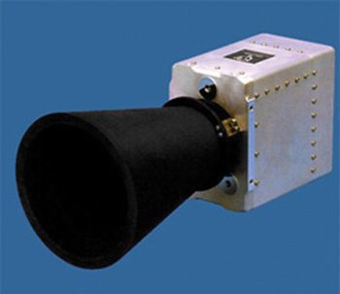
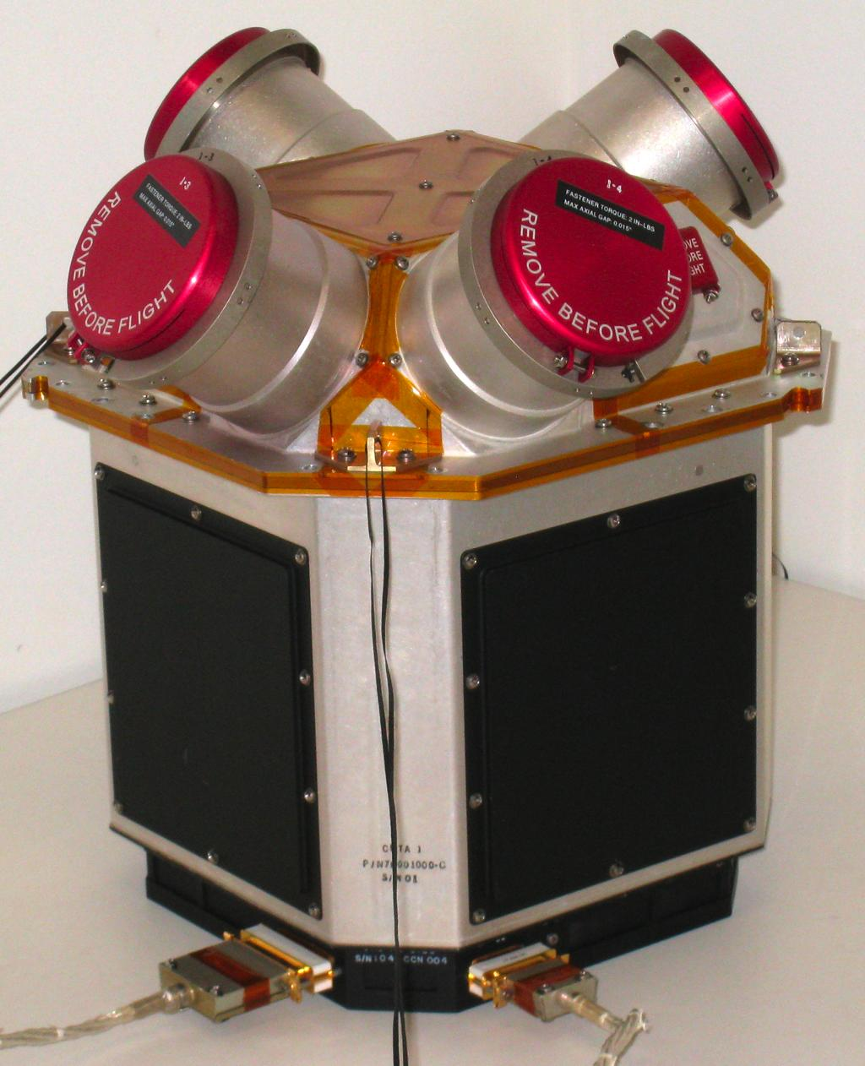

Device and Software Component EDS
Software Component
Software Component
Software Component
Star trackers
Thrusters
Sun sensors
EDS
EDS
EDS
EDS
EDS
EDS
Software tools
Vision: device manufactures provide an EDS with each component

Slide 13
EDS Is In Reference To What?
An EDS is in reference to the “on the wire” spec from the point of view of the publisher
A CFS Component EDS is written in terms of Big (Network) Endianness
  Run-time tools used to convert to other architectures
Big Endian
System
EDS
Software Component
EDS
Software Component
Network
interface
EDS
EDS
Software Component
Converter
Big Endian
System
Little Endian
System

Slide 14
cFS Software Component
Each cFS component will have an associated SEDS
  Include in next release(6.6) of cFE and selected applications
SEDS specifies the data formats, conversions, limits, commands, telemetry, and exchange protocols in terms of the cFS Software Bus
  Protocols are in terms of command and response state machines
The SEDS will be included in the component directory structure and be Configuration Managed with the component
EDS
Software Component

Slide 15
Integrating EDS wth cmake
APIDs for all subsystems are defined in one mission XML file
  Likely to be generated from tools
The APIDs numbers are arbitrary and only represent a mission wide topic handle
cmake is set up to generate all of the APID header files prior to compiling the source code
cmake can be set up to generate the “as deployed” mission EDS which is imported into the database tools
  ITOS, ASIST, COSMOS…
  Integration with JSC CCDD tool is in progress
cmake can also be used to generate and allocate other cFS system wide identifiers such as Performance ID

Slide 16
Sample Mission APID Definition File
<DataSheet xmlns="http://www.ccsds.org/schema/sois/seds">
<Namespace name="MISSION" shortDescription="Definitions and Data Types for the CFE Project/Mission">
<!-- Mission-specific mappings for CFE "topic IDs" (further embedded within CCSDS APID) -->
<Define name="CFE_ES_CMD_TOPICID" value="6" />
<Define name="CFE_ES_SEND_HK_TOPICID" value="8" />
<Define name="CFE_ES_HK_TLM_TOPICID" value="0" />
<Define name="CFE_ES_APP_TLM_TOPICID" value="11" />
<Define name="CFE_ES_SHELL_TLM_TOPICID" value="15" />
<Define name="CFE_ES_MEMSTATS_TLM_TOPICID" value="16" />
…
<Define name="CFE_TBL_CMD_TOPICID" value="4" />
<Define name="CFE_TBL_SEND_HK_TOPICID" value="12" />
<Define name="CFE_TBL_HK_TLM_TOPICID" value="4" />
<Define name="CFE_TBL_REG_TLM_TOPICID" value="12" />
<!-- Constants used throught all commands and telemetry -->
<Define name="SIGNED_INTEGER_ENCODING" value="twosComplement" />
<Define name="TELEMETRY_TIMESTAMP_SIZE" value="6" />
<DataTypeSet>
<!-- Commonly used string types in all CFE/cFS messages -->
<StringDataType name="ApiName" length="CONFIG/CFE_MSG_MAX_API_LEN" />
<StringDataType name="PathName" length="CONFIG/CFE_MSG_MAX_PATH_LEN" />
<!--
CPU memory addresses in messages can be either 32 or 64 bits.
This depends on specific CPUs in use, but it should be consistent
across all cpus.
-->
<IntegerDataType name="CpuAddress" shortDescription="CPU memory address">
<IntegerDataEncoding sizeInBits="64" encoding="unsigned" />
</IntegerDataType>
</DataTypeSet>
</Namespace>
</DataSheet>

Slide 17
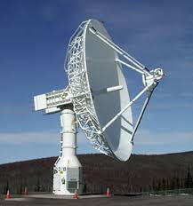

Components and Build Time Parameters
Each device and software component includes an associated SEDS
SEDS specifies the data formats, conversions, limits, commands, telemetry, and exchange protocols in terms of the message bus and/or hardware interface
Some parameter values in the message packet EDS are determined at build time
  The original component EDS author does not know these values
  Values are defined in mission deployment files
  The values will be set by a tool that reads the mission files and creates a software component header file at build time
  The EDS Schema has mechanisms for this
EDS
Hardware Component
EDS
EDS
Hardware device
Hardware device
EDS
Library
Software Component
Software Component
Tools
Software Component
Mission
Configuration
Control center

Slide 18
Existing and Upcoming/proposed Tools
C headers
Flight
Software
ITOS
Database
ESA TASTE
Models
LUA Scripts
Device Drivers
JSC Cmd/Tlm CCDDT
COSMOS
Database
EDS
Component
tests
ASIST
Database
ITOS Page Displays
XTCE
Models Based Systems Engineering tools
JSON
demonstrated
Simulink
Data interfaces
Onboard Control Procedures
Proposed

Slide 19
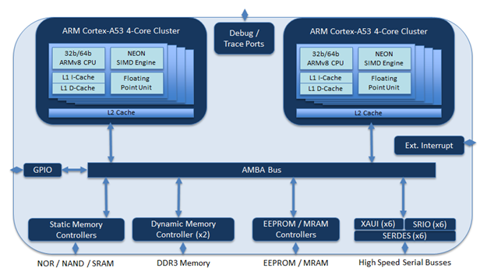
Multicore
cFE 6.6 includes SMP safe updates
PACE mission is adding support for dual core LEON
High Performance Space Computing (HPSC)Joint NASA USAF effort to create game changing radiation hardened space processor
  8 core chiplet approach ARM A53 with internal NEON SIMD
  Includes hardware support for partitions with fault containment
  FY18 – FY21 funding for software middleware/framework development at NASA centers
  cFS support and porting
Need Executive Service updates
Startup script updates
OSAL updates
  Processor affinity

Slide 20
Time triggered Scheduling
Ongoing effort at JSC to align software application scheduling with network scheduling
  Time-Triggered Ethernet schedule (TTTech TTGbE)
  New scheduler app has been created
  Application code unmodified
Andrew Loveless (JSC) is primary contact
  Potential for CCSDS EDS with timing and schedule additions

Slide 21
Real-time Linux
    Xenomai Real-time Linux
      Funded by AES
      Prototype demonstrated in FY2017
      Effort continuing in FY18 at JSC

Slide 22
Partitioning
JSC effort with ARINC-653
  Demonstration completed in 2016 as part of AES project
JSC effort with Linux Xenomai
  Demonstrated simple two partition system
  Hard real-time and science application
Included as part of HPSC project

Slide 23
Onboard file transfer
Transfer files on board
  Not intended to replace CCSDS CFDP space/ground protocol
Ongoing effort at GSFC
  Baseline being used on satellite servicing mission
  Working toward full Class B implementation
TFTP based on RFC 1350 with updates
  Option extension (RFC 2347).
  block size option (RFC 2348).
  timeout interval option (RFC 2349).
  transfer size option (RFC 2349).

Slide 24
64 bit Support
64 bit cFS implementation
  Potentially needed for HPSC (64bit ARM processors)
  Impacts most cFE core services
  Significant development and test effort, timeframe TBD
  Partitioning my mitigate near term need (32bit within a partition)
What are the near term project needs?

Slide 25
Revamp Time services
Simplify interfaces
Reduce configuration options
  Remove unused heritage options
Add Time-Triggered interface(?)

