Slide 1
cFS Community Day Platform Technology Roadmap
Alan Cudmore – NASA Goddard Space Flight Center
JHU / APL
core Flight System Workshop
December 4, 2017

Slide 2
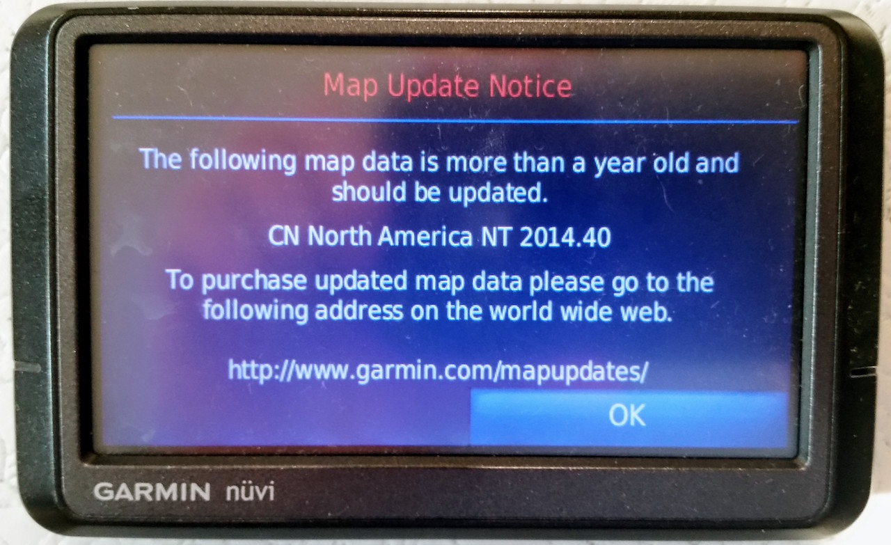
Disclaimer
OSAL and PSP roadmaps
https://coreflightsystem.org/mapudates

Slide 3
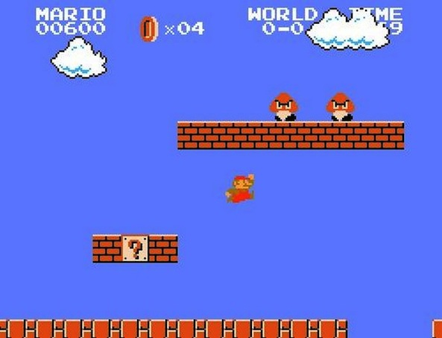
Agenda
What are we talking about?
Platforms
APIs
Operating Systems
Hardware
Where are we?
Current Status
What’s next?
Upcoming platform technologies
Current Device model thoughts
cFS Apps/Libs
cFE Core
OSAL
PSP

Slide 4
What are we talking about?
The cFS is a set of portable libraries and applications that depend on the platform layer
The Platform Layer(s) consists of:
APIs
Operating System Abstraction Layer
Platform Support Package
Device Drivers
Operating Systems
Real Time Operating Systems
Linux / Posix Operating Systems
Partitioned Operating Systems
Hardware
Generic / Simulated ( Linux, VM, QEMU, etc )
Class B processor platforms
Cubesat / COTS processor platforms

Slide 5
Where are we?
In a word – everywhere
The cFS project has a small number of supported platforms
vxWorks 6.x on PowerPC ( MCP750 , RAD750 )
RTEMS 4.10/4.11 ( Generic )
Posix ( Generic Linux )
There are many other unsupported platforms
GSFC Missions
MMS ( RTEMS 4.10 / Coldfire )
NICER / GEDI (vxWorks Broadreach PPC)
Spacecube
Dellingr Cubesat ( FreeRTOS / ARM )
CeRES Cubesat ( Linux / ARM / Zynq )
Balloon missions
Many other missions and platforms outside of GSFC

Slide 6
What’s Next?
Upcoming platform technologies to integrate (cFE is involved here as well)
64 bit compatibility
Cmake
Next Generation OSAL
Symmetric Multi Processing (SMP)
Operating systems to update or integrate
RTEMS 4.11 / 5.0 – Dynamic Loading , SMP
vxWorks 7.x - SMP
FreeRTOS
ARINC
Xenomai
Hardware Platforms
Many Cubesat Platforms
LEON4
High Performance Spacecraft Computer (HPSC)
And many more..

Slide 7
What’s Next – Short Term?
OSAL
Next Generation OSAL
SMP Support ( Linux, vxWorks, RTEMS )
vxWorks 7.0 support
RTEMS 4.11/5.0 Support including the dynamic loader
FreeRTOS port from Dellingr and STF-1
PSP
Cmake / Next Gen / 64 bit support
SMP Support
vxWorks / Generic
RTEMS / Generic
FreeRTOS / Generic ( Is there such a thing? )
Device/Plugin model?
Smallsat group is considering adding portable SPI/I2C/UART/GPIO interfaces

Slide 8
What’s Next – Long Term?
Long(er) Term Platform work
Document the PSP APIs
Create a PSP integration test suite
Create a PSP Porting guide
Formalize a PSP device model
Need to keep the OSAL and PSP APIs relatively simple
This will be key to the maintenance and portability to all platforms
How can we create a sustainable collection of OSAL and PSP ports?
Operating Systems and Platforms
What can we reasonably support?
Simulators (QEMU, etc) may be the key to testing and maintaining platforms
Support a limited number of important operating systems
Support a limited number of hardware platforms and simulators

Slide 9
Current Device Model Thoughts
Dellingr Cubesat Model
cFS
Reuse
App
Mission
App
cFE/cFS
core Flight Executive (cFE)
Mission Hardware Library
( All Mission hardware accessed through this library)
42 Simulator
OS Abstraction Layer
Platform Support Package
Real Time Operating System
RTOS Board Support, File Systems, Drivers, Firmware Libraries, etc
Processor , Memory, Peripherals, and other hardware
Legend:
Vendor Supplied
cFE/cFS Reuse
New on Dellingr

Slide 10
Current Device Model Thoughts
Goddard Smallsat Device Model – Adding common device APIs
cFS
Reuse
App
Mission
App
Mission
App
Mission
App
Mission
App
cFE/cFS
core Flight Executive (cFE)
Mission Hardware Library
( All Mission hardware accessed through this library)
SPI, I2C,
UART,
GPIO Model
OS Abstraction Layer
Platform Support Package
Real Time Operating System
RTOS Board Support, File Systems, Drivers, Firmware Libraries, etc
Processor , Memory, Peripherals, and other hardware
Legend:
Vendor Supplied
cFE/cFS Reuse
New on Dellingr

