Slide 1
Core Flight System on Unique Missions & Experiments
Presenter: David Akre

Slide 2
Agenda
Overview
FSW Baseline
Motivation for cFS
LunIR Mission
Mission Overview
Timeline
ISS STP-H5 Experiment
Experiment Overview
Successes and Challenges
Future Work

Slide 3
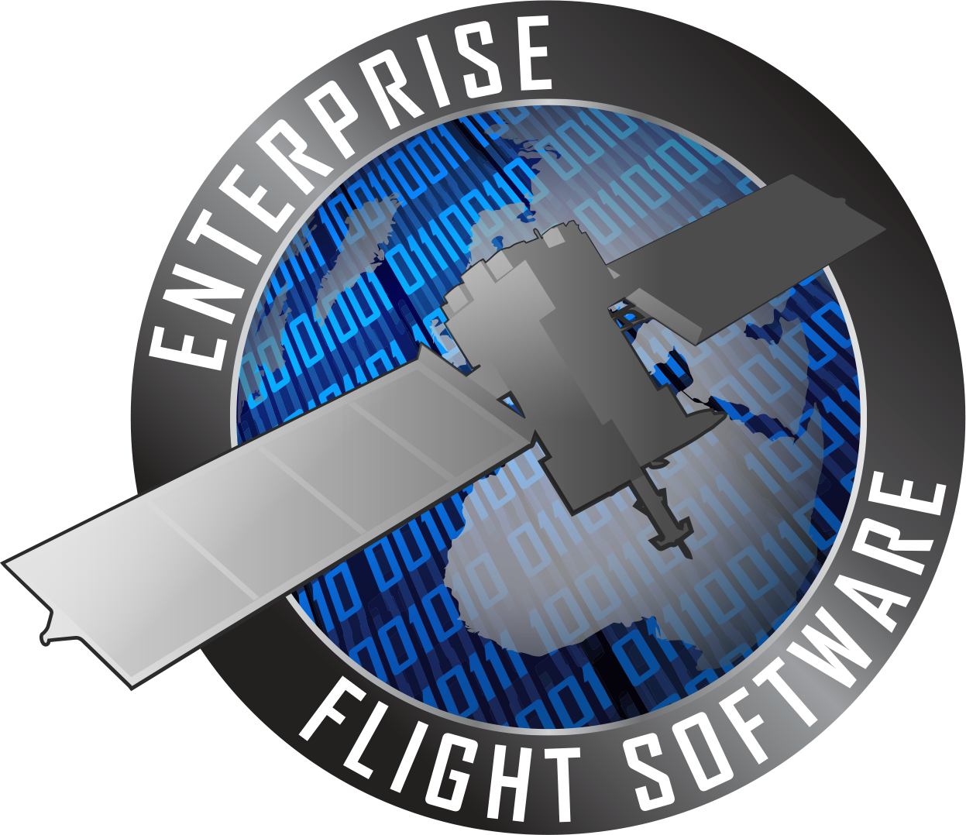
Enterprise Flight Software at Lockheed Martin
Product line engineering
Common flight software baselines
Notes:
Focus on cube sat as seen by CFS insertion around 2015

Slide 4
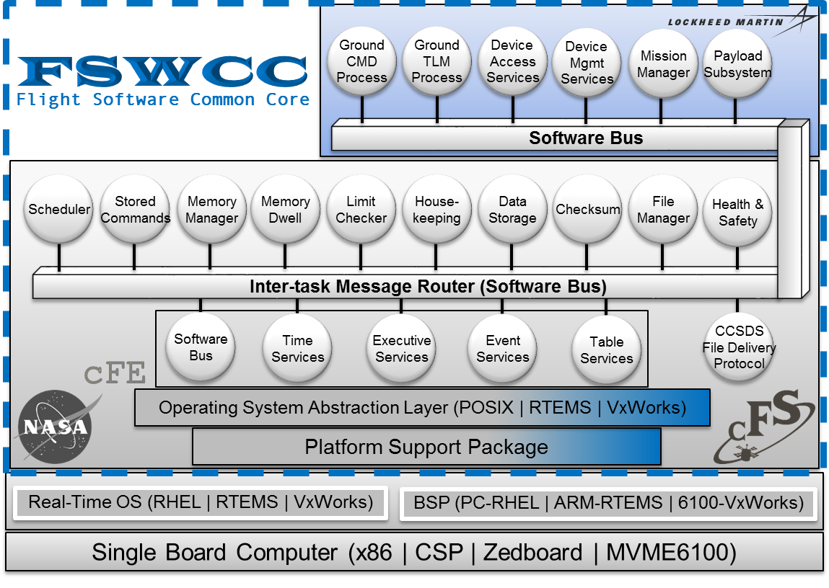
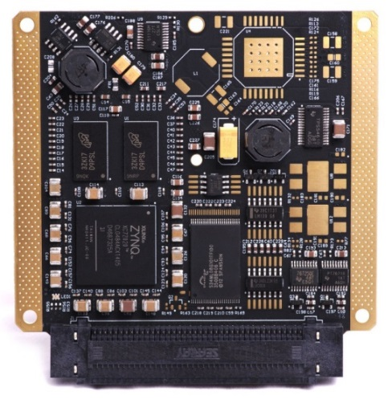
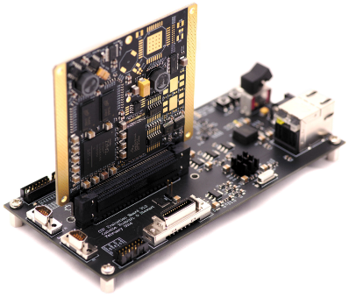
LM50 Flight Software Baseline
CHREC Space Processor
Evaluation Board
Notes:
- Explain the SW baseline and how we run on our COTS flight like targets-- CSP

Slide 5
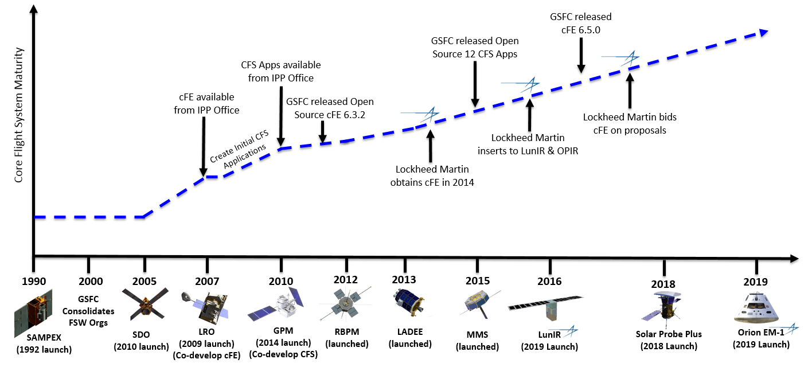
Motivation for cFS
Flight software developed by NASA GSFC and released as open source software
Plug-n-play architecture enables programs to focus on mission-specific applications
Abstracts hardware/operating system dependencies from applications
Lowers flight software costs and risks by leveraging common components

Slide 6
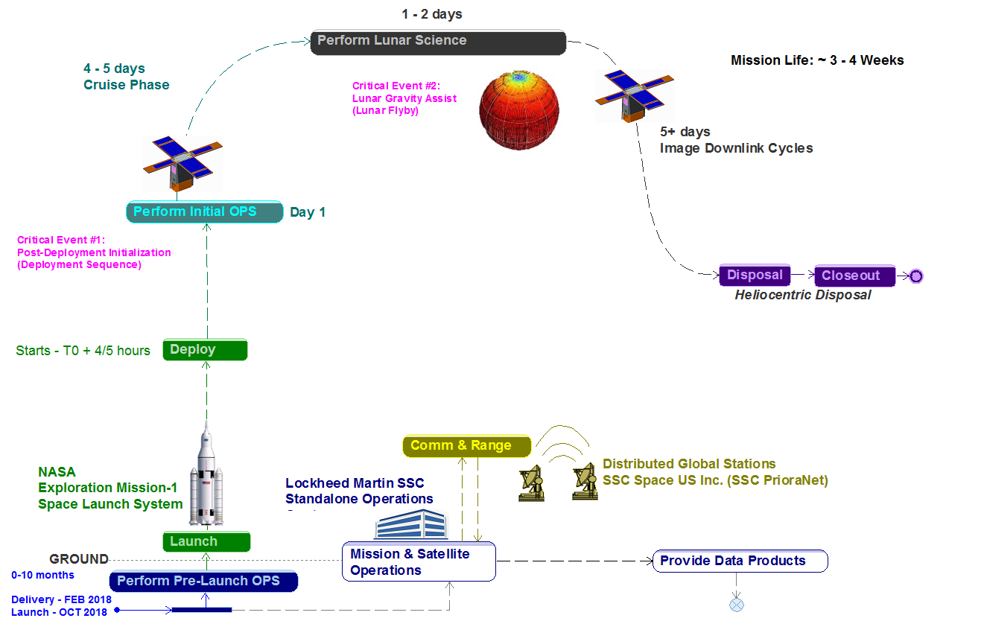
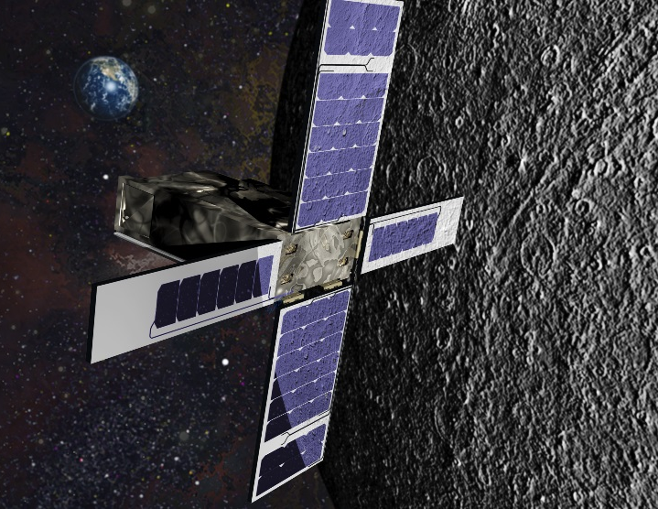
LunIR Mission (LM50)
LunIR
NASA CubeSat Launched on SLS/EM-1
6U Form Factor
Lunar Flyby Mission
Demonstration platform
NASA cFS
CHREC Space Processor
Notes:
Demonstration Platform
LM first time flying cFS & RTEMS at SSC and the CSP
Delivery March 2018
Launch Oct –Dec 2018
Bus/Comm checkout Day 1
SLS provides us with lunar trajectory
Lunar flyby & take IR images of moon

Slide 7
LunIR Timeline
Created Functional Verification Tests
Baselined FSWCC & CHREC Space Processor (CSP)
Demonstrated FSW on RTEMS and CSP
Developed SW drivers and Payload FW
EM1 Launch and Flight
2015
2016
2017
2018
2019
Baselined RTEMS 4.11 kernel
Developed mission specific applications
Performed Unit Tests and Functional Initial Checkout Tests
End to end Payload testing

Slide 8
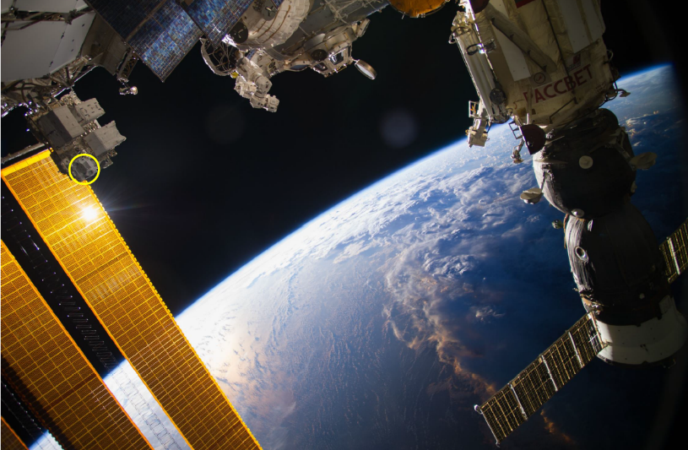
ISS STP-H5 Overview
Hardware
Two CSPv1’s
Two SpaceWire Links
Software
C/C++ FSW
CFE/cFS
OSAL/PSP targeting RTEMS & CSP
Class D
STP-H5
Courtesy NASA/JPL-Caltech

Slide 9
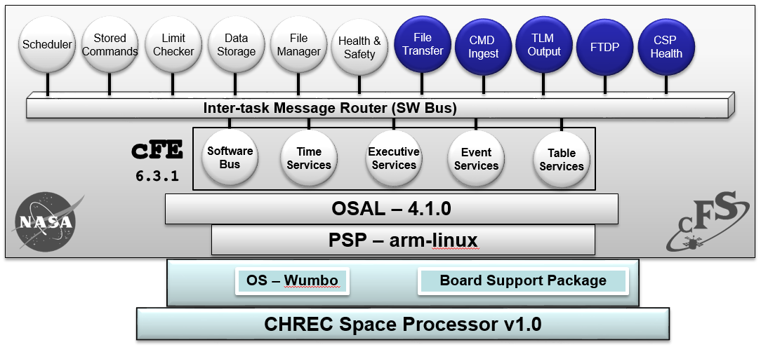
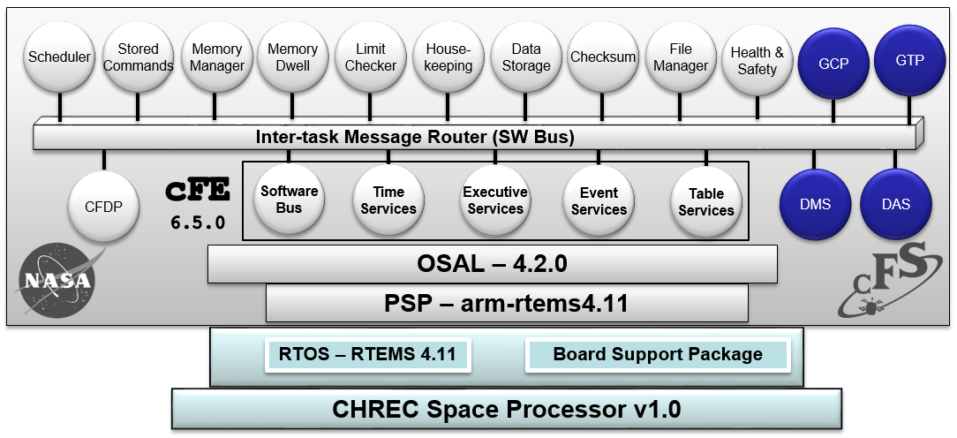
STP-H5 Cont’d
Collaboration with CHREC to upload an updated FSW image
Currently Flying on STP-H5
Proposed to Fly on STP-H5
cFS
App
Non-cFS
App
Software Component | Version
cFE | 6.3.1
OSAL | 4.1.0 (posix)
PSP | arm-linux
OS | Wumbo Linux
SCH | 2.2.0
SC | 2.2.0
LC | 0.0.0
DS | 0.0.0
FM | 2.3.1
HS | 2.2.0
Major Benefits:
RTEMS provides RTOS
Updated cFS and CFE
New RTEMS PSP
cFS stack with RTEMS 4.11
Software Component | Version
cFE | 6.5.0
OSAL | 4.2.0 (rtems-posix)
PSP | arm-rtems4.11
OS | RTEMS 4.11
SCH | 2.2.0
SC | 2.4.0
LC | 2.0.0
DS | 2.5.1
FM | 2.5.2
HS | 2.3.0
Software Component | Version
MM | 2.4.1
MD | 2.3.0
HK | 2.4.1
CS | 2.3.1
CFDP | 2.2.1
DMS | LMPI
DAS | LMPI
GCP | LMPI
GTP | LMPI
Required for CMD/TLM
Notes:
OSAL 4.1 to 4.2
PSP = rtems4.11
CSP v1
CFE 6.3 to 6.5

Slide 10
Successes & Challenges
Successes
Reusability with cFS, CFE, PSP, and OSAL
Ease of usability with RTEMS and CSP
Strong collaboration with CHREC
Challenges
Schedule constraints
Immature testing environment (internal)
License agreement for OSAL/PSP

Slide 11
Future Work
Flight Software Abstraction
Additional Insertion Opportunities in 2018
Baselining FSW on Embedded Multicore Systems
Zedboard/CSP
Notes:
- Real time emphasis

