Slide 1
Study of Tools for Command and Telemetry Dictionaries
Craig Pires
NASA Ames Research Center
FSW Workshop 2017 2017-12-04
Notes:
a Study of Management tools for Command and Telemetry Dictionaries.
The Command and Telemetry Dictionary is at the heart of space missions. The C&T Dictionary represents all of the information that is exchanged between the various systems both in space and on the ground. Large amounts of ever-changing information has to be be disseminated to all for the various systems and sub-systems throughout all phases of the mission. The typical approach of having each sub-system manage it’s own information flow, results in a patchwork of methods within a mission. This leads to significant duplication of effort and potential errors. More centralized methods have been developed to manage this data flow. This presentation will compare two tools that have been developed for this purpose, CCDD and SCIMI that were designed to work with the Core Flight System (cFS).

Slide 2
Spacecraft and Ground FSW needs
Spacecraft Defined by data
  Commands - Formatted to the Spacecraft
  Telemetry – From the Spacecraft
  Ground Software
  Subsystem Teams
    Command and Data Handling (C&DH)
    Electrical Power System (EPS)
    Guidance, Navigation and Control (GN&C)
  Third Party Vendors
  Science Payloads…...........
Flight Software needs to figure out how to talk to all of it.
  And not do it multiple times for each use (Simulink, C Code, ITOS, …)

Slide 3
Our early approach – C&T Database
LADEE – Integrated Command and Telemetry Database (Mostly…)
  Shared between C&DH Flight Software, Simulink Models and ITOS
  Other data analysis tools leveraged
Not for all data uses:
  Legacy source code. (cFS was hand inserted into C&T DB)
  Created “Pass-Thru” Commands
  Mostly just Commands and Telemetry (Packets)
  Other systems for: Parameter Tables, Temperature Calibration Curves
    Monstrous Excel Spreadsheets
    Spreadsheet difficult to maintain

Slide 4
Next Step - SCIMI
SCIMI – System Configuration Information & Mission Interfaces
Relational Database based off of Django
Address limitations of previous “LADEE” approach
  Full Command & Telemetry plus…
  Produces Simulink tables products
  Handle other cFS tables
  Calibration Curves
  Consumes YAML and uses Python for product generation
  Infrastructure entirely Python
  Built-in Embedded web GUI and command-line interfaces
  Light on documentation
  Extremely customizable per mission (almost too much, meaning not out-of-the-box)
Notes:
SQLite, MySQL, PosgreSQL

Slide 5

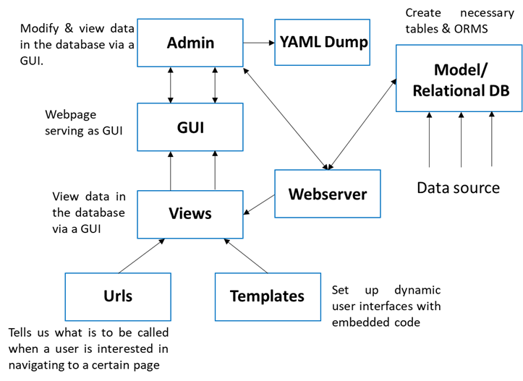
SCIMI Logical Flow

Slide 6

SCIMI In’s & Out’s
Text Archival
(YAML,
JSON,
XML)
Ground
Products
(itos, assist,
etc)
Django –
Relational DB
Docs
(C&T Dict,
ICDs)
MATLAB
(I/F,
tunables)
Spread
Sheets
(xls,csv)
C
Headers
??
Web-based
interaction
Engr.
Drawings
Notes:
12/4/17
6
6

Slide 7
New Development - CCDD
CCDD – Core Flight System (cFS) Command and Data Dictionary
JSC Developed, officially NASA Open-Sourced
  These are two tools similar GIT vs Subversion
Central SQL Database - (PosgreSQL)
Infrastructure implemented in Java
Multiple sources and products
  Consumes CSV, JSON, EDS, and XTCE and uses JavaScript, Python, Ruby, Groovy, etc… for product generation
  Highly customizable due to variety of input and output formats
Embedded web GUI and command-line interfaces
Extremely well documented

Slide 8

CCDD Logical

Slide 9
What to Do? (SCIMI vs CCDD)
Struggled to keep consistency with tools
Problems with “Clone and Own”
Looking hard at transitioning to CCDD – Test Implementation
Creating needed CCDD Additions for us.
  Simulink
    Strength of DB tools is – adapter/translator
Todo for Us
  Interfaces to additional data analysis tools
  Data Marshalling - Translation
  Possible – Database flexibility
Notes:
Strength of DB tools is – adapter/translator

Slide 10
What did we need to do to implement CCDD test for RP?
Every mission has slightly different approach
  Command and Data Dictionary tools need flexibility
  CCDD provides such flexibility through table customization
  In addition, provides full API for interaction with database
Slight modifications to infrastructure
  Facilitated by tool creators
  Particularly relevant for Model Based Design code auto-generation
  Not too much needed because of high customizability of tables
    Namely the ability to add “data fields” to tables that uniquely identify information contained therein
    For example, “Produce REC” and “Simulink App” boolean data fields for structures
Most modification done to scripts that generate products
  Again, primarily to facilitate specific products for MBD auto-generation

Slide 11
Summary
Space Missions are defined by data
Tools for Managing make it much simpler and reduce errors
CCDD and SCIMI are two tools for managing that data
  Both have strengths and weaknesses
  Tools themselves need support
Evaluation of tools based on project/mission needs

Slide 12
Backup

Slide 13
Implementation Details
Common issues for all tools
Maintenance of the tools
Which group “Owns” the Database through the Project?
  Start with FSW
  Transition to Mission Operations
  Science Operation Requirements?
What Tools?
  FSW Development.
  Integration and Test
  Mission Operations
  Science Operations
Procedures for modification?
Backup and CM issues?

Slide 14
SCIMI vs CCDD
SCIMI
  Pros:
    Django
      Powerful/Flexible Database Tool
      Database agnostic
    Met mission needs
  Cons:
    Need for internal mission support
    Lack of documentation
    Mission specific implementation
CCDD
  Pros:
    Complete implementation – with API
    Mission/project agnostic
    Well documented
  Cons:
    Customization needed for missions
    Needed script development (Simulink)

