Slide 1
CCSDS File Delivery Protocol (CFDP) for COSMOS in pure Ruby
FSW 2017
Presenter: Edipo Crispim
Authors: Nickollas Aranha, Edipo Crispim and Danilo Miranda
Date: Dec 4th, 2017 – cFS day

Slide 2
AGENDA
Overview about Visiona
VCUB1 Project
Architecture Choice
CFDP Engine
What does it do?
Engine limitations
Implementation
Commandability and Visibility
CFDP Engine Test
Engine Distribution
Final Remarks

Slide 3
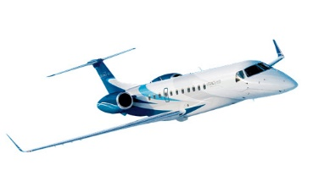
1. Overview about Visiona
Joint-venture Space Start-Up company located in São Paulo, Brazil.
Founded in 2012
Employees: ~60
50% engineers
3 engineers allocated to FSW and GSW
Main Project: SGDC (GEO telecom Ka-Band spacecraft launched in May, 2017)
(51%)
(49%)
Notes:
Suggest for this slide

Slide 4
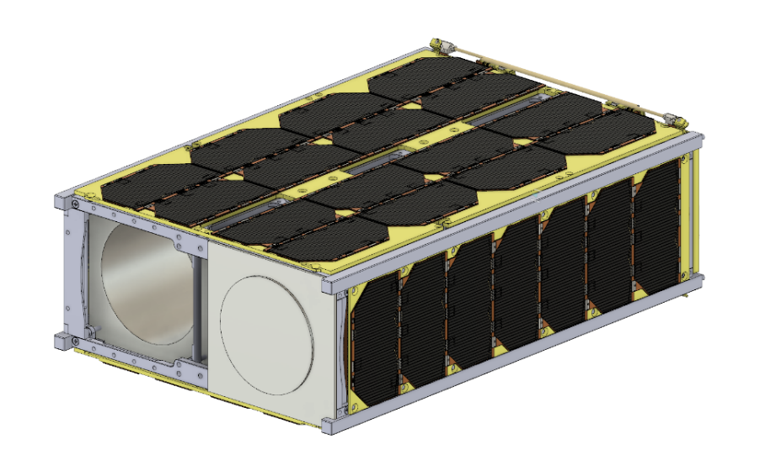
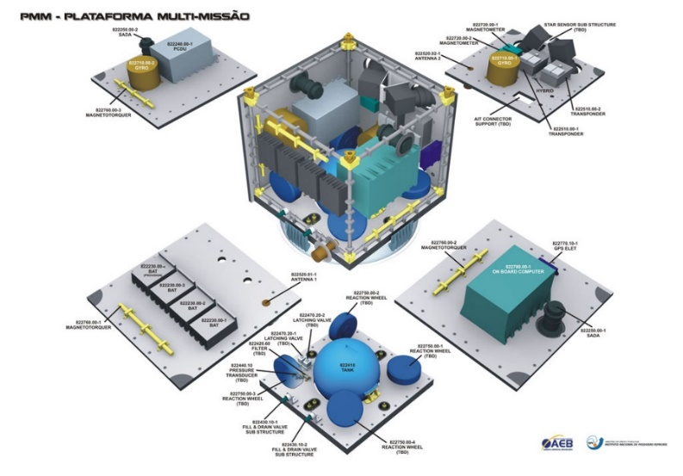
2. VCUB1 Project
VCUB1 → Tech Demonstration CubeSat mission to validate the company’s new SW developments
Long-term goal → Use same SW technologies in small operational satellite missions (~100 kg)

Slide 5
3. Architecture Choice
Criteria for software adoption:
Heritage
Open Source Paradigm
Modularity and Flexibility
Full Space Project Lifecycle Scope
Operational Tool
AIT Tool (EGSE)
FSW based on
GSW based on

Slide 6
4.a) CFDP Engine
What does it do?
Class 1 and 2 file transfer
Uplink and downlink operation
Immediate mode
User indication
Transaction log
Tests with COSMOS’ test runner

Slide 7
4.b) CFDP Engine
Engine limitations
Message to User and Filestore Requests are not implemented
CRC not implemented (cFS CF v2.2.1 does not support)
Engine must work with COSMOS and cFS CF.
Defined values used in CF such as sequenceNumber length = 3, idLength = 1, etc.

Slide 8
4.c) CFDP Engine
Implementation
CFDP Engine
PDUs
Spacecraft
CMD/TLM
COSMOS
CMD/TLM

Slide 9
4.c) CFDP Engine
Engine Interfaces
CFDP Engine
Cycle Timeout
Pop Buffer
Uplink Request
Handle PDU Received

Slide 10
4.c) CFDP Engine
Handle PDU Received
Handle classes 1,2 PDUs
Generate PDUs to buffer
Uplink Request
COSMOS command
Process file, generate PDUs
Pop Buffer
Pop PDU from buffer
Handle PDU Sent function
Cycle Timeout
Verify timer/action limits
Handle timer events

Slide 11
4.d) CFDP Engine
Commandability and Visibility
Commands
- Send File
Visibility
- HK Packet
- Set Seq. Number
- Cancel Request
- Files
- Logs

Slide 12
5. CFDP Engine - Test
Cosmos
CFDP Test Protocol
CFDP Protocol
CFDP Engine
PDU / TCs
HK
Spacecraft
PDU / TCs
PDU / TMs

Slide 13
5. CFDP Engine - Test
Simulate loss of packet sent
Simulate loss of packet received
Packet can be specific PDU class
e.g.:
cmd("CFDP_TEST MISS_RECEIVED_PACKET with PDU_CLASS FILEDATA, PACKET_NUMBER_ARRAY [1, 3, 4]")

Slide 14
5. CFDP Engine - Test
Implemented functional tests with COSMOS
Tests for class 1, 2, uplink and downlink
Var configuration for file size, directories, ip, etc
Tests inputs are saved in outputs/tests
Random PDU Loss test

Slide 15
6. Engine Distribution
Open-Source under COSMOS pre-defined GPLv3 license
GitHub repository for the CFDP Engine:
https://github.com/edipovisiona/cfdp-engine.git
We are open to community contributions!

Slide 16
7. Final Remarks
We understand that a cFS community collaboration, like an open “APP Store/Catalogue”, will strength cFS adoption in the FSW community
We are willing to collaborate in a cFS APPs repository at coreflightsystem.org
A ruby gem distribution for CFDP engine might be released

Slide 17
Special Thanks
David McComas (NASA GSFC)
Alan Cudmore (NASA GSFC)
Susanne Strege (NASA GSFC)
Jason Thomas (Ball Aerospace)
Ryan Melton (Ball Aerospace)

Slide 18
Contact
Edipo.Crispim@visionaespacial.com.br
+55 12 21385844

