Slide 2
Aerial View of SwRI from East Gate
You Are Here ☺
East Gate

Slide 3
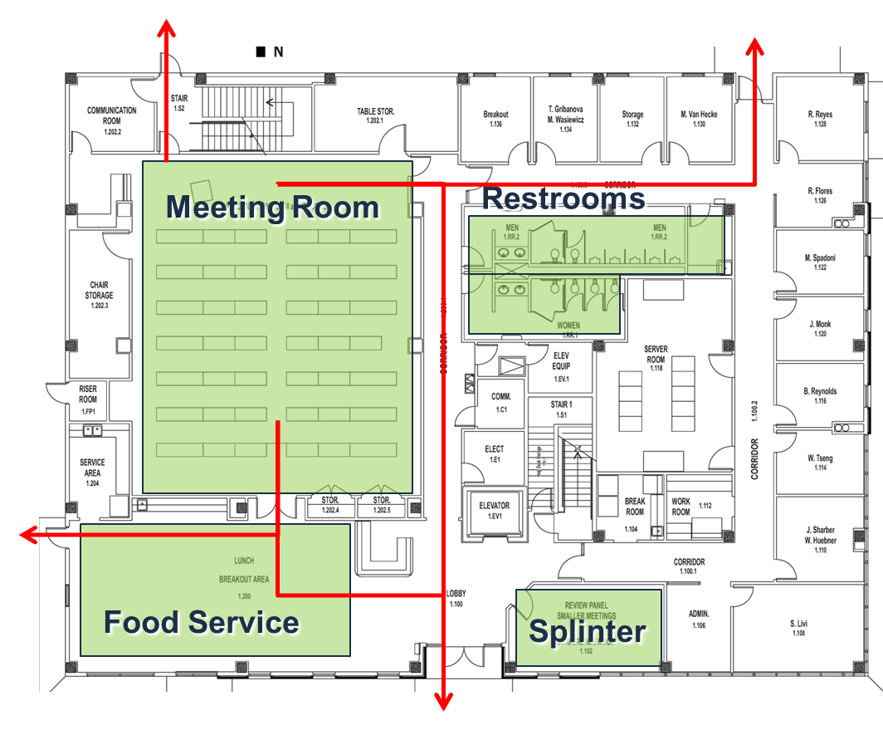
Bldg. 263 Facility Overview
Emergency Exits
Smoking Area
Additional splinter room available on 2nd floor

Slide 4
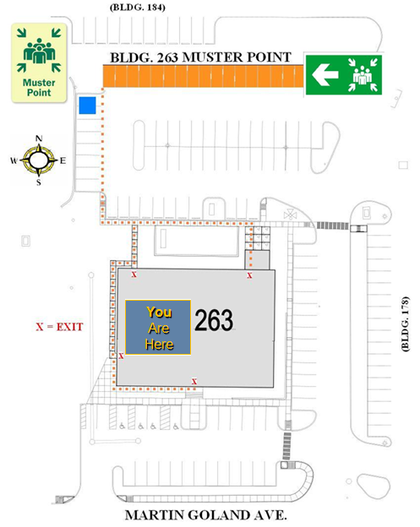
Emergency Muster Point

Slide 5
International Visitors
Non-US Persons
If you have not completed a foreign visitors form, please see registration table to complete one and to get badges
Non-US Persons require a SwRI escort anywhere on the SwRI facility at all times
Badges must be returned to registration table at the end of the day
All Presenters
Please adhere to ITAR and EAR laws

Slide 6
Technical Knows
Wireless network is available in meeting areas
Choose “SwRI Guest”, no authentication is required
All outgoing services are enabled
Tables are equipped with power
Telephone Access
Phones are located in lobby and break-out room(s)
Local: 9+number (area code IS required for 210)
Long Distance: Ask for Assistance
Printer Access
Computers are available in the lobby to print

Slide 7
Monday, December 3, 2018 Meal Plan
Light continental breakfast provided in the lobby
Lunch will be provided and served from Jason’s Deli
Vegan/Vegetarian and Gluten Free options are available
Snacks and refreshments will be available in the afternoon

Slide 8
THANK YOU to our SPONSORS!
We could not put this event on without you!

