Slide 1
cFS Workshop Introduction
core Flight System Workshop
Southwest Research Institute
December 3, 2018
David McComas – NASA Goddard Space Flight Center

Slide 2
Thanks to Host and Sponsors
Host Southwest Research Institute (SwRI)
Planning Committee
Aerospace Corporation
Johns Hopkins University Applied Physics Laboratory
NASA: GSFC, JPL, MSFC
Southwest Research Institute
Sponsors

Slide 3
What is the Core Flight System (cFS) ?
A NASA multi-center configuration controlled open source flight software framework
The framework is ported to a platform and augmented with applications to create Core Flight System (cFS) distributions
A worldwide community from government, industry, and academia
Layered architecture with international standards-based interfaces
Provides development tools and runtime environment for user applications
Reusable NASA Class A/B lifecycle artifacts: requirements, design, code, tests, and documents
cFE Application Programmer Interface
Core Flight Executive Implementation
Platform Application Programmer Interface
Platform Implementation
User Applications
Core Flight Executive
Platform Implementation
Notes:
Who is new to the cFS?

Slide 4
cFS Historical Context
< 2007: Birth of core Flight Executive (cFE)
NASA Goddard Space Flight Center performed an assessment of FSW reuse to date, heritage analysis, architectural trades
Project independent funding kick started the effort
Operating System Abstraction Layer (OSAL) released as open source
2007: cFE goes to the Moon
Lunar Reconnaissance Orbiter (LRO) first to use OSAL & cFE
2008 – 2014: Birth of core Flight System (cFS)
cFE released as open source
Goddard developed 12 cFS applications
Leveraged project funding
JSC certified Class A pedigree of cFE targeted to the ARINC-653
Notes:
Anyone under 25 years old?

Slide 5
cFS Historical Context (cont.)
2014: Birth of a Community
cFS NASA Workshop (12/14 at GRC) established a NASA-wide repository managed by a NASA multi-center Configuration Control Board (CCB)
2015: Community Youth
12 Goddard applications released as open source
CCB successfully released cFE 6.4.2
cFE functional Application Programmer Interface (API) is unchanged since LRO
Held first cFS Workshop at Johns Hopkins Applied Physics Lab
2016-2018: Community Adolescence
CCB successfully released cFE 6.5.* and cFE 6.6
NASA Johnson contributes tools and apps
Held cFS Workshop each year

Slide 6
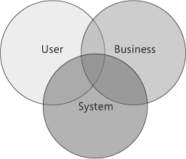
Helpful Architecture View
“Software application architecture is the process of defining a structured solution that meets all of the technical and operational requirements, while optimizing common quality attributes such as performance, security, and manageability.“
“Systems should be designed with consideration for the user, the system (the IT infrastructure), and the business goals.”
Ref: Microsoft Application Architecture Guide, 2nd Edition https://msdn.microsoft.com/en-us/library/ee658098.aspx
Notes:
What do you think happened with each concern? What does optimizing QAs mean?
The intersection is an economy. The optimization of quality attributes is relative to a stakeholder’s values.
The technical quality attributes have made it very successful outside of Goddard: portability, adaptability, scalability, and extendibility.
Conflicts arise: Google and Facebook. User data is part of their business model
Wikipedia bumped Encarta because of the relationship of the technical model with the stakeholders. Who owns content?

Slide 7
cFS Evolution: User Perspective
Users have expanded from a Goddard branch to a global community
Universities, commercial businesses, government agencies, hobbyist
Different users have different QA priorities
E.g. universities want ease of deployment
DoD has only expressed a cursory interest
Security was a low priority QA for Goddard
High demand for information that was people centric at Goddard
Systems engineering documentation, help desk, and training
Frustration with quasi-open source project
Government rules and regulations prevent the government from running a conventional open source community

Slide 8
cFS Evolution : System Perspective
What has scaled well with increased user base
Scheduler as an app
API stability
What has not scaled well
Artifacts developed for Goddard-specific environments and have not been transformed to a general purpose solution
Table generation tools
Build test scripts
Lack of documentation
Ongoing conversations
Binary vs Text Tables
File systems: When, where, and how to use them
Single command & telemetry definition with toolchain generated artifacts
Notes:
Martin Fowler: Shared understanding, hard to change

Slide 9
cFS Open Source: Business Perspective
The NASA user base has expanded to an international community
Lunar Orbiting Platform – Gateway (LOP-G) has the cFS in it’s requirements in part because of the interoperability QA
Current business model unsustainable & inefficient
Help desk is borrowed time
Tax local projects because we can
Missed opportunities in gaining experience from product cycles and user contributions
The product model and community infrastructure is immature
Online component and distribution catalogs
cFS mailing list used as primary Q&A forum
Challenges with government run open source programs
Funding
Software release processes and licensing
Notes:
Goddard launches ever couple of years but community could accelerate that cycle
Goddard management perspective:
Has any Goddard mission missed a deadline?
What do you have left do?
Are you familiar with Microsoft Encarta?

Slide 10
Commercial Lunar Payload Services (CLPS)
11/29/18 NASA announced nine U.S. companies that are eligible to bid on NASA delivery services to the lunar surface through CLPS contracts
These companies will be able to bid on delivering science and technology payloads for NASA, including payload integration and operations, launching from Earth and landing on the surface of the Moon.
The selected companies are:
Astrobotic Technology, Inc.: Pittsburgh
Deep Space Systems: Littleton, Colorado
Draper: Cambridge, Massachusetts
Firefly Aerospace, Inc.: Cedar Park, Texas
Intuitive Machines, LLC: Houston
Lockheed Martin Space: Littleton, Colorado
Masten Space Systems, Inc.: Mojave, California
Moon Express: Cape Canaveral, Florida
Orbit Beyond: Edison, New Jersey
Known cFS user

Slide 11
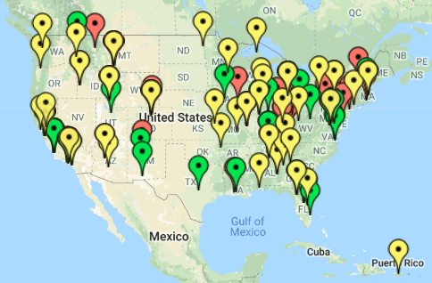
NASA CubeSat Launch Initiatve
Selected
Manifested
Launched
Notes:
Who is or has been involved with a cuebsat

Slide 12
cFS Launches
Launched in 2018
ATLAS, OSAL + cFS in simulator, NASA Goddard
Solar Probe Plus, cFE, Johns Hopkins Applied Physics Lab
Upcoming Launches
BioSentinel, NASA Ames
Cactus-1, Capitol Tech
CeReS, NASA Goddard
GEDI, NASA Goddard
Lunar IceCube, Morehead State
STF-1, NASA IVV
STP-H6, USAF-NASA Goddard

Slide 13
cFS Workshop Goals
Bring cFS user’s together
Communicate the current state of the community organization, products, and technologies
Get feedback to understand people’s perspectives, needs, and goals
Connect people with ideas and organize strategic paths
Thank You

Slide 14
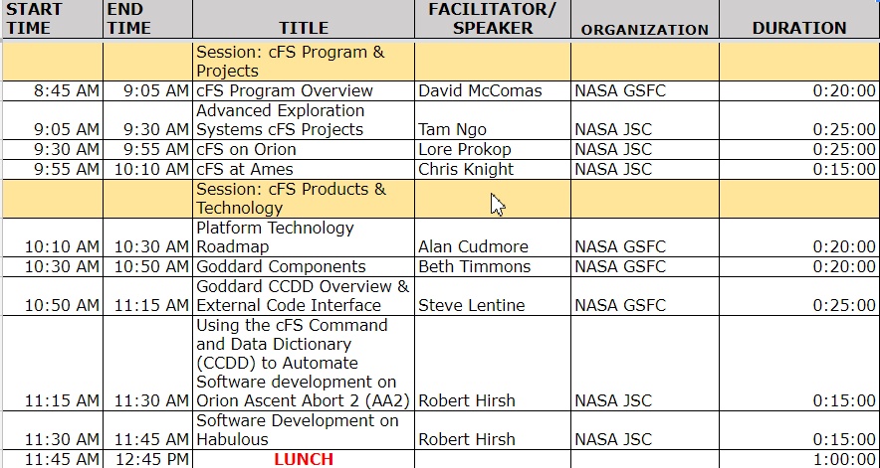
cFS Workshop Agenda

