Slide 1

Core Flight Software Projects on
Orion Multi-Purpose Crew Vehicle
Flight Software Workshop
December 3, 2018
Lorraine E. Prokop, Ph.D
NASA – Johnson Space Center / ER6
lorraine.e.prokop@nasa.gov

Slide 2
Outline
Orion Program Overview
CFS Projects on Orion
  Orion Ascent Abort 2 Flight Test
  Optical Navigation Software
  Backup Flight Software

Slide 3
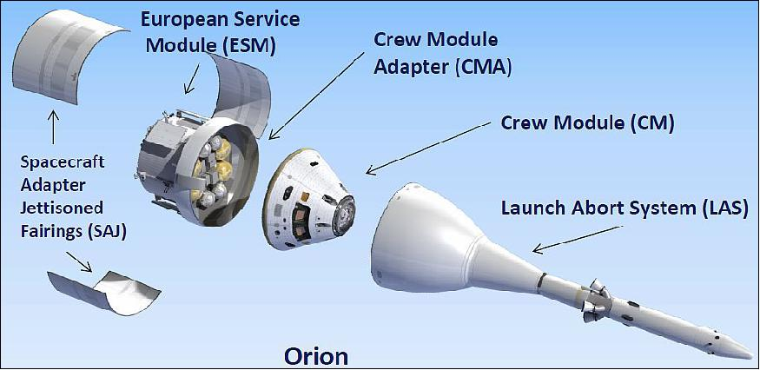
Orion Vehicle

Slide 4
Orion Program Mission Schedule (Wikipedia)
Mission | Acronym | Rocket | Crewed | Launch date | Status | Duration | Destination
Pad Abort 1 | PA-1 | Orion LAS | No | May 6, 2010 | Success | 95 seconds | Troposphere
Exploration Flight Test 1 | EFT-1 | Delta IV Heavy | No | December 5, 2014 | Success | 4 hours, 24 minutes, two orbits | High Earth orbit
Ascent Abort Test 2 | AA-2 | Orion Abort Test Booster | No | April 2019 | Under development | Less than 3 minutes | Stratosphere
Exploration Mission 1 | EM-1 | SLS Block 1 Crew | No | 2020 | Under development | 26–40 days | Lunar orbit
Exploration Mission 2 | EM-2 | SLS Block 1B Crew | Yes | 2023 | Under development | 8–21 days | Multi TLI free-return flight
Exploration Mission 3 | EM-3 | SLS Block 1B Crew | Yes | Between 2023 and 2024 | Planned | 16–26 days | Gateway station
Exploration Mission 4 | EM-4 | SLS Block 1B Crew | Yes | 2025 | Planned | 26–42 days | Gateway station
Exploration Mission 5 | EM-5 | SLS Block 1B Crew | Yes | 2026 | Planned | 26–42 days | Gateway station
Exploration Mission 7 | EM-7 | SLS Block 1B Crew | Yes | 2027 | Planned | 191–221 days | Gateway station
Exploration Mission 9 | EM-9 | SLS Block 2 Crew | Yes | 2029 | Planned | 1 Year | Lunar orbit
Exploration Mission 11 | EM-11 | SLS Block 2A Crew | Yes | 2033 | Planned | 2 years | Martian orbit
Current CFS Projects in Development/Test

Slide 5
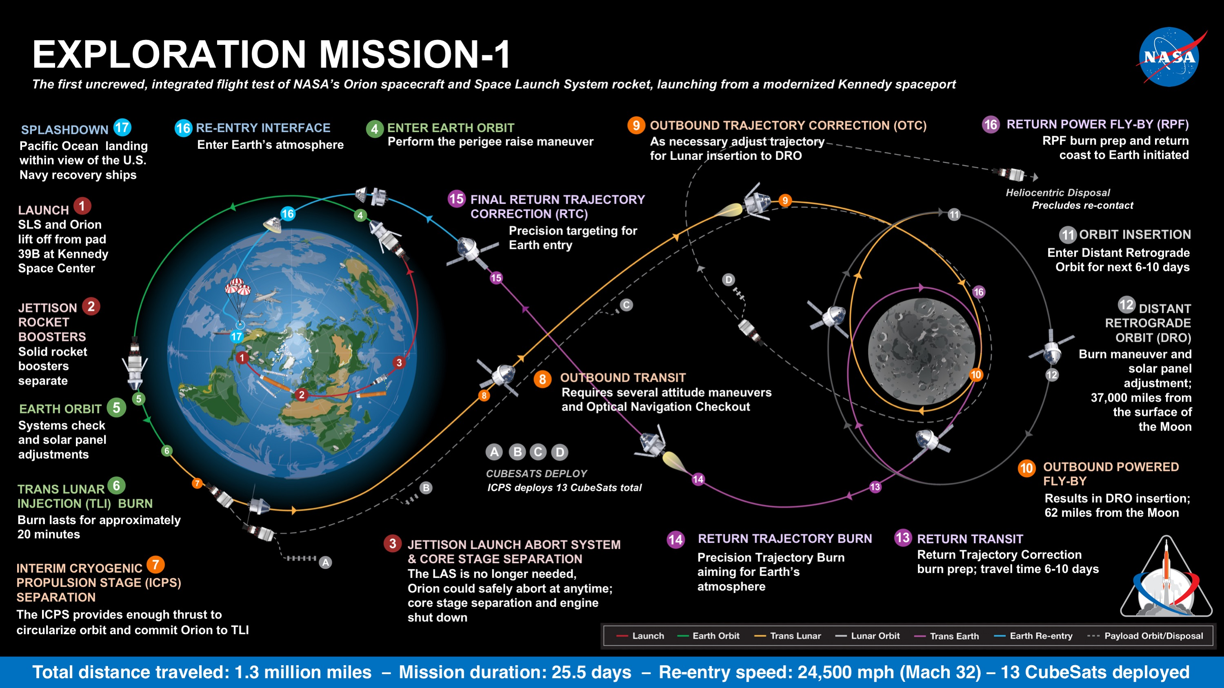
Exploration Mission 1 Overview

Slide 6
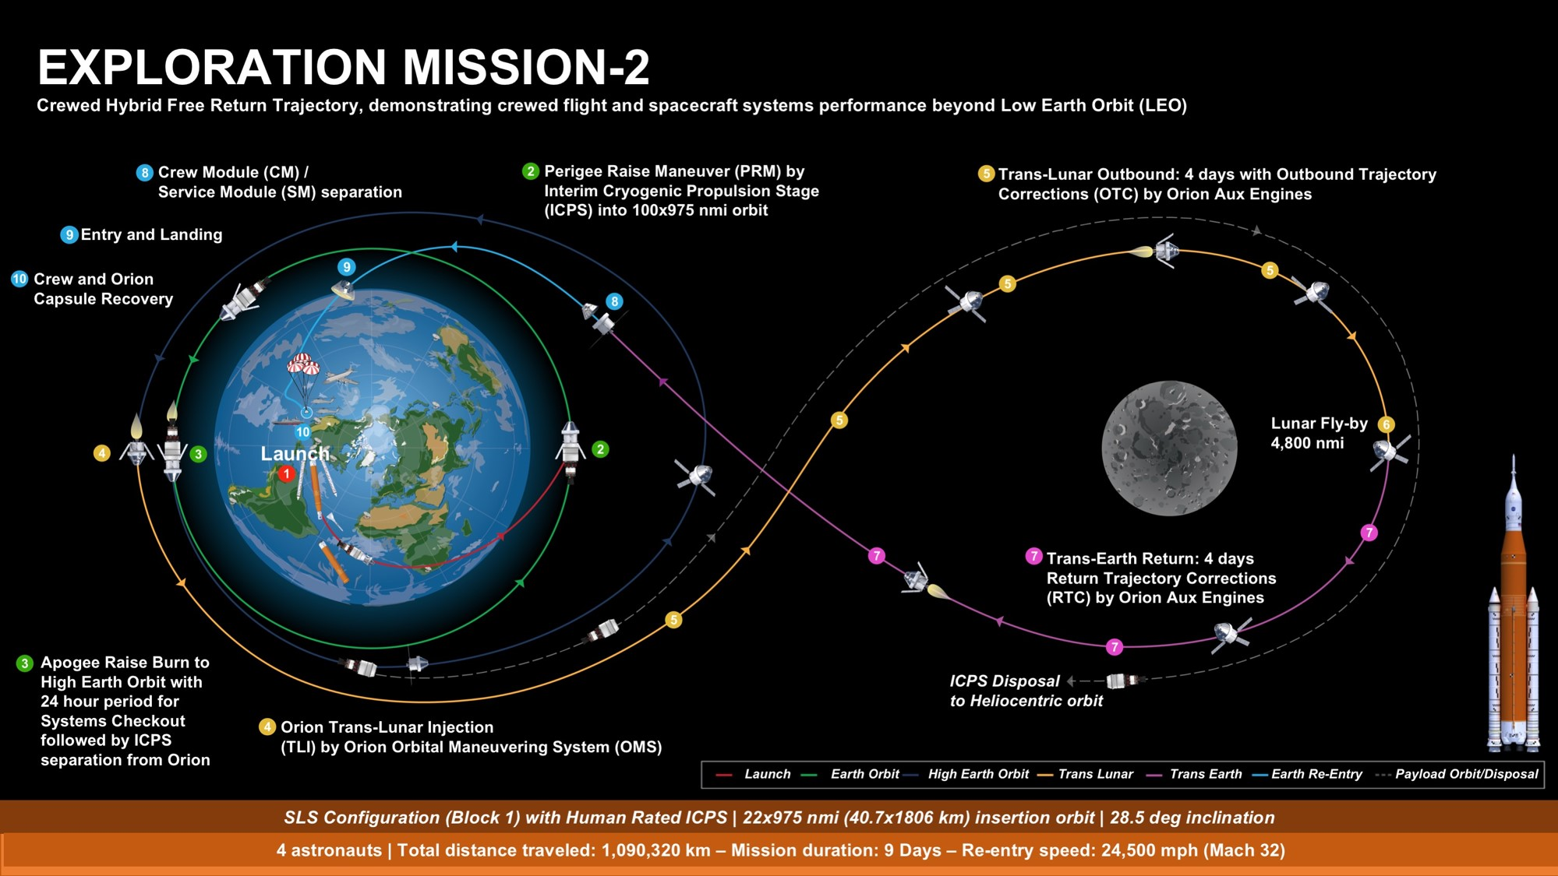
Exploration Mission 2 Overview

Slide 7
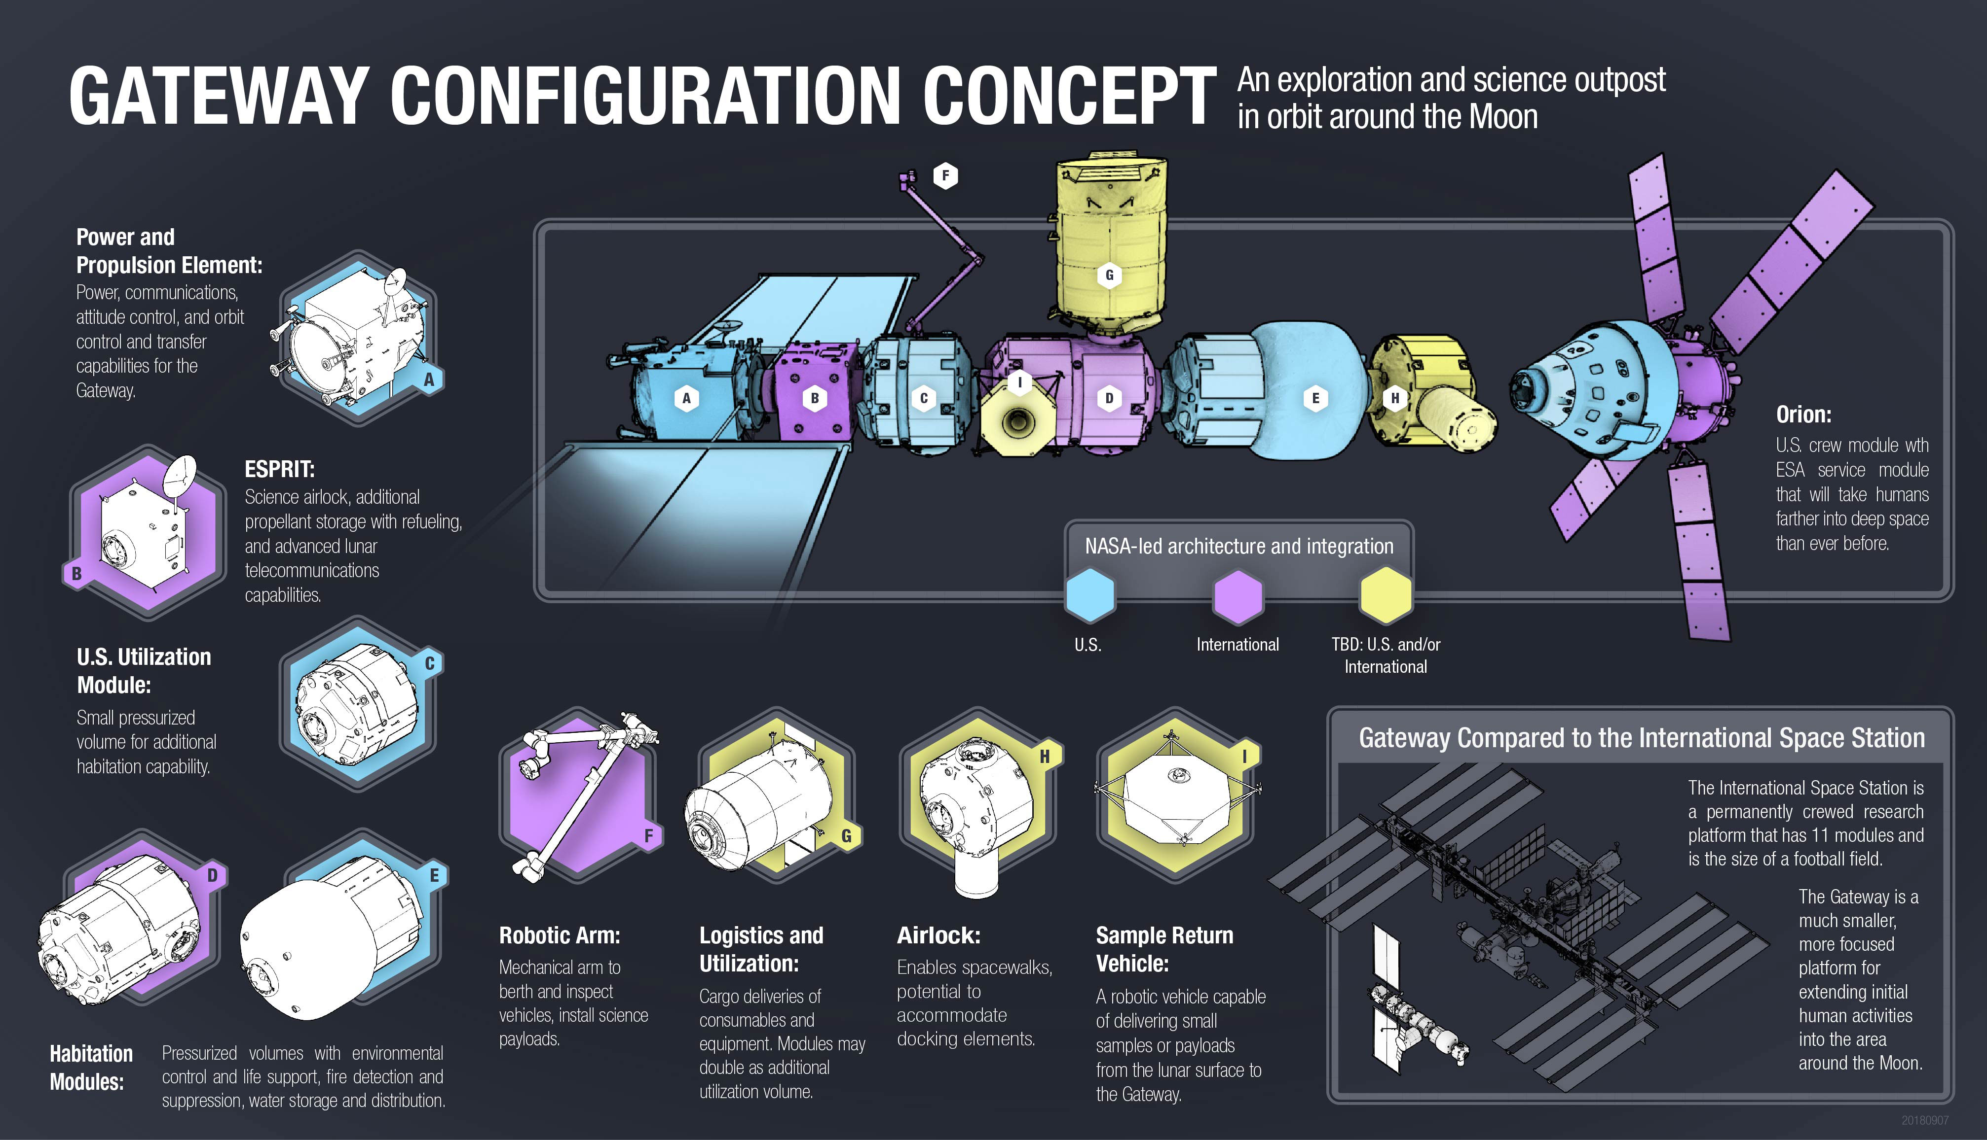

Slide 8
CFS Projects On Orion
CFS Projects on Orion Missions
  Orion Ascent Abort 2 Flight Test
    CFS Framework for Primary Flight Software
    Hardware: AiTech SP0 processor
    Operating System: VxWorks
  Orion Exploration Mission 1 & 2
    Vision Processing Unit (VPU)
      Backup Flight Software
        EM-1: Entry phase, EM-2 & beyond: All Flight Phases
      Hardware: Sparc LEON 3
      Operating System: VxWorks
    Camera Controller Units – Crew Module & Crew Module Adapter
      Camera controlling software (still image & motion video)
      Optical Navigation Software
      Hardware: Intel I5 NUC
      Operating System: Ubuntu-64

Slide 9
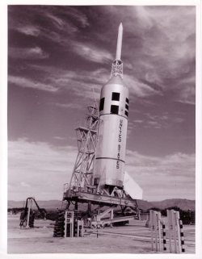
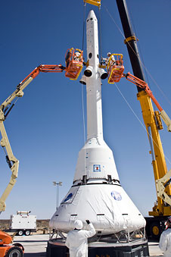
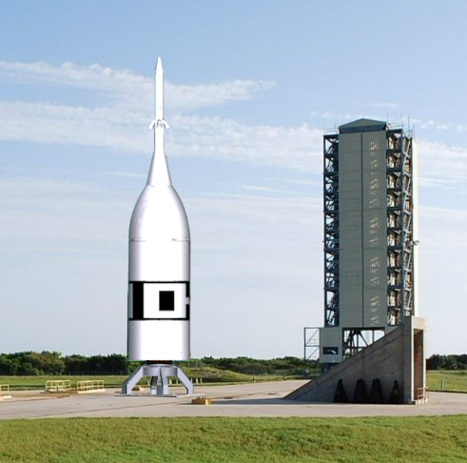
AA-2 Project Introduction
Ascent Abort 2 (AA-2) Flight Test
AA-2 is a Development Flight Test for the Multi Purpose Crew Vehicle (MPCV) Program
Single launch planned for April 2019 from Space Launch Complex 46
AA-2 will test the LAS under flight-like conditions to help certify the system for crewed missions
AA-2 uses a surrogate low cost, less complex booster and Crew Module
AA-2 Avionics & Software
Designing to use COTS avionics wherever possible
Dual string design using cFE/CFS on VxWorks
Reuse of ANTARES Trick Simulation
CFS wrapped GNC Matlab/Simulink Autocode from mainline MPCV
Orion
Apollo Pad Abort Test
Apollo Ascent Abort Test
(Little Joe II Booster)
Orion Pad Abort Test
AA-2 Flight Test Vehicle
Notes:
The purpose of this slide is to provide objective evidence of and/or support the accomplishment of the following CMMI requirements:
IPM-IPPD SG 1Use the projects Defined Process
IPM-IPPD SG2 Coordinate and Collaborate with Relevant Stakeholders
IPM-IPPD SG3 Apply integrated product & process development
GP 2.3 Provide Resources
GP 2.4 Assign Responsibility
GP 2.7 Identify and Involve relevant stakeholders

Slide 10
AA-2 Flight Test Profile
AA-2 Flight Test Profile
Event Description
1 ATB ignites.
Vehicle departs on eastward trajectory.
ATB boosts the FTA to the test condition.
2 Test Condition is reached
ATB sends signals to the FTA
CM triggers the abort event.
CM ignites the LAS AM and ACM
CM separates from SR
LAS propels CM away from ATB.
3 LAS AM burns out.
CM/LAS continue coasting to apogee.
While coasting,
ACM reorients CM heat-shield forward.
4 CM/LAS reorientation is completed.
5 CM ignites LAS JM
CM separates the LAS from the CM
LAS is jettisoned away from the CM.
6 ATB, LAS, and CM free-fall into the ocean.
Flight Test is completed.
No planned recovery. Will depose
of items that are hazards to marine navigation
Note: Trajectory and event times are based on preliminary data.

Slide 11
High-Level AA-2 Avionics Architecture
SIGI
SIGI
1553 Bus
PDU
Flight Computer 1
Flight Computer 2
DFI
PCU, Battery
PCU, Battery
EDR
Ethernet & RS422 Busses
CM & LAS Interface, RS422 & Discrete Pyro
CM – Crew Module
Cmd - Command
LAS – Launch Abort System
PCU – Pyro Control Unit
DFI – Development Flight Instrumentation
SIGI – Space Integrated GPS/INS
GPS – Global Positioning System
INS – Inertial Navigation System
Tlm - Telemetry
PDU – Power Distribution Unit
LAS
Pyros

Slide 12
AA-2 Top Level Software Block Diagram
Flight Software
EDR
CFS Core
Apps
AA-2 Custom Applications
Custom
Sensor/
Effector
Apps
C/C++
Tool Chain
Open Source
  VMWare (local PC/Mac)
  Eclipse (local IDE)
  Scientific Linux (local WS OS)
  GNU C/C++, Java (compile/Xlate)
  UCC (code count metrics)
  Understand (standards checker)
  Bitbucket/Git (CM)
  JIRA (change tracker)
  Bamboo (continuous integration)
  mREST (Test Framework)
  Windriver Workbench
AA-2 Custom Application
Rasberry Pi
MPCV GNC Autocode
CFS Infrastructure (Goddard)
VxWorks Operating System
Aitech SP0 Processor, cPCI
I/O Devices (NAI)
Simulation Software
Ground Software
C++
Specific System & I/O Models (RAMTARES)
Decom System
C/C++
Displays & Controls
Scripts
Java
Payload Telemetry Processor
Test Framework
Dynamics, Time, Environment Models
EDGE Visualization
JEOD
Command & Data Dictionary
Generic Systems
Models
Database
(postgreSQL)
Valkyrie
12->8 bit down select & packetization
Trick Simulation Core (JSC)
Linux OS
ITOS Infrastructure (Goddard)
(Data Com/Decom, Recon, Distribution, Display, Scripting, Recording, Post processing)
Linux OS
12
Linux OS
Notes:
Simulation: Changed ANTARES to RAMATRES
Added Decom box
Put TBD next to hudson and C++ test in tool chain box

Slide 13
AA-2 Flight Software Architecture
Framed CCSDS
1.28 Mbps (combined)
SSRs, Avionics temps, voltage, etc.
Launch Abort System
RS-422 (two channels)
DFI
Pyros, ATB discrete signals
Ethernet
Manchester Encoded
RS-422
Telemetry
Output Serial
(40 Hz)
Telemetry
Output
(40 Hz)
Command
Ingest
(10 Hz)
House-
Keeping
(10 Hz)
A IO
(40Hz)
LAS I/O
(40 Hz)
Scheduler /
Sync
(40 Hz)
D IO
(40 Hz)
SIGI
1553
SIGI
IO
(40 Hz)
Automated
Flight
Manager
(AFM)
(40Hz)
GNC 40 Hz
(40Hz)
GNC 1 Hz
(1Hz)
EDR
RS-422
EDR
IO
(40 Hz)
Inter-task Message Router (SW Bus – Publish/Subscribe)
Software
Bus
Time
Services
Executive
Services
Event Services
Table
Services
cFE Core Services
Mission Specific I/O Apps
CFS Configurable Applications
Mission Specific Apps

Slide 14
Optical Navigation Project Overview -
Background
Optical Navigation (OpNav) Application Software
  NASA/JSC/Engineering Directorate Government Furnished Equipment (GFE) software project authorized October 2016, delivered April 2018
  Orion (EM-1, EM-2) software producing navigation data for onboard GNC flight control in the event of loss of communication with ground
    Determines position and range of spacecraft based on optical image recognition of either earth or moon from images taken by dedicated fixed-mounted camera (Pixelink) on bottom of Orion Command Module
    Self calibrates images onboard prior to navigation use by imaging starfields, high accuracy required
  Functions as Orion backup navigation sensor in the event of comm loss
    Orion requires nav updates from ground, if comm is lost, poses LOC/LOM risk during entry
    Provides autonomous navigation updates upon Loss of Comm
    Class A Safety-Critical Software
  For EM-1, images taken every 30s during approximately 8, 2-hour “passes”
    Dedicated “calibration passes” image star field to determine camera distortion & orientation
    Dedicated “imaging passes” image earth or moon to derive navigation solution
    Function validated on “outbound leg” to moon for EM-1, evaluated as a DTO for this phase
    Activated on the “inbound” from moon for loss-of-comm
      Solution fed to Orion FCM-GNC and downlinked
  Located in Camera Controller (CC) unit on Orion EM-1 vehicle, Linux computer running the Core Flight Software (CFS) framework

Slide 15
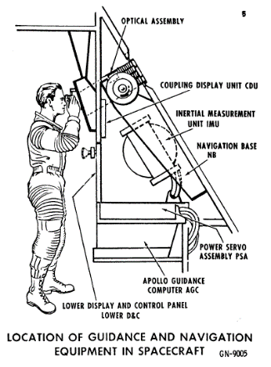
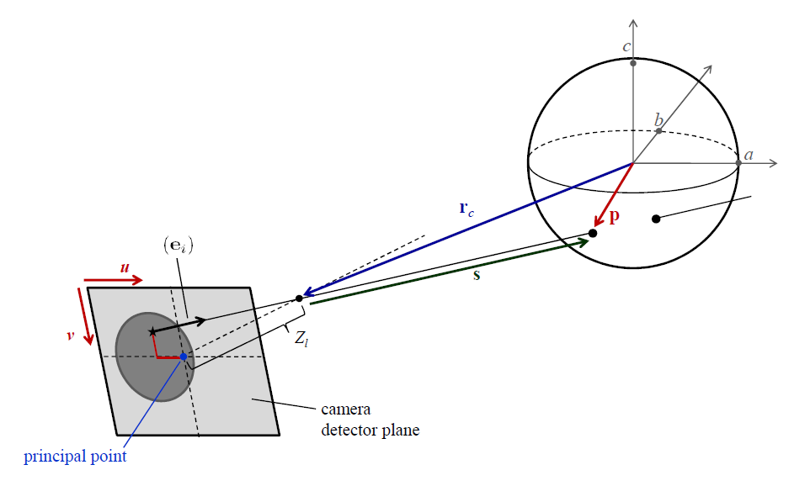
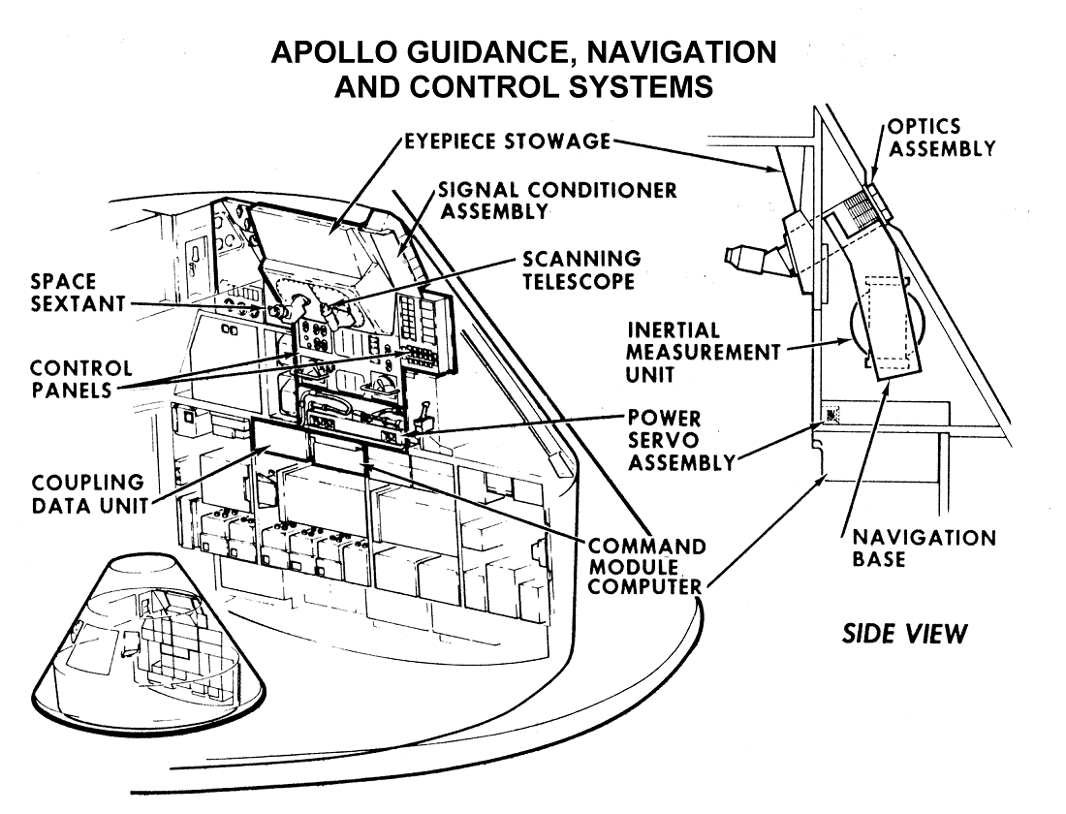
How Optical Navigation Works
Still images of Moon or Earth are processed to find apparent angular diameter and centroid in camera focal plane
Raw data is transformed into range and bearing angle measurements using planetary data and precise star tracker inertial attitude
Measurements are sent to the main flight computer’s Kalman filter to update the onboard state vector
Images are collected over an arc (~2hrs) to converge the state and estimate velocity
The same basic technique was used by Apollo to satisfy loss-of-comm, but Apollo used manual crew sightings with sextant instead of autonomously processing optical imagery
Apollo
Space Sextant

Slide 16
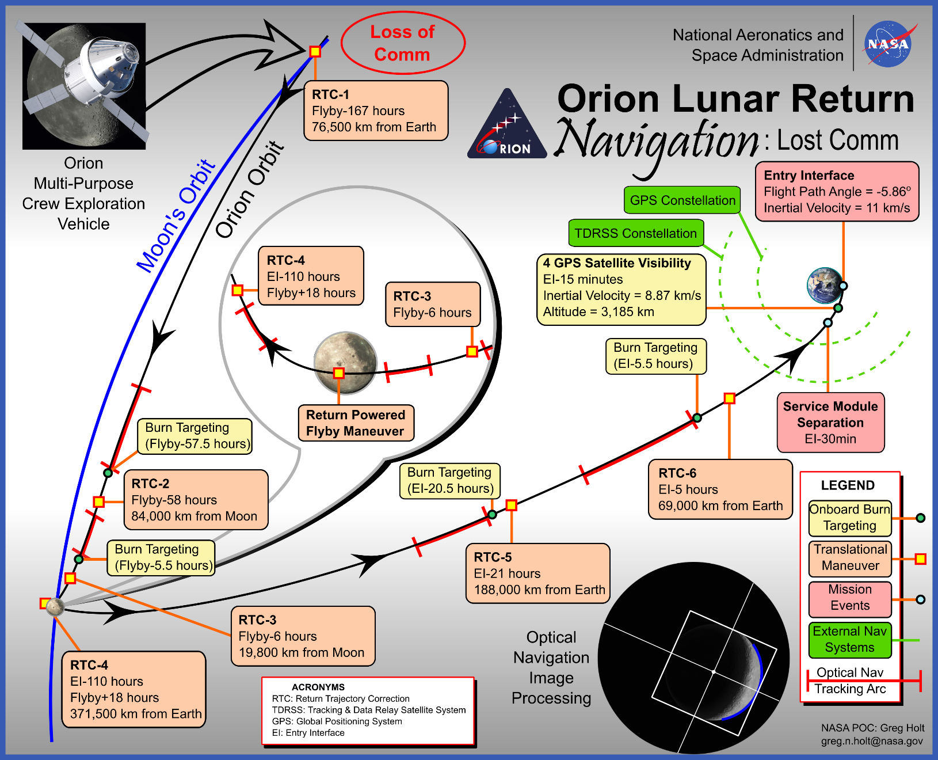
Loss of Comm Navigation

Slide 17
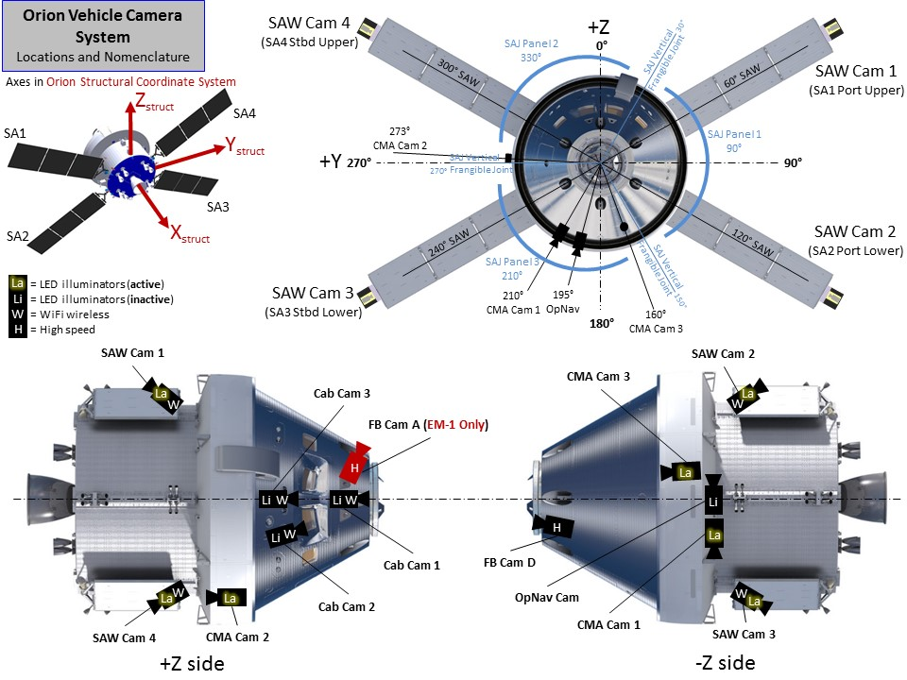
MPCV Camera Locations
Star Tracker & OpNav Camera Locations

Slide 18
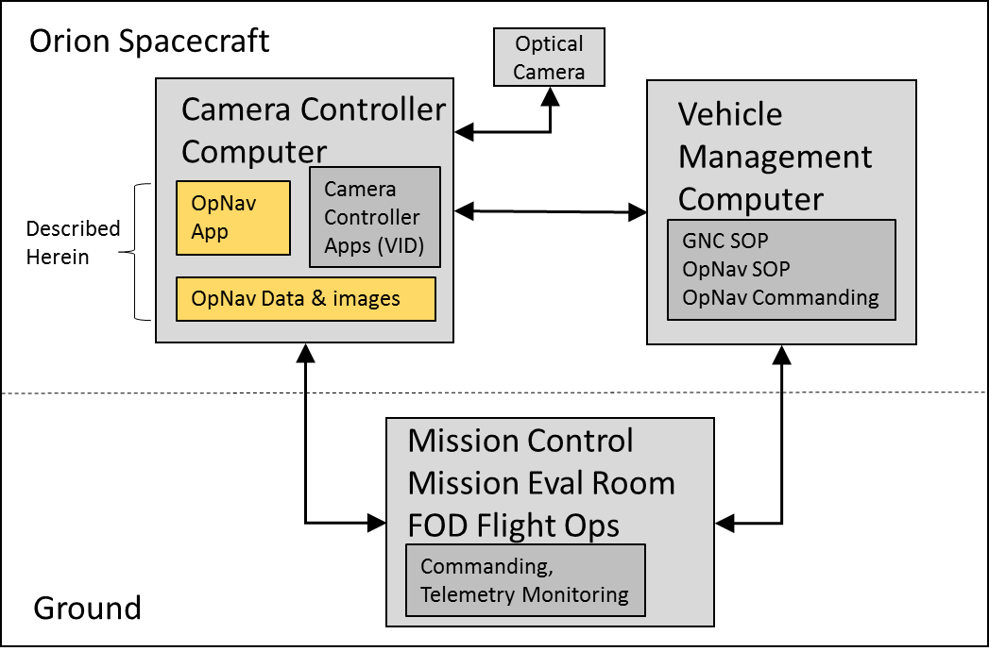
OpNav System Architecture

Slide 19
OpNav Application Software Architecture
OpNav
FileData
Pixelink Camera Drivers, I/O Apps
(64-bit)
Pixelink OpNav Camera
File System
Imagery
OpNav within
CFS Layered Framework
GoPro
App
House-
Keeping
(HK)
CFDP
-File
Transfer
File
Manager
(FM)
File System
Mass Storage
Video,
Still Imagery
Scheduler
(Sch)
Camera
Controller
App
Application
Layer App
Other
Mission Specific CFS Apps
Data
OpNav
App
CFS Reuse
Apps
Storage
(DS)
Stored
Command
(SC)
OpNav
Application
Software
cFE (core Flight Executive)
Services
Software
Bus
CFS Application Framework (32-bit)
Inter-task Message Router
(Software Bus – Publish/Subscribe)
Operating System Abstraction
Layer (OSAL)
OpNav
(1 Hz)
Platform Specific Package
(PSP)
Time
Services
External I/O Apps:
DEM telem
DEM cmd
UDP I/O
(via Data Util Network)
VEPC I/O (via RS-422)
Executive
Table
Services
Services
OpNav App & Data
CFS Core Services
CFS Reuse Apps
Video System (VID) Apps
Data To/From Vehicle Systems
Data To/From Ground

Slide 20
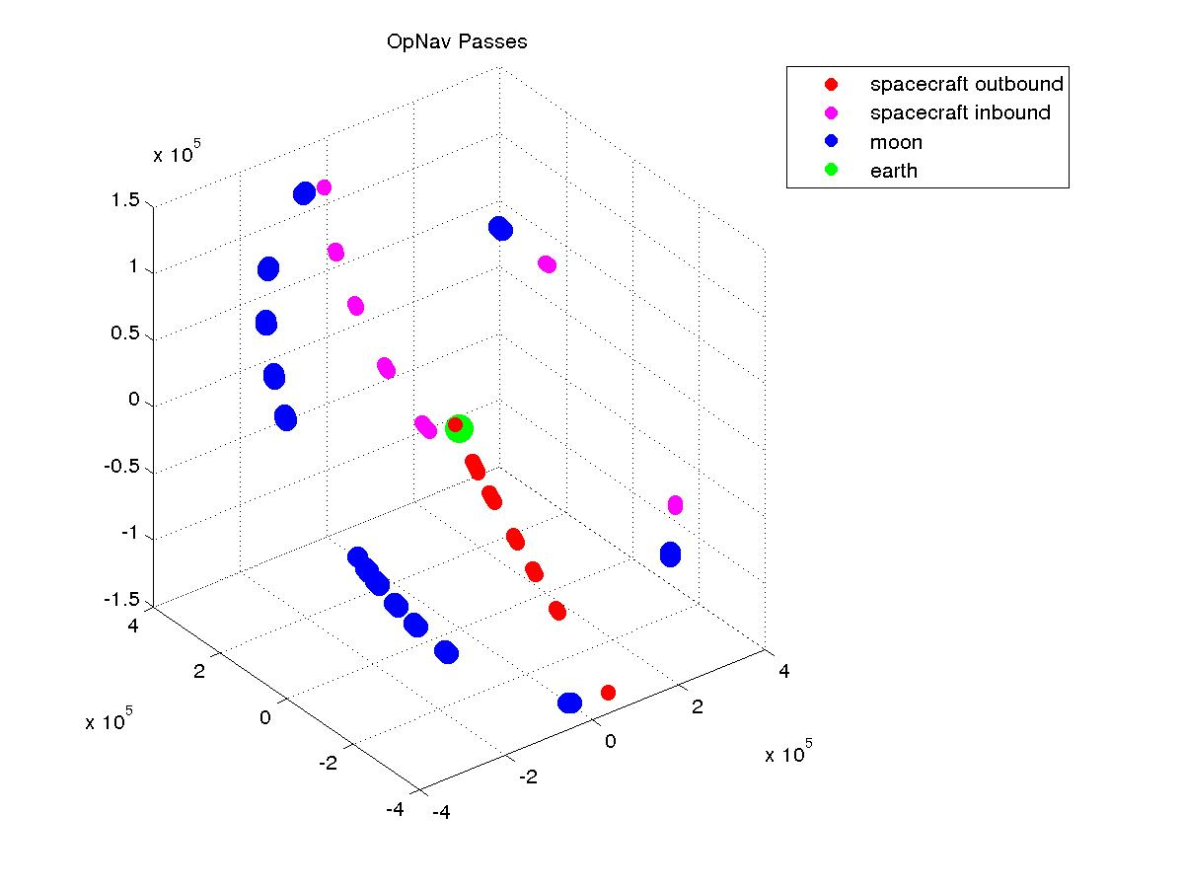
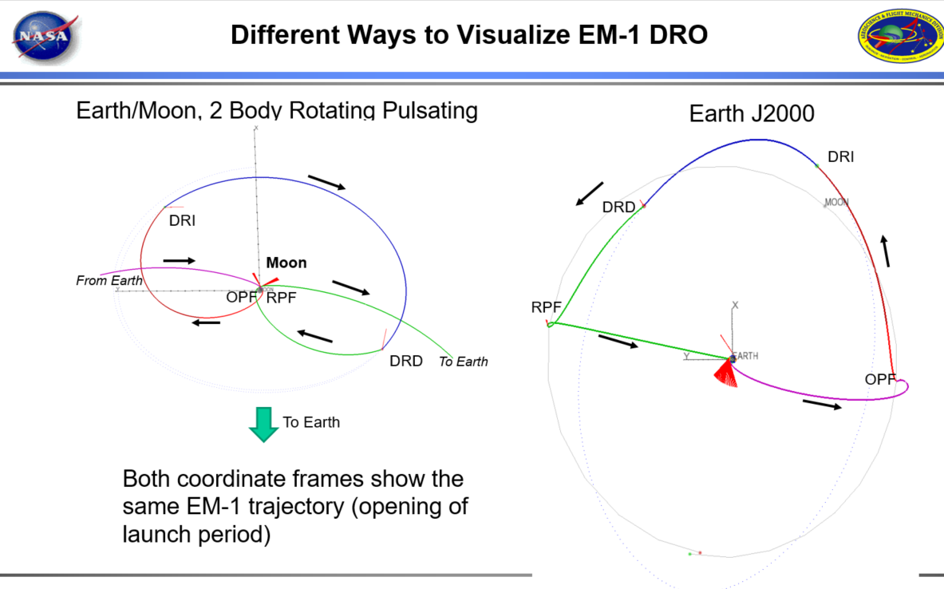
Orion EM-1 OpNav Pass Visualization

Slide 21
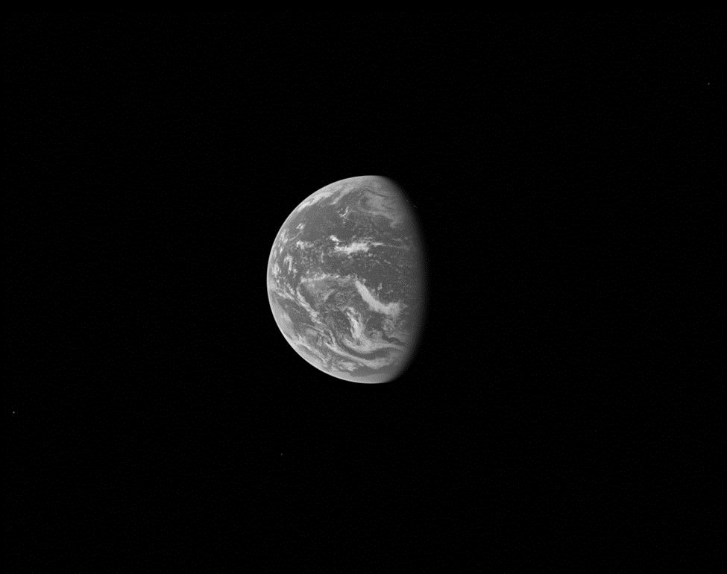
Practice Earth Pass Sample Image, Trajectory Time 39065

Slide 22
8.5.5 Cert 2 Backup Moon Pass Sample Image, Trajectory Time 415275

Slide 23
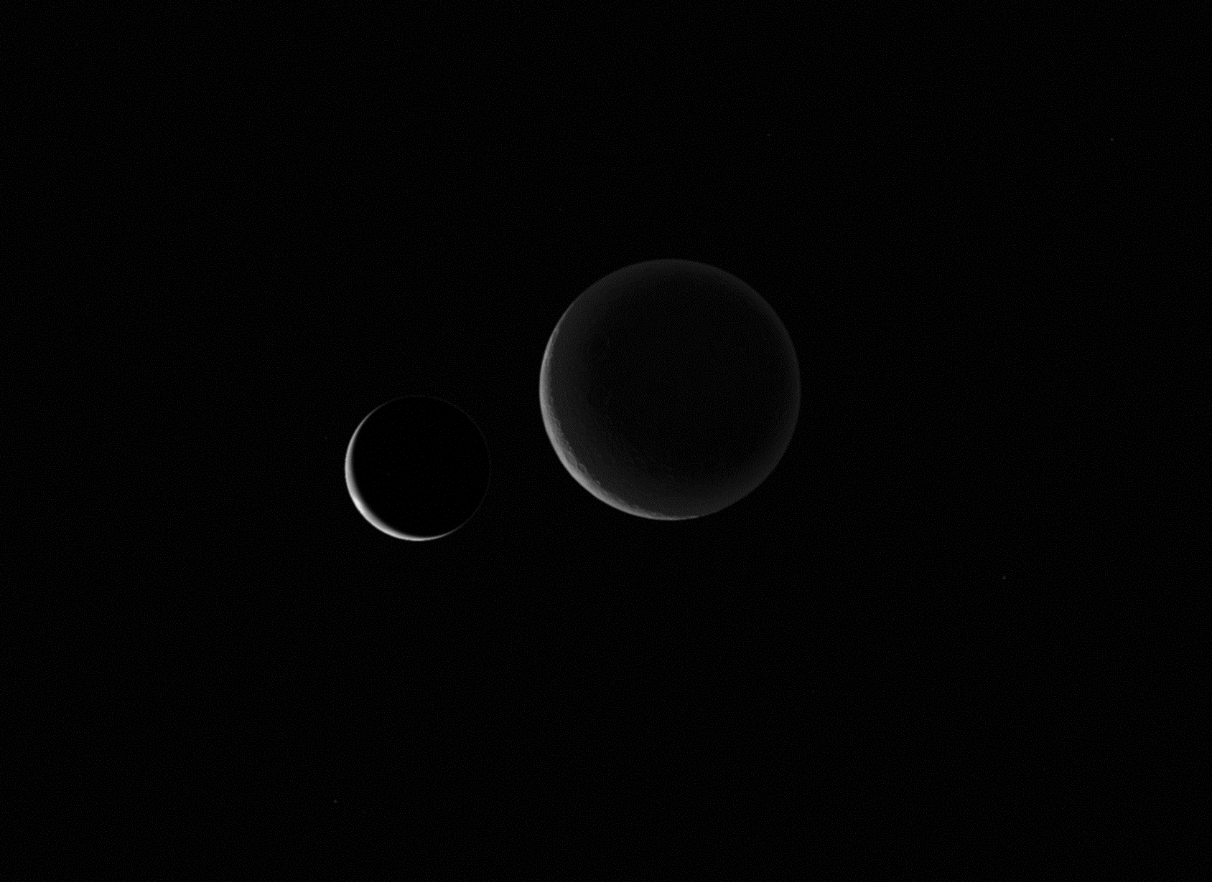
Sample Off Nominal – Earth and Moon in Image during DRO

Slide 24
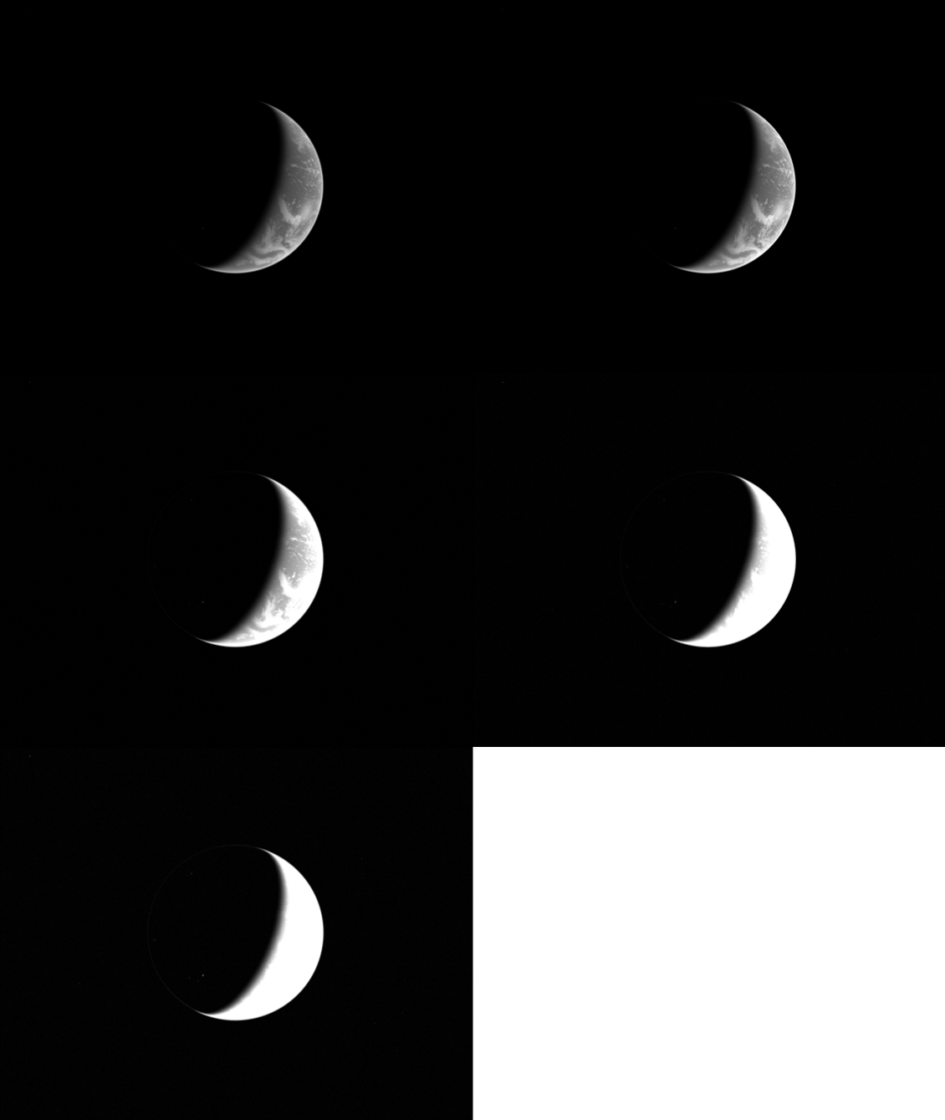
Sample Off Nominal / VT-Image –
Over-Underexposures (exposure bit) for each Pass

Slide 25
Orion Backup Flight Software
Human-rated spacecraft require high degree of redundancy / fault tolerance
  Redundant hardware systems (example: quad-voting systems)
  Redundant software systems
    If primary software fails to operate, backup system is needed
    Backup Flight Software (BFS) exists to mitigate the risk of software common cause failure in the primary flight system
      Strive for dissimilarity in all life cycle phases, process, tools, platform, etc.
Orion backup software
  EM-1 BFS written to support backup during Entry
  EM-2 BFS will be expanded to support all flight phases
    EM-2 project started October 2018
      Joint team with NASA and Lockheed-Martin (Orion prime contractor)
        Mix of C & C++ applications running within CFS framework
        LEON3 processor
        VxWorks OS
    Reduced set of capabilities compared to primary, but can “take over” in event of a primary software failure
      Complete/perform dynamic flight events such as ascent, entry, and burn targeting
      Maintain knowledge and control of vehicle attitude and state during quiescent flight phases
      Maintain control of life support, power, and communication systems
      Monitor and mitigate crew environmental hazards
      Provide manual commanding and piloting capabilities to the crew

Slide 26
Orion BFS vs. Primary Toolchain
Item | BFS | Primary FSW
Hardware and Operating System
CPU | LEON 3 | PPC-750
Operating System / compiler | VxWorks | Green Hills Integrity
Framework | CFS Framework | ARINC653
Development Tools / Language
Algorithm Implementation | Hand-Coded | Auto-generated C++
Development Environment(s) | Eclipse, VxWorks Workbench | Rhapsody/Green Hills
Programming Language(s) | C or C++ | C++
Software, Documentation, and Data Configuration Management
Data Management | CCDD -> ODS | ODS
In-Flight Reconfiguration | CFE tables | SLDB
Documentation Storage | NASA SharePoint, Windchill | Windchill
Requirements Linkage | Excel, DOORS | Rhapsody, DOORS
CM | Git -> Perforce | Perforce
Documentation Tools | Microsoft Office, Doxygen, DOORS, Windchill | Rhapsody, DOORS
Integration, Test, and Simulation
Unit Test Framework (UTF) | GoogleTest & UTAssert | LDRA
Code Coverage | gcov (Linux and VxWorks) | LDRA
Static/Standards Analysis | ucc code check, cpp check | Klockwork
Code Review | Gitlab, Crucible / Code Collaborator | Crucible/Code Collaborator
Simulation / Test | RAMTARES, CFS Test Framework, OrionSim | OrionSim
Development Process / Standards
Coding Standards | C – NASA, C++ - Orion SDP | Orion SDP
Software Development Process | NPR 7150.2B, BFS SDP Addendum | NPR 7150.2, Primary SDP

Slide 27
High-Level Orion Avionics Architecture
VMC
VMC
VPU
Backup Flight Software
VxWorks, CFS, Leon3
FCM
FCM
Primary FSW
Integrity ARINC653 OS,
PPC 750
FCM
FCM
DCM
DCM
ACU
DU
CCM
CCM
DU
ACU
DU
Onboard Data Network (time triggered)
Utility Network
ACU – Audio control Unit
CC – Camera Controller
CCM – Communications Control Module
CFS – core Flight Software
DCM – Display Control Module
DU – Display Unit
FCM – Flight Control Module
FSW – Flight Software
ODN – Onboard Data Network
VMC – Vehicle Management Computer
VPU – Vision Processing Unit
CC
CC (opnav)

Slide 28
EM-2 Backup Flight Software Architecture within VPU’s CFS Framework
(Planning Purposes)
GNCLib
(Common
GNC)
bfs shared libs
BFSLib
(C++, C?
Lib)
BIF
BFS I/F
Lib)
cfe
Time
Table
Services
SOL -Solar
Arrays & Pwr
Mon&Ctrl
Services
PRP
(Prop
Mon & Mgmt)
NAV
(Navigation)
GCE
(Entry Guid &
Ctrl)
GSM
(SM Guidance)
CSM
(SM Control)
Software
Bus
Excutive
Services
20 Hz
1 Hz
40 Hz
40 Hz
40 Hz
40 Hz
HS
(Health &
Safety)
gnc apps
FM
(File
Manager)
MP
(Manual
Piloting)
MD
(Memory
Dwell)
40 Hz
DS
(Data Store)
refs
MC
(Manual Commanding &
Routing)
CF
(CCSDS
File Xfer)
CFS Software Bus
10 Hz
File System
Vpud libs
Vpud apps
LC
(Limit-
Checker)
(EM-1 only)
BEX
(BFS
Executive)
ECS
(Environment
Ctrl &Suits)
stor
DemCmd
MM
(Mem-
Mgr)
SCH
(Scheduler)
LCB
(BFS Limit
Checker)
(hazards)
IOlib
DemTlm
cpplib
Diag
40 Hz
CFSlib
SBNx
1 Hz
ODNlib
UDP
SCB
(Stored Command –
Sequencer)
(40Hz)
40 Hz
VHC
CS
(checksum)
HK
(house-
keeping)
Cmt
MULTIDISIPLINARY
Custom App (BFS & VPU requirements)
  BFS condition & hazard monitoring
  Mode change events
  Sequence Triggering
  Possible refactor BEX from EM-1
Odl
vpud
Data To/From ODN
VPUD Mission Specific Applications
MULTIDISIPLINARY
Modified SC for higher rate time response, sub second times
Multi-Discipline Cmd Sequences (RelTime & AbsTime:
  Ascent Sequences
  Entry Sequences
  Config heaters
  Config pressurization
  Manual Burn Attitude
  BFS Config sequences
  CM RCS prop pressurize
  Functions of EVE (EM-1’s EVE App refactored possibly)
  Possible Incorporate BEX from EM-1
CFS Core Services
CFS Framework & apps VPU and CC/VID
CFS Reuse Apps
BFS-Mission Specific Apps/Sequences
EM1 BFS Apps/Sequences
BFS Libraries

Slide 29
Backup
Questions?

