Slide 1

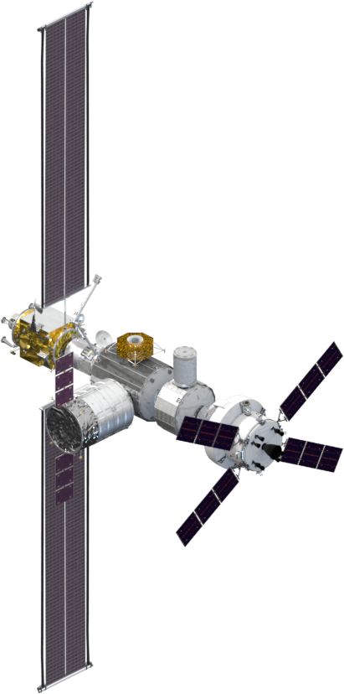
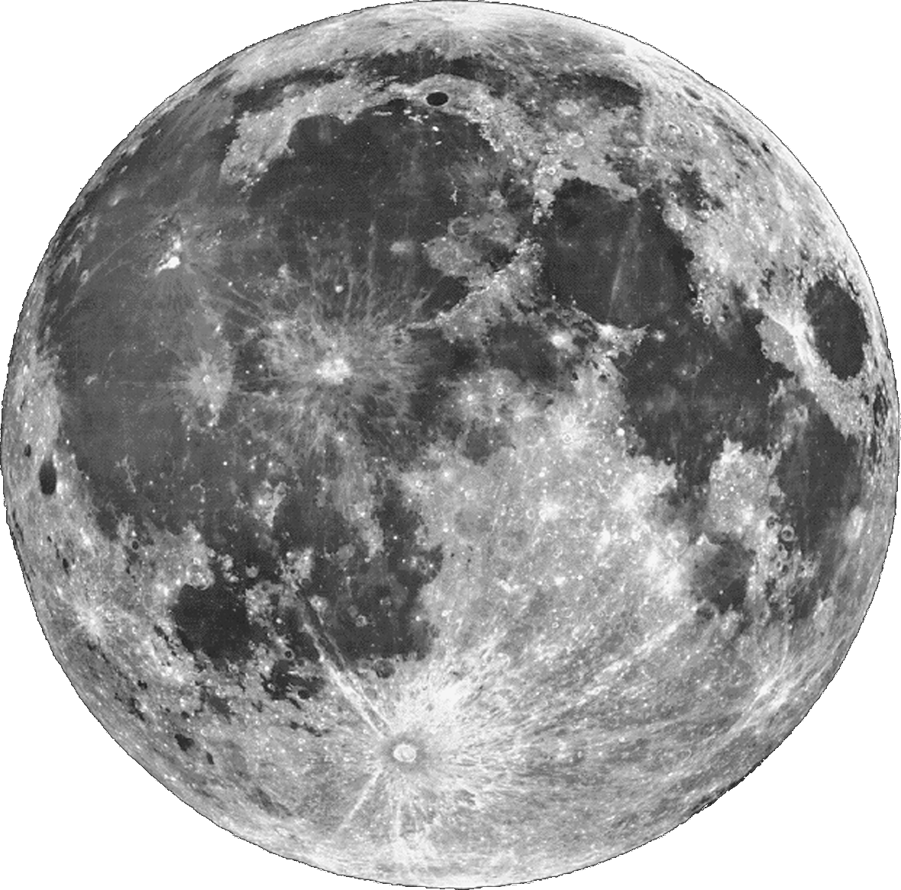
Autonomous
Systems and
Operations
Α
Μ
Σ
10
Core Flight Software
Autonomous Systems Operation
NASA ARC: C. Knight (presenter), J. Frank, M. Iatauro, G. Aaseng, R. Levinson, J. Ossenfort, M. Scott, A. Sweet
NASA GRC: J. Csank, J. Soeder
NASA JSC: D. Carrejo, A. Loveless, T. Ngo
NASA MSFC: Z. Greenwood

Slide 2
Autonomous and
Dormant Operations
Future exploration destinations (e.g. Mars) will operate tens of light minutes from Earth.
Small crews cannot operate complex spacecraft far from Earth without assistance from Mission Control
The Lunar Outpost Gateway (LOP-G) is intended to prove out concepts for future Mars missions.
LOP-G will be dormant (uncrewed) 10-11 months out of the year.
LOP-G elements, including Habitat and Power Production Element (PPE), have numerous autonomy requirements

Slide 3
NASA Advanced Technology
NASA’s Advanced Exploration Systems (AES) program develops and tests technology for LOP-G, including:
  Modular Power Controller
  Avionics and Software
  Habitat Autonomy Technology
A test of these technologies required additional development effort:
  Systems Engineering and Integration
  Testing and Fault Injection

Slide 4
NASA Advanced Technology:
Modular Power System

Slide 5
NASA Advanced Technology:
Avionics
TTE Switches:
Deterministic data delivery
Message delivery redundancy
Triplicate Flight Computers:
cFS Flight Software
Duplicate Flight Load
Non-terministic network:
AMPS End-item control
Linux support/simulation:
Some cFS applications (voting, autonomy applications)
cFS: SCH, SBN, DS + DS_REPLAY, LC, L1V

Slide 6
NASA Advanced Technology:
Habitat Autonomy Technology
Fault Detector
  Leverages cFS LC – with 64-bit and “platform-endian” adds.
  Process system data to detect possible faults.
  Output is pass/fail of ‘tests’.
  Data cleansing for off-scale, stale data, configuration
Diagnostic Executive
  Isolate faults given tests produced by Fault Detector
  Uses declarative model of components and fault modes
  Uses COTS technology (TEAMS)
Fault Impacts Reasoner
  Determines impacts of faults
  Uses same model as Diagnostic Executive

Slide 7
NASA Advanced Technology:
Habitat Autonomy Technology
Hybrid Diagnosis Engine
  Detect and Isolate faults from system data
  Uses declarative model of components and fault modes
  Able to reason over mixed discrete-continuous data
Vehicle Systems Manager: Scheduling
  Schedule system activity in presence of operational constraints
  Reasons about power, energy, system operation modes
Vehicle Systems Manager: PLEXIL
  Sends commands to systems
  Invokes scheduler in response to either APC or fault messages

Slide 8
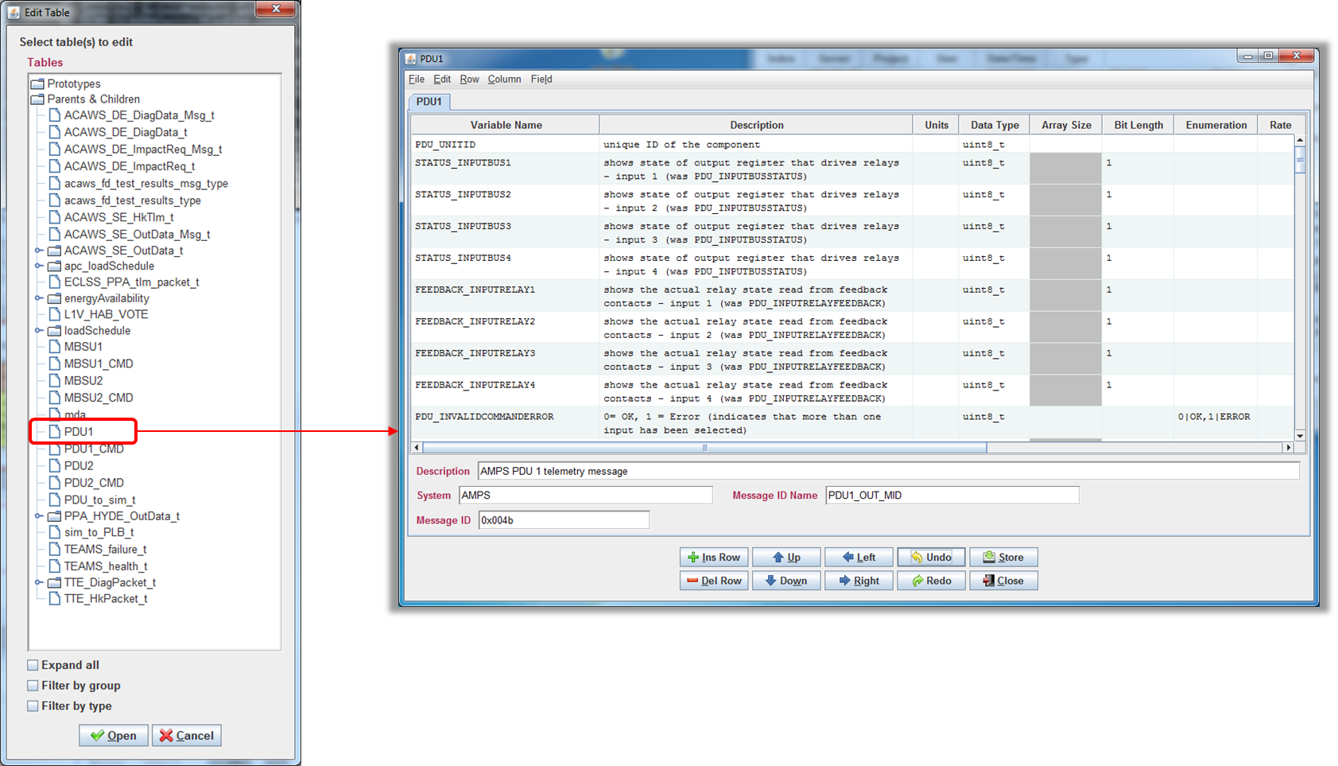
NASA Advanced Technology:
Systems Engineering and Integration
Capture cFS message content
Display messages by sub-system
Convenient Web interface
Message content auto-generates cFS msg-ids

Slide 9
NASA Advanced Technology:
Testing and Fault Injection
cFS: DS_Replay
  Able to replay cFS message traffic captured with standard DS tool
  Able to record and playback fault cases
  Also able to transform other packet data with fault signatures
Modular Power Systems Fault Generation tool
  Simulate dozens of MPS faults
cFS ‘Silent Command’ to Power System
  Cause MPS switch to open/close without registering normally; can simulate failed open, short circuit, power supply faults

Slide 10
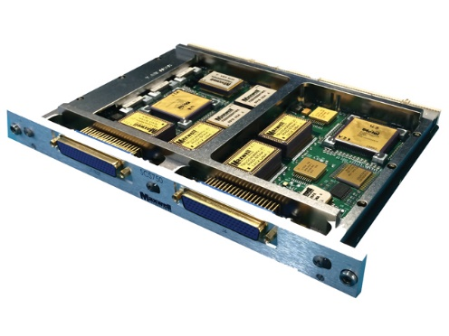
cFS for Orion (EFT-1) Diagnostics
Analysis & Test Architecture
  Orion telemetry played back into cFS environment
  Data transmitted via Ethernet to PPC
  Results returned and logged for functional verification
  Performance data collected on Linux host
Advanced Caution & Warning System (ACAWS)
  ACAWS Fault Detector (FD) performs data filtering and testing
  ACAWS Diagnostic Executive (DE) performs diagnostic reasoning
  Executes with an Orion EM-1 Fault Model
Orion Telemetry Data
Linux
PPC 750
FD_Test_Results_Msg
VxWorks SystemViewer
SBN
ACAWS FD
ACAWS DE
SCH
CFS
Core Flight Executive
Data Playback Server
TLM Bridge
SBN
TLM_Data_Msg
VxWorks
Legend
Diag_Results_Msg
TLM Input
Data Store
CFS Message
Perf Data

Slide 11
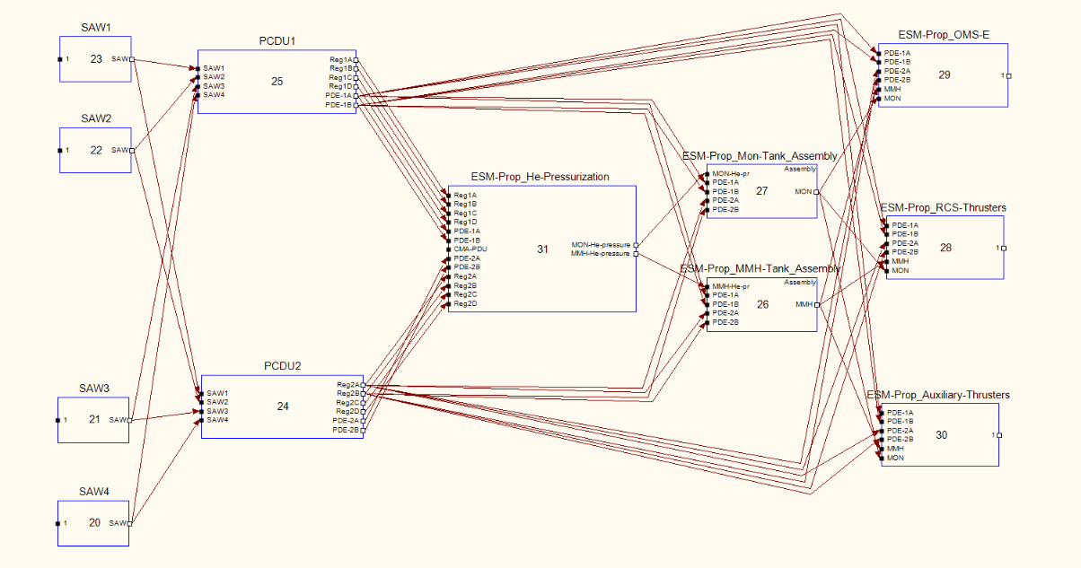
EFT-1 Fault Model
Orion Fault Model
  Faults in Electrical Power System and connected electrical loads
  Built with the TEAMS® modeling toolset
  TEAMS® uses a dependency model that correlates faults and their propagation paths with tests that detect indications of a fault
Model Attribute | Value
Failure Modes | 5473
Components | 2971
Tests | 5372
Failure Modes Per Component | 1.84
Tests Per Component | 1.81
Tests Per Failure Mode | 0.98

Slide 12
ASO cFS Recent Past and Near Future
FY17
  Voting, SBN, real-time OS + cFS integration
FY18
  CCDD: ASO supported iPAS integrated testing by feeding input to the CCDD process and integrating the configuration into autonomy apps.
  Protobetter: iPAS developed framework for data management for mix-platform SBN networks. ASO demonstrated with autonomy apps.
FY19+
  EDS: demonstrate/integrate?
  Further real-time OS + cFS integration.
  Voting 2.0 (distributed voting)?
  Autonomous commanding of cFS?
  Lua (and/or other embedded programming languages) for complex event-driven commanding scenarios? “LC++”!

Slide 13
BACKUP

Slide 14
Autonomous
Systems and
Operations
Α
Μ
Σ
10
Development and Testing of a Vehicle Management System for Autonomous Spacecraft Habitat Operations
NASA ARC: G. Aaseng (presenter), J. Frank, M. Iatauro, C. Knight, R. Levinson, J. Ossenfort, M. Scott, A. Sweet
NASA GRC: J. Csank, J. Soeder
NASA JSC: D. Carrejo, A. Loveless, T. Ngo
NASA MSFC: Z. Greenwood

Slide 15
Talk Outline
Introduction
  Lunar Outpost Gateway
  Autonomous and Dormant Operations
Advanced Technology Development
  Modular Power Controller
  Avionics and Software
  Habitat Autonomy Technology
  Systems Engineering and Integration
  Testing and Fault Injection
Capability Demonstration
  Operations Constraints
  Scenarios
Lessons Learned and Next Steps

Slide 16



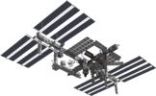

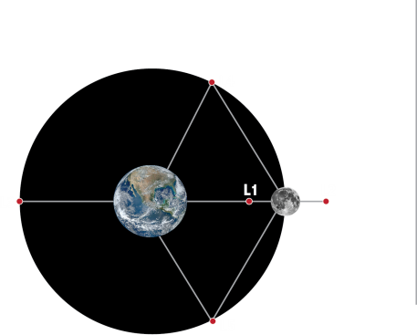
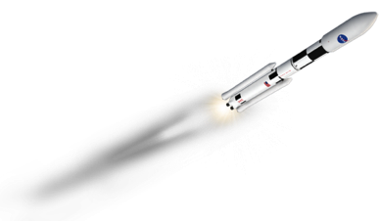

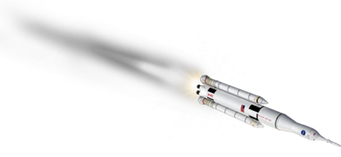
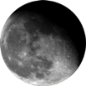


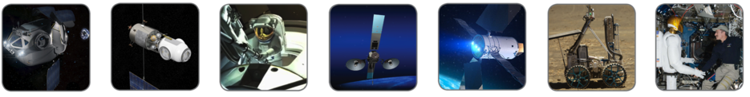
Introduction
Human Exploration Destinations
(one-way travel times)
International
Space Station
(1-2 days)
Mars
(6-9 months)
Moon
(3-7 days)
Earth
Lagrange Points and other
stable lunar orbits
(8-10 days)
Near-Earth Asteroid
(3-12 months)
Future missions will be longer, more complex, & require new technology
Robotics and
Mobility
Deep Space
Habitation
Advanced Spacesuits
Advanced Space Comm
Advanced
Propulsion
Resource
Utilization
Human-Robot Systems

Slide 17
NASA Advanced Technology:
Core Flight Software

Slide 18
Future Work
TTE: Level 0 voting to complement Level 1 voting
AMPS: single-machine APC
VSM: manage more complex operations constraints
HyDE: more complex PPA-SAB fault models
FIR and VSM: port to Flight Computers
CCDD: auto-produce message content headers

Slide 19
Capability Demonstration:
Loads, Operational Constraints
Load | Power (Kw) | PDU-RPC | Priority | Notes
FC1 | 0.25 | 2-2 | 1 | Flight computer (PPC750); live load
FC2 | 0.25 | 2-3 | 2 | Flight computer (PPC750); live load
FC3 | 0.25 | 2-4 | 3 | Flight computer (PPC750); live load
TTE1 | 0.045 | 2-6 | 4 | TTE Switch. Live load. Max power.
TTE2 | 0.045 | 2-7 | 5 | TTE Switch. Live load. Max power.
TTE3 | 0.045 | 2-8 | 6 | TTE Switch. Live load. Max power.
SAB | 0.1 | 1-1 | 7 | Sabatier reactor (air-side life support). Replay data.
PWD | 0.02275 | 1-5 | 8 | Potable Water Dispenser. Simulated.
PPA | 0.1 | 2-1 | 9 | Plasma Pyrolysis Assembly (air-side life support). Replay data.
EXP | 0.2 | 2-5 | 10 | EXPRESS rack (experiment hardware facility). Simulated.
OGA Fan | 0.3 | 1-6 | 11 | Oxygen Generator Assembly. Simulated.
CCCA Fan | 0.4 | 1-7 | 12 | Cryo Cooler Compressor Assembly. Simulated.
SAM | 0.4 | 1-8 | 13 | Spacecraft Atmosphere Monitor. Simulated.

Slide 20
Capability Demonstration:
Power System Operational Constraints
Parameter | Constraint | Notes
Solar Array Power | 2.88Kw | Assumed
MBSU Power | 2.88 Kw | Cross-Strapped; 1 MBSU may power both PDU’s Loads
PDU Power | 2.88 Kw | No load cross strapping
Battery DoD | 30% | Assumed
Battery Energy | 1.134 KwH | Derived from 30 Ah, 126V
Battery Power Rate | 1.235 Kw | Derived from Max Eclipse duration of 55 mins

Slide 21
Capability Demonstration
Operational Constraints
Duty Cycle constraints: system on/off mode schedule
  PPA: 100 minutes on, 15 minutes off
  SAB: 100 minutes on, 15 minutes off
  PWD: 15 minutes on, 1 minute off
PPA-SAB
  SAB produces methane processed by PPA
  PPA and SAB either both on or both off
EXP
  Continuously on in nominal scenario
  May be powered off for max of 30 minutes
  (Proxy for thermal constraint on a freezer with specimens)

Slide 22
Capability Demonstration:
Scenarios
Scenario | Description | Notes
Nominal | All Systems Running, no faults | No eclipse
Nominal plus eclipse | All Systems Running, no faults | Eclipse (55 mins)
2 FC Voting test | 1 FC faulted | No eclipse
1 FC test | 2 FC faulted | No eclipse
3 FC voting test | Inject Mangled Data | No eclipse
Power System Fault | Lose 1 battery during eclipse | Demonstrate load shed and power replanning
Power System Restored | Reconnect battery | Demonstrate fault cleared and battery recharging
Life Support Fault | PPA fault | Demonstrate replanning and power off SAB

Slide 23
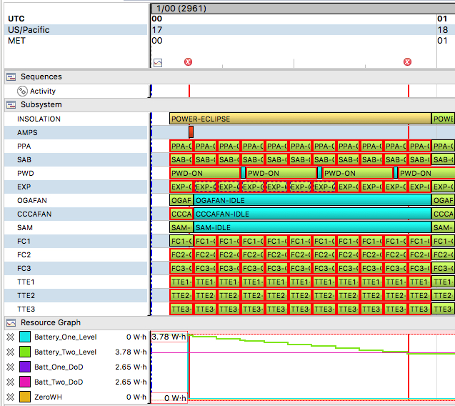
Capability Demonstration:
Scenarios
Power systems fault during eclipse
30% Depth of Discharge constraint violation before leaving eclipse

Slide 24
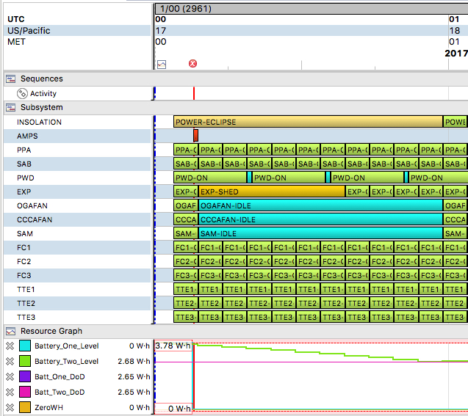
Capability Demonstration:
Scenarios
Power off EXP for 30 minutes, avoid violating EXP power-down (thermal) constraint
30% Depth of Discharge constraint now satisfied

Slide 25
Capability Demonstration:
Habitat Simulation
Fault | Number of Instances | Notes
Power Loss | 14 | Flight computer (PPC750); live load
Switch Fail Open | 30 | Flight computer (PPC750); live load
Switch Fail Close | 30 | Flight computer (PPC750); live load
External Short Circuit | 20 | TTE Switch. Live load. Max power.
Circuit Overload | 14 | TTE Switch. Live load. Max power.
Load Failure | 10 | TTE Switch. Live load. Max power.
Internal Power Supply | 10 | Sabatier reactor (air-side life support). Replay data.
Data Corruption | 3 | Potable Water Dispenser. Simulated.
Data Loss | 10 | Plasma Pyrolysis Assembly (air-side life support). Replay data.
Controller Fault | 4 | EXPRESS rack (experiment hardware facility). Simulated.
Bus Short | 3 | Oxygen Generator Assembly. Simulated.
Power Card Fault | 4 | Cryo Cooler Compressor Assembly. Simulated.

