Slide 1
GSFC cFS Product Status
Elizabeth Timmons – NASA Goddard Space Flight Center
elizabeth.timmons@nasa.gov
The Johns Hopkins University Applied Physics Laboratory
core Flight System Workshop
December 3, 2018

Slide 2
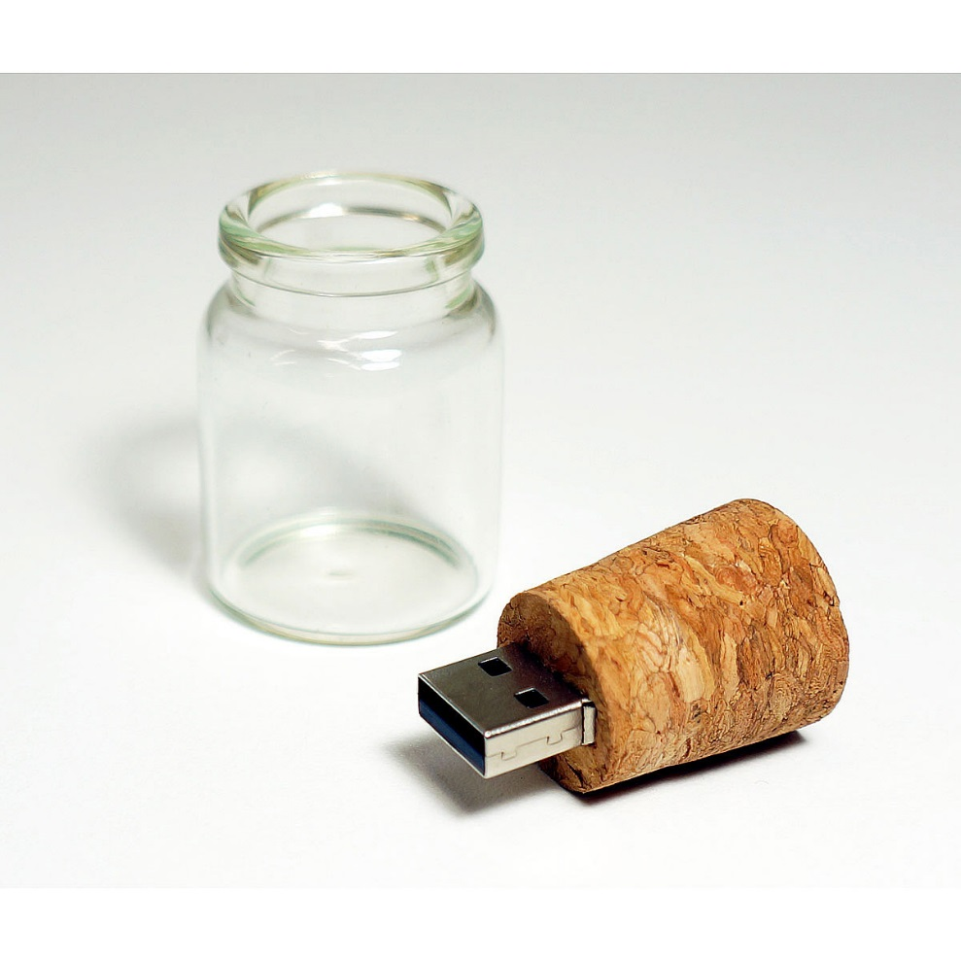
Agenda
Current Product Status
Goals
New Product Release Plan
Planned 2019 Releases

Slide 3
GSFC Product Overview
GSFC Products include:
Apps
Tools
Platforms
Includes internal and open-source products
Does not include:
cFE
OSAL
UT-Assert library

Slide 4
Current GSFC Products
Component | Release
CFDP Application (CF) | 2.2.1
Checksum Application (CS) | 2.4.0
Data Storage Application (DS) | 2.5.1
File Manager Application (FM) | 2.5.2
Housekeeping Application (HK) | 2.4.1
Health and Safety Application (HS) | 2.3.0
Limit Checker Application (LC) | 2.1.0
Memory Dwell Application (MD) | 2.3.1
Memory Manager Application (MM) | 2.4.1
Stored Command Application (SC) | 2.5.0
Scheduler Application (SCH) | 2.2.1

Slide 5
Goals
Increase communication/collaboration within GSFC
Maintain a regular release schedule for GSFC open-source apps
Identify GSFC apps/tools that can be released as open source
Possibly python-based table tools for DS, TO, LC

Slide 6
Key Updates
New CCB for GSFC products starting in 2019
GSFC membership
Initial meeting on outstanding tickets completed
Release mechanism changing from Sourceforge to Github
https://github.com/nasa/
Each cFS application is in a separate repository
Tickets may be submitted through the NASA Github issue tracker

Slide 7
Release Process
Releases are typically driven by (and not limited to):
Hot fixes
Mission/Project needs
All releases will go through a formal test and verification process:
Unit tests
Static code analysis
Functional tests
Includes creating/updating the release documentation:
Test reports
User’s guides
Version Description Documents

Slide 8
New Applications
FCX – File Commander Extended
Capable of taking an command file, command file with embedded delay, or DS file, reading CCSDS packets from said file and sending them over the software message bus with a specified delay between each packet.
SCA – Stored Commands Absolute
Provides the ability to send scheduled commands based on up to five absolute-time sequences. The absolute time sequences are specified in files using a text-based format.
Both apps have been released within GSFC. Open source release process has been initiated.

Slide 9
Release Schedule
App updates for cFE 6.6: ~March 2019
Rolling monthly releases starting in April 2019
Emphasis on CMake and Unit Testing
SC
CF
MD
LC
SCH
FM
CS
HK
HS
DS
MM
Notes:
CS HK HS DS MM

Slide 10
Backup

Slide 11
App Repositories
Component | Repository
CFDP Application (CF) | https://github.com/nasa/CF
Checksum Application (CS) | https://github.com/nasa/CS
Data Storage Application (DS) | https://github.com/nasa/DS
File Manager Application (FM) | https://github.com/nasa/FM
Housekeeping Application (HK) | https://github.com/nasa/HK
Health and Safety Application (HS) | https://github.com/nasa/HS
Limit Checker Application (LC) | https://github.com/nasa/LC
Memory Dwell Application (MD) | https://github.com/nasa/MD
Memory Manager Application (MM) | https://github.com/nasa/MM
Stored Command Application (SC) | https://github.com/nasa/SC
Scheduler Application (SCH) | https://github.com/nasa/SCH

Slide 12
Outstanding Tickets: CF
8 Outstanding Tickets
Ticket # | Ticket Title | Planned for Next Release?
1 | Change all sprintf to snprintf (or other, buffer limit friendly techniques.) | Yes
2 | CF must be tested with cFE 6.6 | Yes
3 | CF App 2.2.1 does not include CMakeLists.txt file | Yes
4 | CF app NULL pointer dereference when CF fails to load its table | Yes
5 | CF OSAL Updates | Yes
6 | CFDP Engine 3.1a1 - PDU Checksum Potential Length Error | No
7 | CF app bitfield use | No
8 | CF endian assumptions for PDU headers may be incorrect | No

Slide 13
Outstanding Tickets: CS
3 Outstanding Tickets
Ticket # | Ticket Title | Planned for Next Release?
1 | CS must be tested with cFE 6.6 | Yes
2 | CS: Fix compiler error using with the latest build scripts | No
3 | Stack smashing via CFE_SB_InitMsg in CS unit test | Yes

Slide 14
Outstanding Tickets: DS
9 Outstanding Tickets
Ticket # | Ticket Title | Planned for Next Release?
1 | DS must be tested with cFE 6.6 | Yes
2 | DS should (optionally) add a timestamp for each packet stored | No
3 | DS file header should include additional metadata | No
4 | DS should add a per-message and/or per-file checksum | No
5 | Data Storage References GPM Spacecraft Header Types (should be removed or generalized) | No
6 | Uninitialized memory in DS unit test | Yes
7 | Data smashing via strncpy in DS unit test | Yes
8 | DS file header values should be big-endian | No
9 | Incorporate ds_replay app | No

Slide 15
Outstanding Tickets: FM
7 Outstanding Tickets
Ticket # | Ticket Title | Planned for Next Release?
1 | FM must be tested with cFE 6.6 | Yes
2 | FM Delete Directory Error Requirement Text Change | Yes
3 | FM_VerifyFileClosed_Test_FileClosed() fails | Yes
4 | FM unit test wrong strncpy parameter | Yes
5 | FM_ProcessCmd_Test_GetOpenFiles() unit test is causing stack smashing | Yes
6 | FM unit tests Test(s) are not agnostic to configuration | Yes
7 | Undefined behavior in FM_ValidateTable_Test_InvalidState() unit test | Yes

Slide 16
Outstanding Tickets: HK
1 Outstanding Ticket
Ticket # | Ticket Title | Planned for Next Release?
1 | HK must be tested with cFE 6.6 | Yes

Slide 17
Outstanding Tickets: HS
4 Outstanding Tickets
Ticket # | Ticket Title | Planned for Next Release?
1 | HS must be tested with cFE 6.6 | Yes
2 | HS app incorrectly defines table filenames during regular make build | Yes
3 | HS idle task consumes 100% CPU on POSIX systems | No
4 | HS idle task needs modification to support SMP | Yes

Slide 18
Outstanding Tickets: LC
8 Outstanding Tickets
Ticket # | Ticket Title | Planned for Next Release?
1 | LC must be tested with cFE 6.6 | Yes
2 | LC: Add requirement for handling byte-swapped inputs | Yes
3 | LC should support numerical telemetry data types that are platform-endian. | No
4 | LC needs more deterministic behavior | No
5 | LC currently does not support 64-bit integers or floats (doubles). | Yes
6 | move LC to ut_assert test framework | Yes
7 | LC - improve events, generate debug events | No
8 | LC Transitions Active Action Points to Passive When Application is in Passive Mode | Yes

Slide 19
Outstanding Tickets: MD
5 Outstanding Tickets
Ticket # | Ticket Title | Planned for Next Release?
1 | MD must be tested with cFE 6.6 | Yes
2 | MD: Fix SendEvent using TBL defintion | Yes
3 | MD Unit Test Stack Smashing | Yes
4 | MD - Table Configuration is Not Consistent with Other Applications | No
5 | Memory Dwell MD_AppData_t MD_AppData Location | No

Slide 20
Outstanding Tickets: MM
1 Outstanding Ticket
Ticket # | Ticket Title | Planned for Next Release?
1 | MM must be tested with cFE 6.6 | Yes

Slide 21
Outstanding Tickets: SC
2 Outstanding Tickets
Ticket # | Ticket Title | Planned for Next Release?
1 | SC must be tested with cFE 6.6 | Yes
2 | Full RTS buffer drops final command | Yes

Slide 22
Outstanding Tickets: SCH (1 of 2)
12 Outstanding Tickets
Ticket # | Ticket Title | Planned for Next Release?
1 | SCH must be tested with cFE 6.6 | Yes
2 | SCH - Should the Scheduler Table's Types be Configurable? | No
3 | SCH - Consider Moving Group Macro Definitions to a Header File | No
4 | SCH cmake table integration | Yes
5 | SCH: Remove dependencies on cfe_platform_cfg | Yes
6 | SCH occasionally hangs when CFS is stopped | No
7 | SCH - Timer Configuration Issues | No
8 | SCH - Minor Frame Interrupt Processed Before Receipt of Startup Sync | Yes
9 | SCH - Does Not Protect Scheduler Table Slots from Being Commanded | No

Slide 23
Outstanding Tickets: SCH (2 of 2)
12 Outstanding Tickets
Ticket # | Ticket Title | Planned for Next Release?
10 | SCH_ValidateMessageData fails for CCSDS_VER_2 | No
11 | SCH - Inaccuracies in Scheduler Minor Frame Slot Timing/Processing | Yes
12 | SCH message table does not validate on little-endian architectures. | Yes

