Slide 1
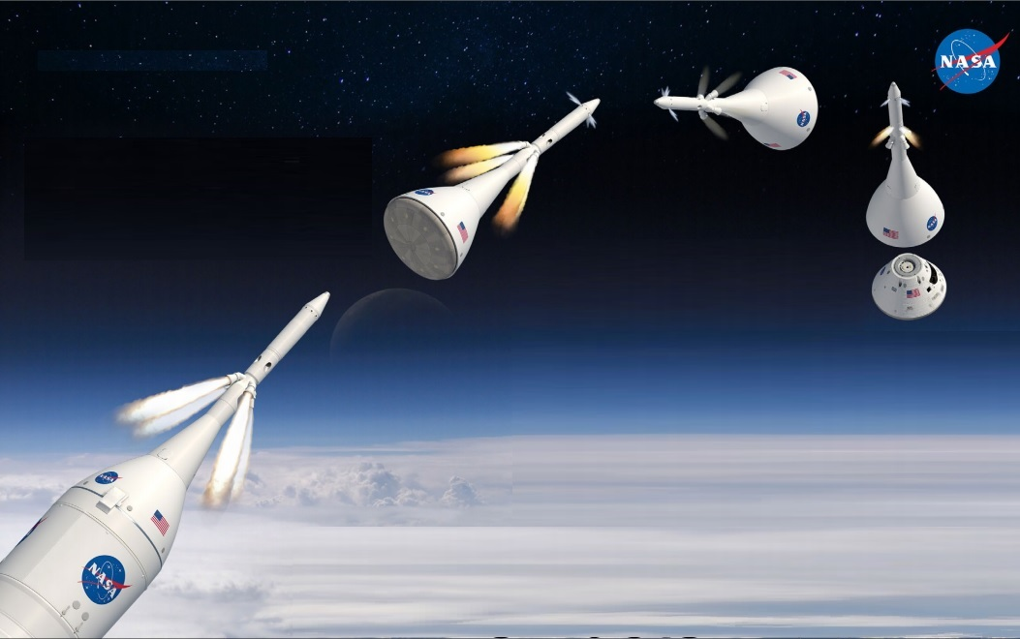
Using CCDD to Automate Software development on AA2
Robert Hirsh
Robert.l.Hirsh@nasa.gov
NASA/ Johnson Space Center
12/3/2018

Slide 2
Agenda
AA2 Background
cFS Command and Data Dictionary (CCDD) Overview
CCDD Products used on AA2
Development on AA2
Next Steps

Slide 3
Ascent Abort 2 (AA-2)
AA-2 is a development flight test for Multi Purpose Crew Vehicle (MPCV)
Launch planned for May 2019 from Space Launch Complex 46
AA-1 test was dropped, but AA-2 was not renumbered
Pad Abort 1 (PA1) demonstrated similar LAS functionality from a launch pad. (May 2010)
Largely a test of the Launch Abort System (LAS) on Orion
Safety system to quickly separate crew capsule from the Booster (during a failure)
Verify LAS works under flight-like conditions to help certify system for crewed missions
Two identical CPU’s running, only 1 is required (redundancy)
Each CPU is cFS instance running on vxWorks ( on a PPC)
Each CPU has separate serial link to the LAS, but only 1 is needed (redundancy)
Code is essentially identical on each computer, but each computer used a different value for each MID that it sends on the Software Bus (SB)
Notes:
since various groups use various types of computer hardware (32/64-bit, big/little endian, Linux/VxWorks/Windows) many additional complications exist in interfacing all the various components into a final integrated system. cFS is used on the majority the flight software (FSW) in running in Habulous.

Slide 4
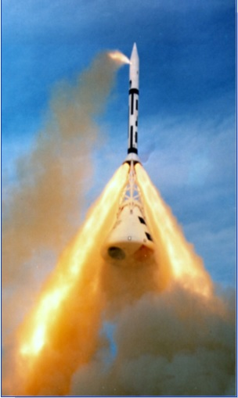
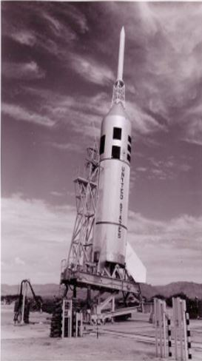
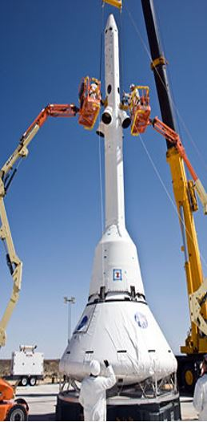
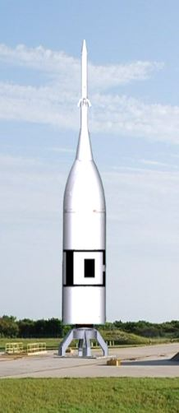
AA-2 Background
50,000
45,000
Reorient
Complete
4
5
LAS
Jettison
40,000
Begin
Reorientation
3
35,000
30,000
2
Initiate Abort
25,000
LAS/CM Separate from ATB
Apollo Pad Abort Test
Apollo Abort Test
(Little Joe Ascent II Booster)
Altitude (feet)
20,000
15,000
10,000
5,000
1
ATB
Ignition
LAS
, CM Impact
6
6
ATB
Impact
6
1
2
3
4
5
6
7
8
9
10
11
12
13
Downrange (statute miles)
AA-2 Avionics & Software
Designed to use COTS avionics wherever possible
Dual string design using cFE/CFS on VxWorks
Reuse of ANTARES Trick Simulation
CFS wrapped GNC Matlab/Simulink Autocode from mainline MPCV
Orion PA-1 Test
AA-2 Flight Test Vehicle
Notes:
The purpose of this slide is to provide objective evidence of and/or support the accomplishment of the following CMMI requirements:
IPM-IPPD SG 1Use the projects Defined Process
IPM-IPPD SG2 Coordinate and Collaborate with Relevant Stakeholders
IPM-IPPD SG3 Apply integrated product & process development
GP 2.3 Provide Resources
GP 2.4 Assign Responsibility
GP 2.7 Identify and Involve relevant stakeholders

Slide 5
CCDD Background
CCDD stands for cFS Command and Data Dictionary
Goddard’s Core Flight System (cFS) has been, is, and is intended to be used by many projects
Examples: Lunar Reconnaissance Orbiter (LRO), Morpheus, Exploration EMU (xEMU) spacesuit, Orion Backup Flight Software (BFS)
Success of the cFS concept is shown by the number cFS projects at FSW-2018
A command and data dictionary (CDD) defines telemetry/command messages
Each cFS project must select a way to manage their CDD
Frequently involves using a spreadsheet, with custom SW to convert into useful files
cFS Command and Data Dictionary utility (CCDD) was designed as a generic utility to eliminate duplication of effort in order to make CDD management easier

Slide 6
CCDD Goals
Create a configurable CDD utility that runs on multiple operating systems
Written in Java for maximum portability
Easy creation/modification of CDD information
Graphical user interface (GUI) to interact with the database
Store all CDD information into a standard database (postgreSQL)
Bidirectional transfer of information to/from the CCDD
Cut-n-paste to Excel, import/export via XTCE/CSV/JSON
Easy access to CDD information (via scripting languages and web applications )
Allows user to code in various languages (ruby/python/js) and access CDD information
Create vehicle and ground software products, data summary, etc
Generate complicated CFS products: Schedule or network tables, copy table, etc

Slide 7
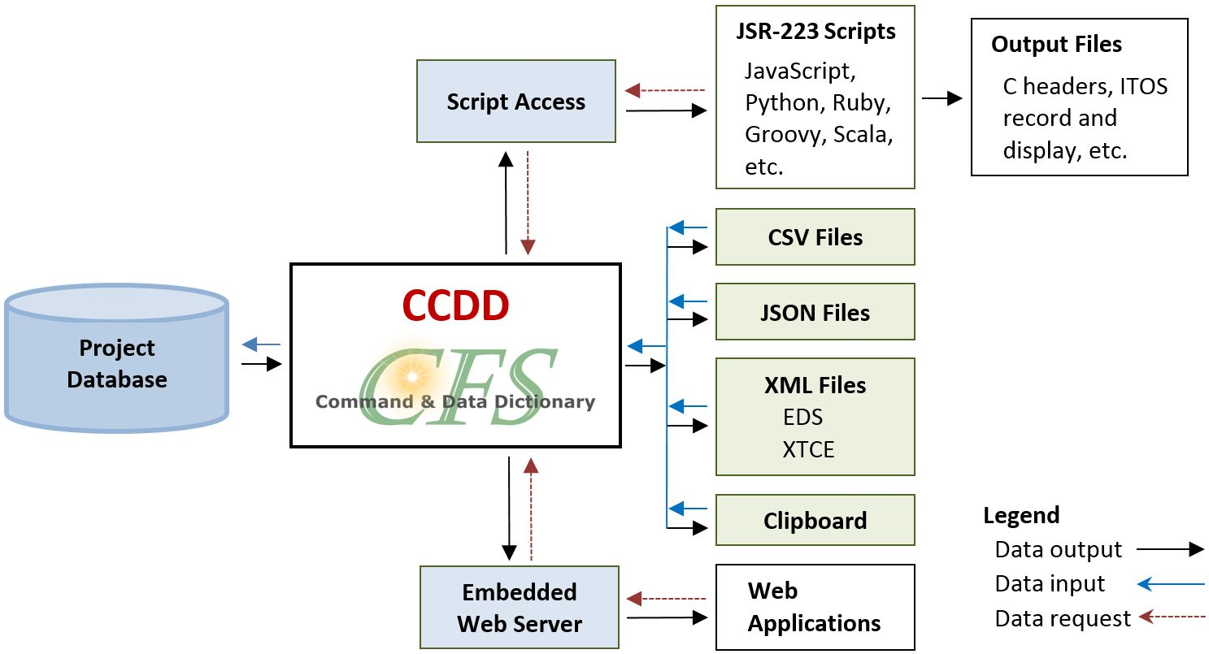
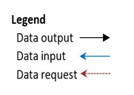
CCDD at a glance
Data is accessible to scripting languages (JavaScript, Python, etc.)
Example scripts provided for common products
Imported/exported via:
CSV (comma-separated values)
JSON (JavaScript Object Notation)
XML (Extensible Markup Language)
EDS (Electronic Data Sheet)
XTCE (XML Telemetric and Command Exchange)
OS clipboard (“cut & paste”)
Web-based dataserver (JSON)

Slide 8
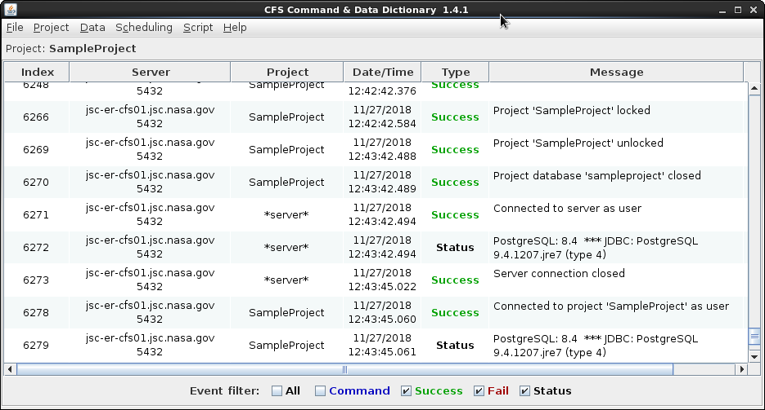
CCDD Demo

Slide 9
CCDD Products in AA-2
C header files defining SB command/telemetry messages
Define the structure for all software bus (SB) messages.
MID file generation ( Same file used by both CPUs )
Defines all the MIDs for each cFS message sent/received on each CPU
CPU2 adds 0x100 to all the MID values sent out by CPU1
Allows Ground SW to know which computer sent a message
HK copy table generation
Telemetry link is constrained. Select various parts of messages to go at different rates
2 separate telemetry paths (per CPU), so 4 separate messages are sent
ITOS “rec” files (ground control system)
Used to define commands/messages in ITOS
Data decom config files (post-flight data processing)
Provides CSV files with desired parameters to be analyzed
Custom built utilities to decode data from “raw” recorded telemetry files
Significantly faster than data replay and seqprt utility in ITOS

Slide 10
Major AA-2 Activity in 2018
Worked to develop the CDD before the SW development was complete
CDD not treated as an “as built” post-development documentation effort
Required iterations on data structures and MIDs, but minimized interface issues
Added ability to track ~900 DFI system parameters (in addition to OFI)
Allows additional insight into vehicle for all ground controllers
Automated data processing and “quicklook” of key parameters after tests
Allows rapid verification of how the system performs during simulation runs
Automated regression testing to perform SW verification activities
Test framework consumed CCDD-generated files to define CCSDS messages
Can verify any parameter (of any messages) meets expected values (at specific times)
Automated remote control/monitoring of ground power supplies
Quite useful since people need to stay miles away during launch window

Slide 11
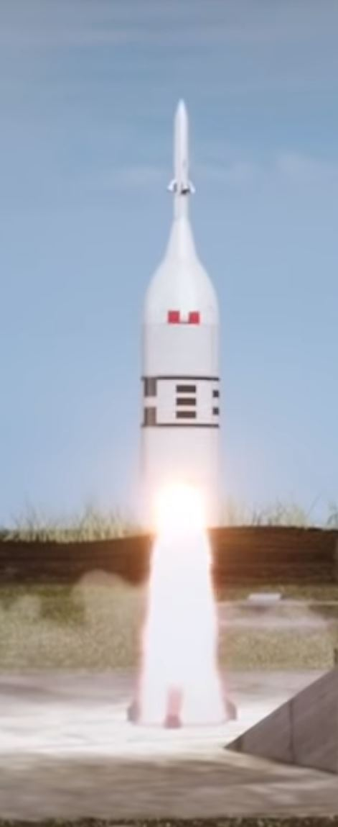
Future Work
Launch (with a successful abort!) in May 2019
Working with Education/Outreach on student outreach contest
Build a real-time application to show the position of the vehicle during the test
Winning team to view KSC launch (and see app in use)
The CCDD tool has successfully been used to automate/autocode a large amount of software used on AA-2.
Pass on the lessons learned so they can be leveraged on other programs

