Slide 1
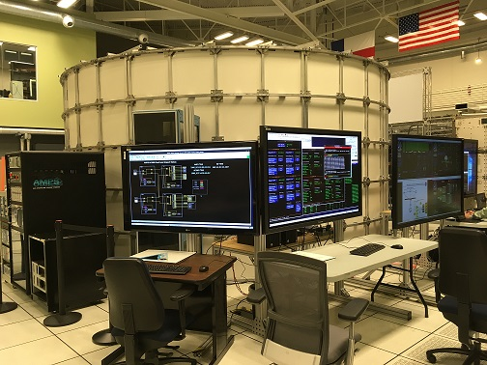
Using the cFS Command and Data Dictionary (CCDD) to Automate Software Development on Habulous
Robert Hirsh
Robert.l.Hirsh@nasa.gov
NASA/ Johnson Space Center
12/3/2018

Slide 2
Agenda
Habulous Background
CCDD Overview
CCDD Products used on Habulous
C header files that define all software bus commands/telemetry messages
Generating file defining the Message ID’s used (cfs_msgids.h )
XML Telemetry and Command Exchange (XTCE) files (displays)
“Protobetter” code (to manage different endian-ness/architectures)
Development on Habulous
CCSDS_v2 extended headers
Extending/customizing SBN to pass messages among computers on multiple networks
Using SBN_lib to allow non-cFS node to communicate with cFS nodes
Next Steps
Developing TTE network and schedule tables for all the various CPUs to use

Slide 3
Habulous Background
The Habulous project is an Earth-based testbed (HW/SW)
Prototyping future space habitat unit and technologies
Representation from various NASA centers and aerospace organizations
ARC/JSC/GRC/Goddard/Stennis
Distributed nature of the team makes data interfaces especially critical
Massively heterogeneous computer architectures and operating systems
32/64-bit, Big/Little Endian, Linux/VxWorks/Windows, x86/PPC/RaspberryPi
Multiple CPUs use the SBN application to communicate
Most CPUs run cFS (use SBN app and Protobetter)
Non-cFS CPU (use SBN_lib with Prototbetter)

Slide 4
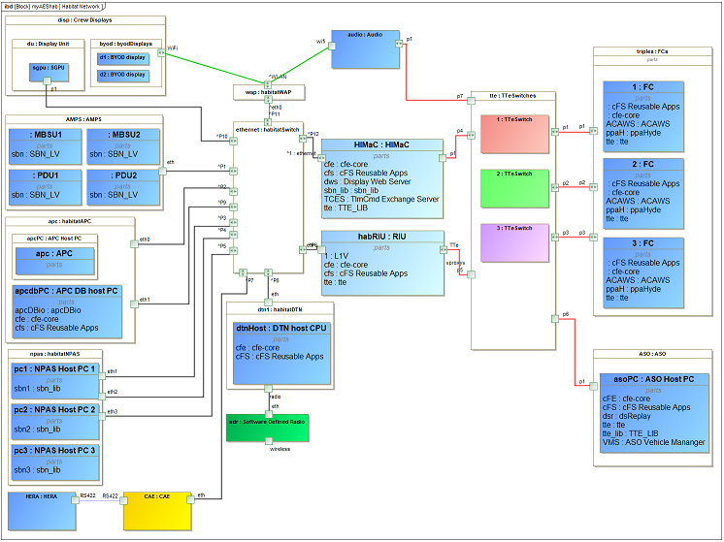
Habulous Block Diagram

Slide 5
CCDD Background
CCDD stands for cFS Command and Data Dictionary
Goddard’s Core Flight System (cFS) has been, is, and is intended to be used by many projects
Examples: Lunar Reconnaissance Orbiter (LRO), Morpheus, Exploration EMU (xEMU) spacesuit, Orion Backup Flight Software (BFS)
Success of the cFS concept is shown by the number cFS projects at FSW-2018
A command and data dictionary (CDD) defines telemetry/command messages
Each cFS project must select a way to manage their CDD
Frequently involves using a spreadsheet, with custom SW to convert into useful files
cFS Command and Data Dictionary utility (CCDD) was designed as a generic utility to eliminate duplication of effort in order to make CDD management easier

Slide 6
CCDD Goals
Create a configurable CDD utility that runs on multiple operating systems
Written in Java for maximum portability
Easy creation/modification of CDD information
Graphical user interface (GUI) to interact with the database
Store all CDD information into a standard database (postgreSQL)
Bidirectional transfer of information to/from the CCDD
Cut-n-paste to Excel, import/export via XTCE/CSV/JSON
Easy access to CDD information (via scripting languages and web applications )
Allows user to code in various languages (ruby/python/js) and access CDD information
Create vehicle and ground software products, data summary, etc
Generate complicated CFS products: Schedule or network tables, copy table, etc

Slide 7
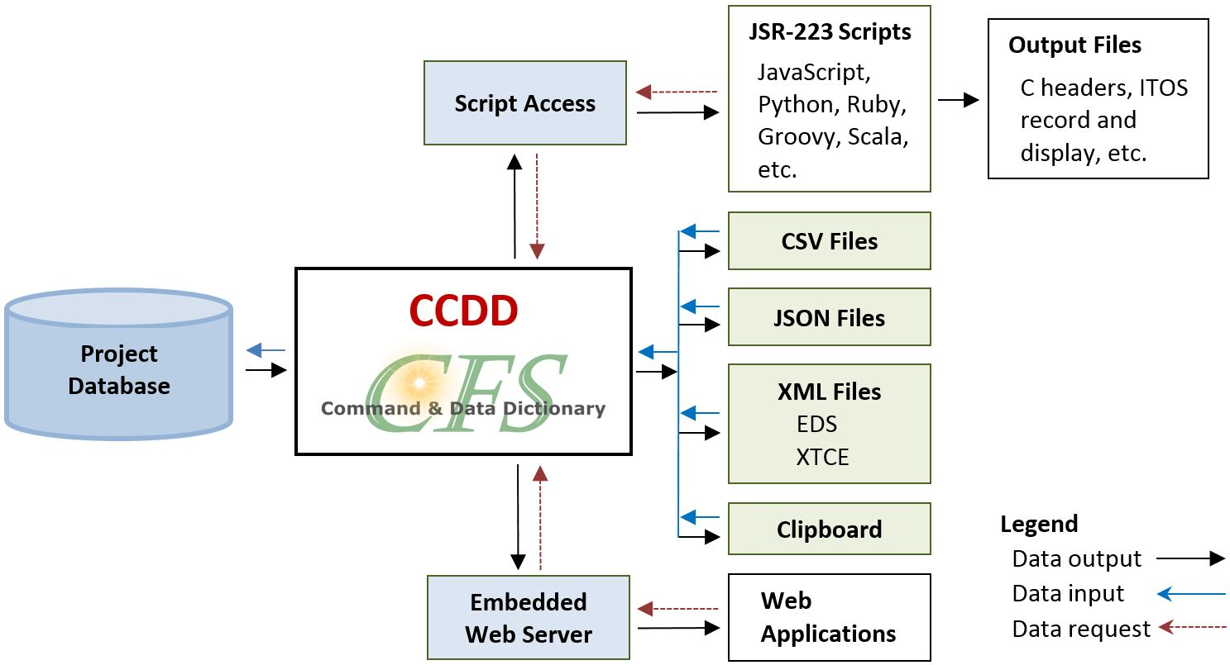
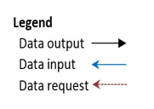
CCDD at a glance
Data is accessible to scripting languages (JavaScript, Python, etc.)
Example scripts provided for common products
Imported/exported via:
CSV (comma-separated values)
JSON (JavaScript Object Notation)
XML (Extensible Markup Language)
EDS (Electronic Data Sheet)
XTCE (XML Telemetric and Command Exchange)
OS clipboard (“cut & paste”)
Web-based dataserver (JSON)

Slide 8
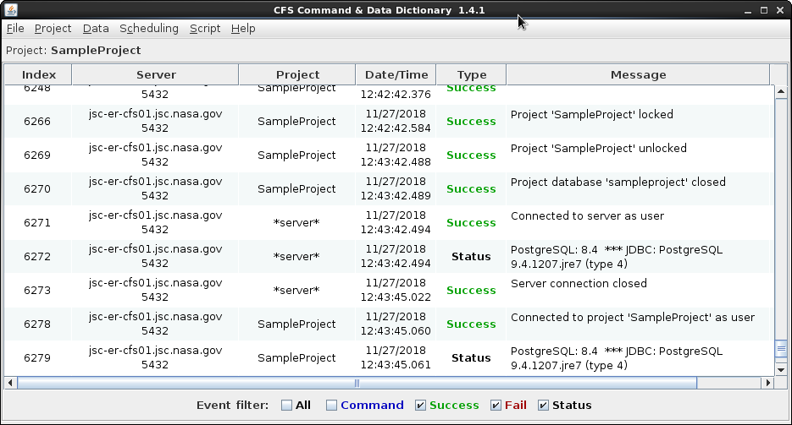
CCDD Demo

Slide 9
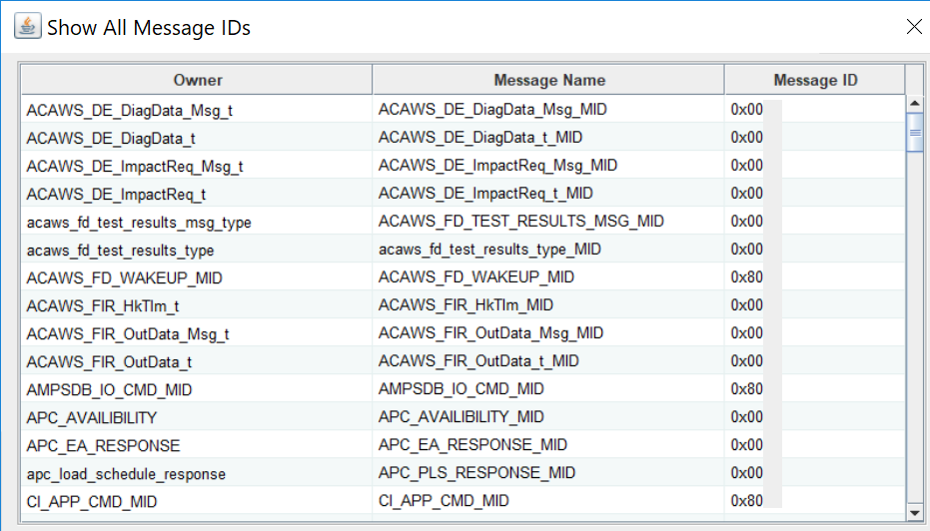
CCDD Products on Habulous
cfs_msgids.h file generation
Same file compiled by all CPUs
Defines all the MIDs for each cFS message sent/received on any of the various CPUs
Using CCSDSv2, so each MID is a combination of APID/SystemID/SubSystemID
Using the CCDD information to automatically generate the C-header files
Define the structure for all software bus (SB) commands/telemetry messages
Generate XML Telemetry and Command Exchange (XTCE) files
Used by display team to make displays for any CPU
Generating “Protobetter” code for communication with other CPUs
Manages packing and different endian-ness/architectures

Slide 10
Habulous MID definition
Telemetry
2018 used by AES
Command

Slide 11
Major Habulous Activity in 2018
Updating to CCSDS_v2 (and using CPU# as subsystem ID)
Running out of room for unique MIDs on all CPUs for the 11-bits of version 1
See next slide
Exporting XTCE files to allow drag-n-drop display development for all CPUs
Extending/customizing SBN to pass messages to computers
Computers with multiple interfaces act as a “bridge” to CPUs that can’t talk directly
“Protobetter” developed to manage packing/endian differences
Using SBN_lib to allow non-cFS node to communicate with cFS nodes
Allows non-cFS nodes to “impersonate” a cFS node and talk to SBN on other CPUs
Worked to develop the CDD before the SW development was complete
Not treat CDD as an “as built” post-development documentation effort
Required iterations on data structures and MIDs, but minimized interface issues

Slide 12
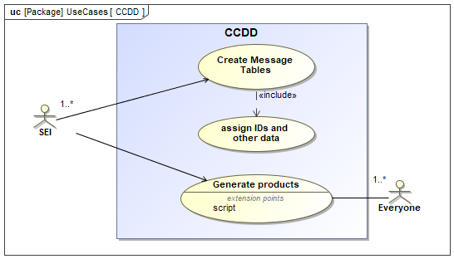
Future Work
The CCDD tool has successfully been used to automate/autocode a large amount of software used on Habulous
Working to allow the CCDD to define even more products including
Time-triggered Ethernet (TTE) network tables/maps
Coordinate message passing between various synchronized machines
cFS schedule table (for each CPU)
Automated CCDD to SysML export

