Slide 2
Welcome by
Dr. Jim Burch
Vice President
Space Sciences & Engineering

Slide 3
Aerial View of SwRI from East Gate
You Are Here ☺
East Gate

Slide 4
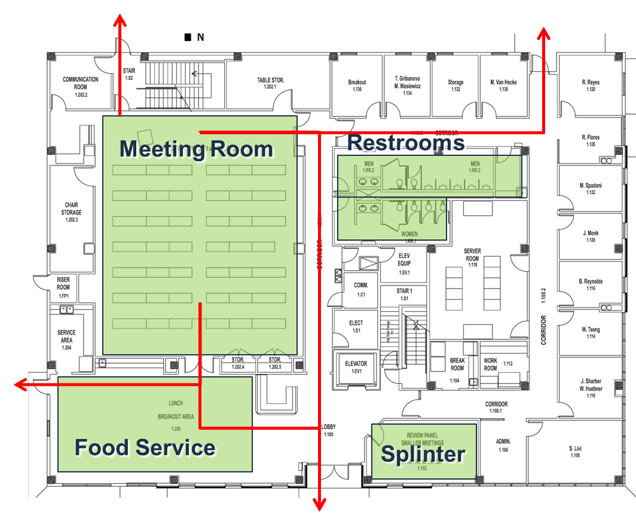
Bldg. 263 Facility Overview
Emergency Exits
Smoking Area
Additional splinter room available on 2nd floor

Slide 5
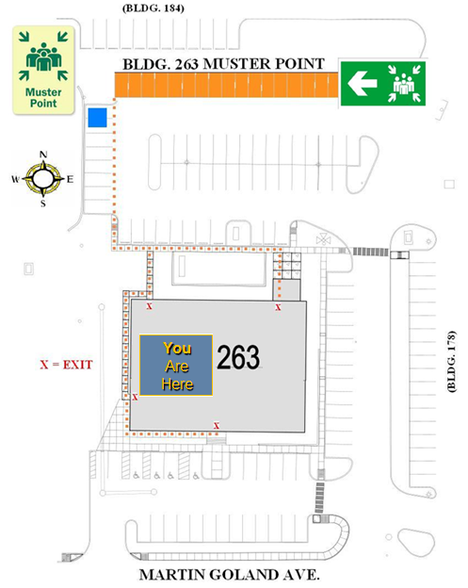
Emergency Muster Point

Slide 6
International Visitors
Non-US Persons
If you have not completed a foreign visitors form, please see registration table to complete on and to get badges
Non-US Persons require a SwRI escort anywhere on the SwRI facility at all times
Badges must be returned to registration table at the end of the day
All Presenters
Please adhere to ITAR and EAR laws

Slide 7
Technical Knows
Wireless network is available in meeting areas
Choose “SwRI Guest”, no authentication is required
All outgoing services are enabled
Tables are equipped with power
Telephone Access
Phones are located in lobby and break-out room(s)
Local: 9+number (area code IS required for 210)
Long Distance: Ask for Assistance
Printer Access
Computers are available in the lobby to print

Slide 8
Shuttle Transportation
Conference Hotel (Courtyard by Marriott)
7:15 a.m. Shuttle departs from hotel to SwRI, Building 263
5:30 p.m. Shuttle departs from B263 to Courtyard by Marriott
Also providing shuttle service to/from hotel for Tue Happy Hour and Wed dinner
SwRI Shuttles
Available on request for Tue Happy Hour and Wed Dinner
Departs from and returns to SwRI Building 263
Signup at registration desk
Let us know of any other transportation needs and we will accommodate if possible

Slide 9
Monday, December 3, 2018 Shuttle Information
7:15 a.m.- Shuttle departs from hotel to SwRI, Building 263.
5:30 p.m. – Shuttle will depart from B263 and arrive to Courtyard by Marriott.

Slide 10
Monday, December 3, 2018 Meal Plan
Light continental breakfast
Lunch will be provided from Jason’s Deli
Snacks and refreshments will be available in the afternoon
Vegan/Vegetarian and Gluten Free options are available
Dinner on your own – suggest visiting the River Walk in downtown San Antonio!

Slide 11
Agenda Updates and Cancellations
Tuesday, December 4, 2018
8:15-9:15 a.m. Joseph Fohn presents History of SwRI
Presentation by Paulette Acheson, “Architecture as the Basis for Systems Integration” has been withdrawn

Slide 12
THANK YOU to our SPONSORS!
We could not put this event on without you!

Slide 13
Day 2-4 Slides

Slide 14
Tuesday, December 4, 2018 Shuttle Information
7:15 a.m.- Shuttle will depart from hotel to SwRI, Building 263
5:55 p.m. – Shuttle will depart from B263 and arrive to Big’z Happy Hour on 151. Then depart to hotel for those not attending the Happy Hour.
8:30 p.m. – Shuttle will depart from Big’z and arrive to Courtyard by Marriott.

Slide 15
Tuesday, December 4, 2018 Meal Plan
Breakfast tacos will be provided from Taurino’s Mexican Restaurant
Lunch will be provided by Bar-B-Cutie
Vegan/Vegetarian and Gluten Free options are available.
Snacks and refreshments will be available in the afternoon
Happy Hour at BigZ on 151 - map available at Registration Desk

Slide 16
Wednesday, December 5, 2018 Shuttle Information
7:30 a.m. – Shuttle departs hotel to SwRI, Building 263.
5:00 p.m. – Shuttle arrives at B263 and departs to Courtyard Marriott.
6:20 p.m. – shuttle departs from hotel for the Team Dinner at Paloma Blanca, 5800 Broadway, St. #300, San Antonio, Texas 78209.
9:00 p.m. – Shuttle departs from Paloma Blanca and arrives to Courtyard by Marriott.

Slide 17
Wednesday, December 5, 2018 Meal Plan
Breakfast will be provided from The Donut Palace
Lunch will be provided from Asia Kitchen
Vegan/Vegetarian and Gluten Free options are available
Snacks and refreshments available in the afternoon
Workshop dinner (only if you registered) at Paloma Blanca on Broadway (map at registration desk)

Slide 18
Thursday, December 6, 2018 Shuttle Information
7:30 a.m. – Shuttle departs hotel to SwRI, Building 263

Slide 19
Thursday, December 6, 2018 Meal Plan
Light continental breakfast will be provided
No lunch on Thursday

