Slide 1
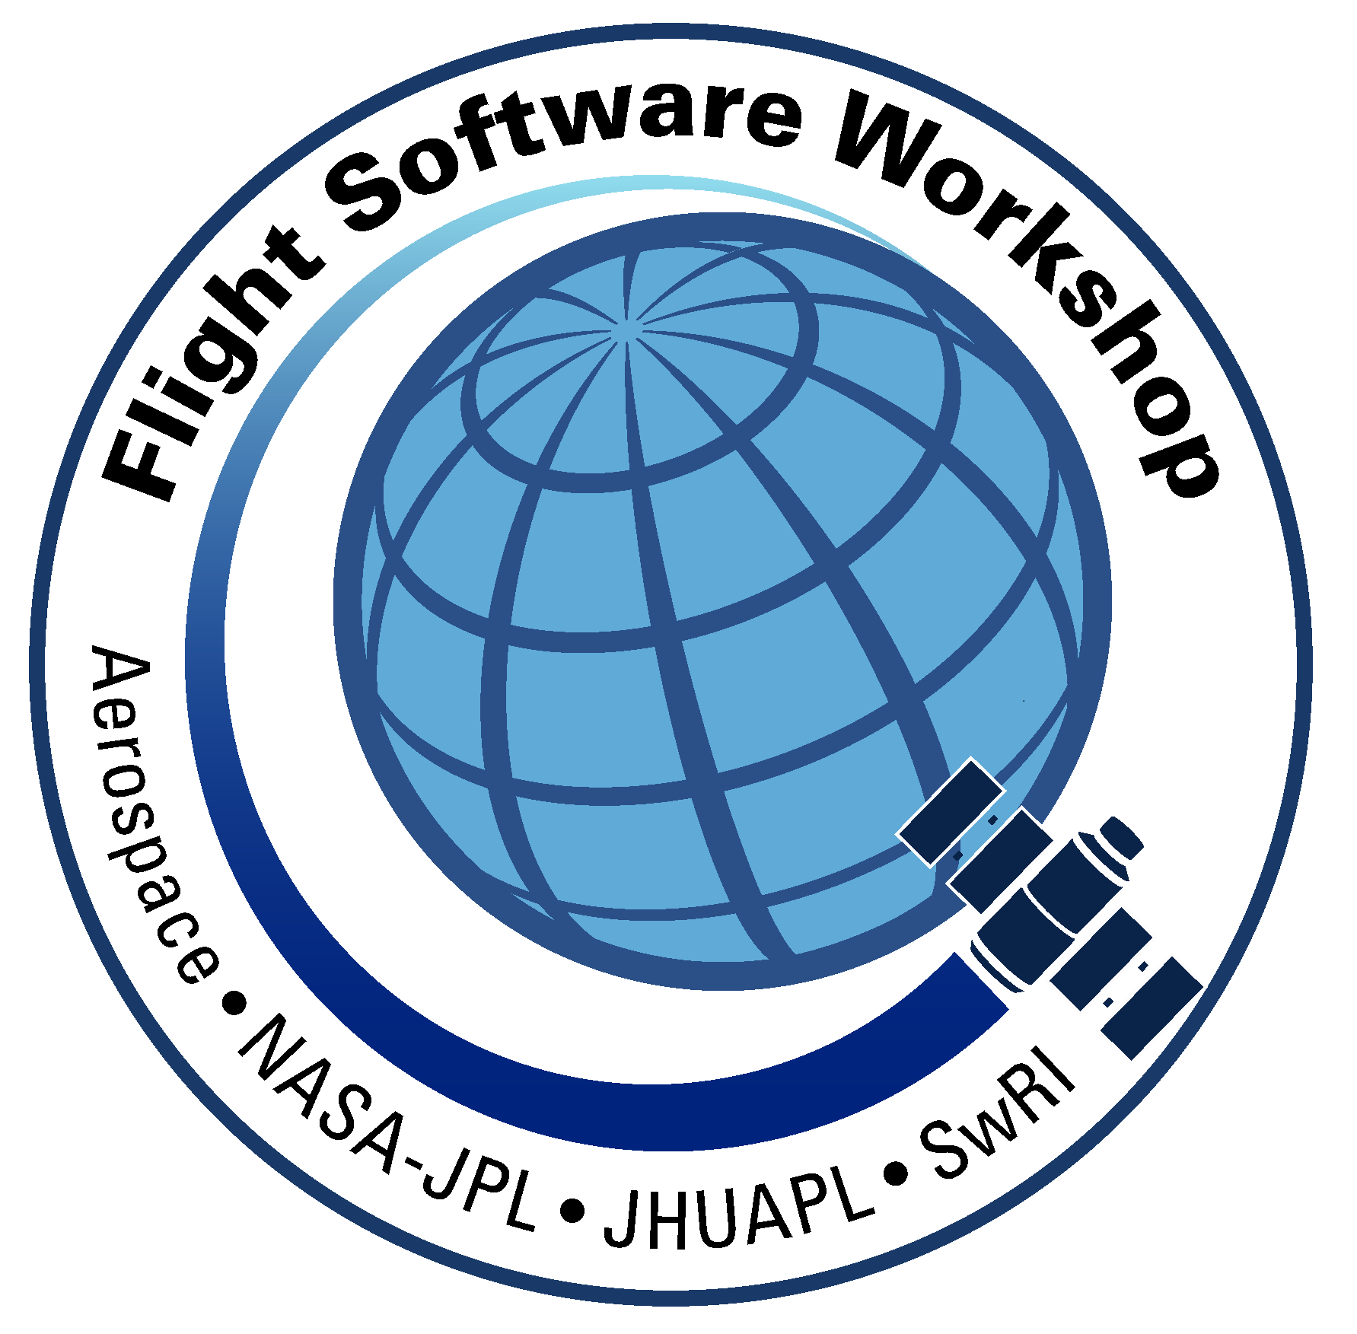
CubeSat vs. Science Instrument Complexity
Chad Loeffler

Slide 2
Topics
Introduction
Processor Boards and Software
Operations
Fault Management
Testing
Stakes Of Destruction
Conclusion

Slide 3
Introduction
Are “low-budget” CubeSats more complex than science instruments?
Are they more similar or more different than expected?
Two instruments are compared to two satellites:
SO-HIS (science instrument)
JUNO-JADE (science instrument)
CUSP (CubeSat)
CYGNSS (SmallSat)

Slide 4
Processor Boards and Software
JUNO-JADE (science instrument)
4 MB SRAM, 0.5 MB EEPROM, 24 MHz CPU
SO-HIS (science instrument)
16 MB SRAM, 2 MB MRAM, 25 MHz and 50 MHz CPU
CUSP (CubeSat)
4 MB SRAM, 2 MB MRAM, 4 GB FLASH, 50 MHz CPU
CYGNSS (SmallSat)
4 MB SRAM, 4 MB MRAM, 4 GB FLASH, 25 MHz CPU

Slide 5
Operations
Science Instruments
Receive commands and send telemetry
Perform fault management and detection
Collect and process science data, including use of high-voltage
Operations Planning only has to handle reactions to thruster firings and orbit change maneuvers, not how to accomplish them
Operations Planning only has to focus on data production to mass memory, not on storage and downlink to ground
Usually no heater control

Slide 6
Operations
CubeSats and SmallSats
Control radio for uplink and downlink
Process commands and telemetry
Perform fault management and detection
Perform thruster firings and orbit change maneuvers
Perform ADCS pointing and stability
Maintain heater control for all components
Maintain power levels and battery charging
Store all data in mass memory, handle partitioning and downlink

Slide 7
Fault Management
Science Instruments
Isolate faults to lowest level
If fault is contained completely within a single sensor, but has multiple sensors, then can remain in science mode with unaffected sensors
For off-nominal but not critically dangerous faults, when isolation of a component is not possible, then stay in Safe Mode
No high voltage
No science data collection
No power to sensors
For critical or dangerous faults, send Power-Off request to spacecraft

Slide 8
Fault Management
CubeSats and SmallSats
“Fail Operational” instead of “Fail Safe”
Most components, except for the payload, are critical and must remain operational, even if only in a minimal capacity
Communications Radio
Power System
ADCS (Attitude Determination and Control System) and Thrusters
Faults usually result in payload instruments being powered off
“Safe Mode” means Sun-pointing instead of Earth-pointing

Slide 9
Testing and Integration
Science Instruments
Test with a single spacecraft interface simulator or emulator
Minimal external interfaces, either to the spacecraft or component between instrument and spacecraft
Can have multiple internal interfaces, possibly with different protocols
Sensors and detectors go through science calibration beam testing

Slide 10
Testing and Integration
CubeSats and SmallSats
Test with multiple instrument interface simulators or emulators
Test with multiple spacecraft component interface simulators or emulators
Many interfaces
Each payload instrument
ADCS (Attitude Determination and Control System) and Thrusters
Power System
Communications Radio
Each interface may have different software or hardware protocols

Slide 11
Stakes Of Destruction
Science Instruments
Overwrite non-volatile memory with junk data and have no software to run
Improperly use high-voltage and cause loss of science capability in sensors and detectors
Low-voltage short-circuit in main electronics or non-switched component
Mass produce too much data and fill up spacecraft mass memory (with caveats)

Slide 12
Stakes Of Destruction
Science Instruments
A properly isolated science instrument can only end in its own destruction, not impacting the spacecraft or other science instruments
Usually draws power from a switched source and has limiting or monitoring on power input
Usually limited in mass-memory partition size and cannot overwrite other instruments buffers
Can only cause mission end if not completely isolated from spacecraft and other science instruments, sharing power circuits or memory partitions

Slide 13
Stakes Of Destruction
CubeSats and SmallSats
Failure to deploy solar panel arrays and start battery charging
Failure to de-tumble and stop spinning
Enable maximum power draw and point away from sun
Fire thrusters too long or too little and change attitude or orbit
Overwrite non-volatile memory with junk data and have no software to run
Low-voltage short-circuit in main electronics or non-switched component

Slide 14
Stakes Of Destruction
CubeSats and SmallSats
Unrecoverable faults in hardware and software can lead to mission end, either in loss of spacecraft or loss of payload

Slide 15
Conclusion
Stakes are higher for the CubeSat: loss of mission vs loss of single instrument.
Complexity of operations, fault management, and testing is higher for the CubeSat.
FSW processing needs are similar, such that similar or common processing board architectures can be used.

