Slide 1
National Aeronautics and
Space Administration
High-Performance Spaceflight Computing (HPSC) Middleware Overview
Alan Cudmore
NASA Goddard Space Flight Center
Flight Software Systems Branch (Code 582)
Alan.P.Cudmore@nasa.gov
www.nasa.gov/spacetech

Slide 2
Agenda
High Performance Spacecraft Computing (HPSC) Overview
HPSC Contract
HPSC Chiplet Architecture
HPSC System Software
HPSC Middleware
NASA HPSC Use Cases
HPSC Ecosystem
Summary/Status
2

Slide 3
High Performance Spaceflight Computing (HPSC) Overview
The goal of the HPSC program is to dramatically advance the state of the art for spaceflight computing
HPSC will provide a nearly two orders-of-magnitude improvement above the current state of the art for spaceflight processors, while also providing an unprecedented flexibility to tailor performance, power consumption, and fault tolerance to meet widely varying mission needs
These advancements will provide game changing improvements in computing performance, power efficiency, and flexibility, which will significantly improve the onboard processing capabilities of future NASA and Air Force space missions
HPSC is funded by NASA’s Space Technology Mission Directorate (STMD), Science Mission Directorate (SMD), and the United States Air Force
The HPSC project is managed by Jet Propulsion Laboratory (JPL), and the HPSC contract is managed by NASA Goddard Space Flight Center (GSFC)
3

Slide 4
HPSC Contract
Following a competitive procurement, the HPSC cost-plus fixed-fee contract was awarded to Boeing
Under the base contract, Boeing will provide:
  Prototype radiation hardened multi-core computing processors (Chiplets), both as bare die and as packaged parts
  Prototype system software which will operate on the Chiplets
  Evaluation boards to allow Chiplet test and characterization
  Chiplet emulators to enable early software development
Five contract options have been executed to enhance the capability of the Chiplet
  On-chip Level 3 cache memory
  Added a real-time processing subsystem containing two lockstepable ARM R-class processors and a single ARM A-class processor
  Triple Time Triggered Ethernet (TTE) interfaces
  Dual SpaceWire interfaces
  Package amenable to spaceflight qualification
Contract deliverables are due April 2021
4

Slide 5
HPSC Chiplet Architecture
5

Slide 6
HPSC Chiplet Architecture
Timing, Reset, Config & Health Controller (TRCH)
Triple Modular Redundant low power ARM M4F core for configuration, health and status, and fault monitoring
6

Slide 7
HPSC Chiplet Architecture
  Real Time Processing Subsystem (RTPS)
  Dual lockstep R52 ARM v8-R (600Mhz)
    Three 1MB Tightly Coupled Memories (TCM)
    FPU and NEON SIMD
  Single A53 ARM v8 compliant cores(600Mhz)
    A53 w/512KB Level 2, 32KB Instruction & 32KB Data cache
    FPU and NEON SIMD
  Separate PCIe and DDR3/DDR4 interfaces
7

Slide 8
HPSC Chiplet Architecture
  High Performance Processing Subsystem (HPPS)
  8 A53 ARM v8 compliant cores (800Mhz)
  Shared 4MB L3 cache
  Quad shared 2MB L2 x 2
  Per core 64KB Instruction & 64KB Data cache
  Includes FPU and NEON SIMD
8

Slide 9
HPSC Chiplet Architecture
3-DDR3/4 interfaces(800Mhz)
  can be populated with DDR and/or MRAM
2-NAND/NOR/SRAM/MRAM interfaces
  (not shown)
9

Slide 10
HPSC Chiplet Architecture
High Speed I/O
6 SRIO high speed interfaces w/4 lanes per port for 41.24Gb/s per port
  Total of 59.1GB/s of IO bandwidth
Embedded sRIO switch with 2 internal endpoints
2 Gen2 PCIe ports at 2 lanes per port 10Gb/s per port
  Total of 20Gb/s of IO bandwidth
3 Time Triggered Ethernet ports at 10/100/1000Mb/s each
2 SpaceWire ports at 400Mb/s each
1 general purpose Ethernet port at 10/100/1000Mb/s
10

Slide 11
HPSC Chiplet Architecture
Low Speed I/O
Non-volatile memory
JTAG
UART
I2C
SPI
64 general purpose I/O
11

Slide 12
HPSC Chiplet Architecture
Fault Tolerance and Debug Features
HW based fault tolerance
EDAC, scrubbing
TMR of critical logic
ARM TrustZone
Access isolation regions
ARM Coresight debug and trace subsystem
12

Slide 13
HPSC System Software
The HPSC Chiplet will be delivered with a complement of prototype system software developed by Boeing subcontractor University of Southern California/Information Sciences Institute (USC/ISI)
The System Software leverages a large complement of existing open source software including:
  Libraries, operating systems, compilers, debuggers, and simulators.
  Much of the software will be unmodified.
The System Software consists of:
  Board support packages for Linux and RTEMS
  Development tools (e.g., compilers, debuggers, IDEs)
  Chiplet Configuration APIs
  Mailbox API
  Software-based fault tolerance libraries
  Chiplet emulators
The goal is to build a sustainable software ecosystem to enable full lifecycle software development.
13

Slide 14
HPSC System Software
Config Mgmt
TRCH Config
Management
System Software APIs
System SW APIs
Fault Detection
Fault Detection
Fault Detection
Fault Detection
64 Bit ARM (Aarch64)
Yocto Linux A53 BSP
RTEMS
Cortex M4
BSP
RTEMS
R52
BSP
(TBD)
RTOS
A53 BSP
Operating Systems
and Chiplet Drivers
(RTPS A53 RTOS is TBD)
KVM Hypervisor
High Performance Processing Subsystem (HPPS)
Chiplet Configuration Manager
Subsystem (TRCH)
Real Time Processing Subsystem (RTPS)
ARM A53 Cluster
ARM
M4
ARM A53
ARM
M4
ARM R52
ARM A53 Cluster (4)
TMR
ARM
M4
ARM R52
Chiplet Hardware

Slide 15
HPSC System Software
HPSC Reference Board Support Package (BSP) Features:
  TRCH Cortex-M4 will execute RTEMS with support for:
    SRIO, low speed I/O, configuration registers, windowed-access into all memories.
  RTPS Cortex-R52 will execute RTEMS with support for:
    SRIO, PCIe, Spacewire, TTE, low speed I/O, RTPS DDR, windowed access into HPPS DDR, NVRAM.
  HPPS Cortex-A53 clusters will execute Yocto Linux with support for:
    SRIO, PCIe, Spacewire, Ethernet, TTE, HPPS DDR, NVRAM
HPSC Chiplet supports running Linux, which makes available a rich and familiar development environment. This improves efficiency of software development in particular for science applications
  Many science applications already start off development in Linux only to be ported to a different OS. With HPSC, no extra porting step is required, saving effort and reducing risk

Slide 16
HPSC Fault Isolation
High Performance Processing Subsystem (HPPS)
Real Time Processing Subsystem (RTPS)
Linux on A53 clusters
R52 cores
A53
KVM Hypervisor
Subsystem Isolation
High Performance Data Processing Software
Software
Fault
Real-time Mission Critical software
High Performance Data Processing Software
AI, Vision processing, etc
The HPSC Chiplet ensures that misbehavior in HPPS cannot interfere with critical functions in the RTPS
  The HPSC Chiplet provides a Trusted Computing Base (TCB) that is small relative to the overall capability of the system.
  For example, a minimal TCB would consist of flight control, communications, health monitor, and software update management running on the RTOS. These high criticality functions remain safely isolated from any misbehavior in Linux
One of many potential examples of fault isolation in the HPSC
  Other examples include the use of a hypervisor or partitioned OS on the HPPS
16

Slide 17
HPSC Middleware
The Air Force Research Laboratory (AFRL) is funding NASA Jet Propulsion Laboratory (JPL) and NASA Goddard Space Flight Center (GSFC) to develop HPSC Middleware
HPSC Middleware will provide a software layer that provides services to the higher-level application software to achieve:
  Configuration management
  Resource allocation
  Power/performance management
  Fault tolerance capabilities of the HPSC chiplet
Serving as a bridge between the upper application layer and lower operating system or hypervisor, the middleware will significantly reduce the complexity of developing applications for the HPSC Chiplet
17

Slide 18
HPSC Middleware
Mission Flight Software Applications
Mission FSW
Middleware
On HPPS A53s
Middleware
On RTPS R52
Middleware
On RTPS A53
Middleware
Config Mgmt
System Software APIs
System Software
Fault Detection
Fault Detection
Fault Detection
64 Bit ARM (Aarch64)
Yocto Linux A53 BSP
RTEMS
Cortex M4
BSP
RTEMS
R52
BSP
(TBD)
RTOS
A53 BSP
High Performance Processing Subsystem (HPPS)
Chiplet Configuration Manager
Subsystem (TRCH)
Real Time Processing Subsystem (RTPS)
KVM Hypervisor
ARM A53 Cluster
ARM
M4
ARM A53
Chiplet Hardware
ARM
M4
ARM R52
ARM A53 Cluster
TMR
ARM
M4
ARM R52

Slide 19
Middleware Functions
The HPSC Middleware provides the following key functions:
  Boot and Load Services
  Chiplet Configuration Management
  Chiplet Resource Allocation and Management
  Chiplet Power and Performance Management
  Fault Tolerance and Redundancy Management
  Messaging Services
These functions are implemented through 13 Middleware Services

Slide 20
Middleware Services (1 of 2)
Middleware functions are provided by the following services
  Deployment and Multicore Programming Services
    Deployment of time critical vs computational intensive applications to RTPS & HPPS
    Thread creation and assignment to specific processing cores for execution
    Utilize multicore environment to establish parallel processing capability
      Utilize Linux/MPI features
      Utilize OpenMP library for multicore programming functions
  Machine Information Services
    Get information about cores, clusters, chiplets, and system
  Resource Management/Arbitration Services
    Manage configuration files and assign available resources to software clients
  Memory Management Services
    MMU configuration, memory allocation to applications
  Interrupt Services
    Configure Interrupt controller to route interrupts to specific cores at runtime
  Timing Services
    Establish, synchronize, and distribute time

Slide 21
Middleware Services (2 of 2)
  Messaging Services
    Send/receive messages between tasks on the same or different cores and Chiplets
  Power Management Services
    Power on/off setting for cores/clusters/Chiplets, and set clock rates
  Debug and Trace Services
    Support the interface for software debugging during development
    Support the capability for performance metrics collection during execution
  Boot and Load Process and System Configuration Services
    Provide an Initial Program Loader (IPL) and support various boot types/processes
  Peripheral IO Services
    Allocate and configure Chiplet Peripheral I/O to software clients
  Multi-Chiplet Management Services
    Configure and manage Inter-Chiplet interfaces (e.g., boot, messaging, resources)
  Fault and Redundancy Management Services
    Fault detection (HW/SW faults) and recovery

Slide 22
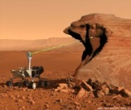

HPSC Use Cases – Rovers and Landers
Rover
Lander
22

Slide 23
HPSC Use Cases - High Bandwidth Instruments and SmallSats/Constellations
High Bandwidth Instrument
Smallsat
23

Slide 24
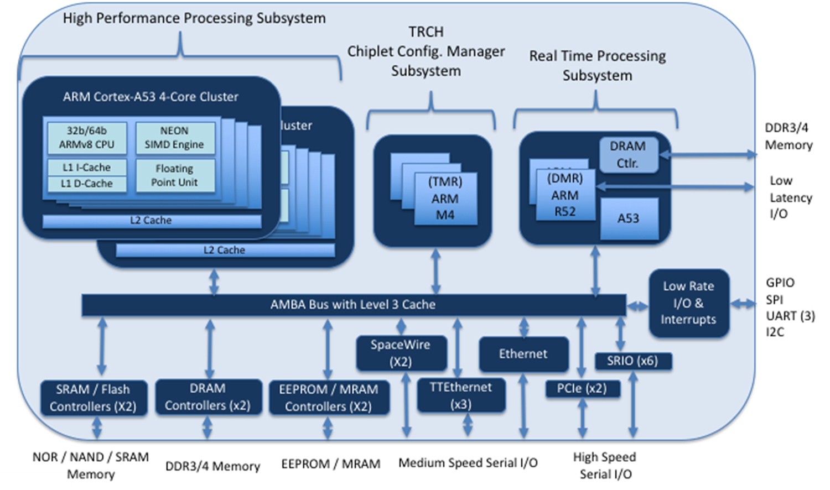
HPSC Use Cases – Human Exploration and Operations (HEO) Habitat/Gateway
Notional Two Fault Tolerant System
Sensors
(Cameras, Lidars, etc.)
Sensors
(Cameras, Lidars, etc.)
Sensors
(Cameras, Lidars, etc.)
Sensors
(Cameras, Lidars, etc.)
FCR
FCR
FCR
FCR
TTGbE
x3
24

Slide 25
Broader HPSC Ecosystem
Beyond the HPSC Chiplet, System Software, and Middleware developments, further investments can implement a robust HPSC avionics ecosystem
  Advanced Spaceflight Memory
  Increased RTOS Support
  Multi-Output Point-Of-Load Converters
  Coprocessors (GPU, Neuromorphic, etc.)
  Special Purpose Chiplets (Security Chiplet, etc.)
  Advanced Packaging (Multiple Chiplets in a Package)
  Single Board Computers
25

Slide 26
Conclusion/Status
Conclusion
  As illustrated by the NASA use cases, our future missions demand the capabilities of HPSC
  Improved spaceflight computing means enhanced computational performance, energy efficiency, and fault tolerance
  With the ongoing HPSC development, we are well underway to meeting future spaceflight computing needs
  The NASA-developed Middleware will allow the efficient infusion of the HPSC Chiplet into those missions
  Further investments can implement a full HPSC avionics ecosystem
Status
  USC/ISI delivered System Software Release 1.0 at the May 2018 HPSC Preliminary Design Review
    Consists of a QEMU based software emulator and initial Yocto Linux based software development kit
  The NASA JPL and GSFC HPSC Middleware team will complete Middleware release R1 this month (December 2018)
    Middleware release R1 consists of a subset of the services, mostly targeting A53 Linux functionality while the hardware is being developed
Acknowledgements: Wes Powell (GSFC), Rich Doyle (JPL), Rafi Some (JPL), Jim Butler (JPL), Irene Bibyk (GSFC), Jonathan Wilmot (GSFC), John Lai (JPL), J.P. Walters (USC/ISI), and Jon Ballast (Boeing) for diagrams and use case definitions.
26

Slide 27
Acronyms (1)
Acronym | Meaning | Acronym | Meaning
AFRL | Air Force Research Laboratory | FPGA | Field programmable Gate Array
AMBA | Advanced Microcontroller Bus Architecture | GNC | Guidance Navigation and Control
API | Application Programmer Interface | GOPS | Giga Operations Per Second
ARM | Advanced RISC Machines | GPIO | General Purpose Input Output
BIST | Built In Self Test | GPU | Graphics Processing Unit
BSP | Board Support Package | GSFC | Goddard Space Flight Center
C&DH | Command and Data Handling | HEO | Human Exploration and Operations
CPU | Central Processing Unit | HPPS | High Performance Processing Subsystem
DDR | Double Data Rate | HPSC | High Performance Spacecraft Computing
DMIPS | Dhrystone Millions of Instructions per Second | HW | Hardware
DMR | Dual Modular Redundancy | I/O | Input / Output
DRAM | Dynamic Random Access Memory | I2C | Inter-Integrated Circuit
FCR | Fault Containment Region | IDE | Integrated Development Environment
27

Slide 28
Acronyms (2)
Acronym | Meaning | Acronym | Meaning
IPL | Initial Program Loader | NVRAM | Non Volatile Random Access Memory
ISA | Instruction Set Architecture | PCIe | Peripheral Component Interconnect express
ISI | Information Sciences Institute | QEMU | Quick Emulator
ITAR | International Traffic In Arms Regulations | RTEMS | Real Time Executive for Multiprocessor Systems
JPL | Jet Propulsion Laboratory | RTOS | Real Time Operating System
KVM | Kernel Based Virtual Machine | RTPS | Real Time Processing Subsystem
MIPS | Millions of Instructions per Second | SCP | Self Checking Pair
MMU | Memory Management Unit | SIMD | Single Instruction Multiple Data
MPI | Message Passing Interface | SMD | Science Mission Directorate
MRAM | Magnetoresistive Random Access Memory | SPI | Serial Peripheral Interface
NAND | NOT-AND logic | SPW | Spacewire
NASA | National Aeronautics and Space Administration | SRAM | Static Random Access Memory
NEON | Single Instruction Multiple Data architecture | SRIO | Serial Rapid Input Output
28

Slide 29
Acronyms (3)
Acronym | Meaning | Acronym | Meaning
SSR | Solid State Recorder
STMD | Space Technology Mission Directorate
SW | Software
TBD | To Be Determined
TMR | Triple Modular Redundancy
TRCH | Timing, Reset, Configuration, and Health
TTE | Time Triggered Ethernet
UART | Universal Asynchronous Receiver Transmitter
USC | University of Southern California
VMC | Vehicle Management Computer
29

