Slide 1
Autocoding Software
and Device Interfaces from
CCSDS Electronic Data Sheets
December 2018
Jonathan Wilmot
NASA/GSFC Code 582
Notes:
1

Slide 2
Agenda
Definitions
Overview
State Machines and Activities
Tools for development and Systems Integration
Lunar Orbital Platform - Gateway Use Case
Summary and Status

Slide 3
Definitions
An Electronic Data Sheet (EDS) is a formal specification of a device, system, or software interface in a machine readable format
  Unambiguous and machine verifiable specification
    Written in Extensible Markup Language (XML)
  Delivered with the device, (sub)system, or software component
  It is not an Interface Control Document (ICD) in that it does not specify how a system or mission will use the device or software
  EDS specifies black box view of interfaces: data formats, conversions, limits, exchange protocols (state machines)
An EDS is different from an XML Telemetric and Command Exchange™ (XTCE™) database in that XTCE is targeted to operational command and telemetry systems and does not define network stacks or interface interaction patterns

Slide 4
Electronic Data Sheet Definition
Definitions
Consultative Committee for Space Data Systems CCSDS
  International standards organization
A CCSDS Spacecraft Onboard Interface Services (SOIS) EDS (SEDS) is an EDS defined using the SOIS Dictionary of Terms and the SOIS EDS XML schema
  Electronic Data Sheets and Common Dictionary of Terms - Overview and Rationale (Green 870.1)
  XML Specification for Electronic Data Sheets for Onboard Devices and Software Components (Magenta 876.0)
  Specification for Dictionary of Terms for Electronic Data Sheets for Onboard Components (Blue 876.1)
  SEDS schema and dictionary of terms are keep in SPACE ASSIGNED NUMBER AUTHORITY(SANA) REGISTRY http://sanaregistry.org/r/sois/sois.html
Provides a standard to exchange system, device and software interface definitions between organizations and agencies

Slide 5
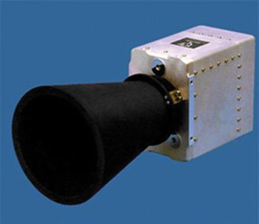
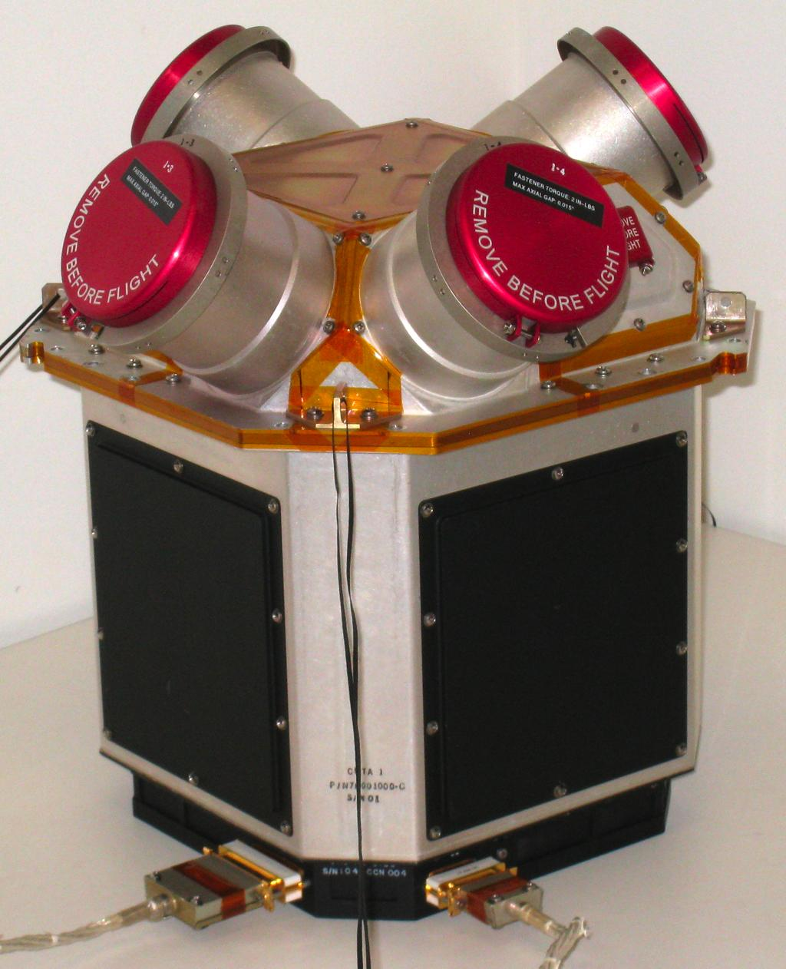

Device and Software Component SEDS
Software Component
Software Component
Software Component
Star trackers
Thrusters
Sun sensors
EDS
EDS
EDS
EDS
EDS
EDS
Software tools
Goal: Device manufactures provide an SEDS with each component

Slide 6
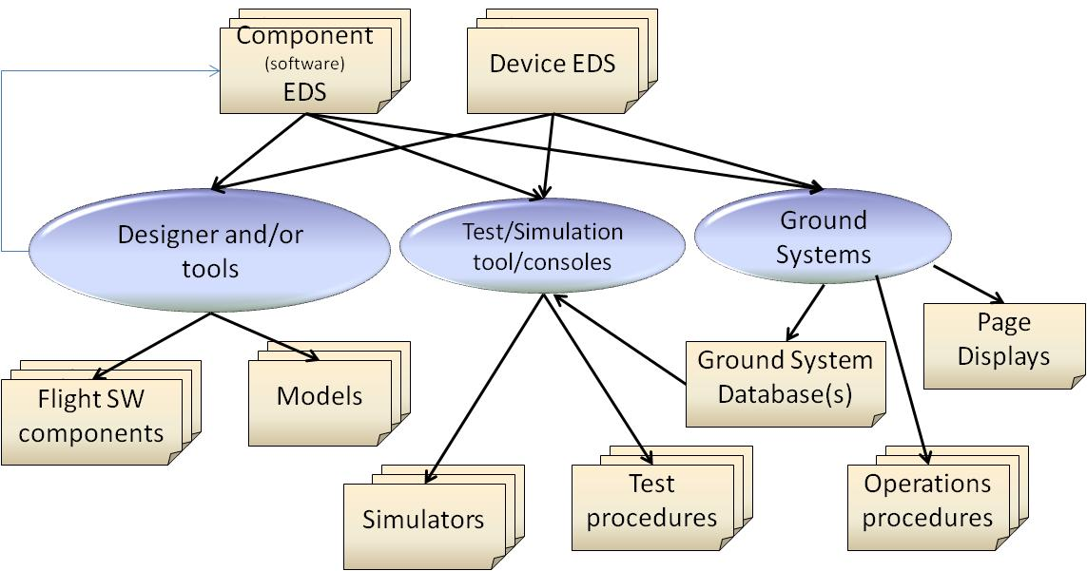
Current EDS Tool Prototypes
Development and Operations Products
Models
Models
Models

Slide 7
Primary Use Cases for Devices
Devices are delivered with a SEDS that also contains device specific information, version, serial number, calibrations…
  SEDS has placeholders for project deployment configuration (MAC address, MIL1553 RT, …
  These SEDS will not validate with generic XML tools (XML Spy)
SEDS used to autocode interface tests that are run against that specific device to verify compliance to the data sheet prior to shipping
SEDS is a input to systems integration tools
Flight project can used those tests or autocode test set specific tests to verify the device is compliant and preforms as stated
Autocoding of device drivers
Autocoding of device models

Slide 8
Primary Use Cases for Software Components
Software components are delivered with a SEDS
  SEDS has placeholders for project deployment configuration
  These SEDS will not validate with generic XML tools (XML Spy)
SEDS are configuration managed with the component
  Any interface changes must be reflected in the SEDS
SEDS is a input to system integration tools
  These tools create a new SEDS with all the variables populated
SEDS are used to autocode integration tests
  Interface black box (not a unit test)
Flight project can used those tests or autocode test set specific tests to verify the component matches it’s EDS interface
Autocoding component models in a modeling language

Slide 9
State Machines and Activities
Examples

Slide 10
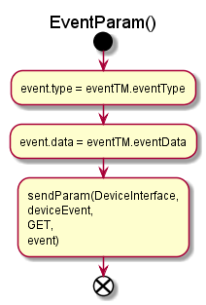
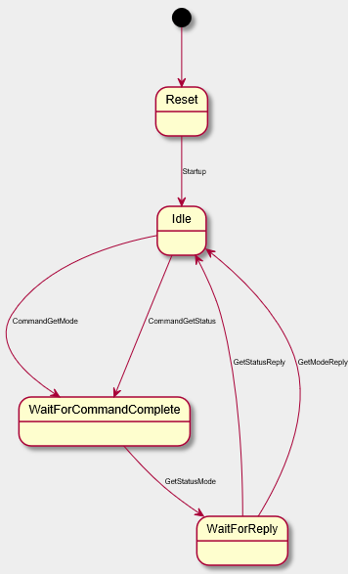
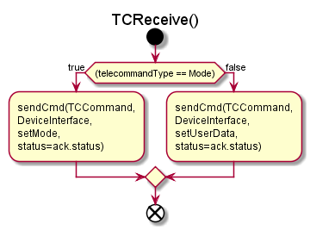
State Machine and Activity Diagram Examples
Examples from CCSDS interoperability tests
UML State Diagram for
GetExtendedStatusMode

Slide 11
Complex SEDS State Machine Example
State machine in graphical format
State transitions in table format

Slide 12
Tools for Development and Systems Integration

Slide 13
SEDS Work Flow / Tool Chain (GSFC)
1. Supplied by user
2. Supplied with cFS Applications (multiple)
Project-
Specific
Config
Project-
Specific
Test
EDS
(xml)
Source
Code
Test
Procedures
(Lua)
EDS
Processor
C Compiler
Test Executive
(EDS-Lua Bindings)
3. Intermediate Output Products
4. Final Output Products
Binaries
Test
Results

Slide 14
Integration Toolchain Overview
CCDD (JSC)
Binary Table Files
FSW
Default Table
Table Definitions
Devices
EDS
cFS
Command Data
Dictionary
(CCDD)
Apps
EDS
App Table
Generator
Default Tables
Design
Parameters
EDS
cFE Code
Generator
Mission
Mnemonics
Constraints
Header Files
Runtime Data Dictionary
Bus
Definitions
SIL &
Embedded Coder
Model-Based-App
Mission
Database
Subnetwork schedule
In work
EDS Runtime Library
    CCDD tool provides consistent data definitions system wide

Slide 15
cFS Command and Data Dictionary tool
NASA cFS Command and Data Dictionary tool (CCDD)
  Database of system data exchange and configuration
  Auto-generation of design, code, and configuration artifacts
  Graphical User Interface for viewing and editing
  Inputs:
    Component EDSs
    System design parameters
  Outputs:
    Component EDSs (as modified by design parameters)
    Ground system databases (XTCE, ITOS)
    System configuration files
    “C” header files for software components
    Parameter table definition files
    Bus definitions for modeling tools (Mathworks Simulink)
    System documentation

Slide 16
Lunar Orbital Platform - Gateway Use Case

Slide 17
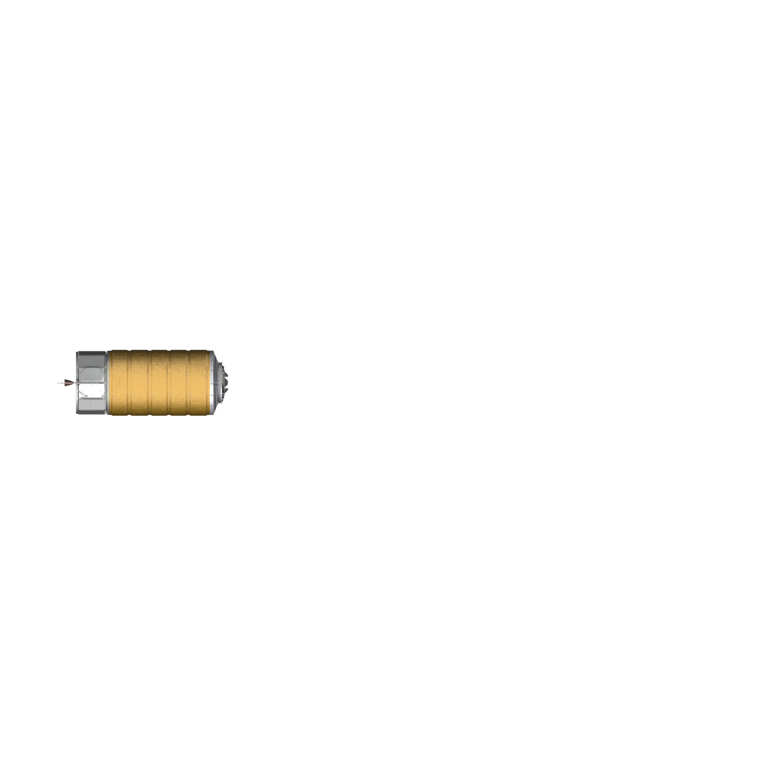

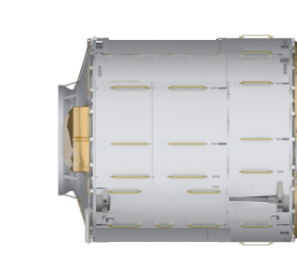
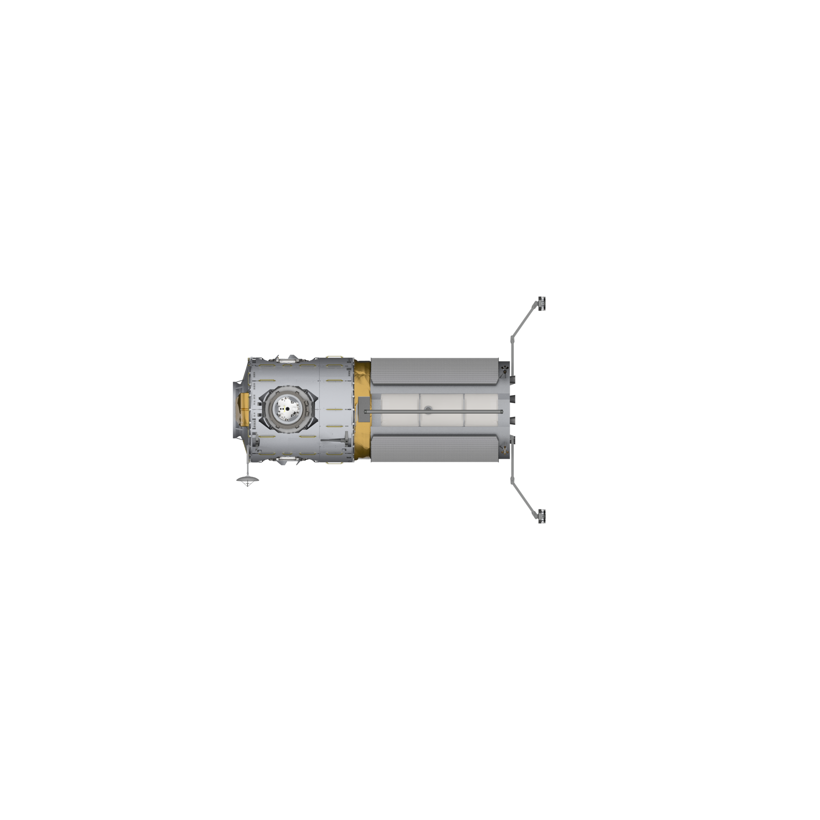
Lunar Orbital Platform - Gateway Elements
Conceptual View
SEDS use with Lunar Orbital Platform - Gateway (LOP-G) international partners with varied tool chains and software architectures
Comm.
Thermal
I/O
Vehicle
Management
Comm.
I/O
Power
Time-Triggered
Ethernet Backbone
GN&C
ECLSS
Propulsion
I/O
I/O

Slide 18
LOP-G Use Case
Program has international partners potentially using different software architectures
  Think of it as a International Space Station (smaller) at the Moon
International partners may provide devices to another partners system/subsystem
SEDS defines the formats and interaction patterns of those interfaces
  SEDS can describe ECSS PUS interfaces and cFS Software Bus(SB)/Software Bus Network(SBN) interfaces
SEDS includes the full subnetwork stack to access the interface
  Example: Space Packet -> UDP-> IP -> Ethernet
SEDS is used as input into each partners architecturally specific tool chains
SEDS provides the internationally recognized standard to exchange those interface definitions

Slide 19
Summary and Status
Devices and software components are developed and delivered with a SEDS
The SEDS is an input into tools that generate system configuration, documentation, test procedures, operations procedures and other artifacts
SEDS is an open international standard allowing exchange of interface definitions that can be used in multiple architectures across agencies
Through tooling, devices and software components can be made interoperable
SEDS standards books have completed final agency review and interoperability test and are in the CCSDS queue for publication
SEDS standards books are included in the LOP-G requirements
ESA and NASA are actively developing tools support SEDS in flight projects
Active project to integrate Time-Space Partitioning architecture and time-triggered network (AES funded)
Effort to expand SEDS to cover device thermal and power attributes

Slide 20
Acronyms

Slide 21
Backup cFS SEDS Work Flow Details

Slide 22
EDS Work Flow: Pre-build
1. Supplied by user
2. Supplied with cFS Applications (multiple)
Project-
Specific
Config
Project-
Specific
Test
EDS
(xml)
Source
Code
(C?)
Test
Procedures
(Lua)
EDS processor reads all supplied EDS files from all applications and merges with project configuration
Produces C header files that can be directly used (#include'ed) by C source code
Produces a runtime database with only basic types and sizes
Produces a second database to augment the runtime database with full information including names, display formats, etc.
EDS
Processor
3. Intermediate Output Products

Slide 23
EDS Work Flow: Compilation
1. Supplied by user
2. Supplied with cFS Applications (multiple)
Project-
Specific
Config
Project-
Specific
Test
EDS
(xml)
Source
Code
(C?)
Test
Procedures
(Lua)
All source code compiled using generated header files for message formats and enumeration values
Binaries may link in only runtime EDS DB (small size) or both DBs (full features)
C Compiler
3. Intermediate Output Products
4. Final Output Products
Binaries
Test
Results

Slide 24
EDS Work Flow: Verification
1. Supplied by user
2. Supplied with cFS Applications (multiple)
Project-
Specific
Config
Project-
Specific
Test
EDS
(xml)
Source
Code
(C?)
Test
Procedures
(Lua)
Test procedures written in a procedural language (Lua) specify a sequence of inputs and expected results
Tests are based on messages defined in the EDS
Combined with project-specific test configuration, tests are executed against running binaries
Test Executive
(EDS-Lua Bindings)
3. Intermediate Output Products
4. Final Output Products
Binaries
Test
Results

Slide 25
EDS Results: Development Cycle
Changes to a any application's EDS get reliably, automatically propagated to all other entities that rely on the definition
  Debug tools and control systems are always in sync
  Tedious and error-prone manual propagation is eliminated
Improved quality and usability of debug tools
  Instead of showing binary traces, debug tools can fully decode all messages and show in user-friendly formats
Expands options available to developers
  No longer locked into only developing in “C”
  EDS can drive bindings to Lua, Perl, Python, Javascript or even more
Improves code-sharing opportunities and portability to other platforms
  Problems such as Space Packet APID conflicts are greatly reduced
  EDS will detect and report any issues at an early stage

Slide 26
EDS Results: Run Time
Much more runtime code is able to be “common”
  Historically, each app received messages from the SB and validated them individually based on size and content.
  Now the validation code is based on the EDS “runtime” DB and can be validated by SB code itself.
  More complete and consistent message verification with and simpler application code
EDS solves many CPU endianness problems
  EDS “runtime” DB has all needed information in order to reliably byte swap / re-pack messages between a “native” format and a “wire” format
  Optimized for fast operation in case the wire format matches the native CPU format (pass through)
  Project can choose which endian to use “on the wire” to best match the architecture of the actual CPUs in use.
  Swapping/Re-pack done by the “Gateway” application to external devices. No additional code needed in app to support this!

Slide 27
EDS Results: Verification
Greatly improves the ability to perform “black-box” style testing
  Each app can supply an individual “isolated” test procedure that checks the basic inputs and outputs, independent of deployment details such as APIDs, physical uplink type, or other apps running on the target.
  Uses Lua, a fully-featured embeddable programming language, so the tests can be as complex as they need to be (variables, if statements, for/while loops, function calls, etc)
  Actual I/O messages are driven by EDS so they get automatically updated if EDS is ever updated, and they are not specific to any particular target CPU architecture.
The project can choose to extend the tests beyond just single-app tests
  Additional test procedures defined at the top-level can exercise dependencies between running applications and check for the correct system responses.
When combined with a simulation environment / virtual target machine, testing can be done frequently in completely automated and repeatable fashion

