Slide 1
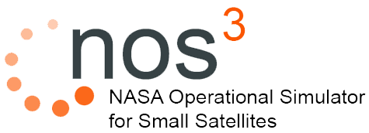
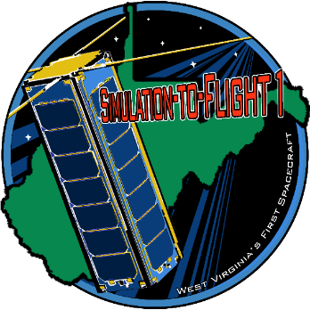
Mark Suder
Mark.D.Suder@nasa.gov
www.nos3.org

Slide 2
Overview
JSTAR ITC Introduction
NOS³
STF-1
Day In The Life
On Orbit Operations
Ground Station Testing
Framework for S/C Security
Demonstration

Slide 3
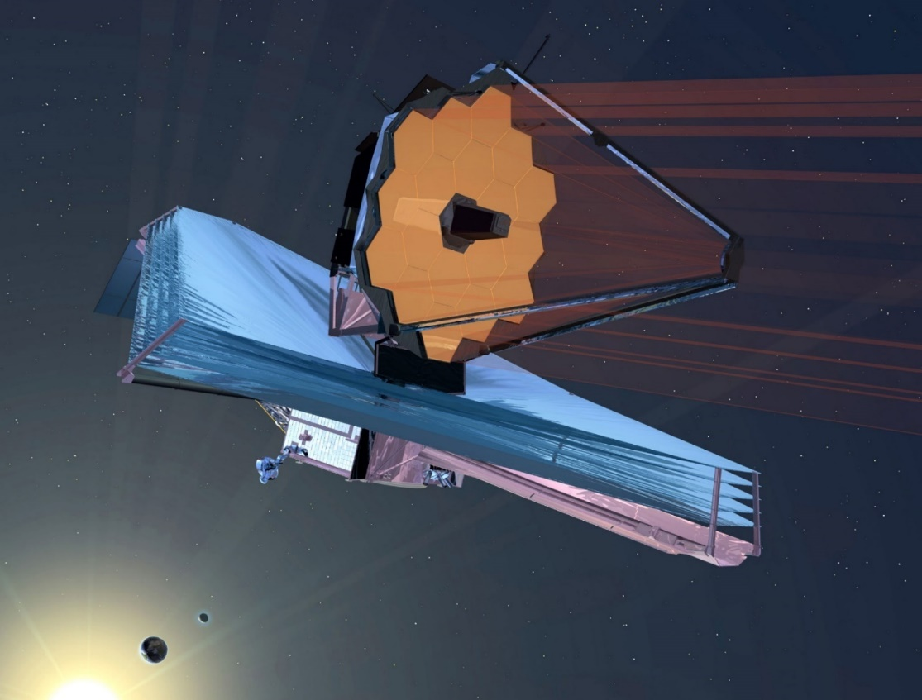
NASA IV&V – JSTAR ITC
Acquire, develop, and manage adaptable test environments that enable the dynamic analysis of software behaviors for multiple NASA missions .

Slide 4
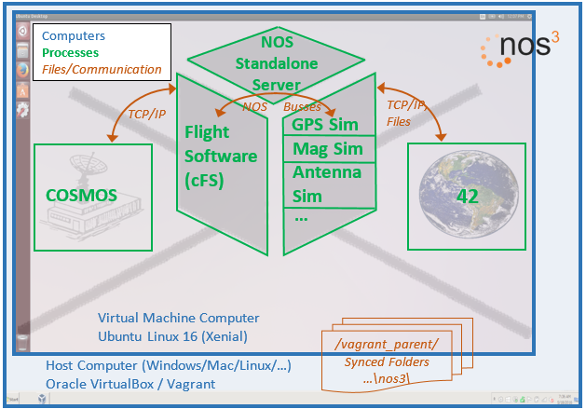
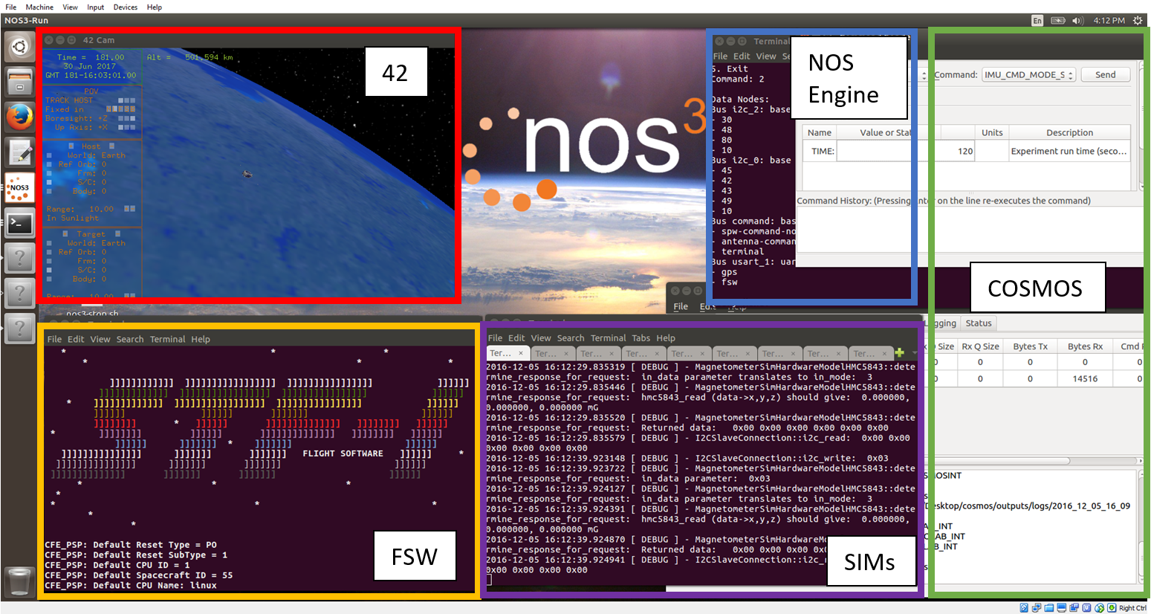
Flight Software
Core Flight System (cFS)
Ground Station
Ball Aerospace COSMOS
Dynamics Engine
42
Provides visualization
NOS Engine
Communication protocols
Hardware simulators

Slide 5
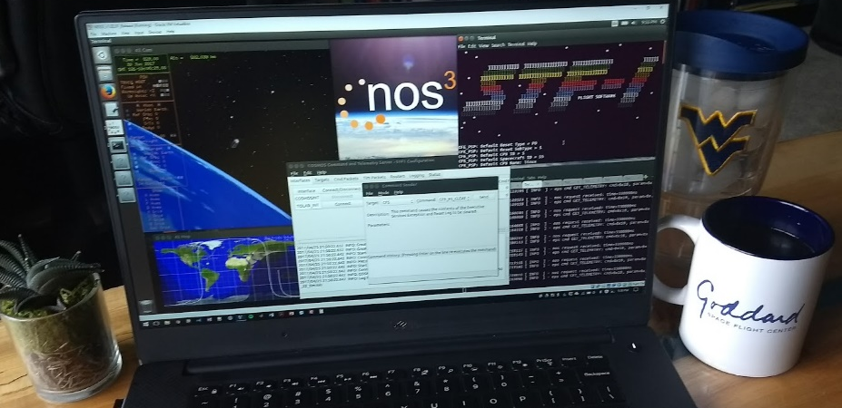
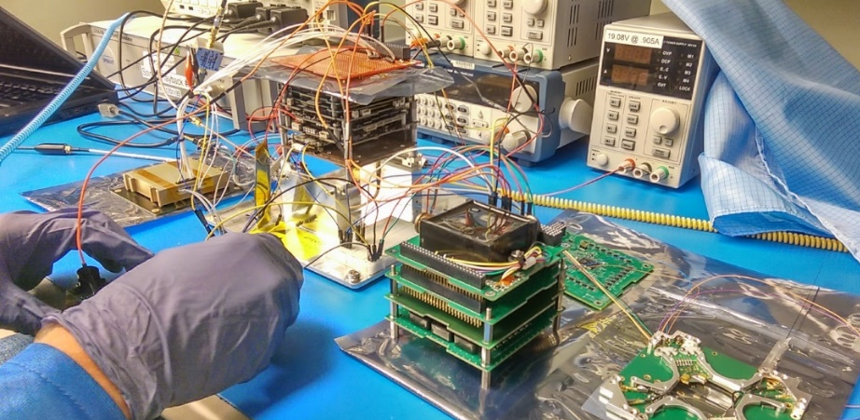
Uses:
Early Development
Integration
Mission Planning / Training
Verification and Validation
Simulated Components:
BCT XACT
Cadet UHF Radio
Clyde Space Batteries / EPS
Generic Science Instruments
GomSpace Nanomind A3200 Sensors
ISISpace Antenna
NovAtel OEM 615 GPS

Slide 6
Simulation To Flight - 1
First CubeSat from West Virginia
Manifested for launch in 2018
Objectives
Primary: Open source simulator
Develop advanced toolset to identify and resolve software issues
Evidence on cost and time savings
Meaningful science
Five separate payloads from WVU
Outreach and continued collaborations

Slide 7
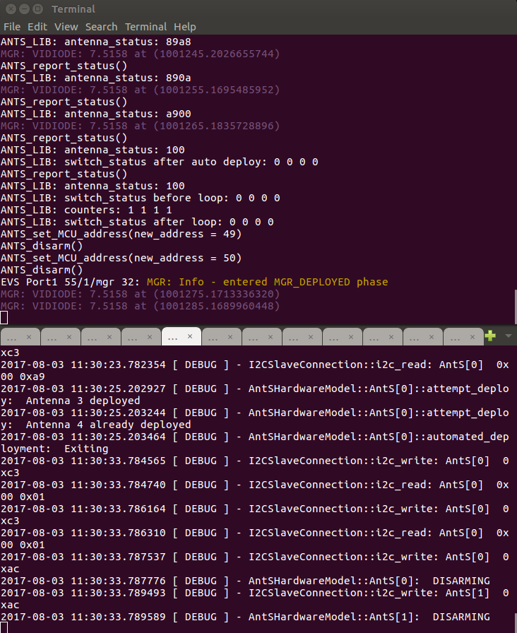
Day In The Life
Explore the system
Investigate areas of interest
Search for bugs
Train for the mission
Verify concept of operations

Slide 8
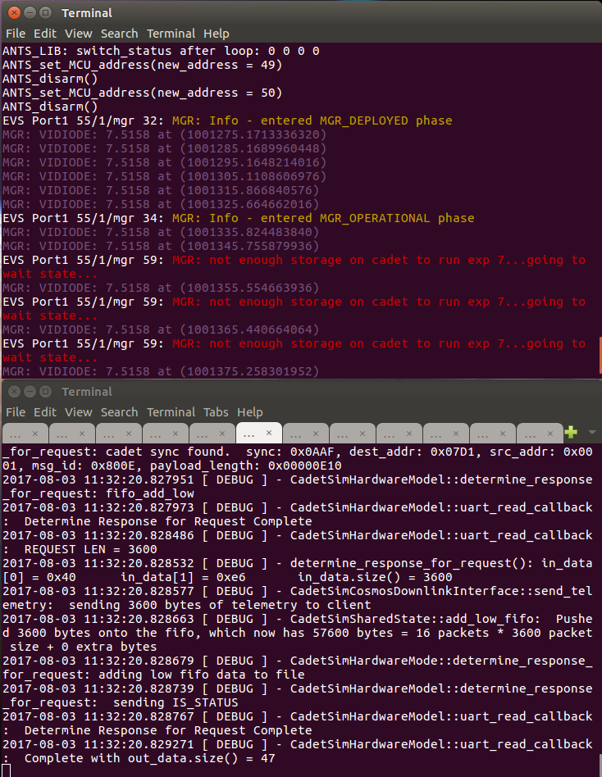
On Orbit Operations
Errors
Corruption
Invalid data
Stuck switch
Timeouts
Failures
Bus
Component
Deployment

Slide 9
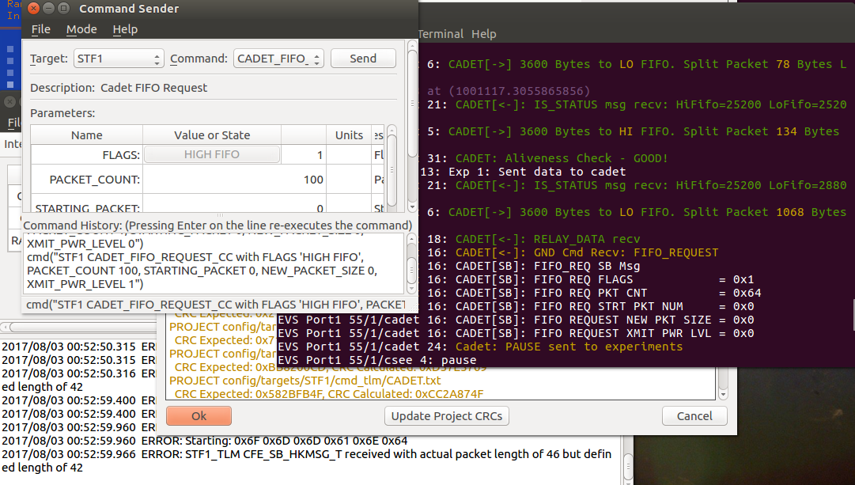
Ground Station Testing
Build database and tables
Verify
Endianness
Packing
Interpretation
Validate
Scripts
Telemetry

Slide 10
Framework for Spacecraft Security
Simulation Test Bed for Security Technologies
Realistic Spacecraft Operations – End-to-End
CryptoLib integration design complete
Will demonstrate AES encryption on the downlink
Software encryption – no specialized hardware needed
Integrates with cFS
Coding has started, wrapping up now
Demonstrates Real-World Standards Based Spacecraft Security
Does not have to be expensive
Does not have to be time consuming
Can be applied to both large and small systems

Slide 11
Demo
https://youtu.be/4RI0fIt6kSA

Slide 12
Questions?
Mark Suder
Mark.D.Suder@nasa.gov
www.nos3.org

