Slide 1
Activity Sequences
An FSW Construct for Science Operations and Autonomous Recovery for the
Europa-Clipper MASPEX Instrument
Greg Dunn
Southwest Research Institute

Slide 2
Outline
Overview
Motivation for Activity Sequences
Activity Sequence Design Overview
Sample Timelines

Slide 3
Overview

Slide 4
Mission and Instrument Overview
Europa Clipper will orbit Jupiter in order to conduct detailed reconnaissance of Jupiter's moon Europa
MAss SPectrometer for Planetary EXploration/Europa (MASPEX) – A very high resolution Multi-Bounce Time of Flight Mass Spectrometer

Slide 5
Sample Orbit (MASPEX Perspective)
Apoapsis Science
MASPEX On/Off
Science Operations Start/Stop
Warm-Up, Table Upload
Cryo-Sample Survey
Cryo-Sample Analysis
Downlink Feed Forward
Data from Flyby Science
Feed-Forward Data
Post-Cryo Cal.
Orbit Direction
Flyby Science
Europa
Jupiter
HV Ramp-Down
Feed-Forward Data
MASPEX Off
Out Run
May occur anytime inbound
Closest Approach
In Run
Pump Down
Cooldown
Warm-Up, Table Upload,
HV Ramp, Tune & Cal,
Pump Down
MASPEX Off

Slide 6
Activity Sequence Overview
An on-board scheduling mechanism for instrument operations activities
Implements a flexible schedule where activities execute any time within a defined time range
Supports sliding or compressing the timeline in order to ensure the most important operations are performed while possibly skipping optional steps
Notes:
This presentation will introduce the concept of Activity Sequence Tables (ASTs), a new construct being designed for the MAss Spectrometer for Planetary EXploration (MASPEX) instrument, which is slated to fly aboard the Europa Clipper mission. ASTs are designed to facilitate robust recovery to science operations by largely removing the reliance on fixed timelines and the distinction between nominal operations and fault recovery. ASTs implement a flexible timeline where individual activities are allowed to execute any time within a defined schedule region, so that even after a Power-On or CPU reset instrument configuration and science activities can be scheduled at alternative but acceptable times and in the correct order. Furthermore, the AST supports compressing the timeline in order to ensure the most important science operations are performed (e.g. closest approach during a flyby) while skipping optional steps, which may involve a tradeoff between science quantity and quality.

Slide 7
Motivation for Activity Sequences

Slide 8
Motivation
Need more flexible operations than traditional methods provide
Need a robust recovery mechanism in order to minimize the impact of an unexpected reset
Allow for prioritization of activities

Slide 9
Traditional Approaches for Science Operations
Method | Description | Disadvantages
Hard-coded Sequence | Instrument configuration and operation is an algorithm implemented in FSW | No complex timelines. Requires FSW change to alter sequence
Absolute Time Sequences | Stored commands are executed at a specific time | Inflexible; No anomaly recovery support; No non-deterministic activities; Must update entire sequence every orbit.
Relative Time Sequences | Stored commands are executed at a time relative to the start of the sequence | Inflexible, does not support resume, flexible timeline, or non-deterministic steps; Triggered by ATS
Notes:
Traditional approaches to sequencing science operations in FSW include hard-coded logic, or use of uploadable command sequences such as absolute time sequences (ATSs) and relative time sequences (RTSs). Hard-coded logic may provide some means for recovery, but is inflexible, is unlikely to anticipate all of the fault scenarios that could occur, and requires FSW changes to alter the logic. ATSs and RTSs provide a more accessible means for on-orbit changes; however, ATSs suffer from the need to update the sequence for every campaign (e.g. every orbit), and there is no clear and deterministic way to know how and where to resume an ATS in the event of a reset (e.g. is it OK to skip all commands that have already executed or not?). RTSs contain relative times and as such don’t necessarily have to be updated for every campaign, but something has to trigger the RTS(s) which is often an ATS. Further, if an RTS is resumed it is even more difficult to know where to resume, because the command execution times are relative to when the RTS was first initiated.

Slide 10
Traditional Approaches for Anomaly Recovery
Method | Description | Disadvantages
Safe Instrument | Boot to a SAFE state, wait for Operator intervention | Long delay before getting back to full operation
Recover to default operating mode | Automatically transition to a default configuration and continue operation | Does not support complex/variable operation.

Slide 11
Activity Sequence Design Overview

Slide 12
Design Goals
Automate all aspects of MASPEX operation for an orbit; minimize reliance on Spacecraft commanding
Allow for execution of non-deterministic-time activities
Keep nominal and recovery operations as similar as possible
Allow robust recovery from a CPU or Instrument Power On reset
Allow tradeoff between science volume and quality during fault recovery.

Slide 13
Scheduler Terminology
Term | Description
Earliest Start (ES) | The earliest time the activity is allowed to start
Latest Start (LS) | The latest time the activity is allowed to start running. This accounts for the minimum run time for the activity (i.e. can the activity do something useful before reaching LF)
Latest Finish (LF) | The latest time the step is allowed to finish. If the step is still running when LF is reached, the scheduler will terminate the step
Schedule Region | The time between ES and LS/LF for a given step
Notes:
ASTs use standard scheduling concepts; Earliest Start (ES), Latest Start (LS), Latest Finish (LF).

Slide 14
Flexible Timeline
Steps will run as early as possible, but can run any time during their Schedule Region, subject to the LS and LF times.
Timeline will ‘slide to the right’ if the sequence is started (or restarted) after the ES for a given step.
Steps will be skipped if the Schedule Region has already passed when the step is reached.

Slide 15
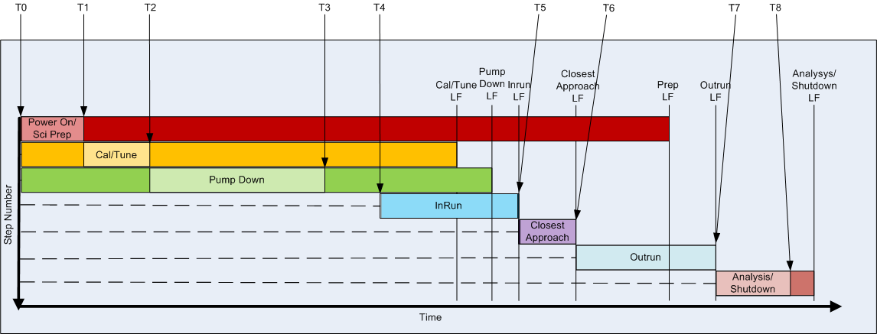
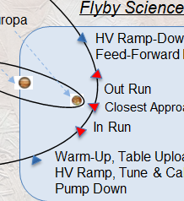
Sample Timeline (Nominal Case)
Notes:
Nominal case:
- T0: Power On/Sci Prep starts
- T1: Power On/Sci Prep finishes; Cal/Tune ES has already passed, so Cal/Tune starts immediately
- T2: Cal/Tune finishes; Pump Down ES has already passed, so Pump Down starts immediately
- T3: Pump Down finishes; InRun ES has not passed, so instrument idles until next time trigger
- T4: InRun starts at InRun ES
- T5: InRun runs until InRun LF and finishes; Closest Approach ES is at the same time, so it starts immediately after InRun finishes
- T6: Closest Approach runs until CA LF; OutRun ES has been reached so it starts immediately
- T7: Outrun urns until OutRun LF and finishes; Analysis/Shutdown runs immediately
- T8: Analysis/Shutdown finishes and asks the spacecraft to power off MASPEX

Slide 16
Activity Sequence Table

Slide 17
RTS Extensions – Pseudo Commands
Extend RTS with pseudo-commands that are handled by the RTS engine:
WAIT_FOR_CONDITION(
VARIABLE_ID, Op, value1, timeout)
ABORT_IF_TRUE(
VARIABLE_ID, Op, value2)

Slide 18
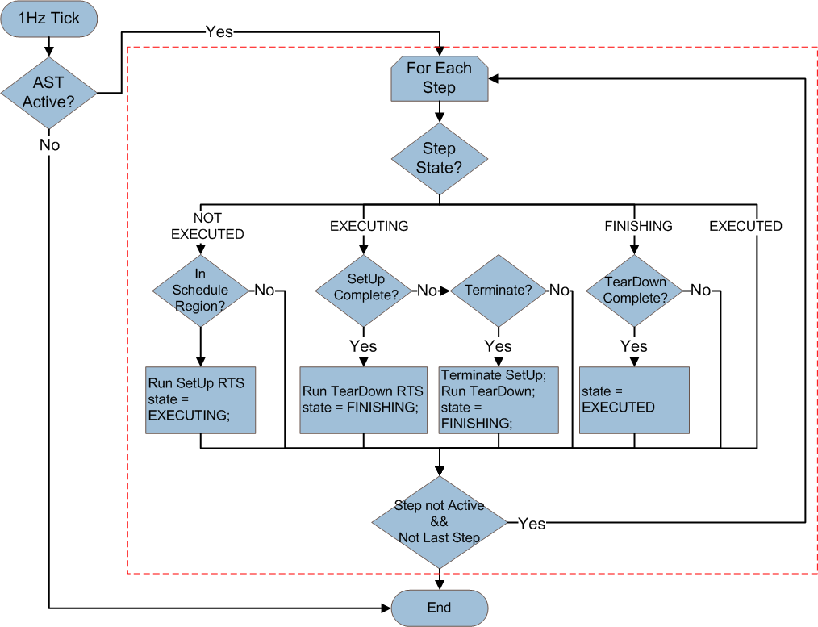
Activity Sequence Processing

Slide 19
Reset Fault Handling
CPU Reset – Resume running sequence table; skip completed steps and steps that have missed their Schedule Region.
Instrument POR – Restart sequence table at 1st step; skip steps that have missed their Schedule Region.

Slide 20
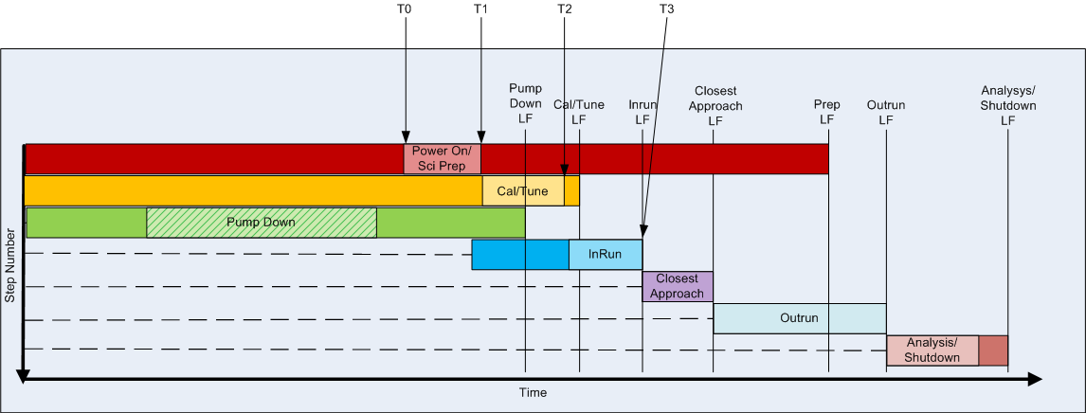
Instrument POR
.
Notes:
Instrument POR case:
- T0: Instrument experiences late turn on or power cycle; After a POR the sequence must start from the beginning since all hardware would have been reset. Is still within Power On/Sci Prep Schedule Region, so Power On step runs
- T1: Power On/Sci Prep finishes; Cal/Tune ES has already passed, but is still before Cal/Tune LF so Cal/Tune starts immediately
- T2: Cal/Tune finishes; Pump Down LF has already passed so Pump Down is skipped in favor of getting some data during the flyby. Looking at the next step (InRun), current time is within the schedule region so InRun is started.
- T3: Remainder of sequence runs nominally

Slide 21
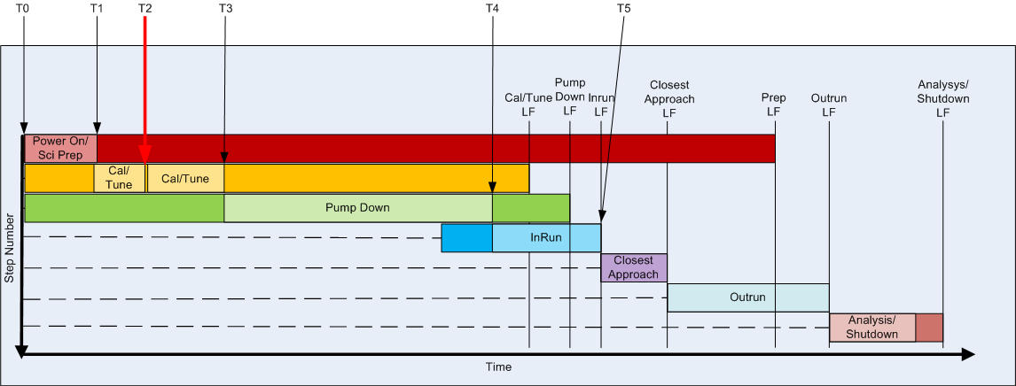
CPU Reset
Notes:
CPU Reset During Cal/Tune:
- T0: Power On/Sci Prep starts
- T1: Power On/Sci Prep finishes; Cal/Tune ES has already passed, so Cal/Tune starts immediately
- T2: CPU Reset! FSW Restarts the sequence – Step one is already marked as complete, so FSW goes to Step 2 (Cal/Tune). The current time is within the ES/LF region for the step, so Cal/Tune executes.
- T3: Cal/Tune finishes; Pump Down ES has already passed, so Pump Down starts immediately
- T4: Pump Down finishes, but was allowed to run into the InRun phase in order to complete; InRun ES has already passed, so InRun starts immediately
- T5: Remainder of sequence runs nominally.

Slide 22
Data Quality Tradeoff
If a fault happens that invalidates the Cal/Tune data or interrupts the Pump Down cycle there are several options for recovery:
Start taking data without re-running Cal/Tune and/or finishing Pump Down; Maximizes amount of data returned, but lower quality.
Delay taking data until interrupted processes are complete; Reduces amount of data returned, but higher quality.
Something in between – Pump for a little while, but not all the way to the desired threshold.

Slide 23
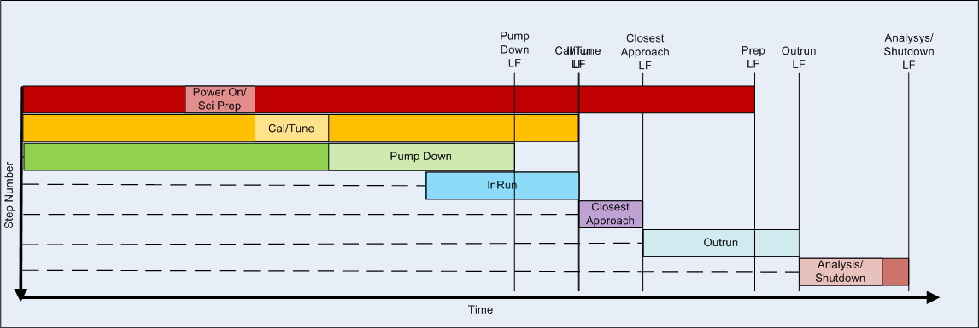
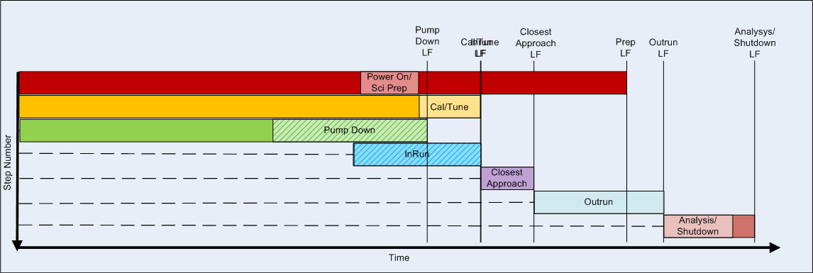
Sample Timelines Quality/Quantity Tradeoff
Pump Down is allowed to consume part of InRun Schedule
Cal/Tune is allowed to run all the way up to Closest Approach; but Pump Down is skipped.
Notes:
Nominal case:
- T0: Power On/Sci Prep starts
- T1: Power On/Sci Prep finishes; Cal/Tune ES has already passed, so Cal/Tune starts immediately
- T2: Cal/Tune finishes; Pump Down ES has already passed, so Pump Down starts immediately
- T3: Pump Down finishes; InRun ES has not passed, so instrument idles until next time trigger
- T4: InRun starts at InRun ES
- T5: InRun runs until InRun LF and finishes; Closest Approach ES is at the same time, so it starts immediately after InRun finishes
- T6: Closest Approach runs until CA LF; OutRun ES has been reached so it starts immediately
- T7: Outrun urns until OutRun LF and finishes; Analysis/Shutdown runs immediately
- T8: Analysis/Shutdown finishes and asks the spacecraft to power off MASPEX

Slide 24
Additional Sample Timelines

Slide 25
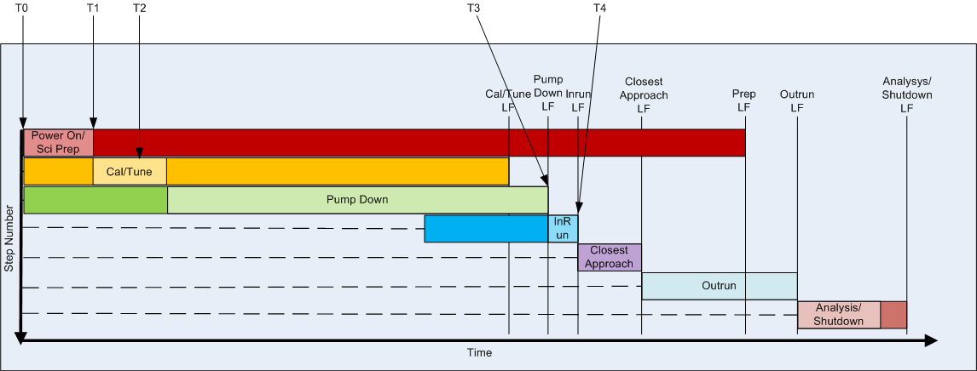
Long Pump Down
Long Pump Down case:
- T0: Power On/Sci Prep starts
- T1: Power On/Sci Prep finishes; Cal/Tune ES has already passed, so Cal/Tune starts immediately
- T2: Cal/Tune finishes; Pump Down ES has already passed, so Pump Down starts immediately
- T3: Pump Down is taking longer than expected; pressure has not reached ideal target, but LF is reached so pump down is terminated; InRun ES has already passed, so InRun starts immediately and runs until its LF (Note that similar behavior would occur if a reset happens during Pump Down such that the Pump Down activity is restarted at a late time)
- T4: Remainder of sequence runs nominally.

Slide 26
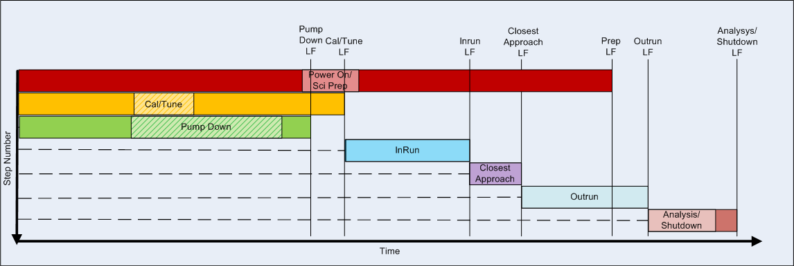
Quantity over Quality
Prioritize data volume over data quality during flyby: Skip Cal/Tune and Pump Down completely if Sci Prep runs into the InRun Schedule Region

Slide 27
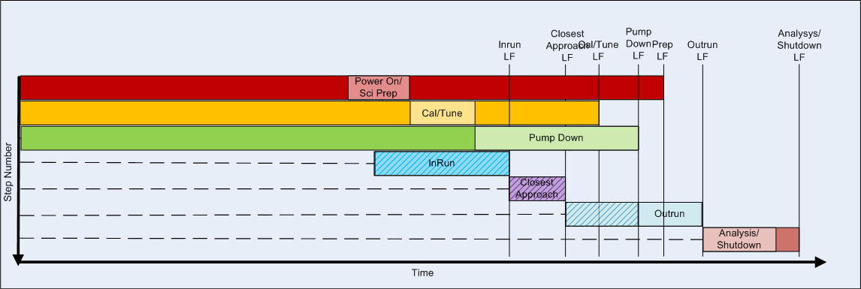
Quality over Quantity
Prioritize data quality over data quantity during flyby: Perform Cal/Tune and Pump Down even though they consume much of the Flyby Schedule Regions

