Slide 1
Single Event Upset Simulation
Carlos Beltran
The Aerospace Corporation
December 4, 2018

Slide 2
SEU Simulation
Overview
Background behind SEU simulation
Implementation of SEU program coined “MemAggressor”
Standalone Testing
Integration into HIL simulations
Future Applications

Slide 3
Background
Aerospace developed a new capability to inject single event upset (SEU) into targeted memory locations.
Provides a more test-like-you-fly Hardware-In-the-Loop (HIL) flight software (FSW) testing capability.
SEUs are result of radiation hits flipping the bits and corrupting the memory of the FSW.
Aerospace developed SEU simulation tool is called MemAggressor.
MemAggressor provides the capabilities to inject temporary or permanent SEUs.
Enables analysts to verify the FSW response under various failure conditions.

Slide 4
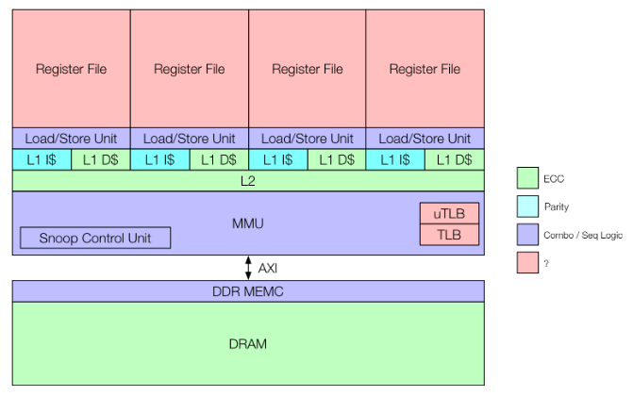
Hardware
An ARM based processor was used for testing
Performing fault injection by flipping a single bit in regions of memory will simulate the scenario where an uncorrectable ECC memory page ultimately ends up loaded into the CPU register file.
Application

Slide 5
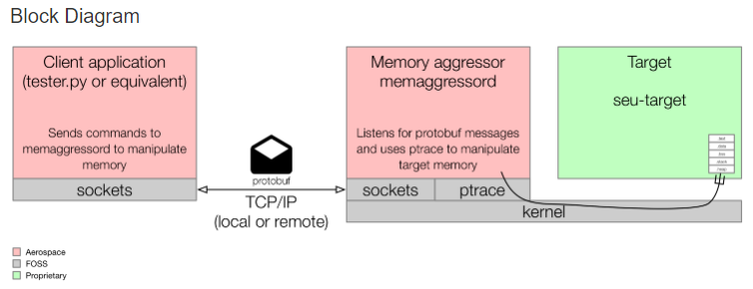
Software
The Aerospace test software is comprised of a memory aggressor daemon (MemAggressord) and a client application.
Client (initiating) application
The client application initiates the modification of target memory. Presumably the client application is some sort of test application running on a standard PC. This PC would have a network connection to the flight computer.
The application sends protobuf messages via UDP to the MemAggressord.
Since protobuf and UDP are fairly ubiquitous, the client application can be written in any language that supports them. The client app can even run on the target board and send UDP packets via localhost.
UDP – User Datagram Protocol

Slide 6
MemAggressor Process
Dynamics
MemAggressor waits for message from client
Client
MemAggressor
PID,
Address,
SEU Type
If UDP message is received
MemAggressor attaches to PID
Set watchpoint(s) (using ARM debug registers)
FSW executes
MemAggressor detaches from FSW process allowing the FSW to execute normally..
No
MemAggressor allows FSW to execute normally
Hard watchpoint ?
Yes
FSW accesses variable and is halted by the watchpoint and a SIGTRAP is sent to MemAggressor
MemAggressor waits for FSW to access address watched by watchpoint
Data is corrupted by the program
MemAggressor implementation in a HIL simulation

Slide 7
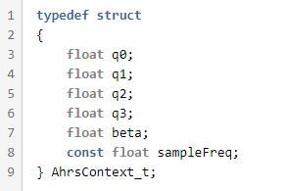
Standalone Testing
A standalone attitude estimation program served as the SEU target for testing.
Within the AHRS program, we focus on the ahrsContext struct shown below.
The AhrsContext_t type encapsulates both state (R/W) memory and constant (R/O) memory.
The state memory can be read from and written to at any time. In this example. the fields q0 through q3 are the current estimated quaternion of the fake system.
On the other hand, constant memory is used to hold immutable data (things like one-time tuning configs, mathematical constants, etc. The value here is 'sampleFreq.'
AHRS - Attitude and Heading Reference System

Slide 8
Standalone Testing
The fake AHRS program contains sensitivities to memory faults. Here are a few:
The quaternion must be normalized, and should never be all 0s.
Denormalized quaternions will propagate and persist, causing bad estimates.
The sampleFreq field is marked const, and thus no sane C compiler would allow the program to manipulate it. The developer is relying on the hardware or system software to ensure that this value is correct and unmodified.
The code does a divide with this field, so if it were to be erroneously zeroed out, NaNs would propagate.
A bitflip in the program's .text section could lead to undefined instruction (prefetch abort) exceptions, either by direct instruction execution or indirect "branching into the weeds."
NaN – Not a Number

Slide 9
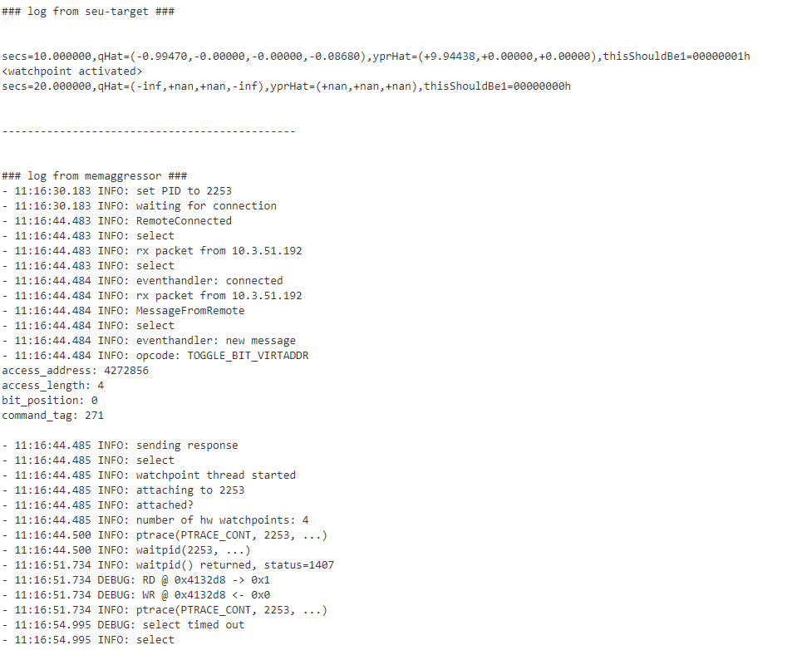
Standalone Testing
To the right is a log file from a test run with the standalone attitude estimation program running alongside the MemAggressor program.
You can see that a message was received from the client and there was a watchpoint set on the variable “thisShouldbe1”.
The attitude estimation program tried to access the variable and the MemAggressor program corrupted the data causing the program to return errors.
This is an example of what could happen from a radiation hit in space with no protection from the FSW.
Next step is to test what would happen in real FSW.

Slide 10
Current HIL Integration
MemAggressor will run along side the Flight Software during an end-to-end mission run.
Flight software is modified to create a log of variable addresses.
MemAggressor reads log to simulate SEU for the desired variables.
Dynamics is modified to use the client SEU injection capabilities.
Client is compiled as library and linked to dynamics.

Slide 11
Future HIL Integration and Concerns
Future HIL Integration Enhancement
Provide options a user can set in config file for an end-to-end mission.
Number of watchpoints to set.
Max number of watchpoints is 4 (limited by architecture).
Time in mission to set watchpoints.
Concerns:
The time it takes to insert the watchpoint and corrupting the data may be too long to stop the FSW and may cause FSW to fail or become unstable. This is something that will need to be monitored when running end-to-end mission runs.

Slide 12
Conclusion
SEUs simulation can be done by leveraging low level debugging capabilities.
The Aerospace Corporation developed SEU simulation capability is currently being used in HIL testing.
This capability can be adapted to other architectures besides the ARM.
In addition to SEU, this capability can be used to corrupt system feedbacks to simulate various sensor and communication failures.

