Slide 1
Juno UVS Ground Science Data Processing
Paul Hoeper
paul.hoeper@swri.org
Brad Trantham
bradley.trantham@swri.org
Chris La Valle
christopher.lavalle@swri.org

Slide 2
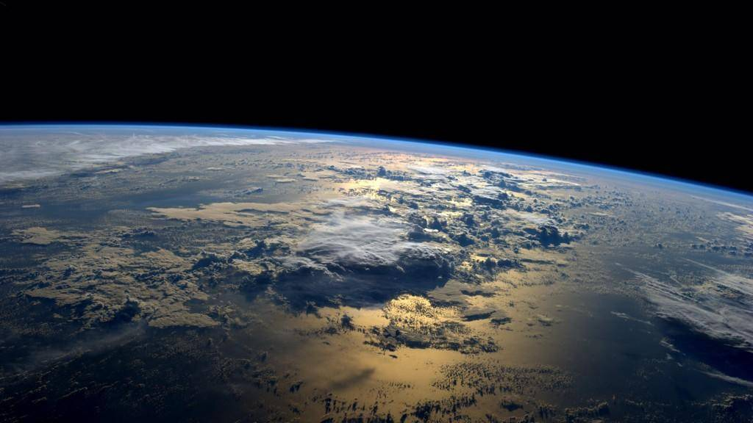
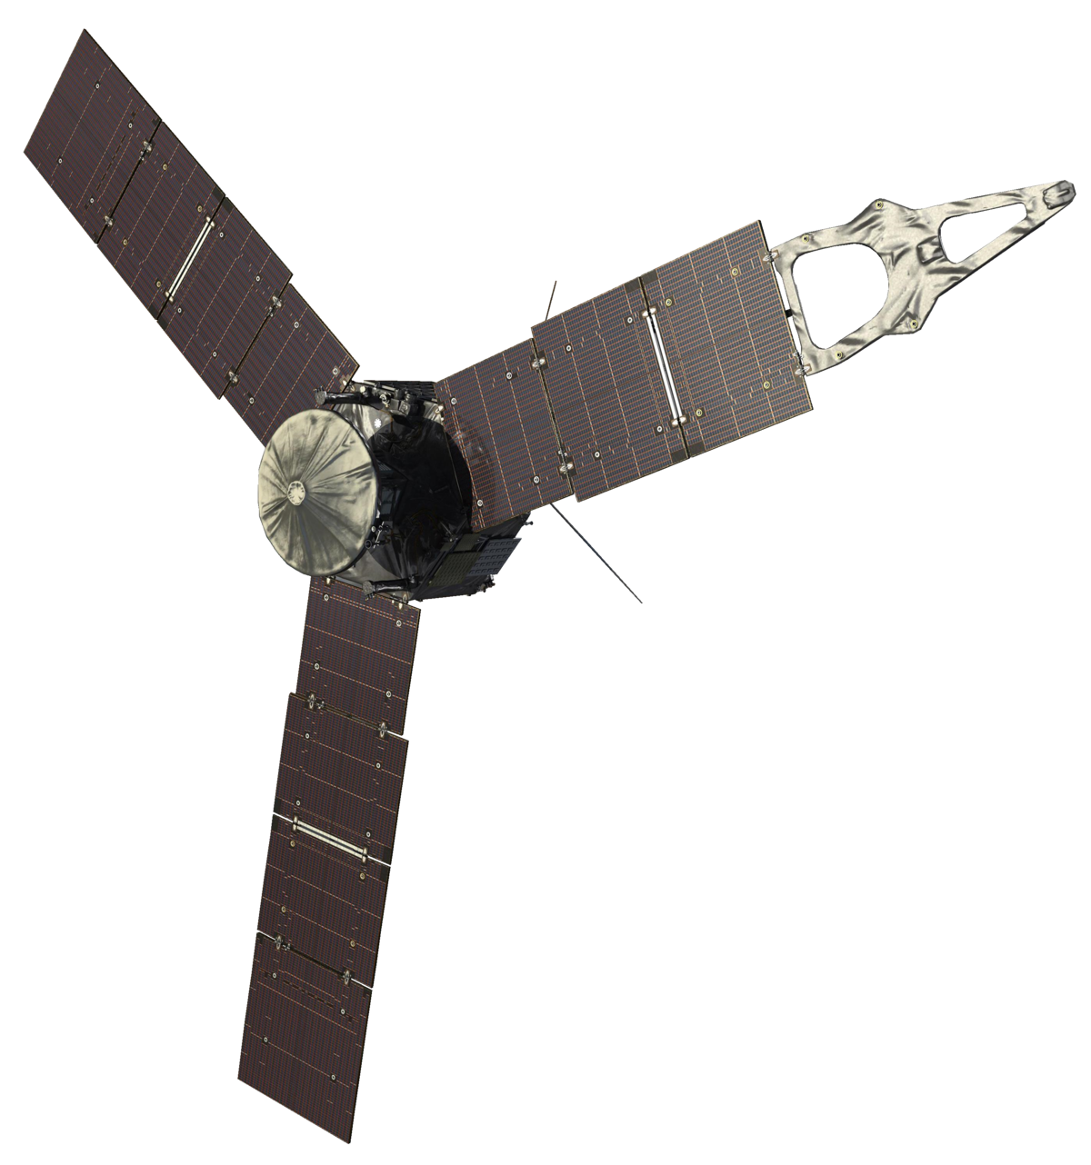
Juno and Jupiter
UVS
Ground Software
UVS Science

Slide 3
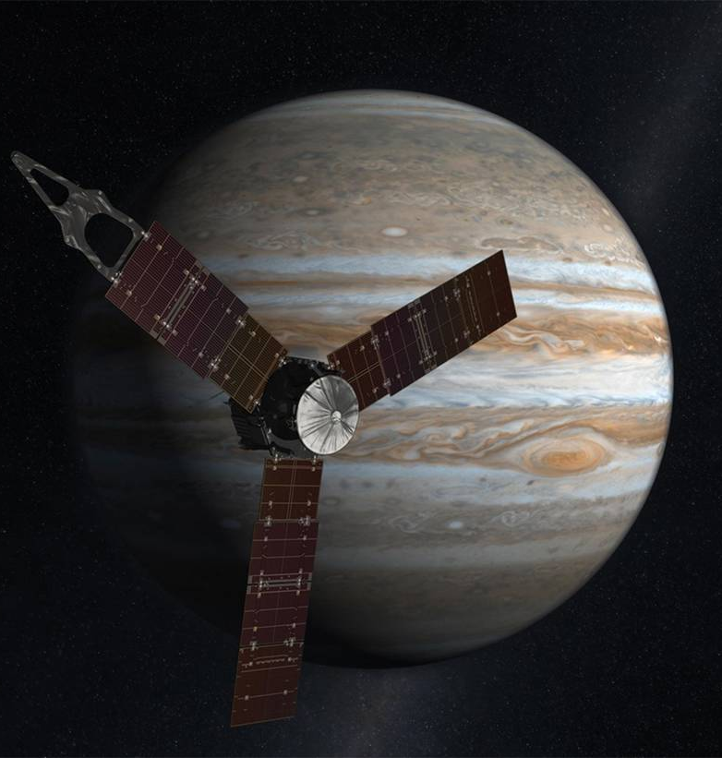
Juno Mission
NASA-JPL Mission to Jupiter
Launched – Aug. 5th, 2011
Jupiter Arrival – July 4th, 2016
-- Still on-orbit --
(Planned deorbit – July 2021)
P.I.: Scott Bolton (SwRI)
All images: NASA/JPL-Caltech https://www.jpl.nasa.gov/missions/juno/

Slide 4
Jupiter
Why Go?
Largest
Big effect on other planets
Likely first to form
Fastest rotation
Emits more heat than it receives from the sun
Strongest magnetic field!
20,000x stronger than Earth’s

Slide 5
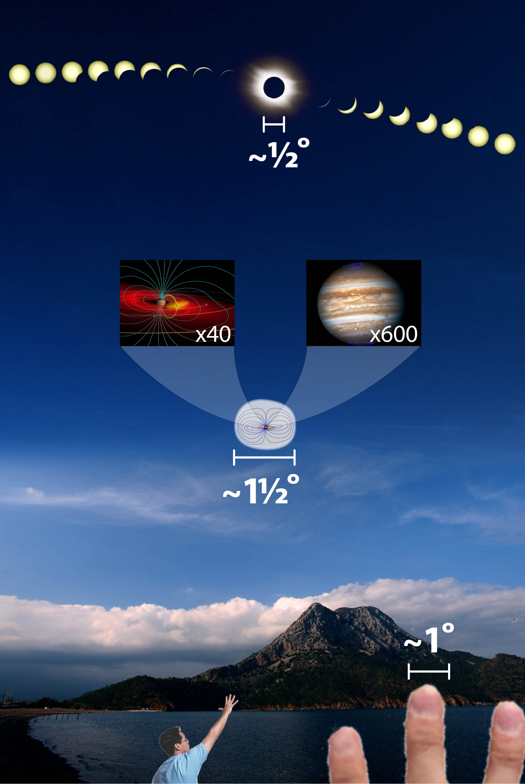
Jupiter’s magnetosphere is enormous
If made visible, Jupiter’s magnetosphere would be the largest object in Earth’s night sky.
3 times larger than the moon.
3 times larger than the sun in our sky despite being 5 times further away.
Image credit: Fran Bagenal & Steve Bartlett
http://lasp.colorado.edu

Slide 6
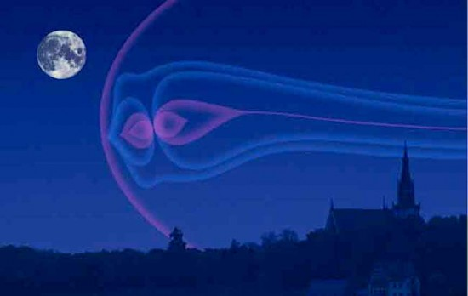
Jupiter’s Magnetosphere Edge-on
Jupiter’s magnetotail stretches all the way to Saturn’s orbit (over 4 AU)!

Slide 7
Jovian Aurora From Hubble
Among the best Earth-based images of Jupiter’s Aurora (May 2016)
Credit: NASA, ESA, J. Nichols (University of Leicester), and G. Bacon (STScI)
Acknowledgment: A. Simon (NASA/GSFC) and the OPAL team

Slide 8
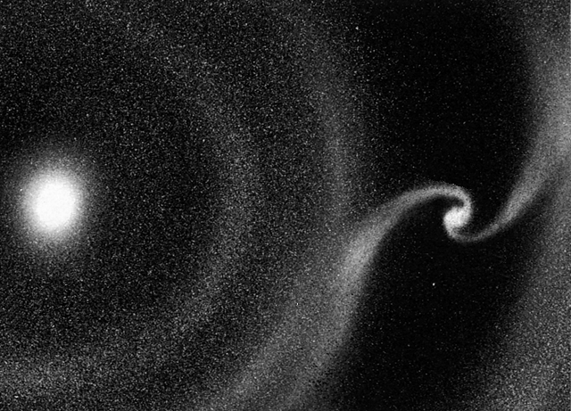
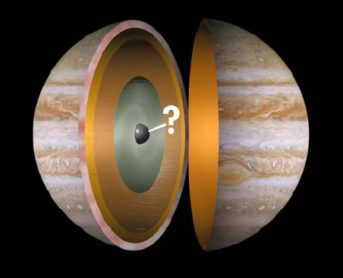
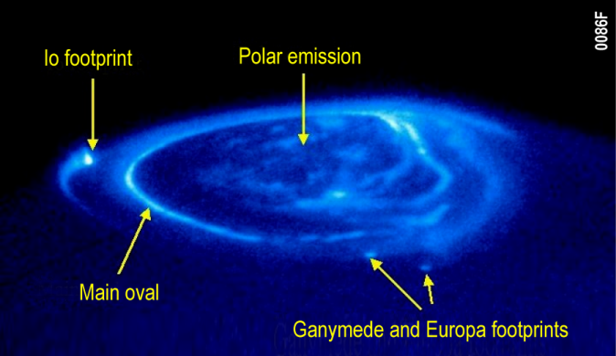
Juno Science Objectives
Origin
Determine water abundance and constrain core mass to decide among alternative theories of origin
Interior
Understand Jupiter's interior structure and dynamical properties by mapping its gravitational and magnetic fields
Atmosphere
Map variations in atmospheric composition, temperature, etc. to depths greater than 100 bars at all latitudes
Magnetosphere
Understand Jupiter's magnetosphere and auroras
HST FUV Image

Slide 9
Juno and Jupiter
UVS Ground
Software
UVS Science

Slide 10
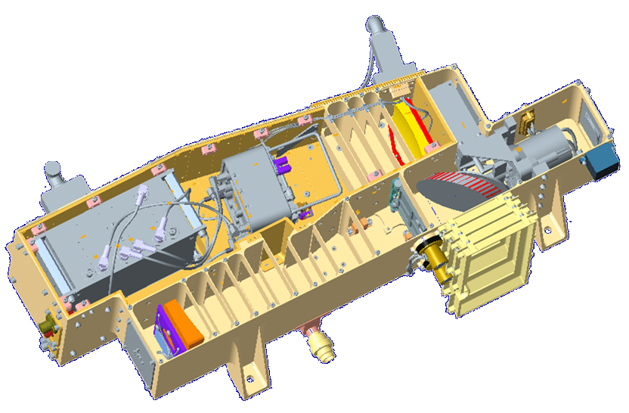
Juno Ultraviolet Spectrograph (UVS)
Toroidal Grating
Detector Door
Scan Mirror
Assembly
MCP Detector Assembly
Slit
Detector Electronics
Entrance Baffle
Fail-Safe Door
Aperture Door
OAP Mirror
Baffles

Slide 11
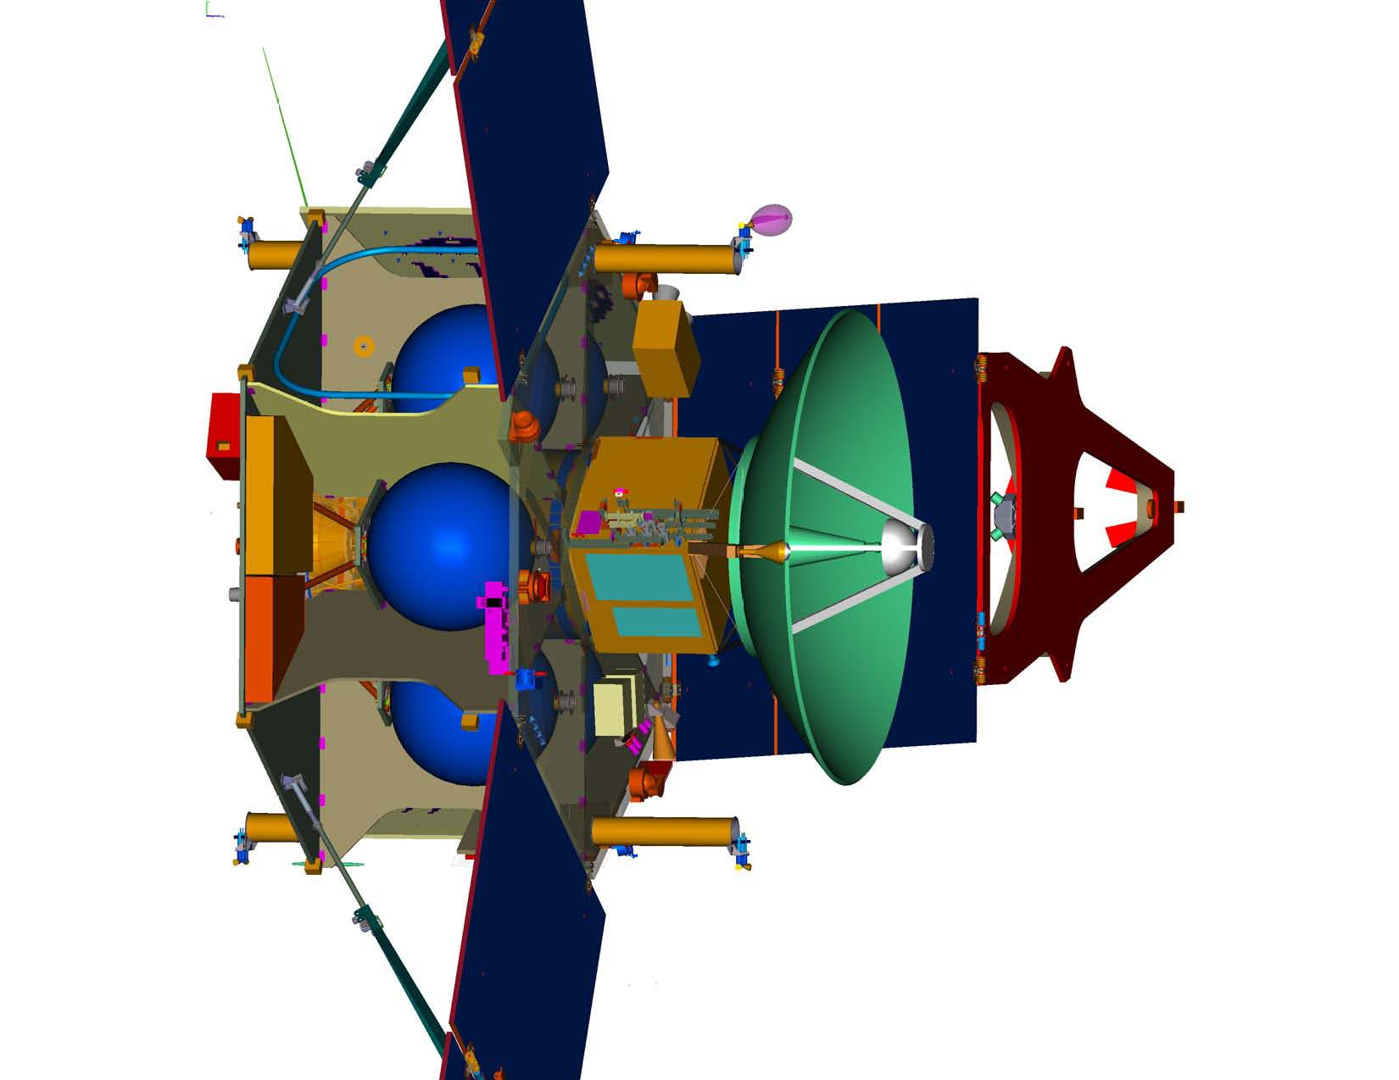
Juno Ultraviolet Spectrograph (UVS)
UVS Team Lead: Randy Gladstone (SwRI)
UVS mission goals:
Characterize Jupiter’s Aurorae
Map the precipitating electron energies
Observe the S/C footprint region to compare UVS data with particle & waves data
Look for structure & variability in low-latitude airglow emissions
Scan Mirror motion
Spin Axis
UVS

Slide 12
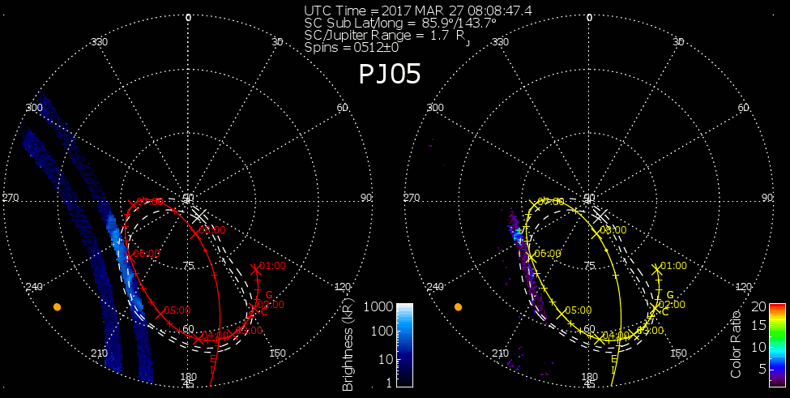
UVS Science
It takes ~40 spins to produce a full image at 0.6 R_{J} Alt.

Slide 13
Northern Auroral Day
Notes:
Update images

Slide 14
The Auroral Curtain
Limb view shows vertical extent of UV auroral emissions.
Io’s footprint is located just right of center in this view.
Hydrocarbon absorption is evident right along the limb.

Slide 15
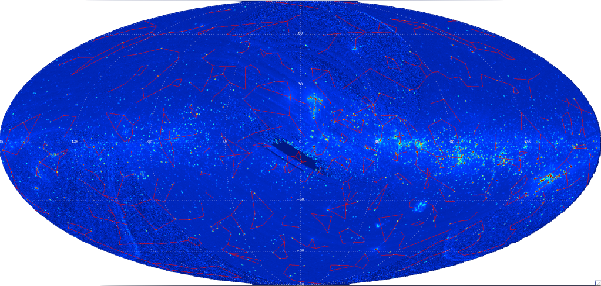
UV All Sky Map
During part of every orbit, Juno-UVS performs regular calibration observations using the stars as a reference.
Since mission start, UVS has observed over 99% of the sky in the 100-210 nm spectral range at a spectral resolution of up to 1.3 nm.
Over 8000 stellar UV-spectra have been extracted to date (Hue et al. 2018b).
Image is the integrated brightness (135-180 nm) shown in Galactic coordinates and Mollweide projection.
V. Hue et al. 2018
Notes:
The Juno-UVS detector experiences a large degradation due to radiation and frequent stellar calibration are needed to characterize the instrument response. To date, over 8000 stellar spectra have been extracted from the UVS dataset.
Using the previous UV platforms such as IUE and HST, UVS was calibrated at a high precision. One of the by-product of the calibration work is that UVS observed more than 99% of the sky since Launch, in the 100-210 nm spectra range

Slide 16
Juno and Jupiter
UVS Ground
Software
UVS Science

Slide 17
UVS Ground Data Processing

Slide 18
SPICE
A Space Science Observation Geometry System
Maintained by NASA’s Navigational and Ancillary Information Facility (NAIF) at JPL (naif.jpl.nasa.gov)
Dawn
Cassini
Galileo
Deep Impact
Mars Pathfinder
Rosetta (ESA)
Chandrayaan-1 (ISRO)
Hayabusa (JAXA)
InSight
OSIRIS REx
New Horizons
etc., etc. …
S - Spacecraft
P - Planet
I - Instrument
C – Camera-matrix
E - Events
Computes observation geometry parameters
trajectory design
science observation planning
science data analysis
All logos from Wikimedia Commons https://commons.wikimedia.org

Slide 19
SPICE
Diagram courtesy NAIF https://naif.jpl.nasa.gov

Slide 20
How UVS Data Processing has Evolved
Notes:
Discuss Lima & SPICE automation changes

Slide 21
How UVS Data Processing has Evolved
Notes:
Discuss Lima & SPICE automation changes

Slide 22
How Science Data is Generated
24 bits
Detector
32,768
words
On the Spacecraft
Packets Transmitted
Data
To Earth
Data
Data
Data
Data
Data
Data
Data
Data
Data
Data
Data
Data
Data
Data
Data
Data
Data
Data
Data
Data
Data
HK
Data
HK
HK
HK
Data
Data
HK
Data
Data
HK
Data
Data
HK
HK
Data
HK
HK
HK
Data
Data
Data
Data

Slide 23
How Science Data is Correlated
Matching 18-bit time hacks in data packets to full 32-bit time strings in the housekeeping packets is complicated!
Time
Data
Data
Data
Data
Data
Time
Gap
Data
Time
Gap
Data
Data
HK
HK
HK
?
HK
On the Ground
Time gaps and missing data cause many edge cases.
Why use such a complex scheme?
Saves bandwidth
Increases science data throughput despite the occasional data loss

Slide 24
Processing Speed
~15 mins
~5 days!
“Mike” Process

Slide 25
Processing Speed
SPICE code is non-reentrant (i.e. it cannot be interrupted in the middle of its execution and safely called again, “re-entered”, before its previous invocation completes).
NAIF is currently working to create code that works in parallel.
Improvements in the works
Distributed computing on our own local cloud
Automating Mike
Let it decide when/if we have enough data and SPICE kernels to run.

Slide 26
The Future
Directions for possible future work with our data:
Advanced analytics, particularly deep learning.
SwRI Intelligent Systems division has lots of experience with image processing and high dimensional datasets.
"Insight discovery” (a.k.a. Unsupervised Learning)
Help scientists identify the underlying trends in large, multi-dimensional datasets.

Slide 27
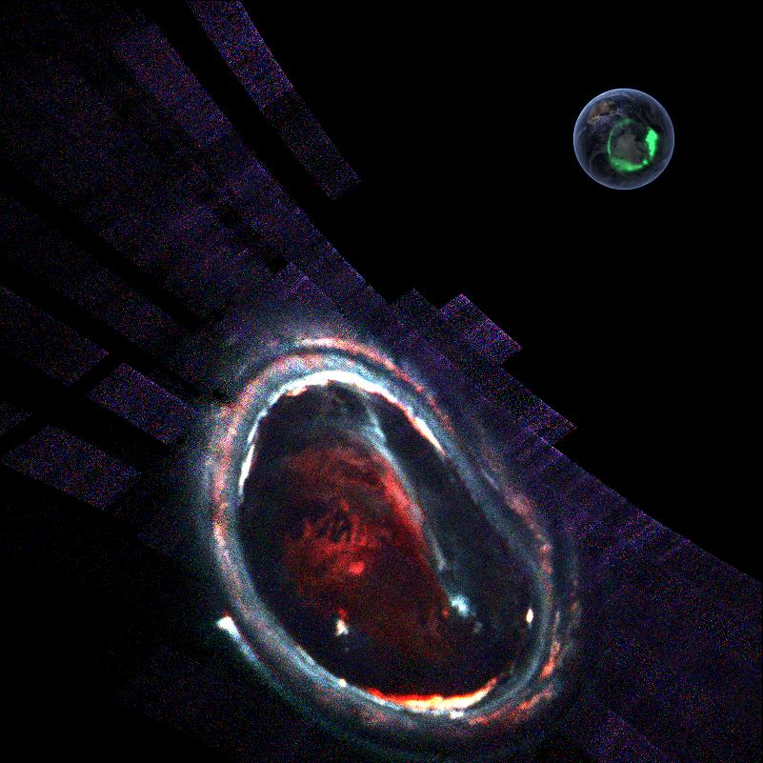
Thanks!

Slide 28
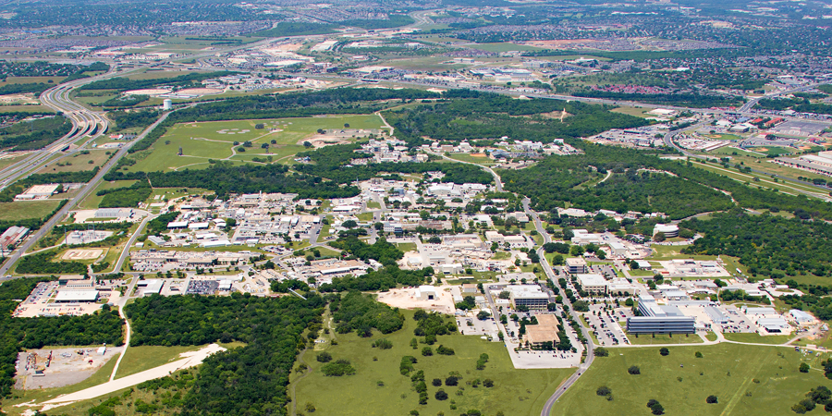
Questions?
Maarten Versteeg
Randy Gladstone
Thomas Greathouse
Vincent Hue
Etc.
Many thanks to:

Slide 29
Extra Slides

Slide 30
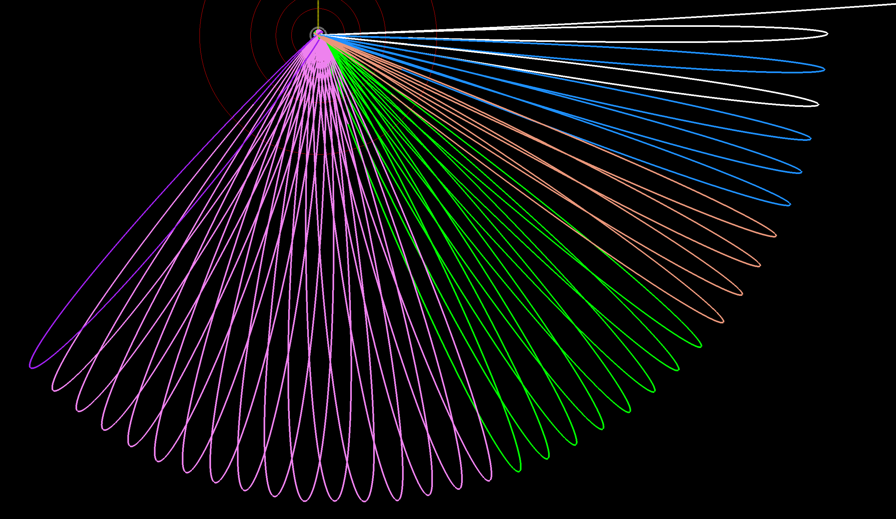
Juno’s Orbits
Sun
Earlier plan:
2x 53-day orbits (apojove ~115 R_{J}) then 14-day orbits (apojove ~45 R_{J})
Current plan:
All 53-day orbits (apojove ~115 R_{J}); this makes the Juno mission ~4x longer, and the orbit geometry changes as Jupiter goes around the Sun
Juno is here now (16th 53-day orbit)
x
Blue = Orbits 1 & 3-5 (yield initial 90-deg spacing)
Brown = Orbits 6-9 (45-deg spacing)
Green = Orbits 10-17 (22.5-deg spacing)
Magenta = Orbits 18-33 (11.25-deg spacing
Purple = Orbits 34-35 (extra and deorbit)

