Slide 1
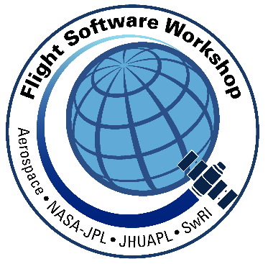
Security Considerations for Small Satellites
Paul Wood, Abe Garza, and Robert Klar
paul.wood@swri.org, abe.garza@swri.org, robert.klar@swri.org
Southwest Research Institute
This is a non-ITAR presentation, for public release
and reproduction from FSW website.

Slide 2
Outline
Why do we care?
Attack surface analysis
Risk Analysis
Mitigations
Recommendations
Note: Our focus is on the flight segment. We have assumed that the ground segment is shared with others, and, as a consequence, security practices should already be in use.

Slide 3
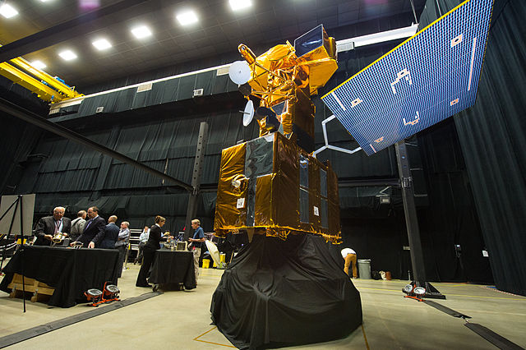
Why do we care?
Instances of interference have been documented
In 2008, NASA Terra EOS saw interference of several minutes on two separate occasions that “achieved all steps required to command the satellite”*
In 2007 & 2008, NASA Landsat 7 saw interference of several minutes on two separate occasions that “did not achieve all steps required to command the satellite”*
More satellites mean more opportunities exist for trouble
Lower cost development processes means we’re reducing effort on development including security
Larger community of people knowledgeable about satellites means security through obscurity is less effective
Notes:
*U.S.-China Economic and Security Review Commission
2011 REPORT TO CONGRESS of the U.S.-CHINA ECONOMIC AND SECURITY REVIEW COMMISSION. pp 216+.
1https://commons.wikimedia.org/wiki/Category:Landsat#/media/File:Land_Sat_satellite_at_the_Asteroid_Grand_Challenge_anniversary_event_2015.jpg
2https://commons.wikimedia.org/wiki/File:Terra_logo.png

Slide 4
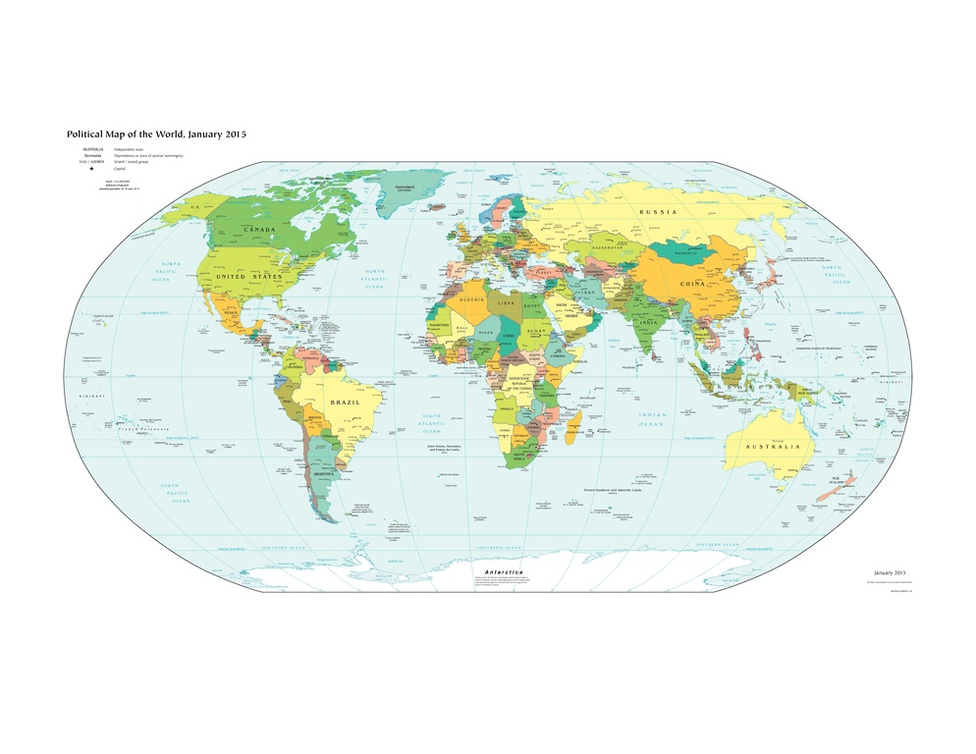
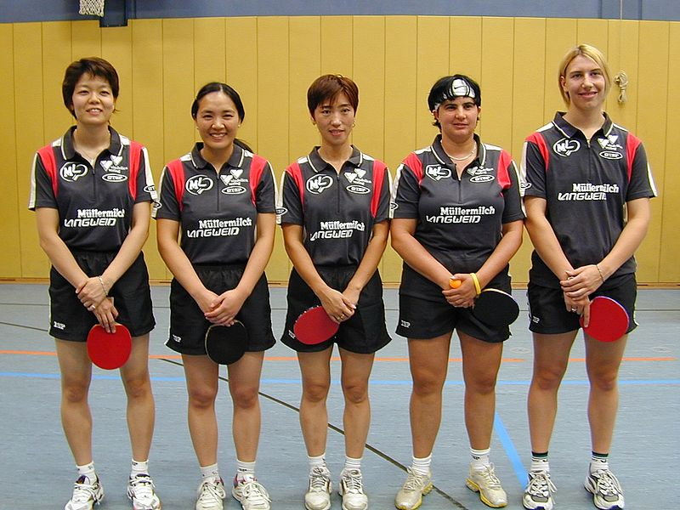
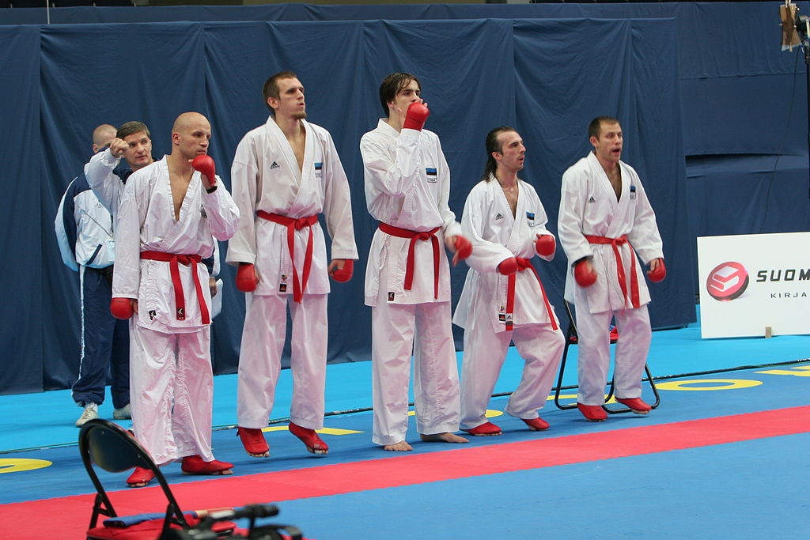
Why do we care?
We all want our activities to be successful
Unfortunately, not everyone wants us to be successful
Threats come from many sources
Within our own organization or team
Rivals (commercial or otherwise)
Criminals
Flat-earthers (hactivists)
Foreign actors
New threats are emerging all the time
Ease of interference is increasing
Notes:
1https://commons.wikimedia.org/wiki/File:Langweid_Team_2005.jpg#file
2https://commons.wikimedia.org/wiki/File:%C3%89quipe-Estonie-Tampere-2006.jpg
3https://commons.wikimedia.org/wiki/File:Classical_gangster_clothing.jpg
4https://commons.wikimedia.org/wiki/File:Wikileaks_logo.svg
5https://commons.wikimedia.org/wiki/File:CIA_WorldFactBook-Political_world.pdf

Slide 5
Attack Surface Analysis
A well-established method to perform a security evaluation for a system
Seeks to identify areas of potential vulnerability
What is an attack surface?
Any physical or logical interface that an attacker can use to potentially gain unauthorized read/write access to a system
Physical Attack Surfaces require physical access
Logical Attack Surfaces do not require physical access
Logical “landscapes” are always changing
Notes:
Physical attack surfaces usually require physical access. Logical attack surfaces include various stages
Logical “landscapes” are always changing - Just because an attack surface is invulnerable now, does not mean it will always be true. An attack surface must be regularly tested and analyzed for potential vulnerabilities.

Slide 6
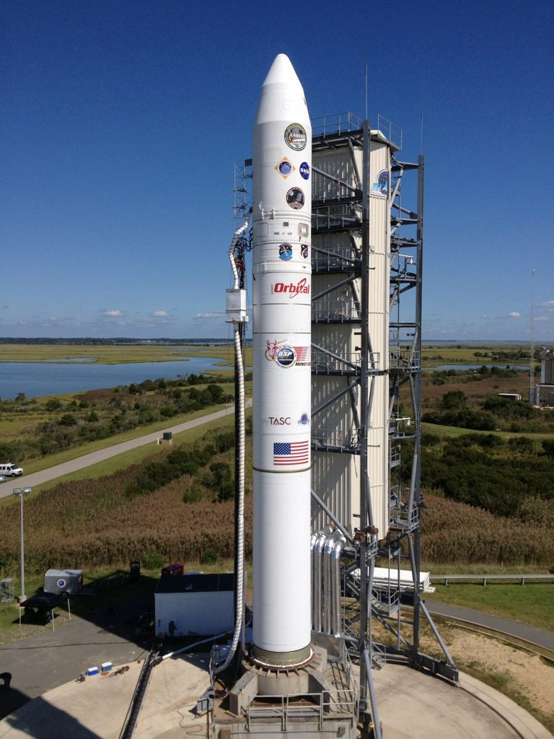
Physical Attack Surfaces
This Photo by Unknown Author is licensed under CC BY-NC
Probably not something to worry about up here…
But they should be analyzed while the nanosat is still down here
Examples: JTAG, SPI, I²C, and UART
This Photo by Unknown Author is licensed under CC BY-SA
Notes:
Probably not in space, but maybe before launch while its still on the ground
Who is launching your nanosat? NASA? SpaceX?
Who is delivering the nanosat to the launch facility? UPS? DHL?
All of these are points where a malicious party could have unrestricted physical access to your nanosat
Examples of commonly exploited attack surfaces include JTAG, SPI, or other Serial interface ports on any embedded device.
Any port which offers read/write access. Some only allow you to read (still potentially valuable), others allow you to both read/write (potentially greater value)
Typically remnants from the development phase

Slide 7
Logical Attack Surfaces
On-board
Weak application isolation/boundaries, or weak system call verification (Android Intents anyone?)
Unencrypted, accessible storage of application data (e.g. shared memory)
Supply chain elements: processors, I/F devices, etc.
RF interface
Exploiting RF communications protocols to gain access to valuable data in-transit, or to gain access to a system
Think like an Adversary!
Notes:
On-board attack surfaces are when a system has already been partially compromised, but not completely. For example, one compromised application does not necessarily compromise another application running on the same system. Thus, it’s still important to analyze the inter-application or inter-process surfaces for potential vulnerabilities.
Android Intents is a typical “attack surface” for android applications that expose themselves to too many intents. An Android Intent is just Android’s way for processes/applications to communicate with one another, and you explicitly define which Intents your application will respond to when you create your app. Obviously this has caused a lot of vulnerabilities where malicious apps can manipulate non-malicious apps in many ways. This happens because these non-malicious app developers didn’t properly analyze their app for this attack surface when they exposed it to the rest of the Android system.
Wireless/Networking attacks are another method of external intrusion into a system to either partially or completely compromising the entire satellite.
Review the specs for every single circuit board going into your nanosat for any wireless interface capabilities. Confirm which of these interfaces are active in any way (just because your application doesn’t use Bluetooth doesn’t mean that it is deactivated for the system). For those interfaces which are active, what processes/drivers/programs are interacting with those interfaces? How do they receive and parse the incoming data? How do they establish a connection (if using a connection-oriented protocol), and how do they transmit and ensure that data was received?
Nanosat developers need to answer these questions about their system, and then for each answer try to think about how someone could cause harm to the nanosat using those components/protocols.
Think like an Adversary
Developers know their code better than anyone - if you want to minimize the risk of an attack, then you need to look at your code from a different lens and think about how an attacker would compromise your system.

Slide 8
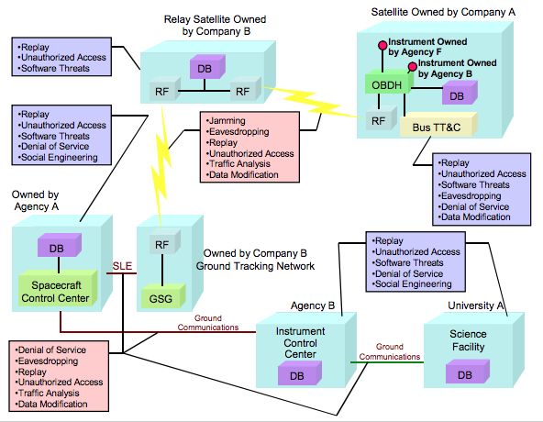
Networking/Communication Attack Surfaces
https://public.ccsds.org/Pubs/350x1g2.pdf
Notes:
Replay attacks are when you record a previous communication stream and replay it at a later point, to gain unauthorized access or to disrupt service
Eavesdropping, or snooping, is when you can receive communication that is not directed to you, and ideally be able to fully understand it (i.e. decrypt and decode it). Used as part of the reconnaissance phase of an attack

Slide 9
Security Risk Analysis
Examine risks using a methodological approach
Identify threat actors
Codify likelihood and consequences (impact)
Analyze risks (from attack surface analysis) and rank them
Identify mitigations
Develop a plan to accomplish mitigations and apply them

Slide 10
Risk Analysis – Threat Actors
Threat Actor | Attacker Motivations | Threat Level | Likelihood
Insider | Ego, bruised Financial | High | Medium
Rivals | Financial Competitive Advantage | Medium | Medium
Criminals | Financial Gain | Low | Low
Flat Earthers | Ideological | Low | Medium
Foreign Actors | Political Advantage Economic Advantage | Very High | Low
Notes:
Insider threat: https://www.observeit.com/blog/new-ponemon-institute-study-insider-threats-lead-to-big-losses-and-significant-costs/
Ponemon report states $8.76 million, >3,200 incicdnts; causes: negligent/carelessness, criminal/malicious, credential thieves
Rivals: https://en.wikipedia.org/wiki/Industrial_espionage
Reuters: Employees/students take sensitive information with them when they leave.
Criminals: Well-know threat, but the cost/benefit for small sats are probably low
Flat Earthers: https://techcrunch.com/2017/02/22/the-dramatic-rise-in-hacktivism/
Techcrunch: Hackers with a cause.
Foreign actors: https://www.dni.gov/files/NCSC/documents/news/20180724-economic-espionage-pub.pdf
US National Counterintelligence and Security Center

Slide 11
Risk Consequence vs. Likelihood

Slide 12
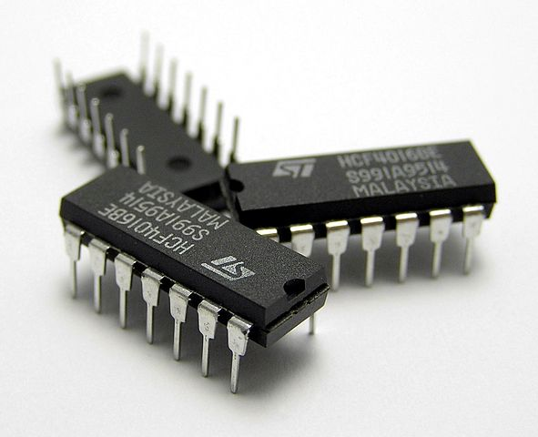
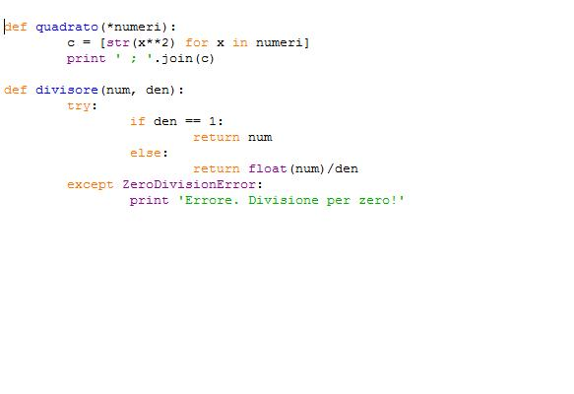
Risk Analysis – Attack Surfaces
Attack Surface | Likelihood | Consequence | Risk
Electronics, Data leak | Very Low | Limited | Low
Electronics, Denial of service | Very Low | Catastrophic | Medium
Flight Software, Open Source | Low | Significant | Medium
Flight Software, Custom | Low | Non-Trivial | Medium
Notes:
1https://commons.wikimedia.org/wiki/File:Three_IC_circuit_chips.JPG
2https://commons.wikimedia.org/wiki/File:Python_example.jpg

Slide 13
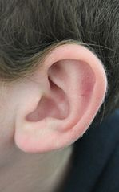
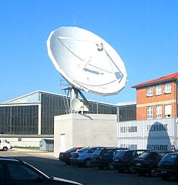
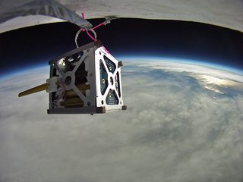
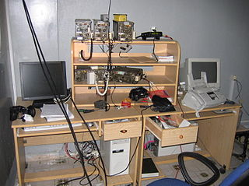
Risk Analysis – RF Attack Surfaces
Attack Surface | Likelihood | Consequence | Risk
RF, Jamming | Medium | Significant | Medium
RF, Eavesdropping | High | Limited | Medium
RF, Replay Attack | Low | Significant | Medium
RF, Unauthorized Access | Very Low | Catastrophic | Medium
RF, Traffic Analysis | Medium | Limited | Medium
RF, Data Manipulation | Very Low | Significant | Medium
Command & Telemetry
Notes:
1https://commons.wikimedia.org/wiki/Category:PhoneSat#/media/File:CubeSat_picture-02.png
2https://commons.wikimedia.org/wiki/File:BTV-Parabolschuessel.jpg
3https://commons.wikimedia.org/wiki/File:Earrr.JPG
4https://commons.wikimedia.org/wiki/File:Flickr_-_Israel_Defense_Forces_-_Lebanese_Eavesdropping_and_Recording_Station.jpg

Slide 14
Evaluation of Attack Surfaces – Mitigations
Component | Risk Rating | Vulnerability | Mitigation | Cost
Electronics | Low to Medium | Counterfeit Parts | Include security in part selection Beware of abnormally low cost | Low
Flight Software, Open Source | Medium | Known defects Unknown features Insider threat | Learn defects in open source SW Open source SW may have many features not needed | Low
Flight Software, Custom | Medium | Insider Threat | Independent review | Low
RF Links | Medium | Several | See next slides

Slide 15
Evaluation of Attack Surfaces – Mitigations
Component | Risk Rating | Vulnerability | Mitigation | Cost
RF | Medium | Jamming | Sophisticated electronics | High
RF | Medium | Eavesdropping | Encryption | Low to Medium
RF | Medium | Replay Attack | Sequence numbering Sessions | Low, Medium
RF | Medium | Unauthorized Access | Encryption, key rotation | Low to Medium
RF | Medium | Traffic Analysis | Encryption Traffic resizing/retiming | Low to High
RF | Medium | Data Manipulation | Encryption | Low to Medium

Slide 16
Recommendations
Pay attention to security during design
Make sure electronics and open source software don’t have known security vulnerabilities
Use independent review to protect against insider threat and design flaws
Use low-cost methods to improve security of RF link
Use encryption feature of modern space processors
Use sequence numbering to protect from replay attacks
Don’t spend effort on asymmetric threats
You cannot protect against nation states cost effectively
Balance your security efforts against your goals including operational time period
You don’t want your satellite hacked!

Slide 17
Questions/Comments?

