Slide 1
Gathering Spectra on Mars
An Overview of Flight Software for Two Spectrometer Instruments on the Mars2020 Rover
Satellite Flight Software Workshop 2018
John Michel
Los Alamos National Laboratory
Unlimited release
LA-UR-18-30943

Slide 2
Outline
Overview of SuperCam and SHERLOC Instruments
Instrument Flight Software
Interfaces
Design and Architecture
Development and Test Environment
Electronic Data Sheet
Automation
SHERLOC Onboard Spectra Processing
Automated Target Selection
Cosmic Ray Removal
SuperCam Image Optimization
Focus Stacking

Slide 3
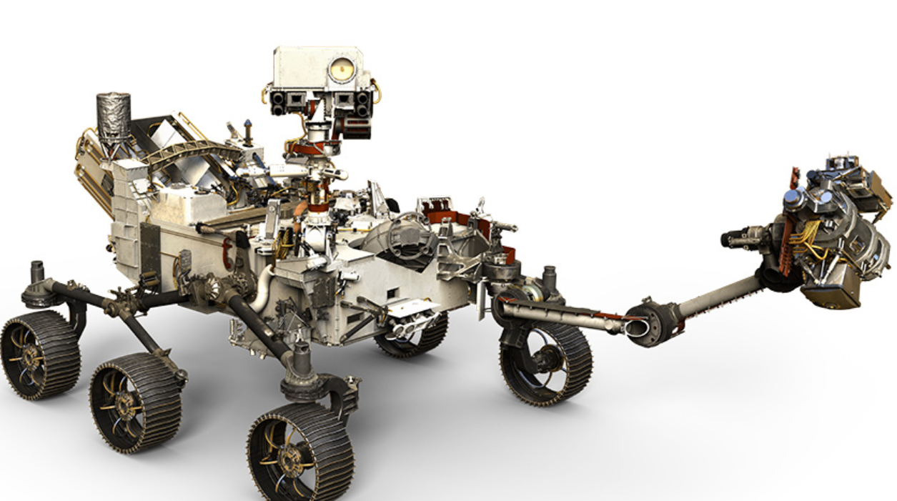
Mars2020 Rover
SuperCam Mast Unit
SHERLOC Turret Assembly

Slide 4
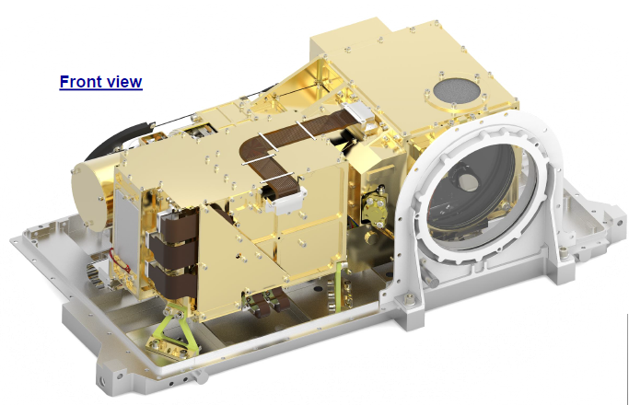
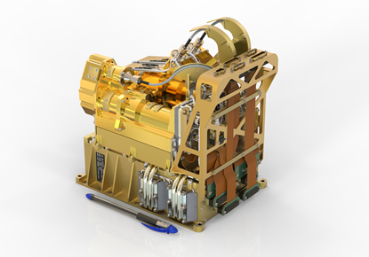
SuperCam Instrument
Upgraded version of ChemCam instrument currently operating on Curiosity rover
Lead by Los Alamos National Laboratory (PI: Roger Wiens) and the French space agencies CNES and IRAP (Deputy-PI: Sylvestre Maurice)
Laser Induced Breakdown Spectroscopy (LIBS) and microphone
Raman/Fluorescence Spectroscopy
Visible and Infrared Spectroscopy
Color Remote Micro Imaging
Mast unit contains lasers, telescope, IR spectrometer, imager, and microphone
Body unit contains three spectrometers, main processor, and rover communications
Mast Unit
Body Unit

Slide 5
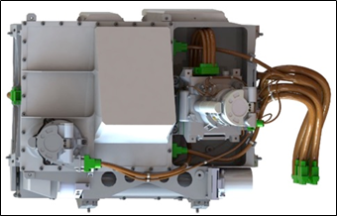
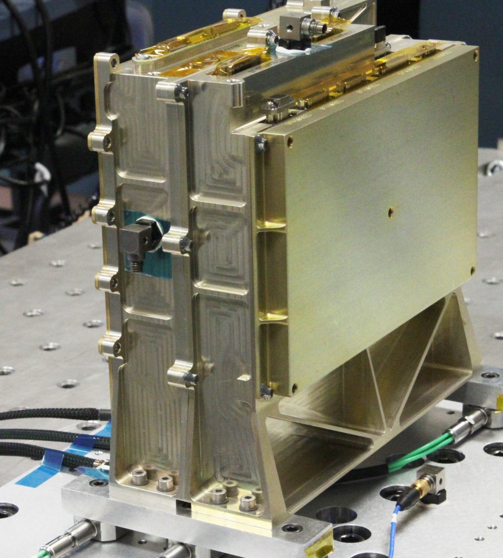
SHERLOC Instrument
New rover instrument lead by JPL (PI: Luther Beegle, Deputy-PI: Roh Bhartia)
Scanning Habitable Environments with Raman & Luminescence for Organics & Chemicals (SHERLOC)
Raman/Fluorescence Spectroscopy focused on organics at micro-scale
Scanning mirror
UV laser
Onboard spectra analysis
Laser and scanning mirror on end of rover arm
LANL provided spectroscopy electronics subsystem and flight software
Arm mounted laser and optics
Rover mounted spectrometer electronics with CPU

Slide 6
Shared Hardware and Software
SuperCam
Mast Unit
Same LANL designed rad hard LEON3 based processor board used for both instruments
Actel FPGA
250 MB SDRAM
~35% software code shared
Rover compute element (RCE) interface
SpaceWire based spectrometer interfaces
FPGA firmware includes spacewire endpoint to convert Mast Unit and Spectrometer electronics to DMA capable spacewire
Spectrometer Electronics (CCD readout)
UART and custom LVDS high speed serial
(1) SHERLOC
(3) SuperCam
FPGA with SpaceWire endpoint(s)
Custom Rover LVDS high speed serial
DMA capable high speed SpaceWire links
Rover Compute Element
Memory mapped I/O
LEON3 CPU Running Instrument Flight Software

Slide 7
Software Development
Both instruments approximately 13 KLOC
Good ‘ole C99
Custom driver for Rover LVDS interface
Board support package and modified GCC compiler by Cobham Gaisler
VxWorks operating system
Coverity static code analysis
Test Anything Protocol (TAP) unit testing
Custom python scripted functional testing
Jenkins nightly build and test

Slide 8
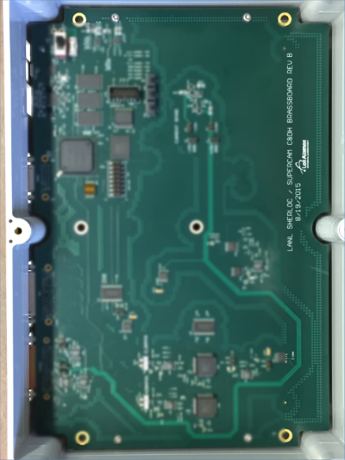
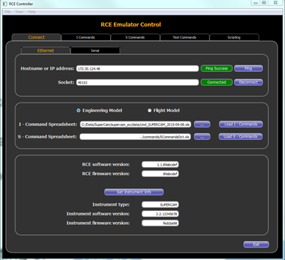
Software Development and Test
FPGA based brass board
Very early created inexpensive ‘brass boards’ with LEON3 instantiated in a Xilinx FPGA
Provided ubiquitous software and firmware development and test platforms that works with the custom interfaces
With minor software and firmware changes, the same brass board is used as rover and SuperCam mast unit emulators
Python based command and telemetry software user interface to complete RCE emulator
User Interface SW
LEON3 processor
MU Connector
RCE Connector

Slide 9
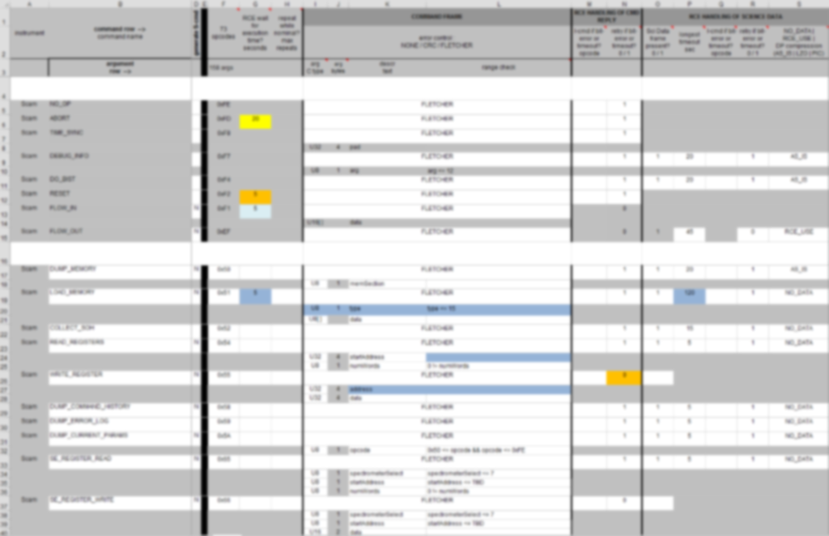
Electronic Data Sheet (sort of)
Fairly rigorous command-response method of communication
Commands and telemetry defined in Excel 97 spreadsheet
Carry over from Curiosity rover and ChemCam
JPL uses python module to convert spreadsheet into rover flight software
LANL rover emulator software uses same python module
Advantage of excel when sharing command and telemetry details with system and test engineers
Command | Description | Opcode
CONFIGURE_CCD_TIMING | Set the timing configuration of a spectrometer's CCD | 0x70
CONFIGURE_CCD_REGIONS | Set the readout region(s) of a spectrometer's CCD | 0x71
CONFIGURE_INTENSIFIER | Configure the BU intensifier. | 0x72
CONFIGURE_HVPS | Enable / disable and set parameters for the High Voltage Power Supply. | 0x73
DO_SPECTRA | Acquire Raman or LIBS spectra | 0x7C
MU_CONFIGURE_AUTOEXPOSURE | Configure the RMI autoexposure algorithm.
MU_TAKE_RMI_IMAGE | Take an RMI Image. | 0xD2
Example of Instrument Commands

Slide 10
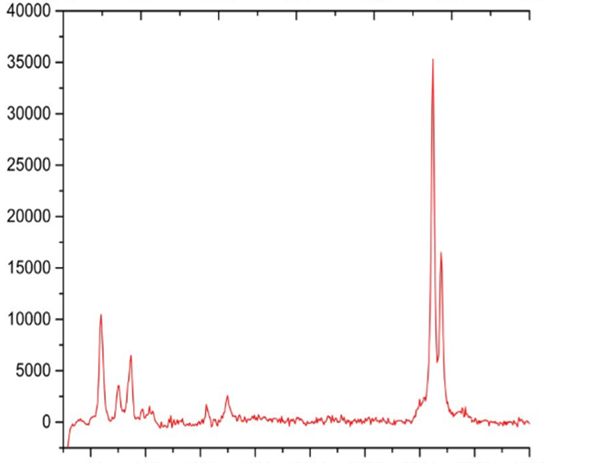
SHERLOC Automation
Using a scanning mirror, SHERLOC gathers hundreds of spectra in a coarse pre-defined pattern
Instead of sending all the spectra back to Earth, go back to the ‘most interesting’ point and perform a fine scan
However spectra processing must be done for accurate analysis
Background subtraction
Bad pixel removal
Laser normalization
Cosmic ray removal
0 1024 2048
Channel number
Science team defines weighted regions of channels (blue lines)
Spectrum with greatest weighted intensity summed from those regions considered ‘most interesting’
SHERLOC software automatically goes back to that spectrum location

Slide 11
SHERLOC Automation
Cosmic Ray Removal
Cosmic ray’s affecting CCD data can cause erroneous analysis results
Multiple spectra are gathered from one spot
Data for each wavelength channel is analyzed
JPL developed statistical analysis technique implemented in flight software used to find outliers
Sigma clipping plus Freedman-Diaconis rule
Demonstrated very large datasets (1296 spectra take ~5 minutes on flight processor)
Location A – spectra 1
0 1024 2048
Location A – spectra 2
Cosmic ray effect
0 1024 2048
Location A – spectra 3
0 1024 2048

Slide 12
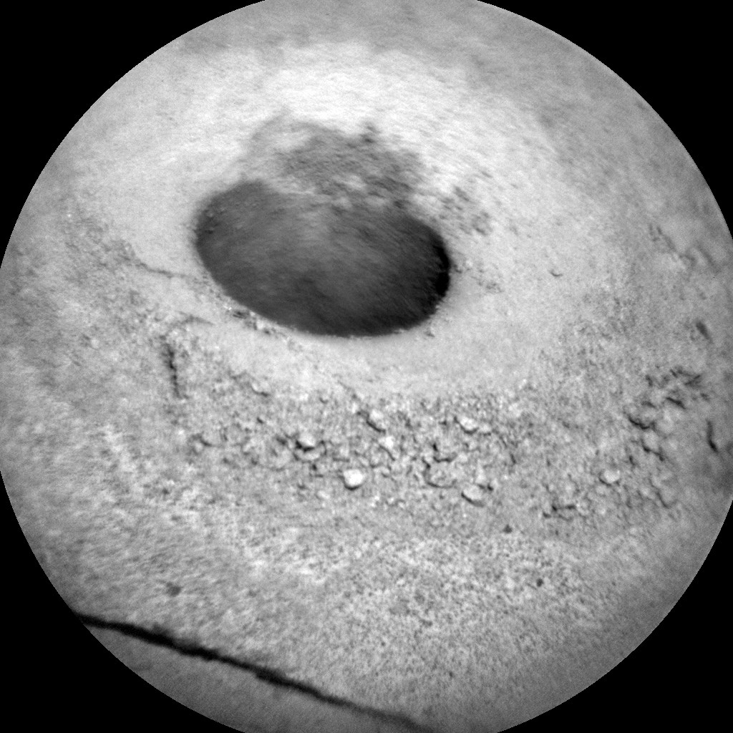
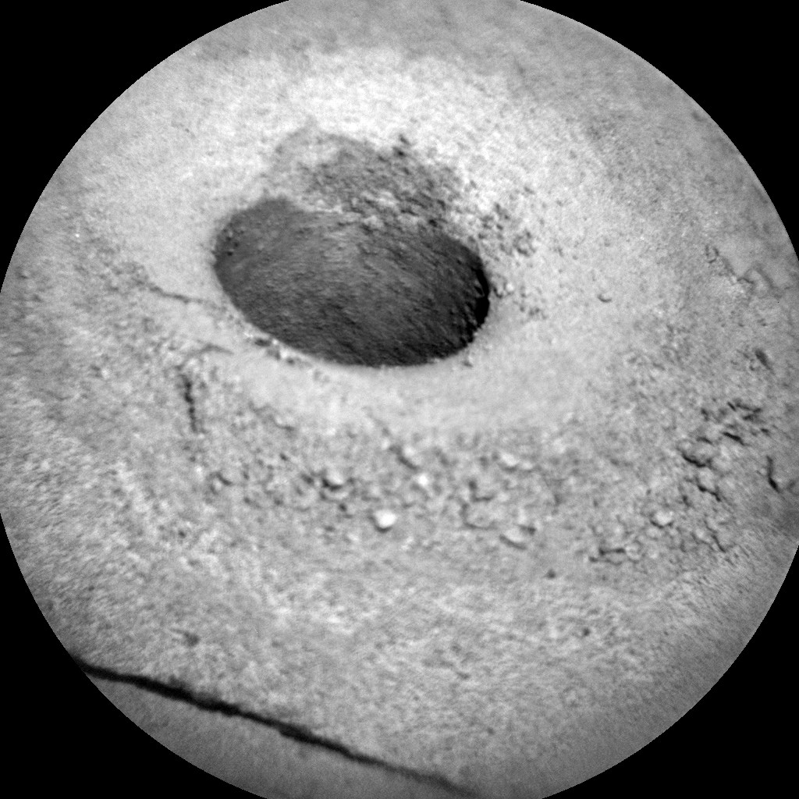
SuperCam Image Optimization
Focus stacking a.k.a Z-stacking
Combine multiple images into one image selecting the best focus for each pixel
Resulting image has greater depth of field
Data reduction technique, transmit fewer images
Apply Gaussian blur and Laplacian filters to determine sharpest pixel
Registration currently not supported, images must be very similar wrt. position and content
Drill hole on Mars captured by ChemCam instrument

